Slide 1
ГБОУ СОШ № 213 с углубленным изучением английского языка
Английский язык
8 класс
Тема урока: Sports Equipment and Places
Учитель: Мурлина Татьяна Дмитриевна
2021

Slide 2
Plan
ГБОУ СОШ № 213 с углубленным изучением английского языка
Revision of different types of sports
Learning words on topic “Sports equipment”
Revision of Conditional II
Doing exercises
Giving your own description of different types of sports

Slide 3
ГБОУ СОШ № 213 с углубленным изучением английского языка
What do we need to play football?
What sports need ball?
Where is hockey played?

Slide 4
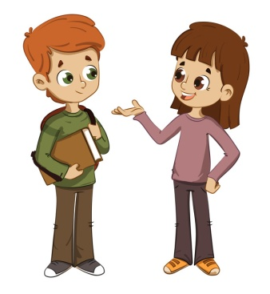
Exercise 1. Listen to the dialogue and underline words connected with sports
ГБОУ СОШ № 213 с углубленным изучением английского языка
Alice: Martin, what sports do you play?
Martin: I play football, volleyball, tennis, and table tennis. But tennis is my favourite game as everything depends only on you.
Alice: Is it quite a fast game as well?
Martin: Yes.
Alice: Where do you play, then?
Martin: I play at local sports centres at special tennis courts.
Alice: But what do you need to play it? Is there any special equipment?
Martin: Nothing special. The most important things are a racket and a tennis ball. Also you wear trainers, shorts and a T-shirt. If you want you can wear a cap in sunny weather.
Alice: I see. Are you playing any sports today?
Martin: I am. In 15 minutes I’m having another table tennis school competition.
Alice: Good luck! Thanks for the talk. Bye.
Martin: Have a good day!

Slide 5
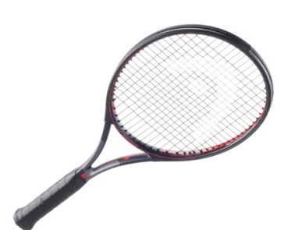
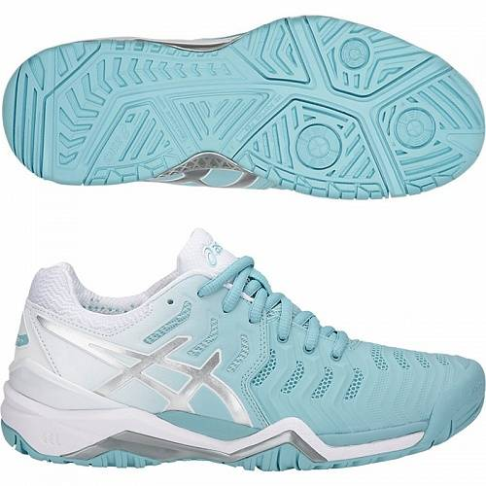
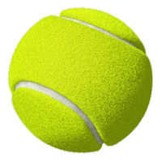
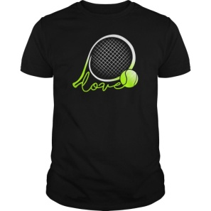
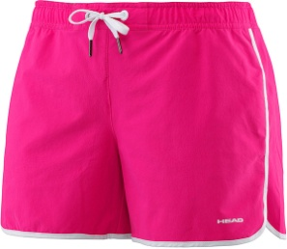
Exercise 2. Find the pictures of equipment that is need for tennis and match the words with the right transcription
ГБОУ СОШ № 213 с углубленным изучением английского языка
Trainers
[ˈtreɪnəs]
[ˈtreɪnəz]
A T-shirt
[ˈtiːʃɜːt]
[ˈtiːʃɔːt]
A tennis ball
[ˈtenɪs baːl]
[ˈtenɪs bɔːl]
A racket
[ˈrækɪt]
[ˈrɔkɪt]
A cap
[kæp]
[kʌp]
Shorts
[ʃ3ːts]
[ʃɔːts]

Slide 6
ГБОУ СОШ № 213 с углубленным изучением английского языка

Slide 7
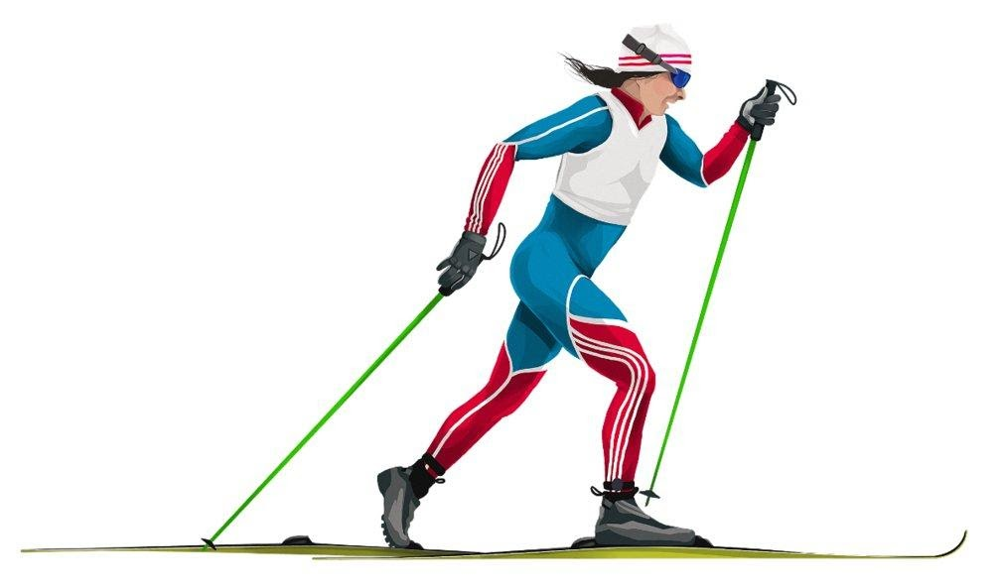
Skiing
ГБОУ СОШ № 213 с углубленным изучением английского языка
Ski run
hat
goggles
ski suit
gloves
poles
ski
ski boots

Slide 8
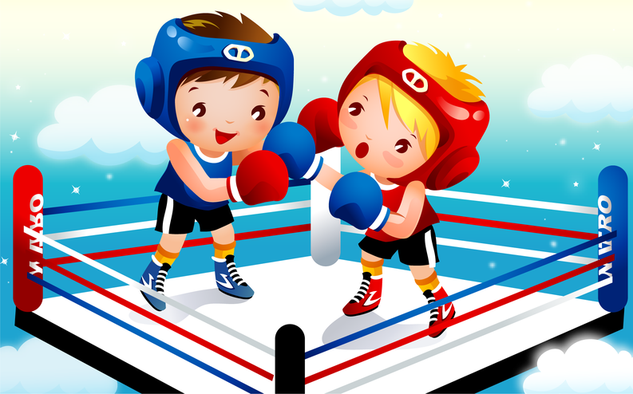
Boxing
ГБОУ СОШ № 213 с углубленным изучением английского языка
Ring
helmet
boxing gloves
trainers
boxing shorts

Slide 9
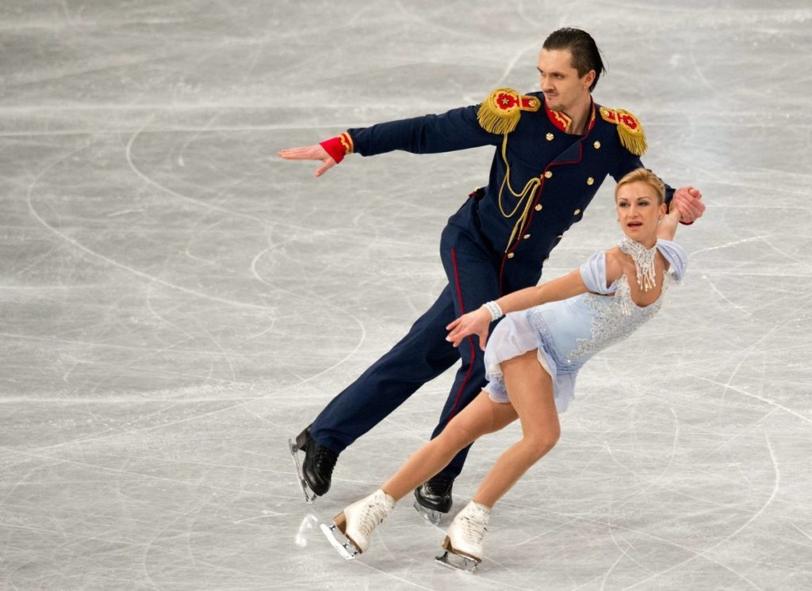
Figure Skating
ГБОУ СОШ № 213 с углубленным изучением английского языка
Skating rink
suit
skates

Slide 10
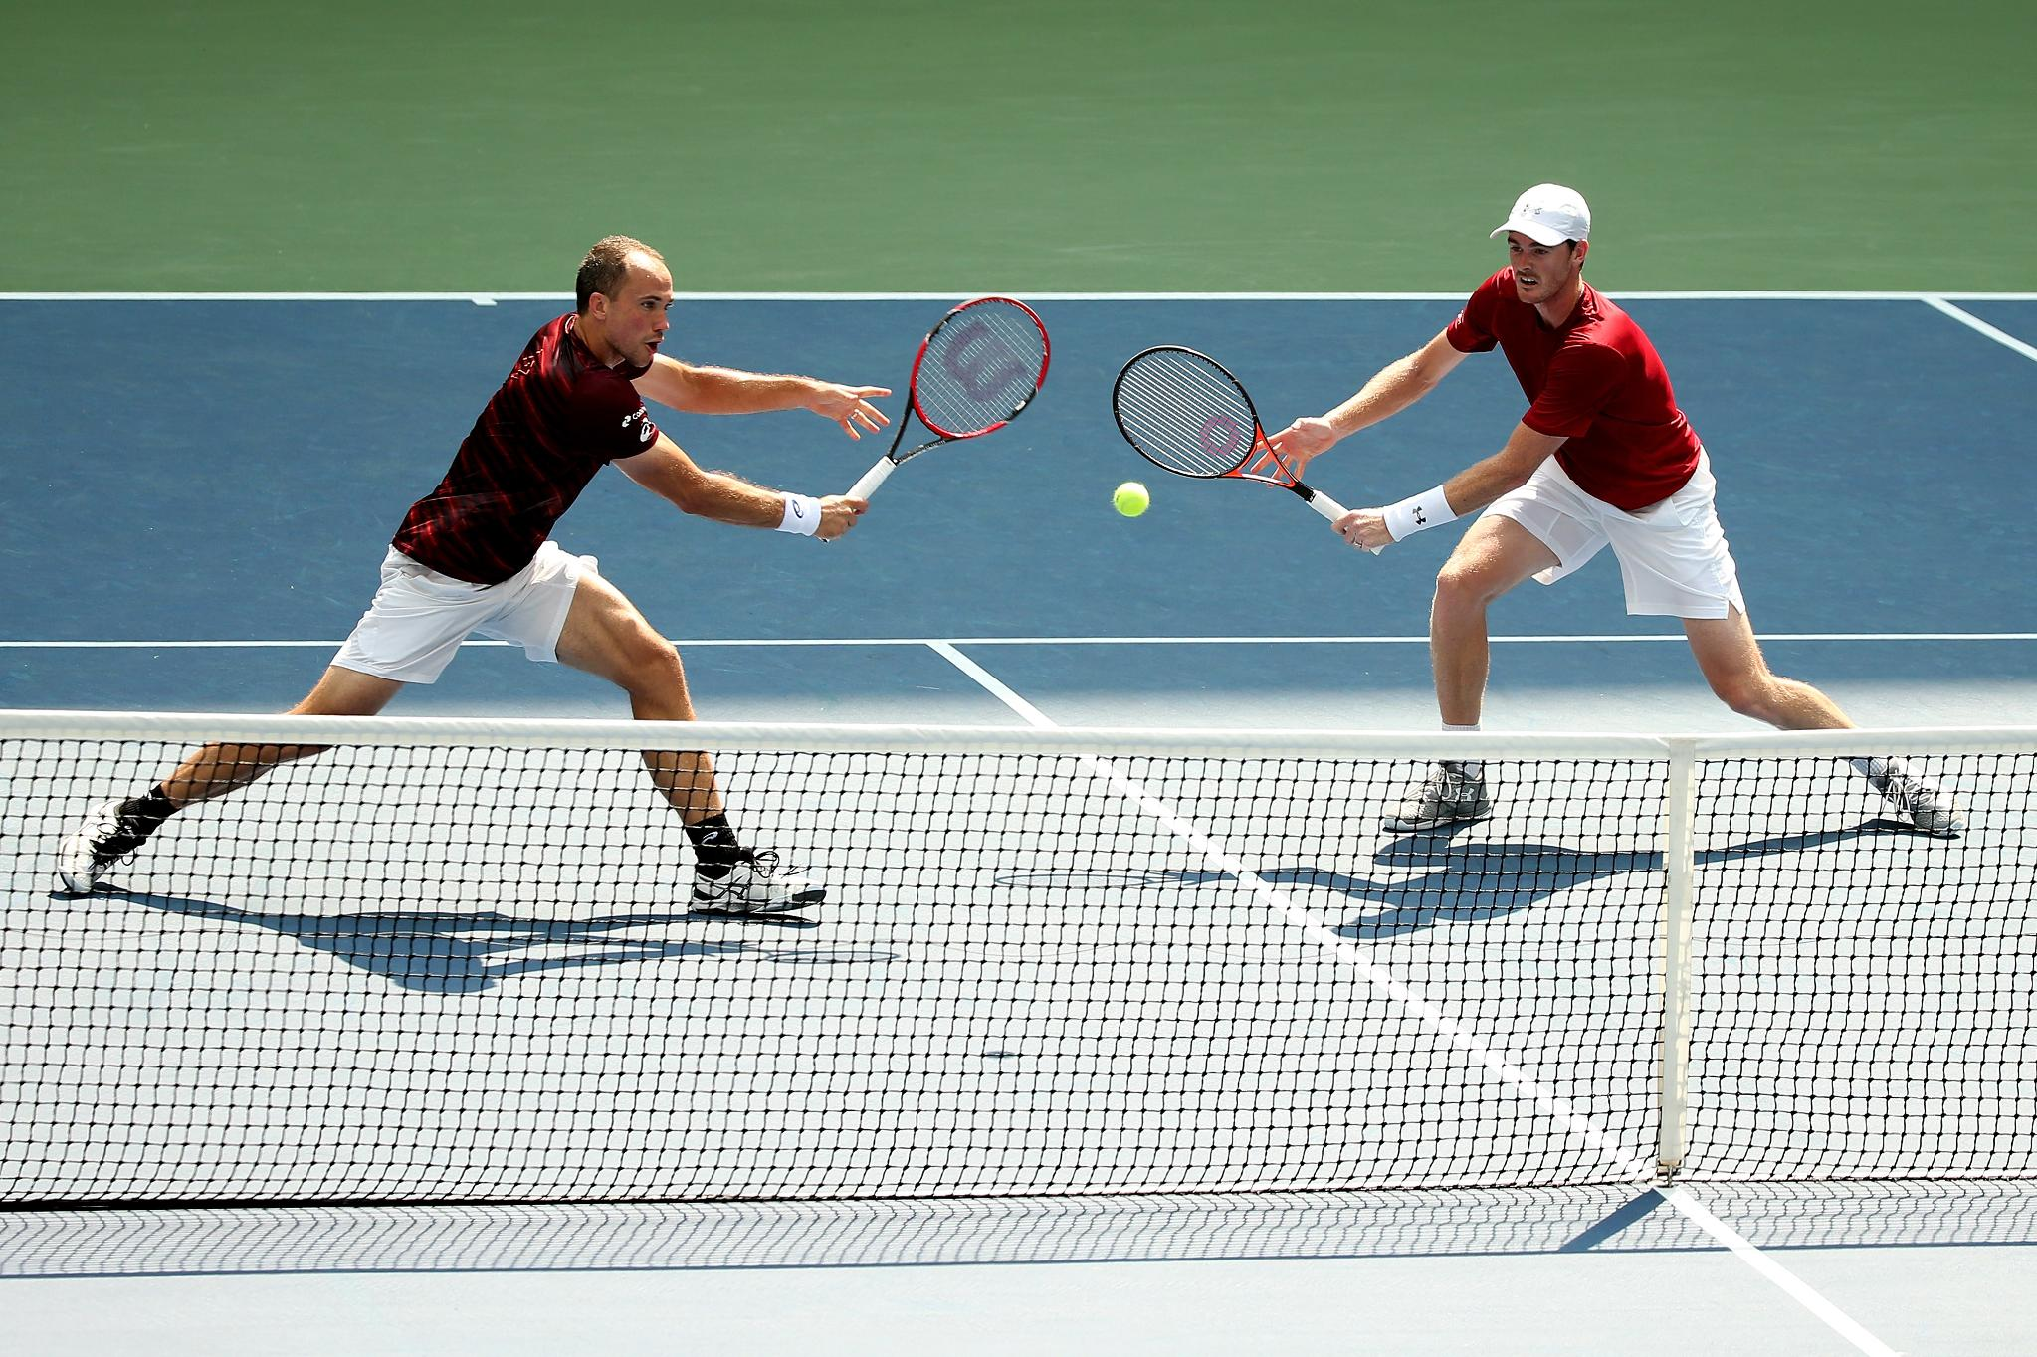
Tennis
ГБОУ СОШ № 213 с углубленным изучением английского языка
Court
T-shirt
cap
tennis ball
racket
trainers
net

Slide 11
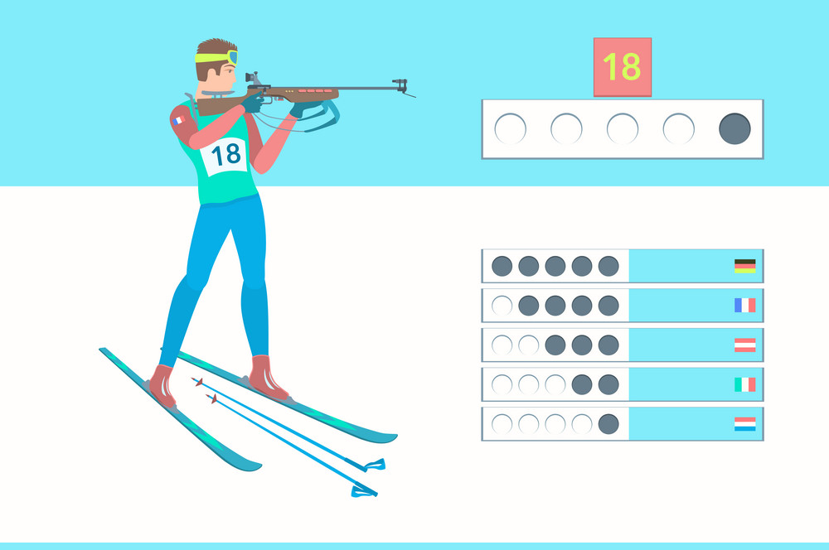
Biathlon
ГБОУ СОШ № 213 с углубленным изучением английского языка
Track
goggles
gloves
targets
racing suit
rifle
BIP number
ski
poles

Slide 12
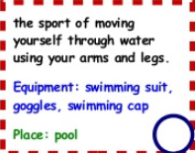
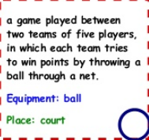
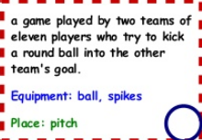
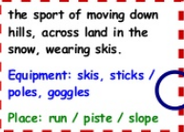
Exercise 3. Write the name of sports near the definition
ГБОУ СОШ № 213 с углубленным изучением английского языка
Football
Figure skating
Tennis
Swimming
Skiing
Volleyball
4
3
6
2
5
1

Slide 13
Exercise 4. Fill in the table
ГБОУ СОШ № 213 с углубленным изучением английского языка
ball track rifle figure skating poles tennis racket skates ski run target helmet boxing gloves skiing suit biathlon shorts trainers goggles net ring
Sports | Equipment | Places
Figure skating | ball | track
Helmet
Rifle
Poles
Racket
Skates
Target
Gloves
Suit
Shorts
Trainers
Goggles
Net
Tennis
Boxing
Skiing
Biathlon
Ski run
Ring

Slide 14
Exercise 5. Complete the text
ГБОУ СОШ № 213 с углубленным изучением английского языка
pitch goals gloves match jerseys football boots players ball
_____________ is the most popular game in the world and it is played nearly in all countries. Football is played on a ____________ and two teams compete there. Football team consists of 11 ___________: a goalkeeper, backs, half-backs and forwards. Each team has a captain who is usually the best player. During the _____________ every team tries to throw the __________ into other team’s ___________. Players usually wear ____________ on their feet and ______________. Goalkeepers can wear ____________ on their hands to catch the ball.
Football
pitch
players
match
ball
goals
boots
jerseys
gloves

Slide 15
Thanks for your attention! See you! Good Luck!
ГБОУ СОШ № 213 с углубленным изучением английского языка

