Slide 1
Fashion in all ages
History of women’s fashion

Slide 2
Something eternal…
In all ages people wanted to look attractive. In different centuries different styles were popular, so the history of fashion is an interesting theme to discuss.

Slide 3
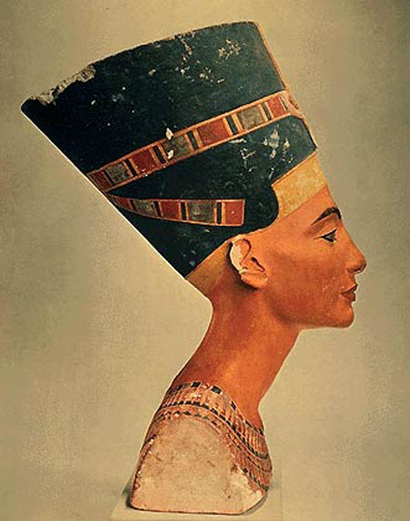
At the very beginning
In the Ancient Egypt women used to wear long skirts and waistcoats with wide sleeves. It was also popular to pencil eyes and eyebrows. The perfect type of a woman was Nefertiti the Queen of Egypt.

Slide 4
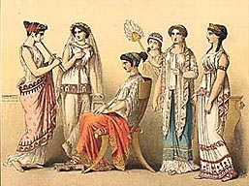
In the age of antiquity
Greek women used to wear a tunic or a himation. Different colours meant different. White colour was the colour of aristocracy; black, dark-green and ruby colours meant grief. And peasants wore brown and grey clothes.

Slide 5
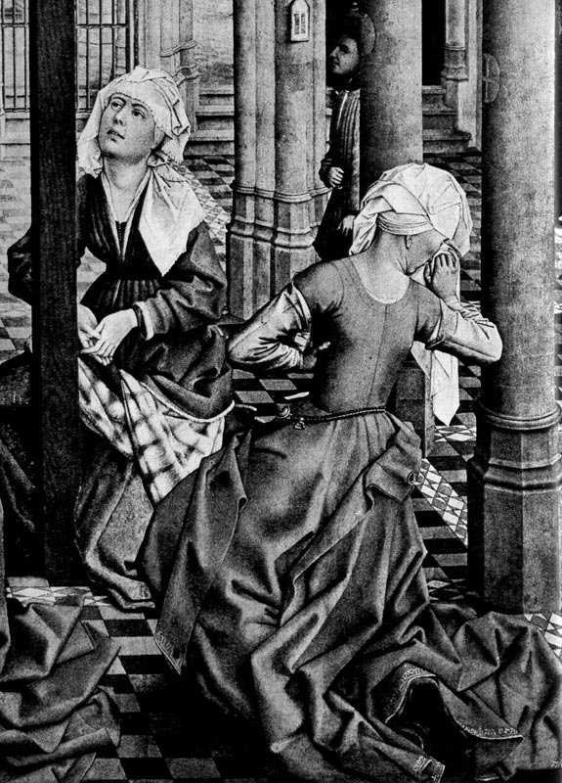
The Middle Ages – Gothic style
In the Middle Ages women’s dresses resembled monastic clothes. But in the XIII century a new type of dress appears. It consisted of a bodice and a skirt.

Slide 6
Renaissance and baroque
The time of Renaissance brought new views, new art and definitely new fashion. Elegant, bright dresses with a lot of pleats were very trendy. The ideal of Renaissance fashion was the antique style.
In the time of Elizabeth I the style of baroque (stand-up collars, luxurious dresses, long gloves) was very popular.

Slide 7
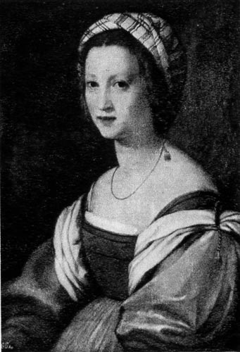
Renaissance

Slide 8
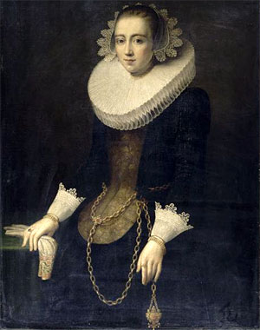
Baroque

Slide 9
Some centuries ago…
People of the XIX century argued a lot about woman’s clothes. On the one hand ordinary, functional clothes appears, but on the other hand it was still fashionable to wear long, inconvenient dresses and corsets. It was still fashionable to have 85-50-85 characteristics.

Slide 10
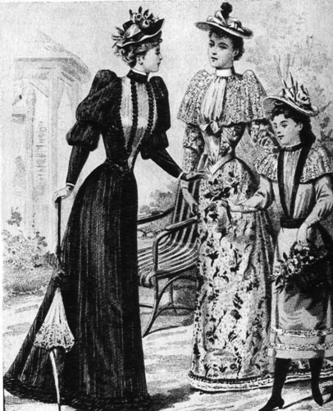
XVIII and XIX centuries

Slide 11
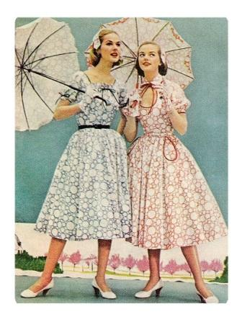
XX century: something new
In the XX century fashion crazes change each other extremely fast. There were many ideals of a woman: Merilin Monroe, Marlene Dietrich, Twiggy and some others.

Slide 12
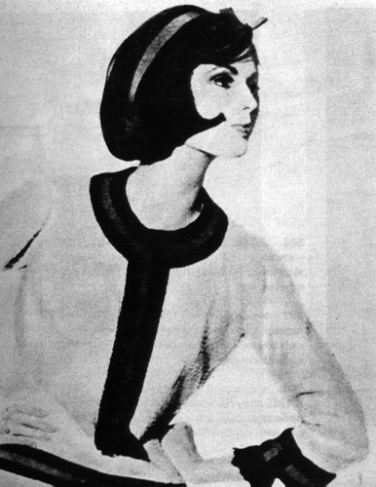
XX century

Slide 13
Something forgotten but really stylish!

Slide 14
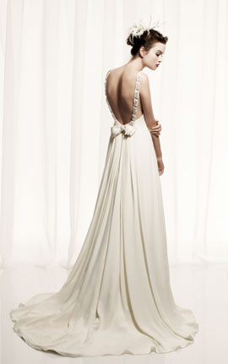
Something forgotten but really stylish!

Slide 15
Thank you for your attention!

