Slide 1
Graffiti

Slide 2
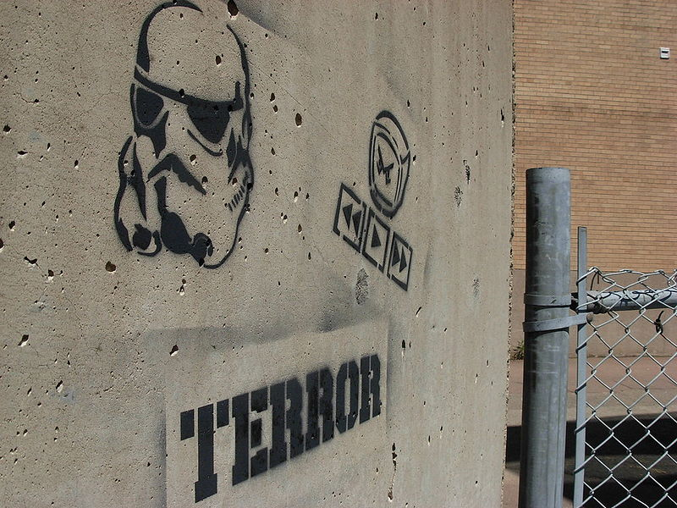
Graffiti is the name for images or lettering scratched, scrawled, painted or marked in any manner on property. In modern times, spray paint, normal paint and markers have become the most commonly used materials. In most countries, defacing property with graffiti without the property owner's consent is considered vandalism, which is punishable by law. Sometimes graffiti is employed to communicate social and political messages.

Slide 3
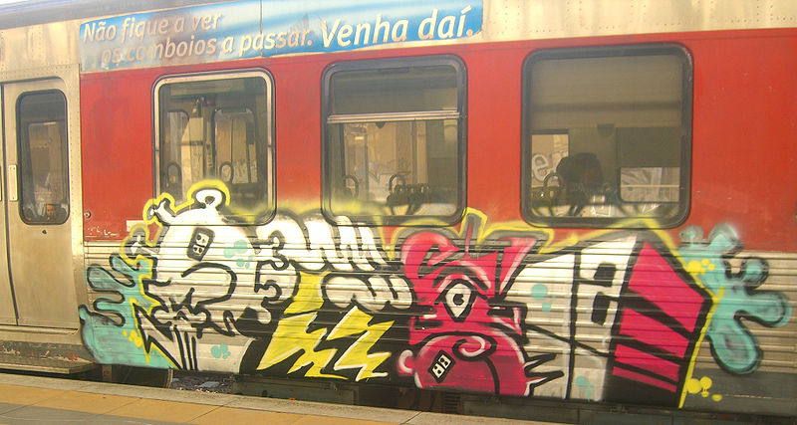
Graffiti is often seen as having become intertwined with hip hop culture and the myriad of international styles derived from New York City Subway graffiti .However, there are many other instances of notable graffiti this century. Graffiti has long appeared on railroad boxcars and subways.

Slide 4
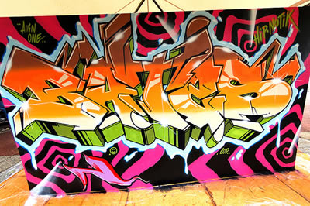
Graffiti as an element of hip hop
Graffiti is one of the four main elements of hip hop culture .The relationship between graffiti and hip hop culture arises both from early graffiti artists practicing other aspects of hip hop, and its being practiced in areas where other elements of hip hop were evolving as art forms

Slide 5
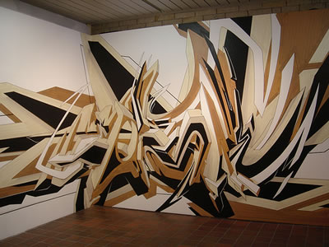
A 2006 exhibition at the Brooklyn Museum displayed graffiti as an art form that began in New York's outer boroughs and reached great heights in the early '80s with the work of Crash, Lee, Daze, Keith Haring and Jean-Michel Basquiat.
It displayed 22 works by New York graffiti artists, including Crash, Daze and Lady Pink. In an article about the exhibition in Time Out Magazine, curator Charlotta Kotik said that she hoped the exhibition would cause viewers to rethink their assumptions about graffiti. Terrance Lindall, an artist and executive director of the Williamsburg Art and Historic Center, said regarding graffiti and the exhibition:
"Graffiti is revolutionary, in my opinion," he says, "and any revolution might be considered a crime. People who are oppressed or suppressed an outlet, so they write on walls—it's free."

Slide 6
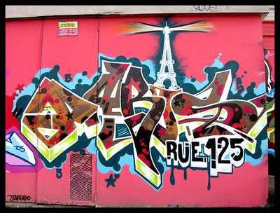

Slide 7
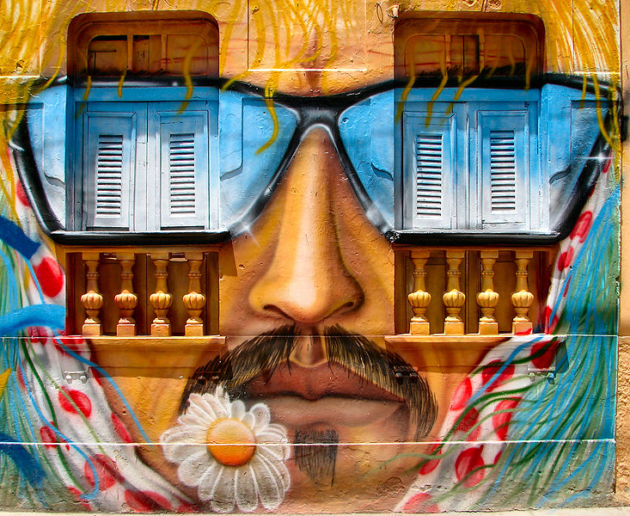

Slide 8
