Slide 1
Ecological problems
Aim: by the end of the lesson students will learn to make dialogues and talk about ecological problems using traversed vocabulary
Author: Ryzhova Olga Alexandrovna

Slide 2
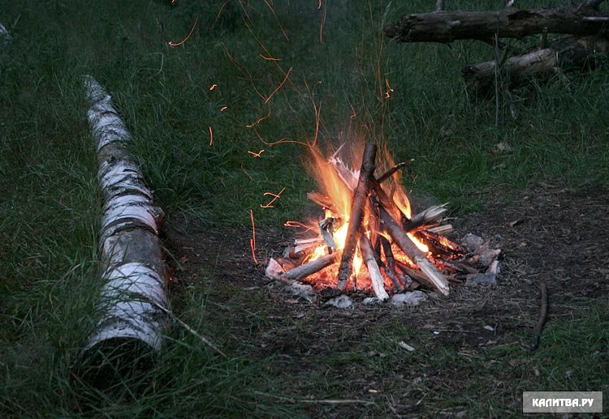
What can you see at the picture?

Slide 3
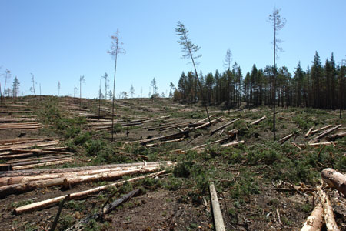
What can you see at the picture?

Slide 4
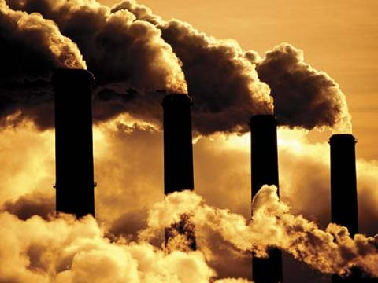
What can you see at the picture?

Slide 5
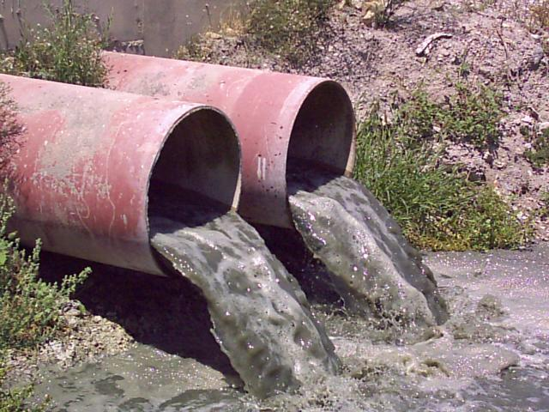
What can you see at the picture?

Slide 6
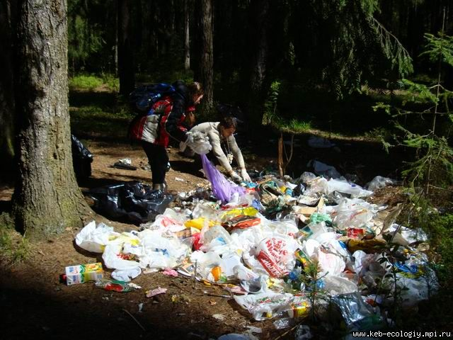
What can you see at the picture?

Slide 7
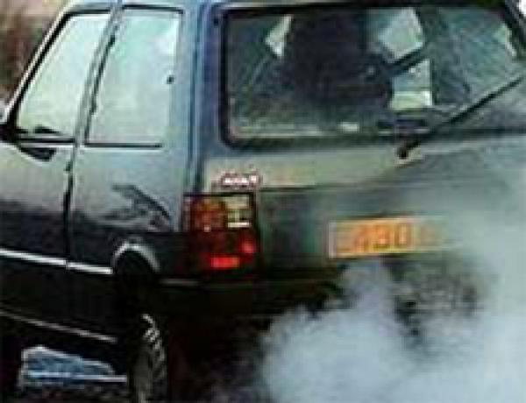
What can you see at the picture?

Slide 8
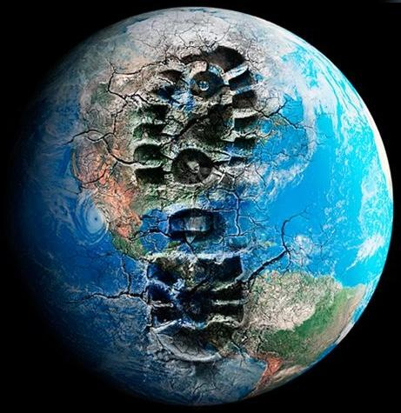
What can you see at the picture?

Slide 9
«Kids for saving Earth Promise Song».
The Earth is my home. I promise ……… it healthy and beautiful. I will love the land, the air, ……… and all living ………... I will be a defender of my ………...
United with friends, I will save the ……….. United with friends, I promise to keep it, United with friends, I will …….. the land, United with …………., I’ll be a defender, I will …….. The Earth.

Slide 10
«Kids for saving Earth Promise Song».
The Earth is my home. I promise to keep it healthy and beautiful. I will love the land, the air, the water and all living creatures. I will be a defender of my planet.
United with friends, I will save the Earth United with friends, I promise to keep it, United with friends, I will love the land, United with friends, I’ll be a defender, I will save the Earth.

Slide 11
What can we do to have our planet clean?

Slide 12
What can we do to have our planet clean?
Love our planet!

