Slide 1
Force of current. Ammeter.
1) revise theme current sources, construction and principle of work of the current source
2) know the meaning of force of electric current
3) make electric circuit experimentally and using symbols

Slide 2
Electric sources revision
Translate into English:
1
Электрический ток
1
Electric current
Направление электрического тока
Direction of electric current
2
2
Постоянный и переменный ток
Direct and alternating current
3
3
4
Источники тока
4
Sources of current
Действие электрического тока
Effect of electric current
5
5
6
Электрическая цепь
6
Electric circuit
7
Напряжение
7
Voltage
Положительный и отрицательный заряды
Positive and negative charges
8
8

Slide 3
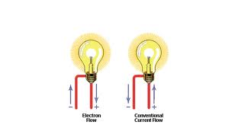
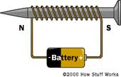
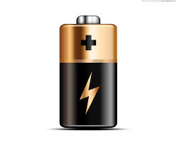
Team competition
You have a list of questions and 2 minutes for preparation. Your teams will answer one by one, but every next answer should be given another student in the team.

Slide 4
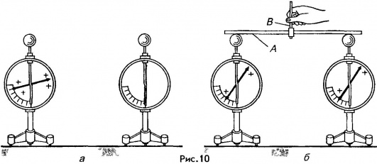
Questions:
Describe figure on the slide:

Slide 5
Questions:
Electric current is the motion of _______
Electric circuit is _________of electricity, _________ and ___________
Current may be of two types:____________and______________.
On the [View] menu, point to [Master], and then click [Slide Master] or [Notes Master]. Change images to the one you like, then it will apply to all the other slides. _

Slide 6
Questions:
What effects of electric current do you know?
What are conditions for current existence?

Slide 7
Questions:
You have prepared electric source. Tell about it.

Slide 8
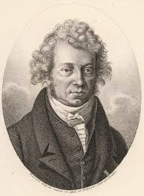
Questions:
Who said the term “electric current” for the first time?
André-Marie Ampère
(20 January 1775 – 10 June 1836)

Slide 9
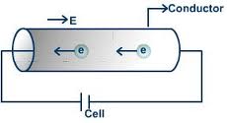
Force of current - Сила тока (I, A)
Force of current is the amount of charge passing through a point in the circuit in one second.

Slide 10
Force of current
I - Force of current (A)
q – Charge (C)
t – time (s)

Slide 11
Units of current
Caution!
1A is dangerous for life!
What is amp?

Slide 12
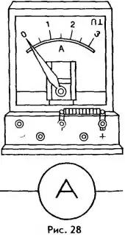
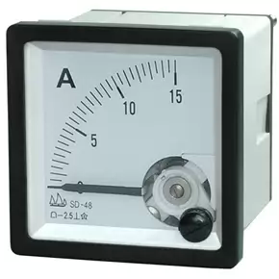
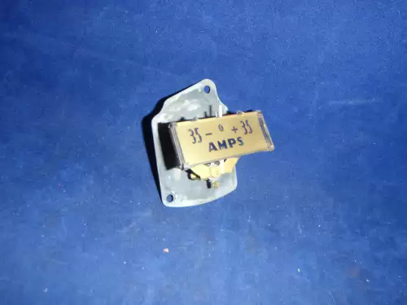
Ammeter (Амперметр)
Ammeter is the device for measuring current

Slide 13
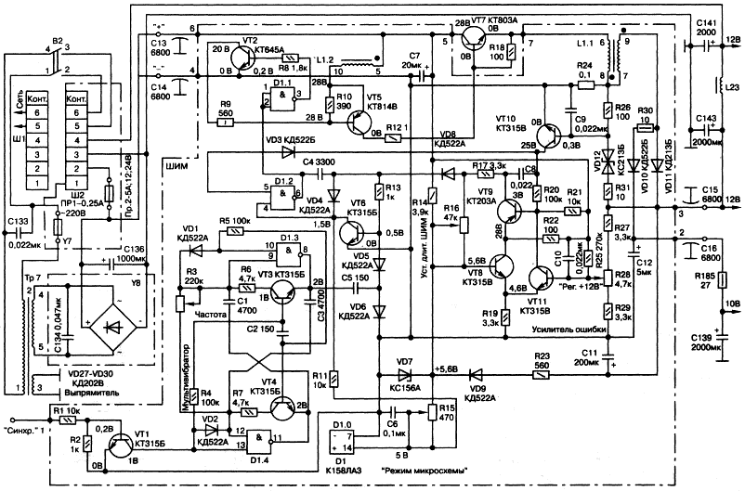
Example of a TV-set circuit:

Slide 14
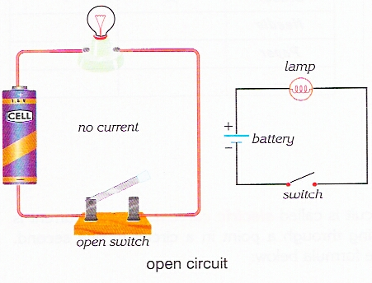
Make a circuit:
Draw a circuit into the exercise-book,
Write down
I= …

Slide 15
Practice:
1
2
Find force of current in electric bulb , if electric charge of 300C travels through it during 10min.
What charge will travel during 3min through ammeter if force of current is 0.2A?
3
4
Force of current is 200A. What is the time the charge of 60000C travels through it?
Force of current in the iron is 0.2A. What charge will travel through it during 5 min?

Slide 16
Test on the theme “Force of current”
# 2
# 3
#1
Test:
# 4
# 5

Slide 17
Question #1
Force of current is…
a
b
c
Is the charge travelled through the cross-section area of the conductor during a minute
Is the charge travelled through the cross-section area of the conductor during a second
Is the thermal motion of electrons

Slide 18
Question #2
Ammeter is…
a
b
c
Device for measuring charge
Device for measuring number of electrons
Device for measuring force of current

Slide 19
Question #3
What circuit is correct?
a
b
c
A
A
A

Slide 20
Question #4
A charge of 3.6*10⁴C passes through a bulb in 1 hour. What is the force of current passing through the bulb?
a
b
c
10A
3.6A
7.2A

Slide 21
Question #5
An amount of 10²⁰ electrons pass through the cross section of a wire in 8 s. What is the current passing through the wire ? (take e=1.6*10⁻¹⁹C)
a
b
c
16A
4A
2A

Slide 22
Diagram
1b
5 - “5”
2c
4 - “4”
3c
3 – “3”
2 – “2”
4a
What is your mark?
5c

Slide 23
Home work:
Home work: §36 p.52 Questions 1-4(or), #5 (wr)

Slide 24
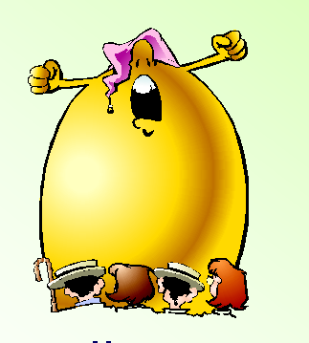
Feedback:
Text
Text
Text
I didn’t understand
anything and was waiting
the end of the lesson
I understood
everything.
I liked the lesson.
I didn’t like
the lesson

Slide 25
Thank You !
http://ppt.prtxt.ru

