Slide 1
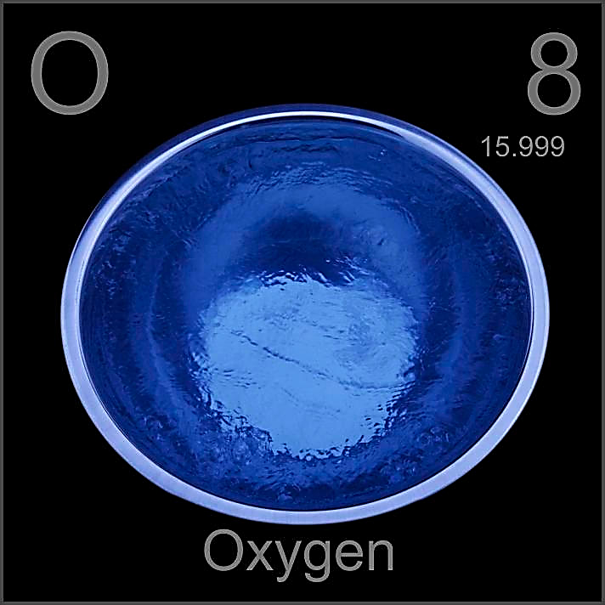
All-russian festival of pedagogic ideas «model lesson» 2016/17
CREATION OF “INORGANIC CHEMISTRY JOURNAL”, ITS ENGLISH EDITION
«RUSSIAN JOURNAL OF INORGANIC CHEMISTRY»
AND WRITING OF ARTICLE “FAMILIAR AND UNKNOWN OXYGEN”
Teacher of chemistry
DENISOVA OLGA IVANOVNA
«Russian journal
of inorganic
Chemistry»

Slide 2
Lesson 2 CREATION OF “INORGANIC CHEMISTRY JOURNAL”, ITS ENGLISH EDITION «Russian journal of inorganic Chemistry» AND WRITING OF ARTICLE “FAMILIAR AND UNKNOWN OXYGEN”
If water is life, so oxygen is breathing of life!
Denisova O.I.

Slide 3
THE LESSON TASKS
Improving of pupils knowledge about oxygen features, spheres of using it, ways of obtaining. Strengthening of pupils skills of defining of connection between features and using of oxygen.
Improving of cognitive interest to the subject, developing of logical thinking, monological and dialogical speech. Developing of abilities to express thoughts in English. Improve the ability to generalize and systematize data.
Bring up creative skills and also aesthetic view on the world. Continuation of formation of ecological way of thinking and uts usage in real life.

Slide 4
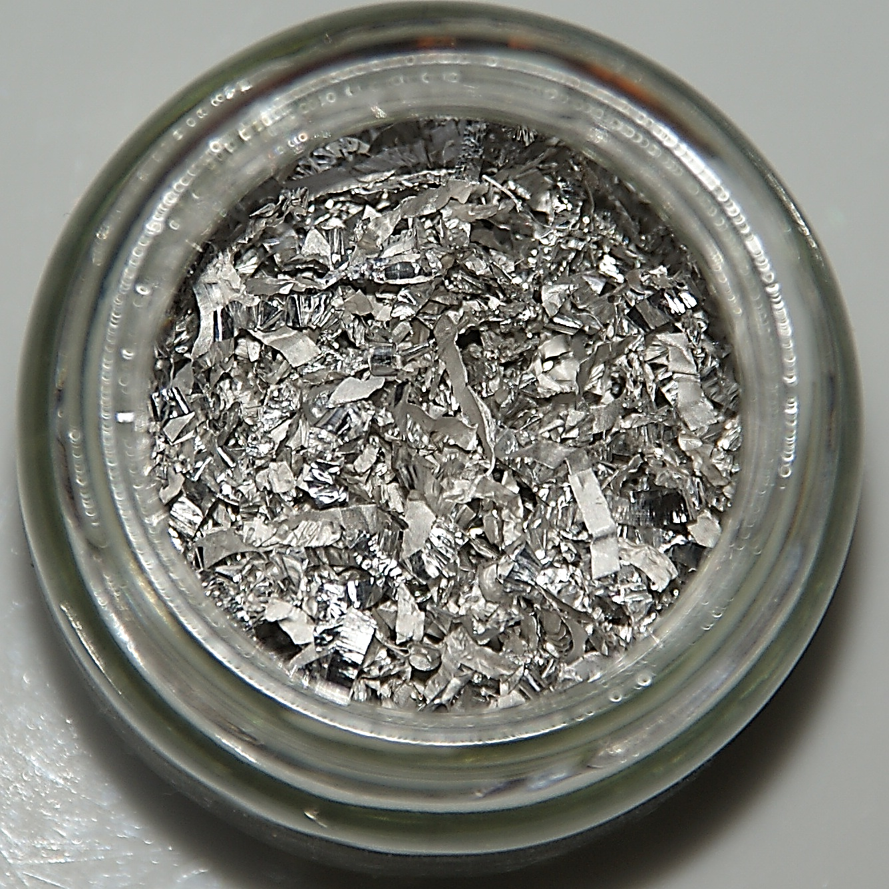
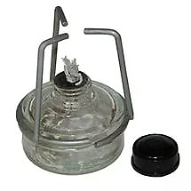
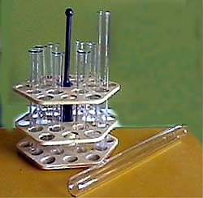
Means of education laboratorical
Hydrogen
peroxide
magnesium
Alcohol lamp
matches
Test tubes
Candle lighter

Slide 5
LABORATORY OF RESEARCHING OF MATTERS FEATURES of SCIENTIFIC AND REASEARCH INSTITUTE.
«Who, when and how?» (discovery of oxygen)
«It is everywhere around us» (oxygen in nature).
«And what is it like?» (physical features of oxygen).
«It is friend of everybody» (chemical features of oxygen).
«We will obtain oxygen by ourselves» (ways of obtaining).
«Everybody needs oxygen» (usage of oxygen).
«What else don’t we know about oxygen?» (unknown oxygen).

Slide 6
«Two centuries ago
It was discovered random.
One and all know it now
It is not mystery for us.
They know for sure
That sulfur, phosphorus, carbon, ferrum, magnesium
Burn off very well in it.
Even hydrogen burns all out in it.
But for this gas there is no life
For human beings and wild animals
Children could easily identify it
Cause this is…».

Slide 7
CARL SHEELE. A PAGE FROM THE MANUSCRIPT

Slide 8
JOSEPH PRISTLEY

Slide 9
ANTHUAN LAVUAZJE

Slide 10
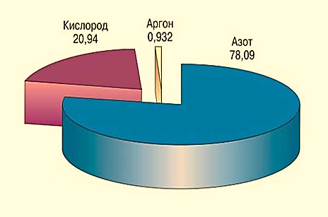
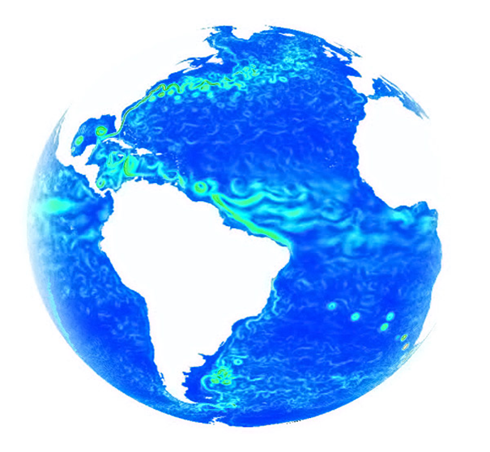
It is everywhere around us

Slide 11
AND WHAT IS IT LIKE?
Gaseous under normal conditions
Colorless
Scentless
Liquid when the temperature is
-182,9˚С
Firm when the temperature is -218,7˚С
Dissolves bad in water
Paramagnetic

Slide 12
PARAMAGNETIC OXYGEN

Slide 13
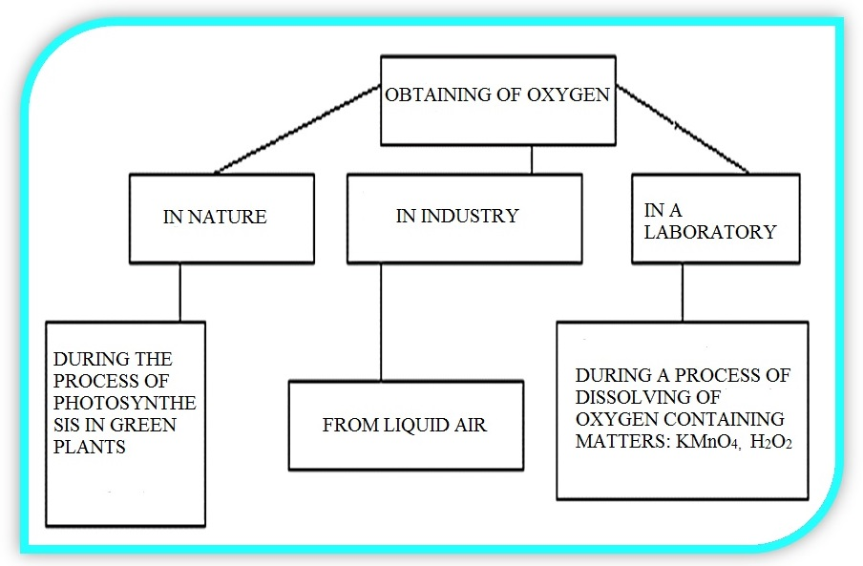

Slide 14
OBTAINING OF OXYGEN IN A LABORATORY

Slide 15
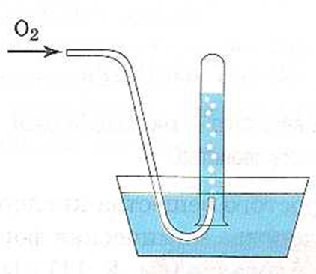
METHODS OF OBTAINING
Dewatering
Air displacement

Slide 16
OBTAINING IN INDUSTRY
Turbo-expanders

Slide 17
«It is a friend for everybody» magnesium combustion

Slide 18
«It is a friend for everybody» IRON combustion

Slide 19
«It is a friend for everybody» Aluminium combustion

Slide 20
«It is a friend for everybody» Phosphorus combustion

Slide 21
Oxygen is all around us
We can’t do without it.
It is essential for life!

Slide 22
«EVERYBODY NEEDS OXYGEN»
In metallurgy
As rocket fuel
In medicine
(medical oxygen)
In food industry
In agriculture
In chemical industry

Slide 23
«One line about oxygen» (interesting oxygen)
All green of the planet forms about 3 trillion tons of oxygen per year.
Atmosphere of metropolises contain 18% of oxygen.
Several millions of years ago concentration of oxygen was almost 2 times more – 37-40%.
If there is less than 8% of oxygen in the air, it is considered to be a threat for life.
Fishes don’t need much oxygen.
But carp needs oxygen concentration of minimum 4 mg/l.
Oxygen is received by organs through the blood-vescular system.
But eye corneas obtain oxygen right from the air.
Oxygen helps us to watch North Light.

Slide 24
«WHAT don’t we know about oxygen?»
Oxygenian injections into mould.
Still there is oxygen on the Mars.
It is all about oxygen.
The richest.
Oxygen was a part of the Universe since the moment it appeared.
Oxygen appeared about 2.5 billion years ago on Earth.
Oxygen appeared on Earth due to mosses.
Liquid oxygen in the subsoils of Earth.
Add a little bit of oxygen
Oxygen appeared 800 millions years earlier in the atmosphere, than it was thought previously.

Slide 25
DIAGRAMM OF OXYGEN CONTAINING IN THE AIR

Slide 26
ARTICLE “FAMILIAR AND UNKNOWN OXYGEN”
Content
“Familiar and unknown oxygen”
“Introduction” p. 3
“Who, when and how?” p. 4
“And what is it like?” p. 6
“We will obtain oxygen by ourselves” p. 7
“It is a friend of everybody” p. 8
“Everybody needs oxygen” p. 9
“Conclusion” p. 10
“Interesting oxygen” p. 11
“Unknown oxygen” p. 12
“Oxygen – is a source of life” p. 13
«Russian journal
of inorganic
Chemistry»

