Slide 1
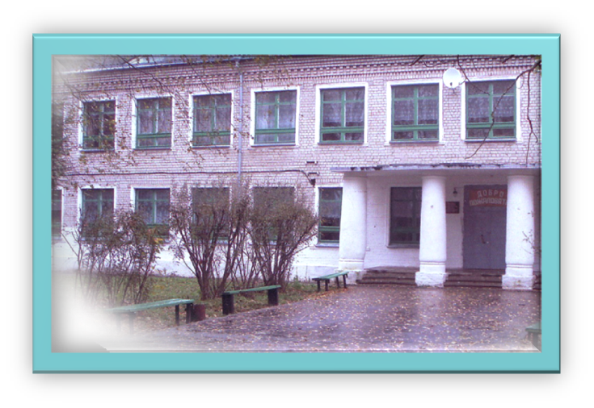
Welcome to Mirny Secondary School by A.A. Voskresensky

Slide 2
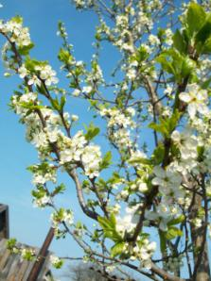
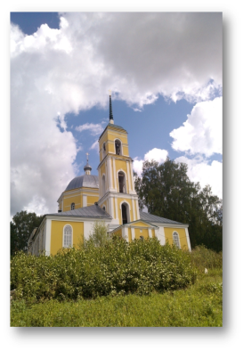
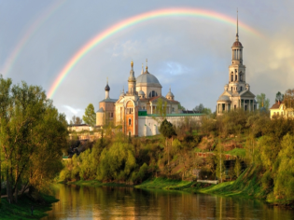
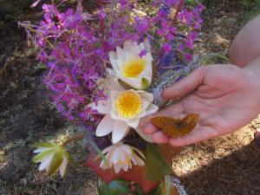
My Native Land (my homeland). Моя милая малая родина.

Slide 3
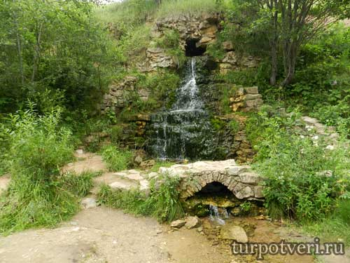
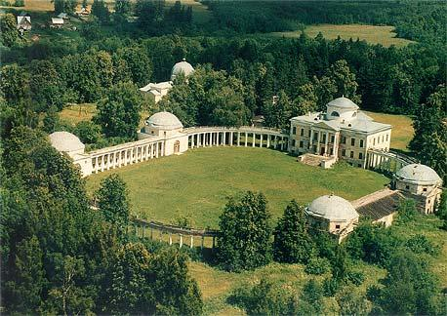
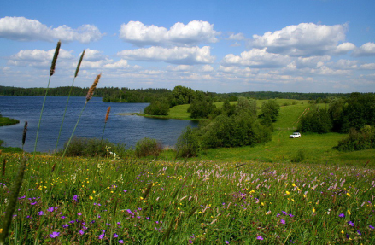
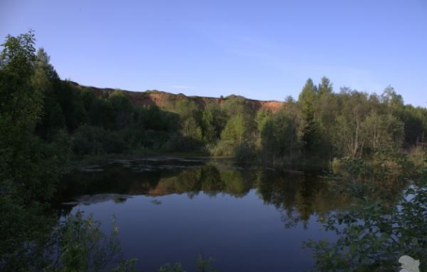
Waterfall in Panika
Znamenskoye Rayok
Natural beauty and charm

Slide 4
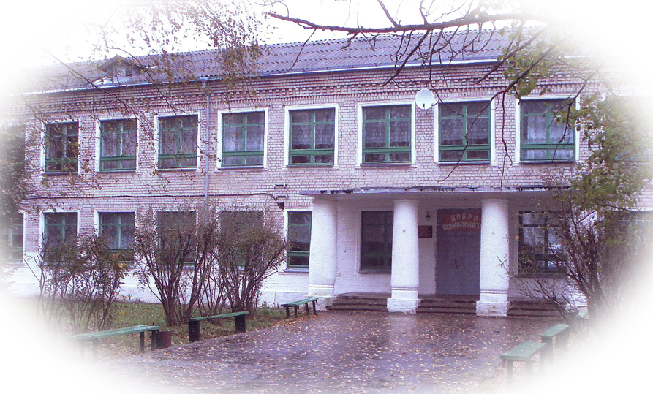
From the history of Mirny Secondary Comprehensive School

Slide 5
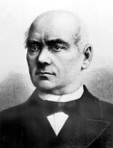
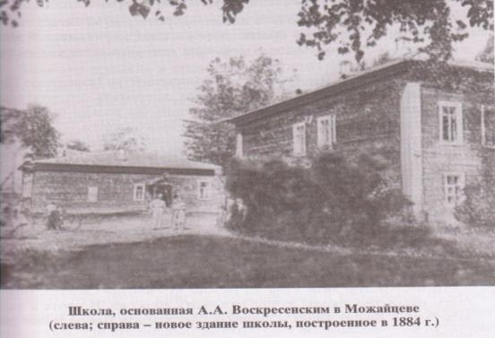
Mirny Secondary school (the former name was Mozhaitsevskaya School) was founded on the 29th of October in 1878 by A.A.Voskresensky.

Slide 6
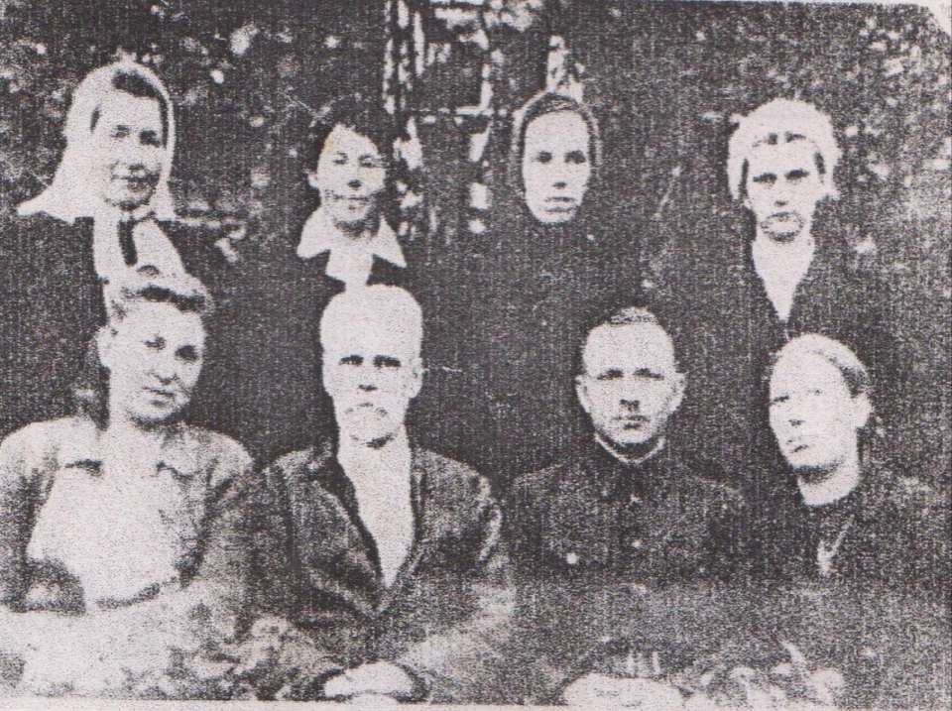

Slide 7
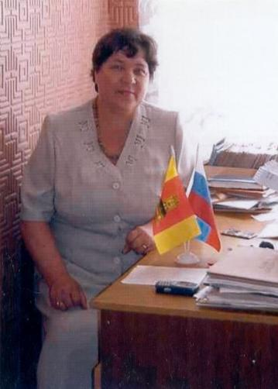
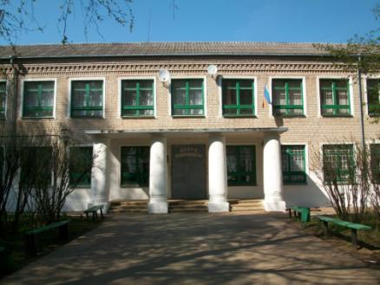
Now our school is headed by Stredinina Klavdiya Pavlovna.

Slide 8
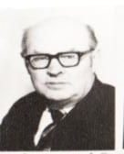
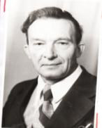
How many destinies were connected with school!

Slide 9
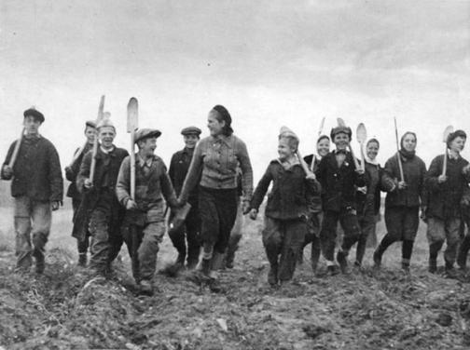
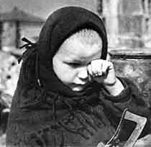
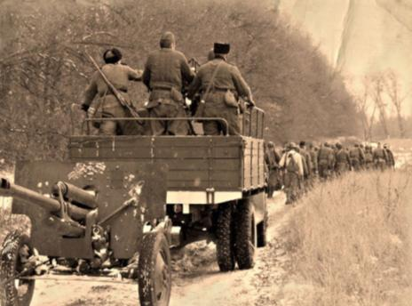
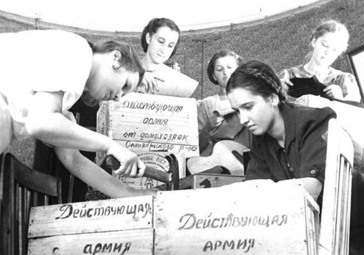

Slide 10
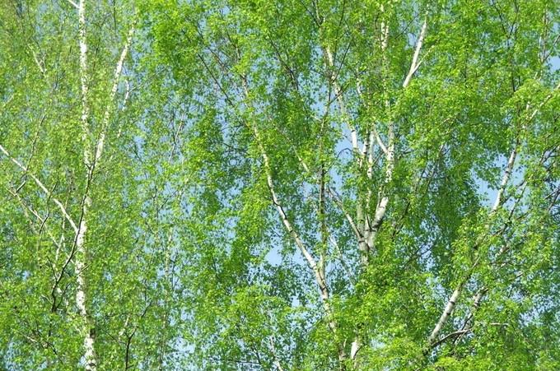
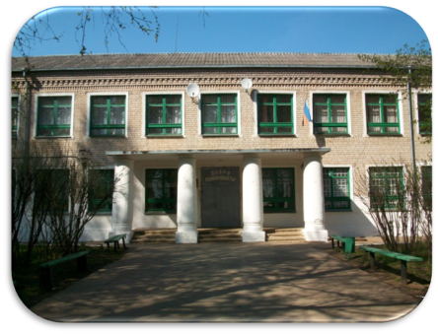
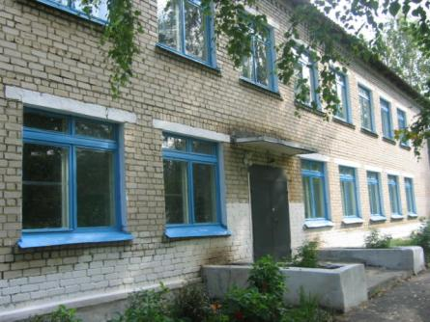

Slide 11
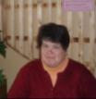
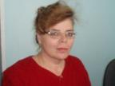
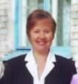
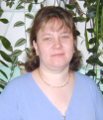
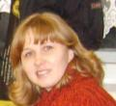
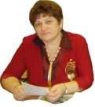
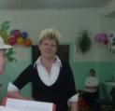
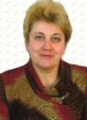
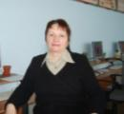
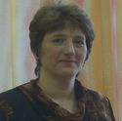
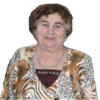
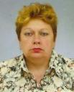
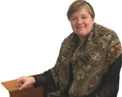
There are a great number of good, handsome, intelligent and skillful teachers at school now.

Slide 12
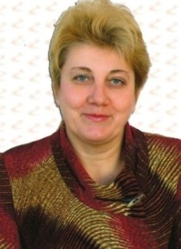
The head of studies at primary and secondary schools is Pushkina Galina Borisovna.

Slide 13
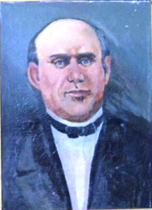
This year (2015) our school celebrates its 137th anniversary.

Slide 14
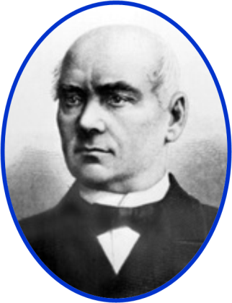
Alexander Abramovich Voskresensky (1808 – 1880)

Slide 15
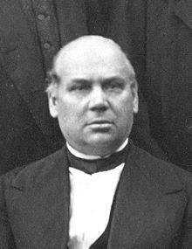
A.A. Voskresensky was not only a prominent scientist and researcher but also a skillful teacher.

Slide 16
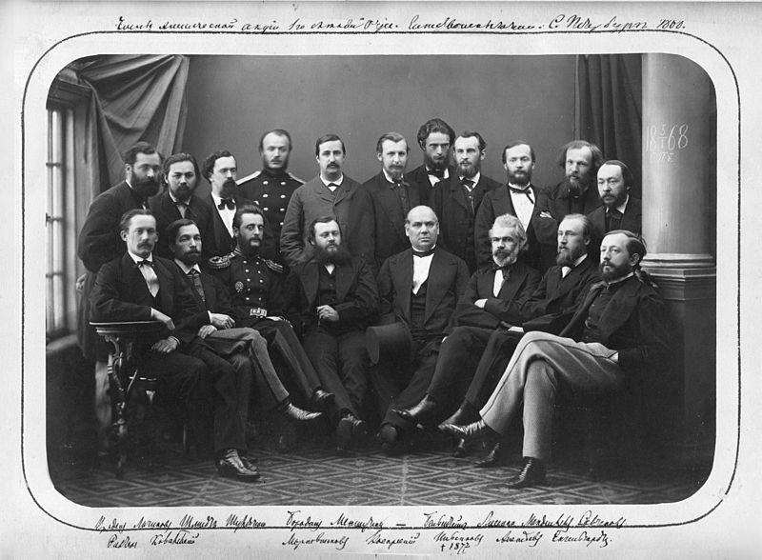
A.A. Voskresensky is known to be an outstanding administrator and organizer of science. His brilliant student was Dmitry Ivanovich Mendeleev. Mendeleev was very grateful to his teacher.

Slide 17
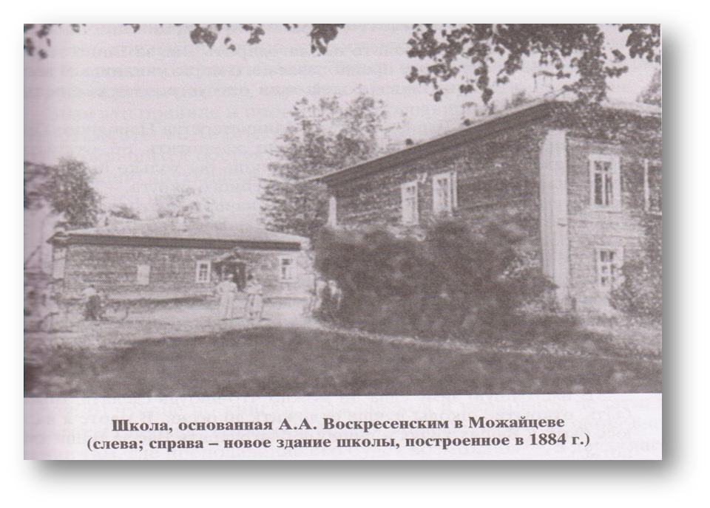
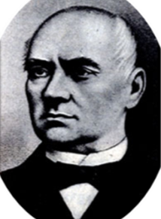

Slide 18
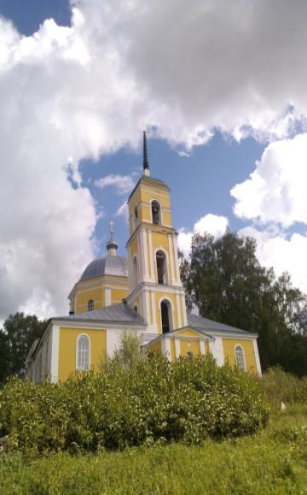
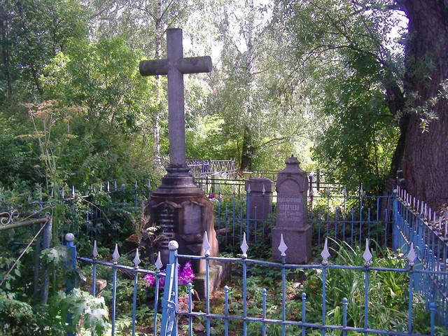
A.A. Voskresensky was buried in Spas not so far from Mirny.

Slide 19
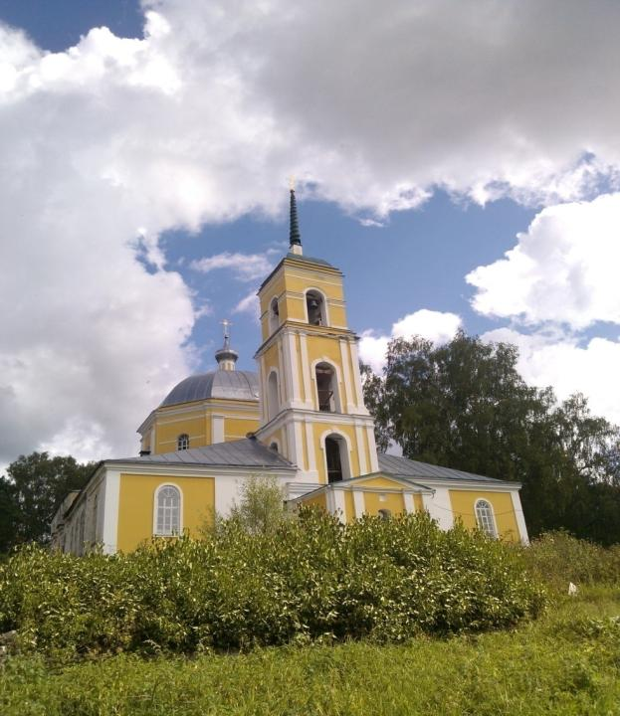
The 210th anniversary of Spas Church
1804 -2014

Slide 20
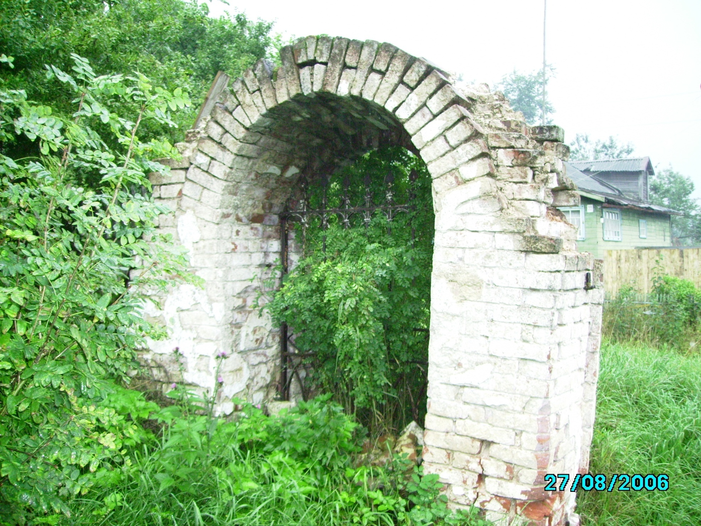

Slide 21
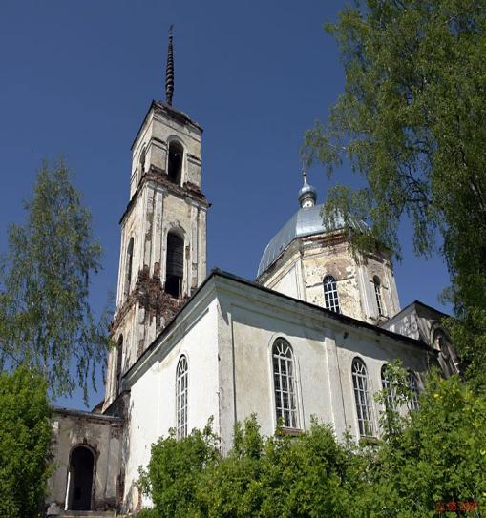
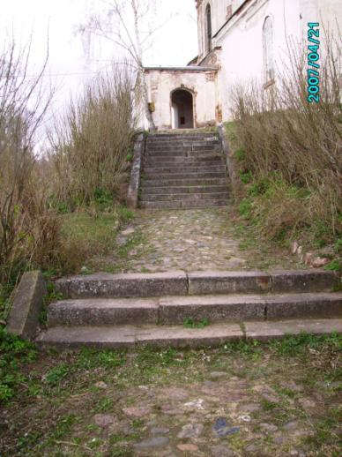
Spas Church

Slide 27
The 210th anniversary of Spas temple we celebrated in 2014

Slide 28
The ancient paintings

Slide 29
“Motherland” «Отечество»

Slide 30
A unique technique - Grisaille

Slide 31
A unique technique - Grisaille

Slide 32
“Motherland” «Отечество»

Slide 34
The paintings require restoration work

Slide 35
The full name of the Spas temple - The Transfiguration of our Lord God and Savior Jesus Christ

Slide 36
The central icon of the altar - Transfiguration of our Lord Jesus Christ

Slide 37
The central icon of the altar - Transfiguration of our Lord Jesus Christ

Slide 38
The icon of Michael the Tver and Ann of Kashin

Slide 39
The icon "Under the canopy"

Slide 40
The image of Christ's Crucifixion

Slide 41
A lectern

Slide 42
The main stories of the Bible

Slide 43
“The Pharisee and the Publican”

Slide 44
“Widow's Mite”

Slide 45
“Jesus and the Samaritan”

Slide 46
“The Resurrection of Lazarus”

Slide 47
“The Myrrh-bearing women”

Slide 48
“Christ Blessing the children”

Slide 50
The priest of Spas Church Father George
Протоиерей Георгий Иванович Беляков , настоятель храма Преображения Господня в селе Спас Торжокского района

Slide 51
Long years to the believers of our Church and the Church of the Transfiguration itself.

Slide 52
Torzhok ancient and new

Slide 56
The town is famous for its embroidery in gold.

Slide 57
Gold works of Torzhok art school

Slide 58
The coat of arms of Torzhok

Slide 60
Church of the Entry into Jerusalem and the Savior Transfiguration Cathedral in winter time

Slide 61
The Boris and Gleb Monastery

Slide 62
Church of the Ascension of Christ in Torzhok

Slide 63
The town council and market rows

Slide 64
The town council and market rows

Slide 65
Rotunda

Slide 66
The Museum of Russian Wooden Architecture in Vasilevo

Slide 67
The Pushkin Museum

Slide 69
Do you remember the name of the sight?
1 - Jerusalem Church
2 - The Saviour’s Transfiguration Cathedral
3 - Boris and Gleb Monastery

Slide 70
Do you remember the name of the sight?
1 - Archangel Michael Church
2 - Jerusalem Church
3 - The Ascension Church

Slide 71
Do you remember the name of the sight?
1 - The Ascension Church
2 - Jerusalem Church
3 - Archangel Michael Church

Slide 72
Do you remember the name of the sight?
1 - the Savior Transfiguration Cathedral
2 - Resurrection Monastery
3 - Rotunda

Slide 73
Do you remember the name of the sight?
1 - Сhurch of Iliya the Prophet 2 - Jerusalem Cathedral
3 - Church of George the Conqueror

Slide 76
Thanks a lot for your work
God bless you!

