Slide 1
Жирова Ольга Николаевна
100-735-693
«Russian national dish»

Slide 2
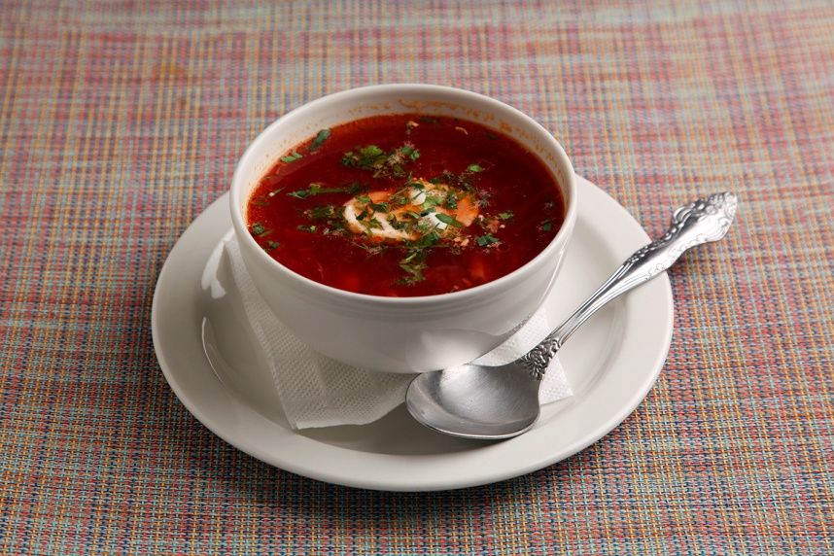
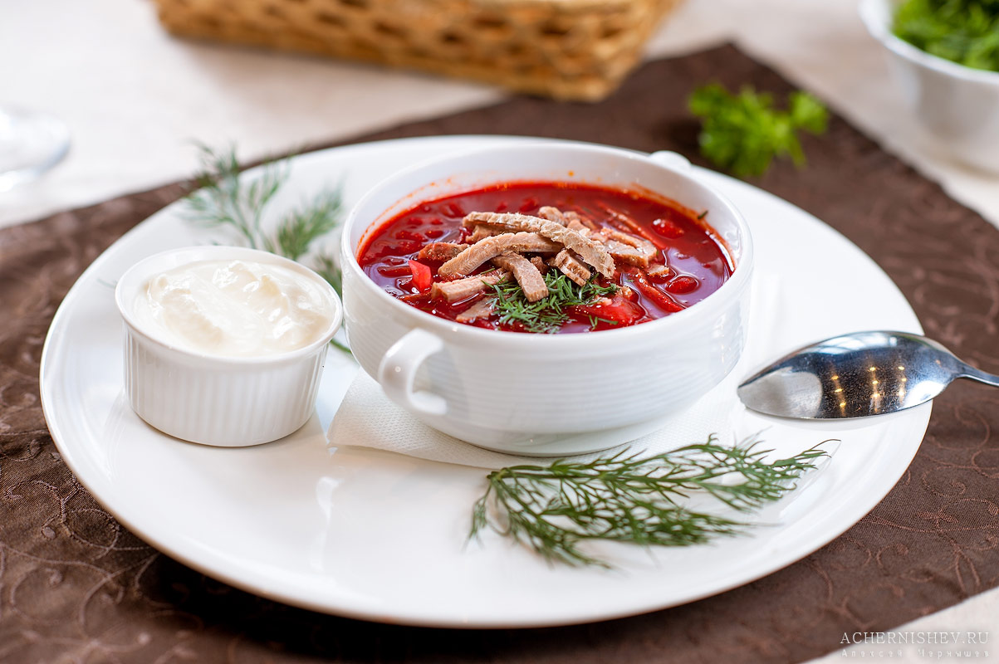
Russian National Dish

Slide 3
Let's train our tongues:
[i:] – meat, beef, beetroot
[ai]- kind, type, like
[ei] – place, tale
[λ] - onion , other
[o:] – tomato, water, more, before
[u:] – juice, food, beetroot , root
[æ] - carrot, cabbage

Slide 4
New words:
borscht
national dish
delicious soup
cold
season
contains
meat
tomato juice
beetroot
vegetables
carrots
cabbage
potatoes
parnips
celery
onion, garlic
sour cream
cook

Slide 5
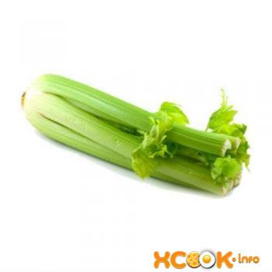
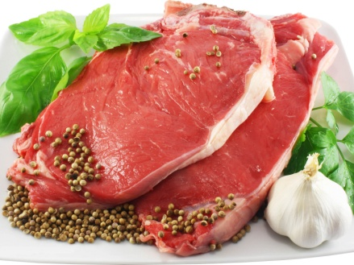
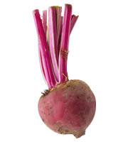
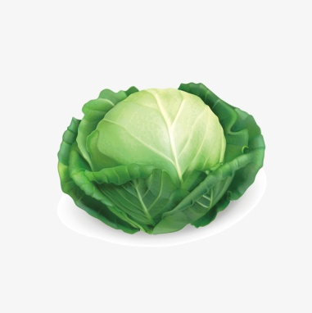
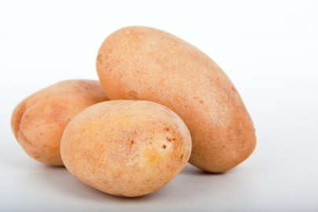
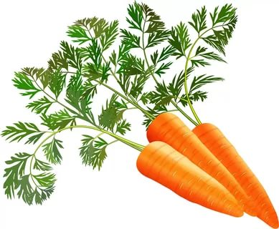
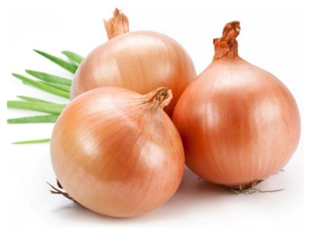
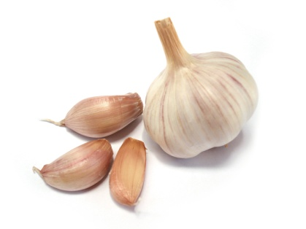
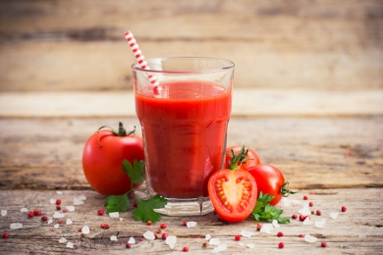
Use words to label the picture:

Slide 6
Answer the questions:
– What is borscht?
- What does it contain?
– What do people eat it with?
- How can you make it?

Slide 7
It’s time to have a rest:
Hands up! Clap! Clap! Clap!
Hands down! Shake! Shake! Shake!
Hands on hips! Jump! Jump! Jump!
Hop! Hop! Hop! Stand still!

Slide 8
Complete the table:
Name:
Ingredients:
What do people eat it with?
How to make it:

