Slide 1
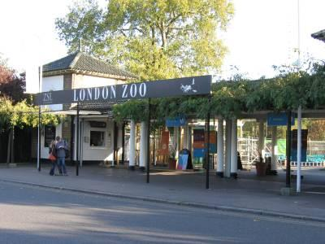
WELCOME TO LONDON ZOO

Slide 2
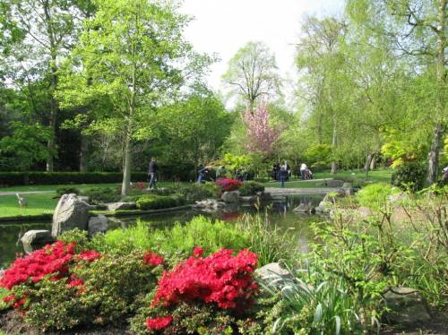
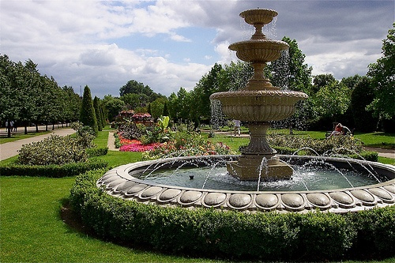
London Zoo is one of the most famous of all London attractions. It is situated in Regent’s Park and was opened in 1828 by the Zoological Society of London
.

Slide 3
This is the oldest zoo and we can see it on the map

Slide 4
A lot of tourists come to the Zoo. The Zoo is open every day from 9 o’clock in the morning till 7 o’clock in the evening.

Slide 5
Visitors can find out facts about the animals, including where they live, what they eat and if they are endangered in the wild

Slide 6
There are a lot of unusual statues at the Zoo

Slide 7
The Zoo is the best place for rest and fun.

Slide 8
Such a strange horse we can see there!

Slide 9
The girl seems not to be afraid of them

Slide 10
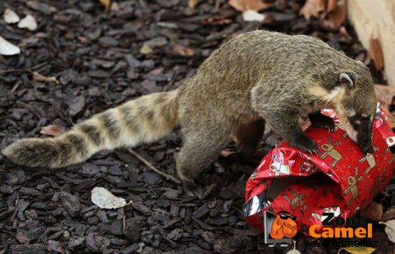
There are about 750 kinds of different animals at the Zoo

Slide 11
Zebra is strong and beautiful

Slide 12
The penguins are fond of swimming in a hot day

Slide 13
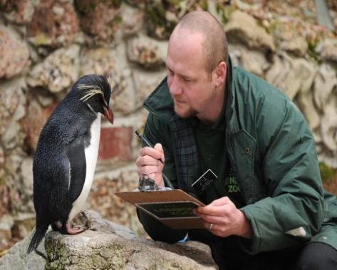
This small penguin is rather curious

Slide 14
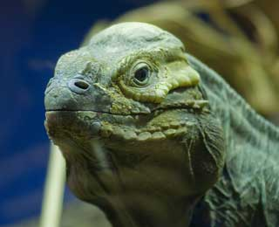
The reptiles are beautiful, aren’t they?

Slide 15
This is Regent’s canal

Slide 16
You can have a trip

Slide 17
There is a big aquarium at the Zoo with a lot of beautiful fishes

Slide 18
The polar bear is a good swimmer

Slide 19
And this one is a bit tired and he is going to rest a little

Slide 20
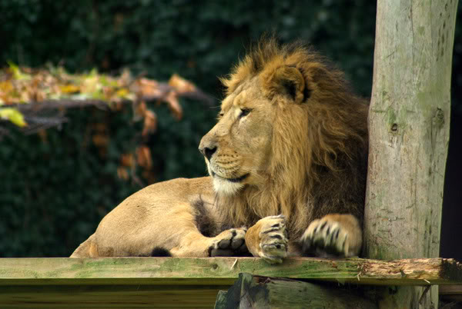
The lion’s family: a father and a mother. They are strong and clever. And their baby is small and friendly .

Slide 21
The mother would like to sleep… but the little lions wouldn’t like to…

Slide 22
The baby lions are so pretty and funny. They look like big kittens

Slide 23
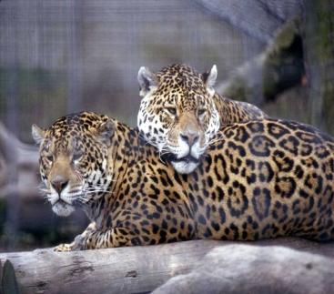
Big cats are so lovely! It’s interesting to watch them.

Slide 24
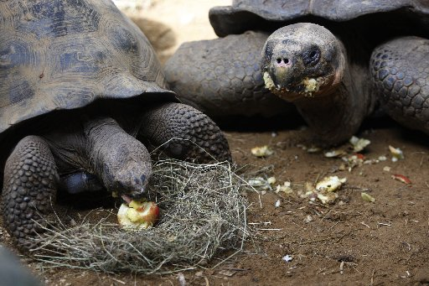
The hippo is too small…

Slide 25
The giraffes live in their own house. They can walk, eat and watch the people who come to watch them

Slide 26
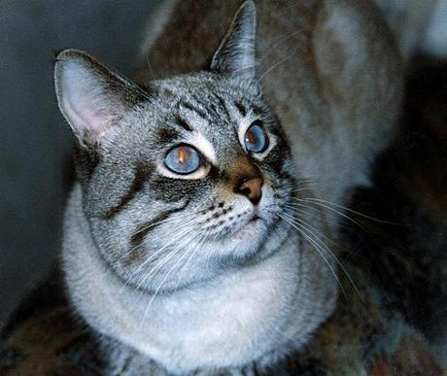
London Zoo has almost 750 species of animals, from the smallest monkey to the tall giraffe. Over 12,000 animals live in the Zoo today, many of them are rare and endangered.

Slide 27
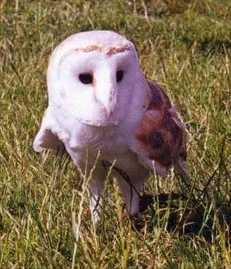
The koala and the owl are so funny

Slide 28
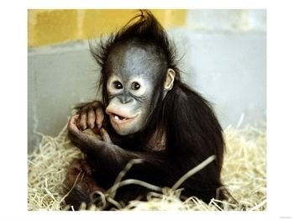
The funniest animals at London Zoo are monkeys. They jump, run and play with each other. They are not afraid of people and can come very close to them.

Slide 29
These animals are endangered The giant panda

Slide 30
The black rhino

Slide 31
The African elephants

Slide 32
The white tiger is endangered too

Slide 33
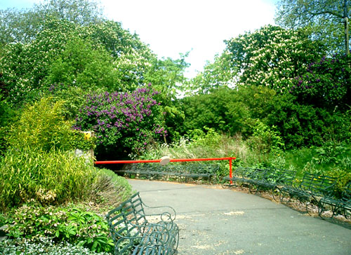
Thank you for your attention
COME TO LONDON ZOO AGAIN !

