Slide 1
WILLIAM SHAKESPEARE 1564 - 1616 ”The stream of time, which is continually washing the dissoluble fabrics of other poets, passes without injury by the adamant of Shakespeare.” Samuel Johnson.

Slide 2
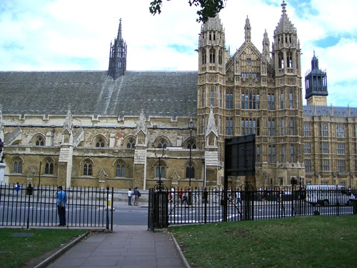
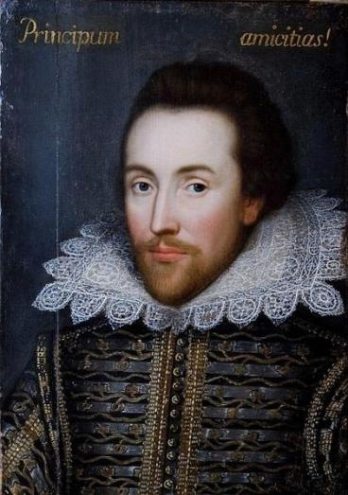
Memorial Theatre in Stratford-on-Avon.
William Shakespeare. The greatest English poet and dramatist.

Slide 3
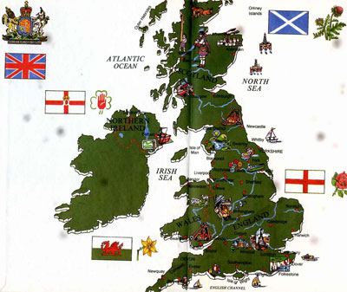
Great Britain is more than 50 thousands square miles. The population - more than 46 mln people.
England has 9 regions and many great cities:
1.Greater London
2.South East Region
3.South West England
4.East Anglia
5.West Midlands
6.East Midlands
7.North West England
8.Yorkshire and Hampshire
9.Northern England

Slide 4
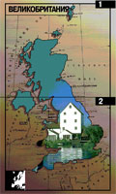
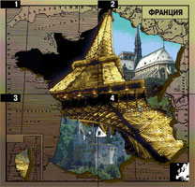
In the 17th century London was an important market and commercial centre.
the North Sea
the Irish Sea
the Severn
the Thames
Nowadays a tunnel has been constructed under the English Channel (connecting England and France).
London
the English Channel

Slide 5
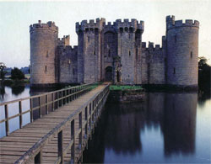
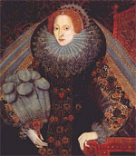
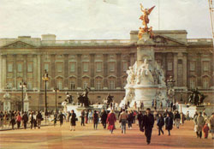
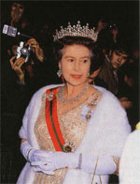
Celts
Romans
Anglo-Saxons
Danes lived in England in the past.
Windsor Castle has been the residence of the Kings and the Queens.
Buckingham Palace is Queen’s Elisabeth II residence.
Elizabeth I
Elizabeth II

Slide 6
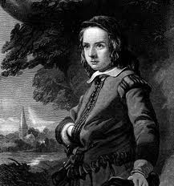
William Shakespeare, the greatest English poet and dramatist, was born in April 1564 in Stratford-upon-Avon.
Stratford – prosperous, self-governing market town.
Shakespeare was born here.
John Shakespeare, the poet’s father, was a glove – maker.

Slide 7
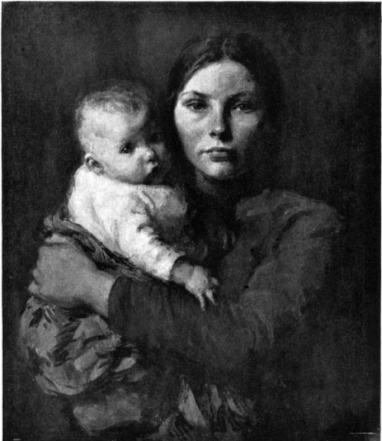
Mary Arden, the poet’s mother, was a daughter of a rich man.

Slide 8
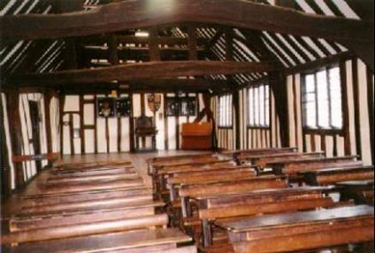
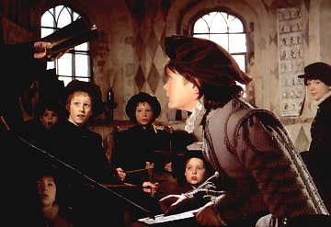
Shakespeare‘s schooling

Slide 9
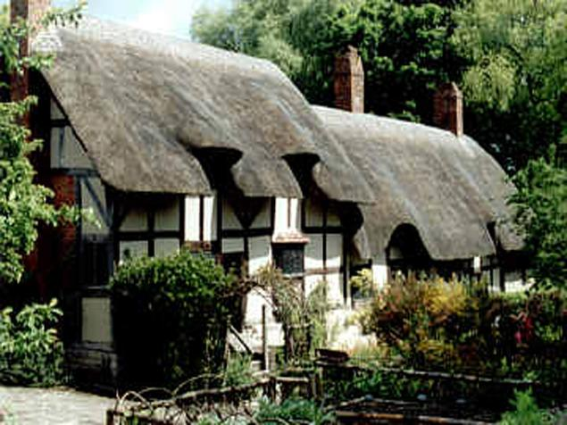
In 1582 at age of 18 William Shakespeare married Anne Hathaway
Anne was 26, he was 18
They had 3 children
The youngest, Hamnet died at the age of 11
William Shakespeare
William Shakespeare
Anne Hathaway’s cottage where she was born in 1556.

Slide 10
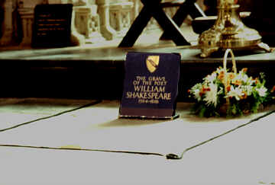
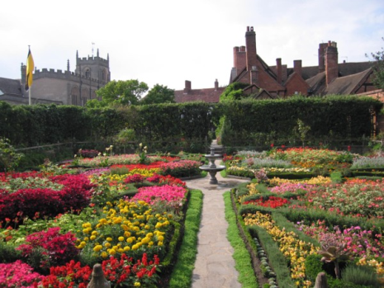
In 1616 Shakespeare
died on April, 23 (his birthday!)
This is a place where the house in which Shakespeare died
used to be.

Slide 11
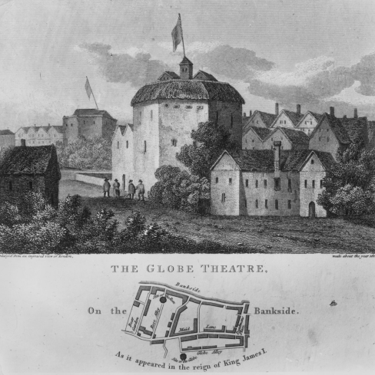
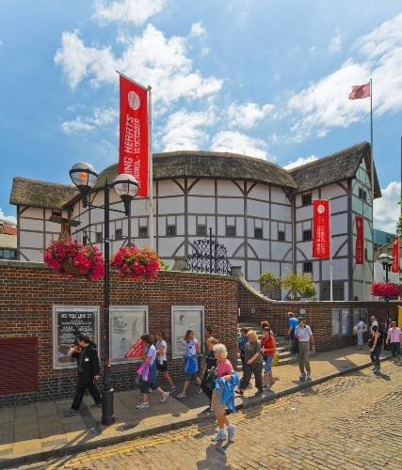
Royal Shakespeare Theatre.

Slide 12
Mach the name of the party with the translation.
1. «Комедия ошибок»
2. «Виндзорские насмешницы»
3. «Венецианский купец»
4. «Лукреция»
5. «Все хорошо, что хорошо»
6. «Мера за меру»
7. «Сон в летнюю ночь»
1. “A Midsummer Night's Dream”
2. “Measure for Measure”
3. “The Rape of Lucrece”
4. “All’s well that Ends well”
5. “The Comedy of Errors”
6. “The Merry Wives of Windsor”
7. “The Merchant of Venice”
YES
NO

Slide 13
1. «Ричард III»
2. «Укрощение строптивой»
3. «Много шума из ничего»
4. «Как вам это нравится»
5. «Два благородных родича»
6. «Двенадцатая ночь»
7. «Буря»
1.“Much Ado about Nothing”
2. “The Two Noble Kinsmen”
3. “The Tragedy of Richard III”
4. “The Taming of the Shrew”
5. “The Tempest”
6. “As you like it”
7. “Twelfth Night”
YES
NO

Slide 14
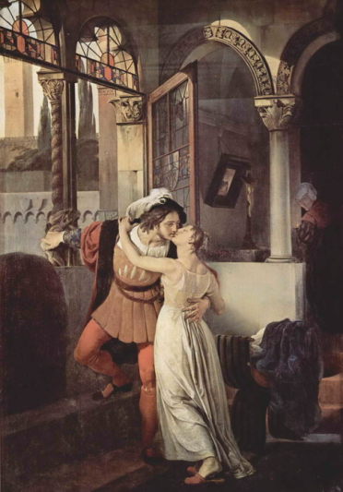
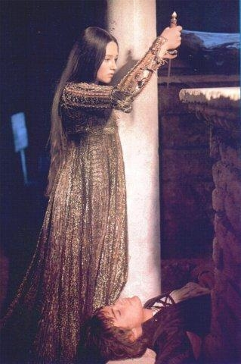
Romeo and Juliet – an optimistic tragedy, staged in all kinds of theatres.

Slide 15
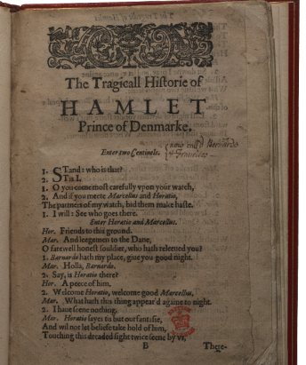
“Hamlet” is a great philosophical tragedy. It is the story of a man who loved good and hated evil who loved truth and hated lies.
The character of Hamlet is one of the most difficult in world literature.
This role was played by the best actors of all times and peoples.
John Gielgud was the best in the role of Hamlet in England.
Russian poet and actor Vladimir Vysotsky was brilliant in our country.

Slide 16
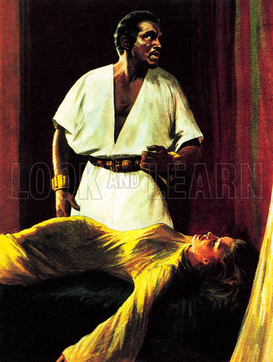
“Othello” is a play about love and jealousy, a play about a person who believed the lie and killed his wife whom he loved dearly.

Slide 17
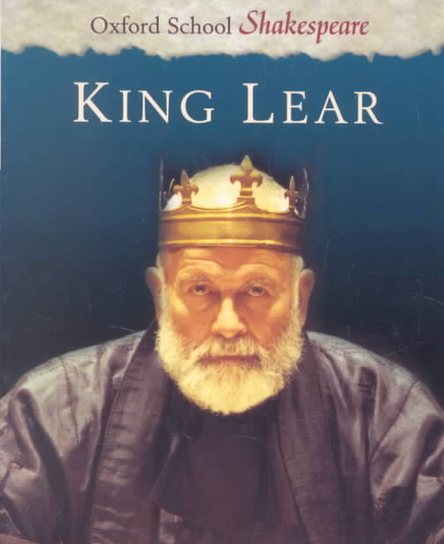
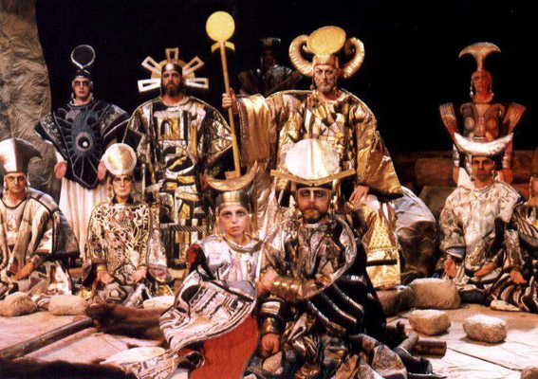
“King Lear” is the story of a man who was so proud, so egoistic that he could not understand a world around him. He heard only what he wanted to hear; he saw only what he wanted to see.

Slide 18
Quotations from Shakespeare There are some common phrases which the English own to William Shakespeare. They have now become part of the everyday language of Englishmen.
NO
YES
1. “To be or not to be
That is the question”
2. “All the world’s a stage, and all the men and women merely players”.
3. “How sharper than a serpent’s tooth it is to have a thankless child…”
4. “Something is rotten in the state of Denmark”.
5. “One that loved not wisely but too well”.
6. “Every inch a king”.
7. “Lord, what fools these mortals be”.
1. «…острей зубов змеиных
неблагодарность детища!»
2. «Король, король – от головы до ног!»
3. «Быть или не быть
Вот в чем вопрос».
4. «Весь мир – театр. В нем женщины, мужчины – все актеры».
5. «Как безумен род людской!»
6. «Подгнило что-то в датском королевстве».
7. «…этот человек любил без меры и благоразумия».

Slide 19
1. “Neither a borrower nor a lender be”.
2. “That way madness lies”.
3. “If music be the food of love, play on”.
4. “Romeo, Romeo! Wherefore art thou Romeo?”
5. “What’s in a name? That which we call a vose by any other name would smell as sweet”.
6. “Tomorrow, and tomorrow, and tomorrow
Creeps in this petty pace from day to day
To the last syllable of recorded time…”
7. “Friends, Romans, countrymen, lend me your ears”.
1. «О музыка, ты пища для любви! Играй же».
2. «Но это путь к безумию».
3. «Друзья, сограждане, внемлите мне».
4. «Что значит имя? Роза пахнет розой, хоть розой назови ее, хоть нет».
5. «В долг не бери и взаймы не давай».
6. «Завтра, завтра, завтра, а дни ползут, и вот уж в книге жизней читаем мы последний слог…»
7. «Ромео! Ромео, о зачем же ты Ромео!»
YES
NO

Slide 20
« To be or not to be, that is the question ».
1. The beginning at the time end.
2. The whirling of time.
3. There’s the rub.
4. All is well that ends well.
5. To win golden opinions.
А. Вот в чем загвоздка.
В. Начало конца.
С. Все хорошо, что хорошо кончается.
D. Превратности судьбы.
Е. Заслужить благоприятное мнение.

Slide 21
Can you answer these questions?
When was William Shakespeare born?
Where was he born?
Did he have a good education?
Did he have a family?
When did he go to London?
What did he do there?
Where were most of his plays performed?
When did he stopped writing?
What the best known plays do you know?

Slide 22
Congratulations!!!

Slide 23
Интернет ресурсы: Сайты : http://wikipedia.org http://4umi.com/shakespeare/ http://www.wshakespeare.ru/id-sa-autor-62/ http://brusentsov.com/2010/05/22/6487 http://alkor.virtbox.ru/theatre.html http://www.turinfo.ru/attractions/teatr-globus/

