Slide 1
Презентация Викторина: “Знаешь ли ты английский язык и англоговорящие страны?” Quiz: “Do you know English and English-speaking countries?” Выполнена учителем английского языка Дроздовой И.В. 232-005-447 (ГБОУ СОШ № 1206, г. Москва)

Slide 2
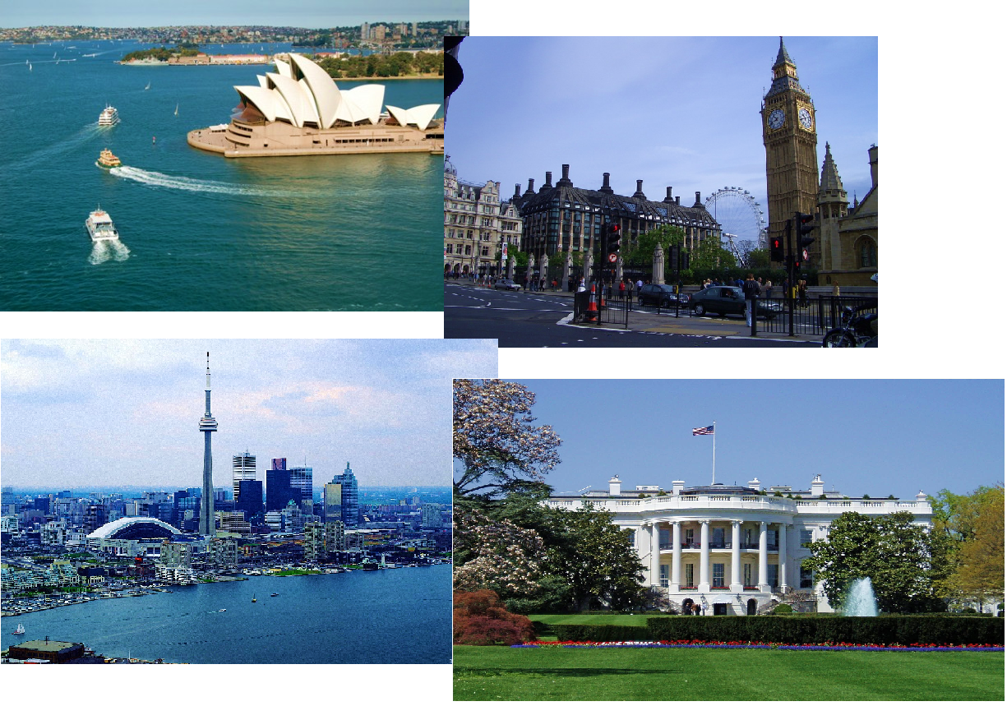
Do you know English and English-speaking countries?

Slide 3
Guess the name of the team. The first letter of the answer corresponds to the number.
TEAM 1
1 2 3 4 5 6 7 8
8. The county which is called “The Gardens of England”.
7. The royal headwear.
6. The famous university of England, not Cambridge.
5. The second letter of the word “prince”.
4. The word for a “king” or a “queen”.
3. The name of Queen Victoria’s husband.
2. The name of Prince William’s brother.
1. The pre-historic monument in the south-west of England consisting of huge stones.
TEAM 2
1 2 3 4 5 6 7
7. The biggest part of Great Britain.
6. The home town of the Beatles pop group.
5. A historic castle in central London built by William the Conqueror, a former prison.
4. The birthplace of William Shakespeare.
3. The island to the left of the island of Great Britain.
2. The name of the famous English king who had a lot of wives.
1. The main square in the centre of London.

Slide 4
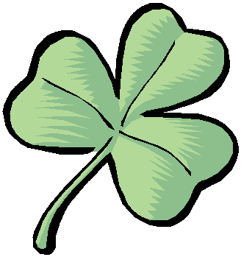
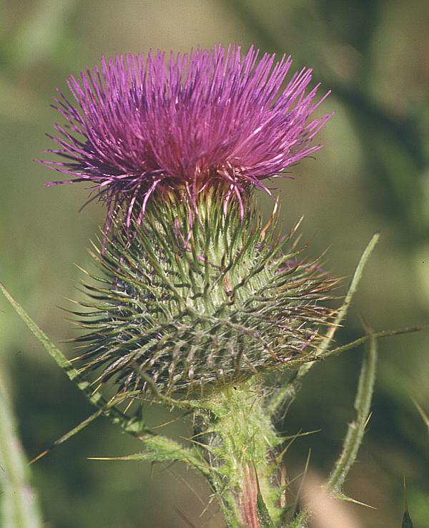
The names of the teams are:
TEAM 1.
SHAMROCK
TEAM 2.
THISTLE

Slide 5
The plan of the quiz.
English-speaking countries
Royal family quiz -5 points
USA quiz – 5 points
Canada quiz – 5 points
Australian animals quiz – 10 points
2. Borrowings – 27 points
3. Idioms quiz
Nose idioms – 5 points
Colour idioms – 5 points
4. Speaking – 5 points
5. Guess the melody – 13 points
Total – 80 points

Slide 6
TASK 1 QUIZ ENGLISH-SPEAKING COUNTRIES

Slide 7
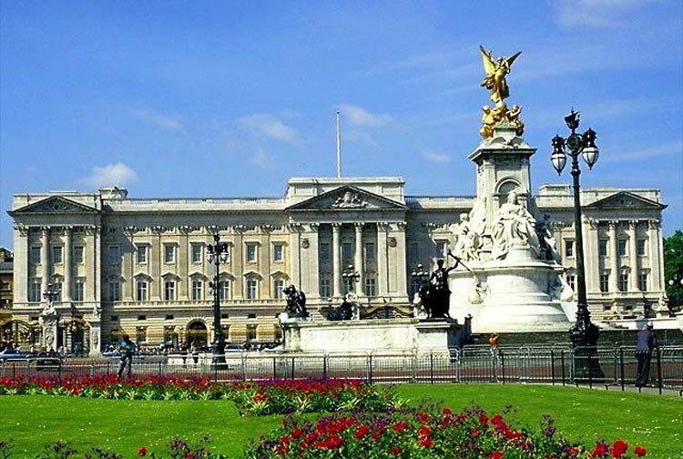
TASK 1 PART 1
Royal family Quiz
How well do you know the British royal family?

Slide 8
Choose the correct answer a, b, c or d

Slide 9
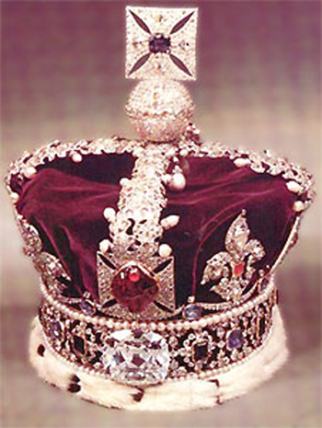
1. What is the family name of the present royal family?
Tudor
Smith
Stuart
Windsor

Slide 10
2. When did Queen Elizabeth II become Queen?
1952
1962
1972
1982

Slide 11
3. Which university did Prince William attend?
Oxford University
Cambridge University
St Andrews University
London University

Slide 12
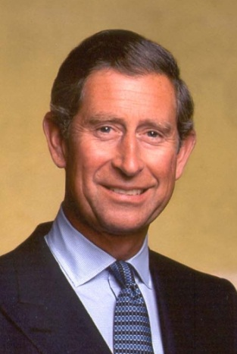
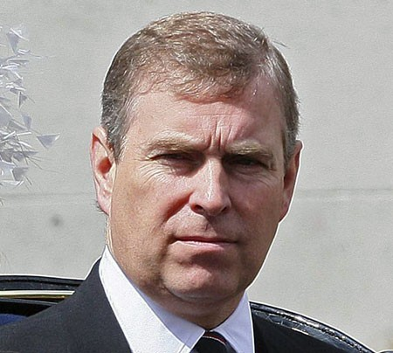
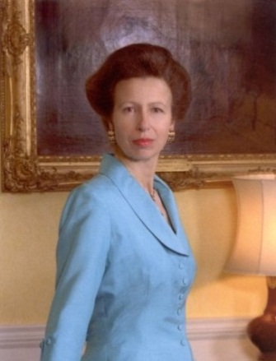
4. Who was once part of the British horse-riding team in the Olympic Games?
Prince Philip
Prince Charles
Prince Andrew
Princess Anne

Slide 13
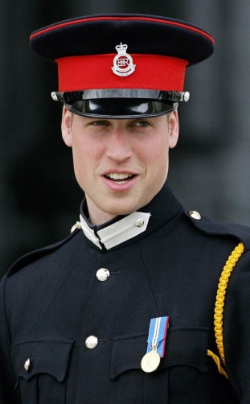
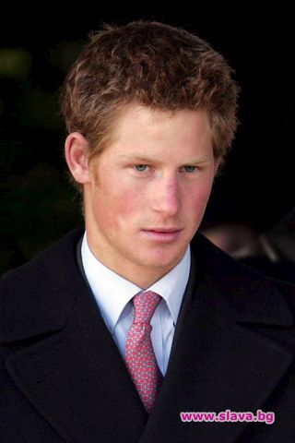
5. Which member of the royal family is president of England’s Football Association? a) Prince Charles b) Princess Anne c) Prince William d) Prince Harry

Slide 14
Answers.
1. Windsor is the family name of the present royal family.
2. Queen Elizabeth II became Queen in 1952.
3. Prince William attended St Andrews University.
4. Princess Anne was once part of the British horse-riding team.
5. Prince William is president of England’s Football Association.
6. British monarchs are crowned in Westminster Abbey.
7. Lady Grey reigned for 9 days.

Slide 15
Score

Slide 16
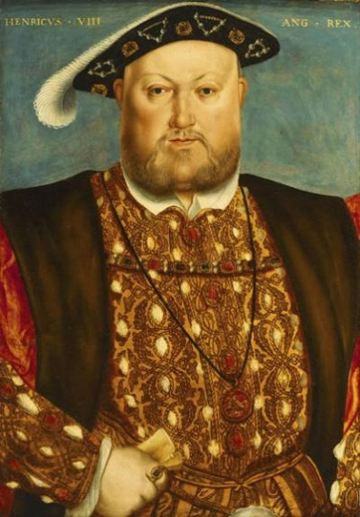
Do you know?
Everybody knows that Henry VIII
had six wives. But not many people
know that his sixth wife, Catherine
Parr, had four husbands of her own
including Henry.
The surname of the British Royal Family is Windsor. This might sound very British, but the Royal Family’s ancestors were German. Queen Elizabeth II’s great-great-grandmother, Queen Victoria, was born in Britain, but her mother and her husband were both German.

Slide 17
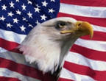
TASK 1 PART 2
USA Quiz

Slide 18
Choose the correct answer a, b or c

Slide 19
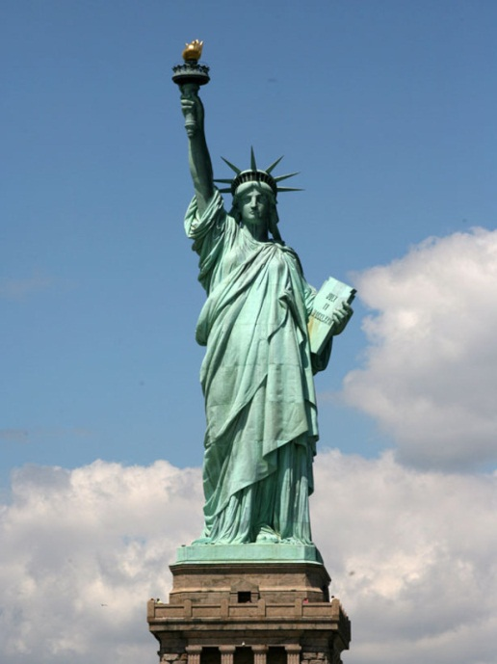
1) The Statue of Liberty was designed by Frederic Bartholdi and was given to the US by France in 1884 as a symbol of Franko-American friendship. But who was the model for the statue?
Bartholdi’s wife
Bartholdi’s mother
Bartholdi’s daughter

Slide 20
2) Which country is bigger, Canada or the USA?
Canada
The USA

Slide 21
3) Your American friends say to you, “ Let’s go see a ball game.” What do they mean?
volleyball
basketball
baseball

Slide 22
4) The two largest political parties in the US are the Republicans and the Democrats. The Republican Party is traditionally represented by an elephant. What animal represents the Democratic Party?
a donkey
a tiger
a monkey

Slide 23
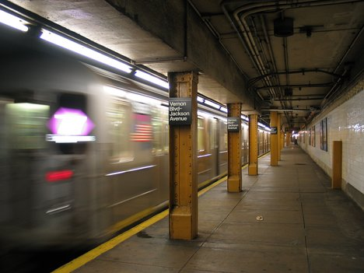
5) What is the New York underground called?
the metro
the subway
the tube

Slide 24
Answers.
The model for the Statue of Liberty was Bartholdi’s mother.
Canada is bigger than the USA.
A ball game is baseball.
A donkey represents the Democratic Party.
The New York underground is called the subway.

Slide 25
Score

Slide 26
Do you know what it is ?
The Great Seal
of the USA

Slide 27
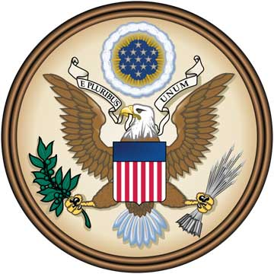
WHO SAYS NUMBER 13 IS UNLUCKY?
This much abused number is the keynote of the Great Seal of the United States. In it there are:
13 stars
13 stripes
13 arrows
13 letters in the motto
13 olive leaves
13 olives
13 feathers on each arrow

Slide 28
TASK 1 PART 3 CANADA QUIZ

Slide 29
Choose the correct answer a, b, c or d

Slide 30
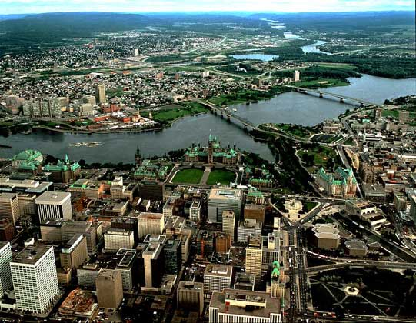
1. The capital of Canada is
Toronto
Montreal
Quebec
d) Ottawa

Slide 31
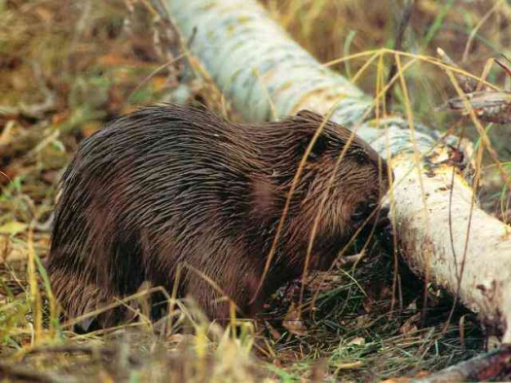
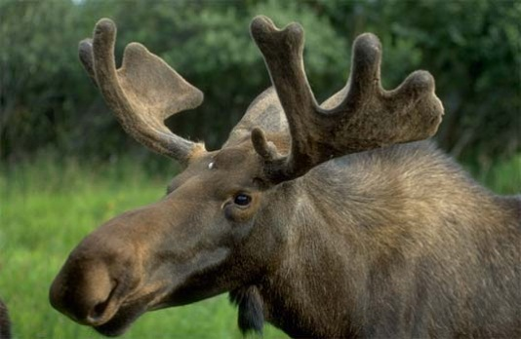
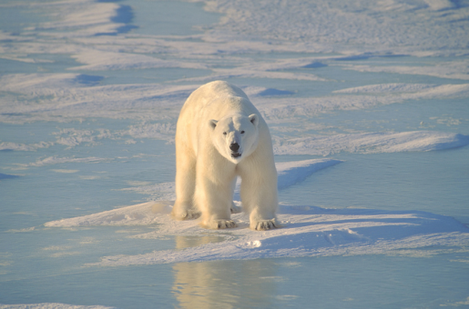
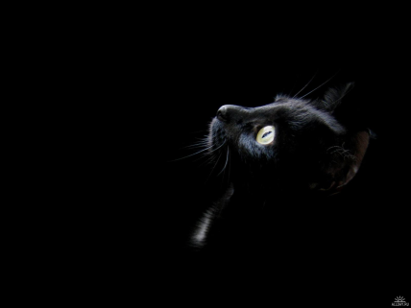
2. Which animal is an official emblem of Canada?
a) the beaver
b) the moose
c) the polar bear
d) the black cat

Slide 32
3. Which place in Canada is called ‘the honeymoon capital of the world’?
the Yukon
Newfoundland
Montreal
Niagara Falls

Slide 33
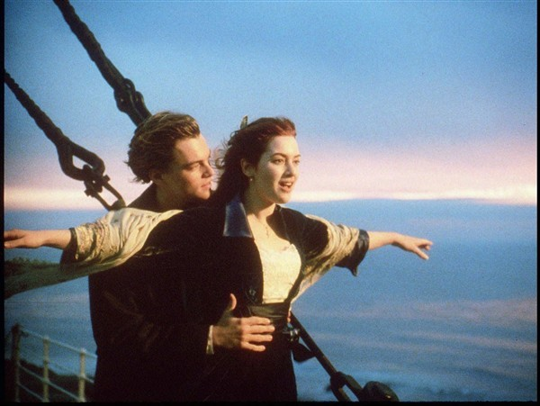
4. Which Canadian singer had a worldwide hit with a song from the Titanic movie?
Avril Lavigne
Shania Twain
Celine Dion
Diana Krall

Slide 34
5. The Canadian head of state is
a) the Queen
b) the President
c) the Prime Minister
d) the Governer General

Slide 35
Answers.
The capital of Canada is Ottawa.
The beaver is an official symbol of Canada.
‘The honeymoon capital of the world’ is the Niagara Falls.
Celine Dion had a hit with a song from the “Titanic”.
The Canadian head of state is the Queen.

Slide 36
Score

Slide 37
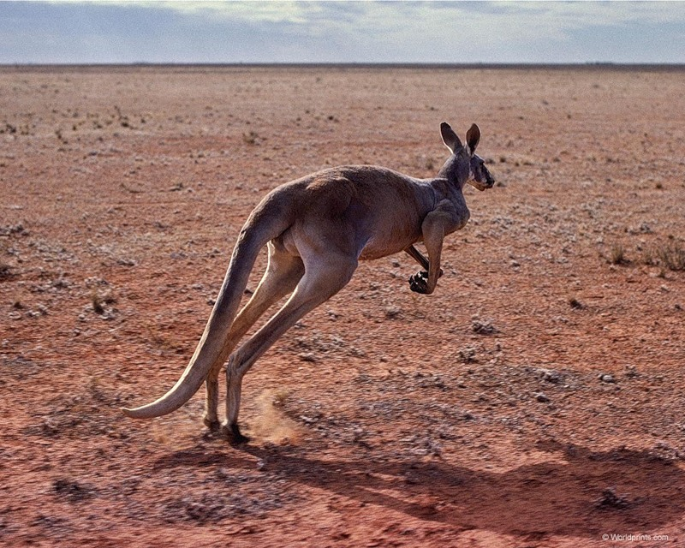
TASK 1 PART 4
AUSTRALIAN
ANIMALS
QUIZ

Slide 38
Match the animals with their names

Slide 39
2
3
4
1
a) echidna
b) koala
c) emu
d) platypus
e) dingo
f) lyrebird
g) kookaburra
h) anteater
cockatoo
j) wombat
6
7
5
9
10
8

Slide 40
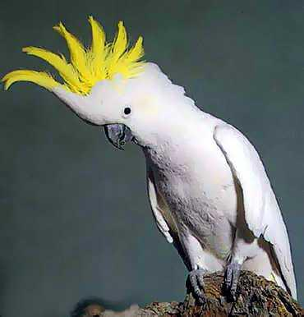
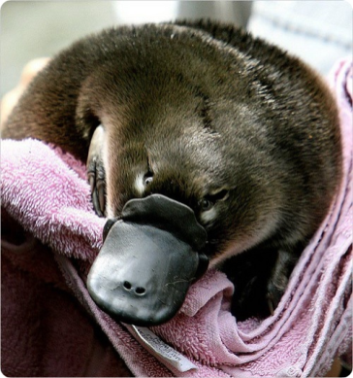
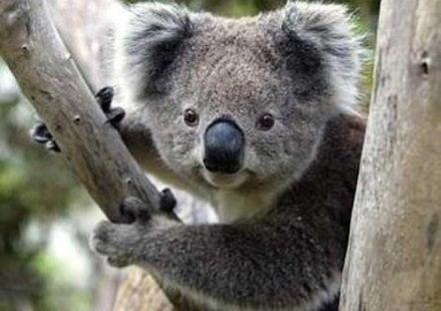
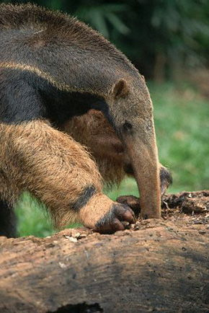
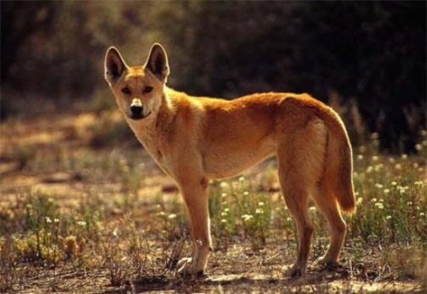
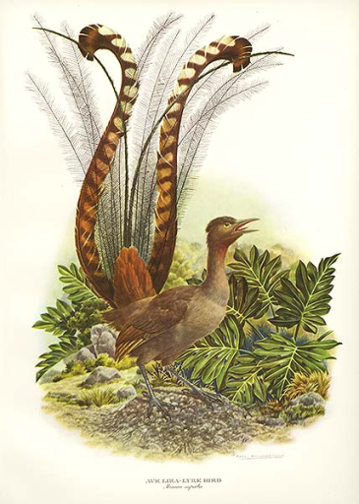
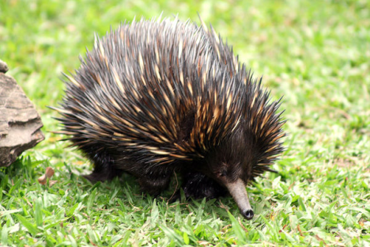
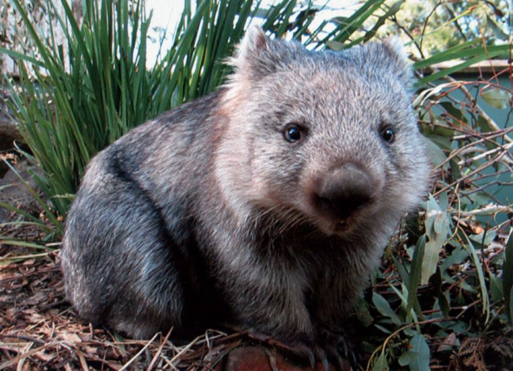
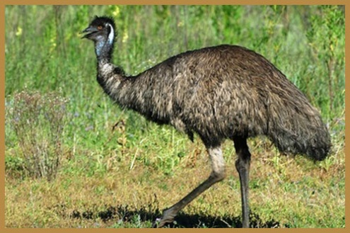
Answers.
1 – kookabarra
2 –cockatoo
3 – platypus
4 – koala
5 – anteater
6 – dingo
7 – lyrebird
8 – echidna
9 – wombat
10 - emu

Slide 41
Score

Slide 42
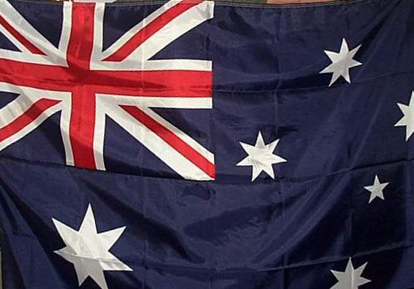
Do you know
what ‘Strine’ is?
Australian people speak English but their English is a bit different from British or American English. They have their own special words and phrases called ‘Strine’.
Here are some examples:
Arvo – afternoon
Barbie – barbecue
Chrissie – Christmas
Cow – anything that is difficult
Crook – not well, ill
Dead horse – tomato sauce
Grizzle – to complain
Kanga or kangaroo - shoe
Lollies – sweets
Lolly – money
Mate – a best friend
Snags –sausages

Slide 43
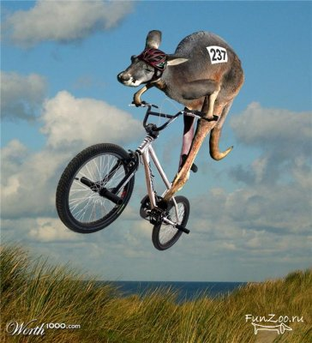
Can you work out what these sentences mean?
Hey, mate! Come along to our barbie this arvo. We’re going to cook the snags.
I don’t mean to grizzle, but I was feeling pretty crook during Chrissie.

Slide 44
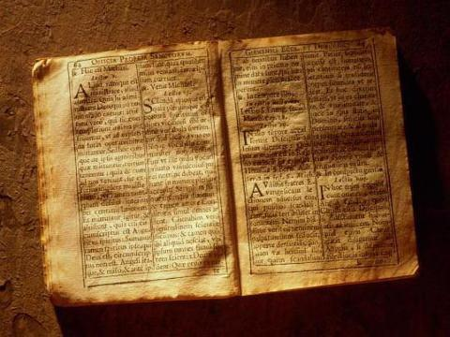
TASK 2. BORROWINGS.

Slide 45
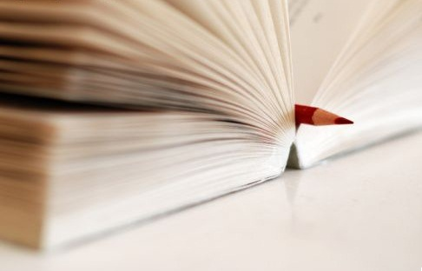
The English language has many words which have been borrowed from other languages. Can you guess where the following words come from? Match the word and the language.

Slide 46
French Greek Italian Russian Spanish
German Turkish Hindi Japanese
Coffee |  | Hamburger |  | Canyon
Menu |  | Kindergarten |  | Poodle
Pizza |  | Physics |  | Soprano
Theatre |  | Judo |  | Kimono
Samovar |  | Guitar |  | Sputnik
Café |  | Bouquet |  | Vodka
Caviar |  | Chemistry |  | Tango
Shampoo |  | Kiosk |  | Pyjamas
Fresco |  | Bungalow |  | Hara-kiri

Slide 47
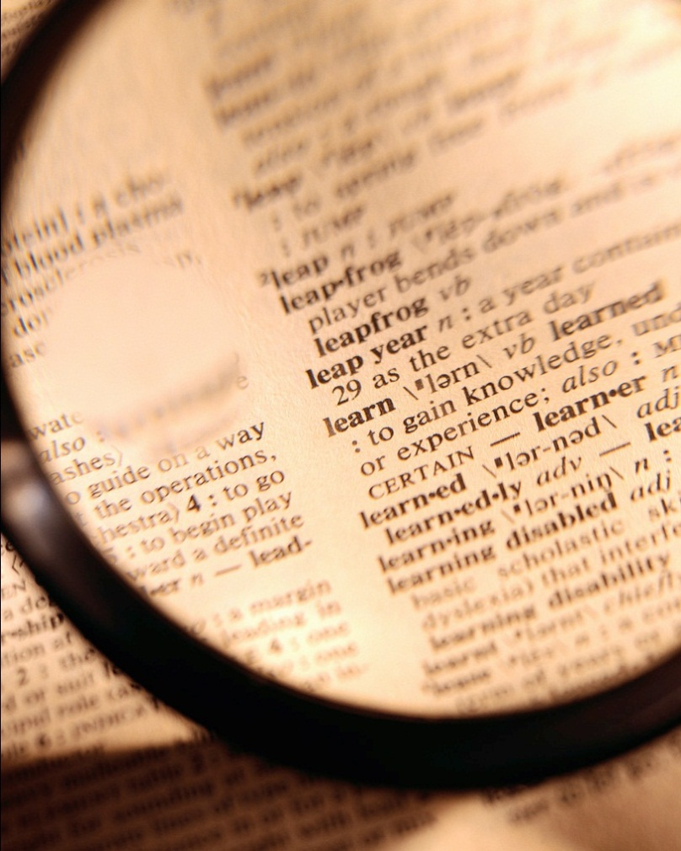
Answers.

Slide 48
French: menu, cafe, bouquet
Greek: physics, theatre, chemistry
Italian: pizza, soprano, fresco
Russian: sputnik, vodka, samovar
Spanish: guitar, canyon, tango
German: hamburger, kindergarten,
poodle
Turkish: coffee, kiosk, caviar
Hindi: shampoo, bungalow, pyjamas
Japanese: kimono, hara-kiri, judo

Slide 49
Score

Slide 50
Do you know English?

Slide 51
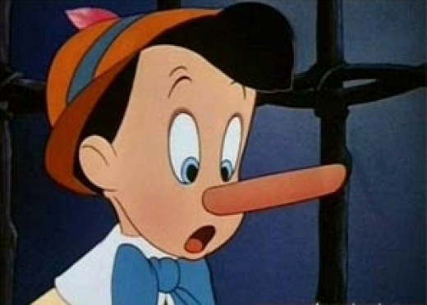
TASK 3. PART 1. “NOSE” IDIOMS

Slide 52
Can you match the “nose” idioms on the left with their definitions on the right?
to pay through the nose
to follow one’s nose
to keep one’s nose clean
to have one’s nose in the air
to have one’s nose in the book
to keep out of trouble,
especially trouble with law
b) to be reading
c) to pay too much
d) to go straight ahead
e) to behave as if you are
better than someone else

Slide 53
Answers.
to pay through the nose
to follow one’s nose
to keep one’s nose clean
to have one’s nose in the air
to have one’s nose in the book
c) to pay too much
d) to go straight ahead
to keep out of trouble,
especially trouble with law
e) to behave as if you are
better than someone else
b) to be reading

Slide 54
Score

Slide 55
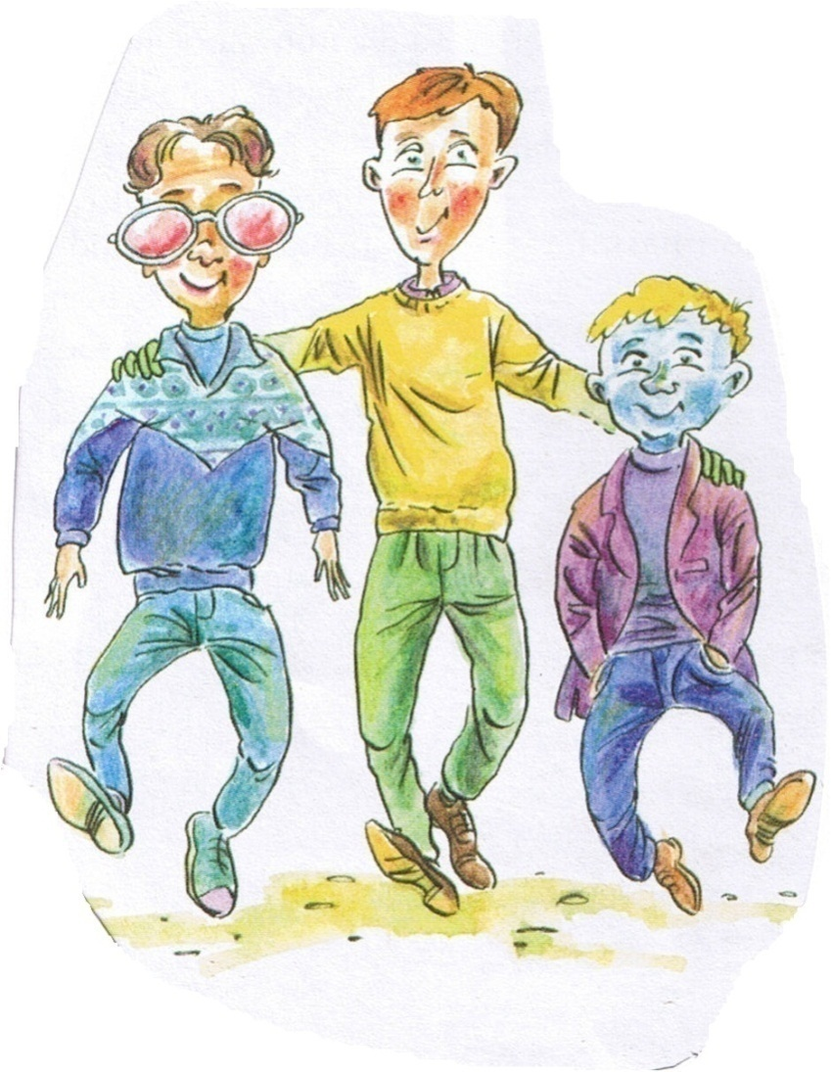
TASK 3. PART 2. COLOUR IDIOMS

Slide 56
Match the idioms with the correct definition.

Slide 57
1. to be in the red
a) to be in a dangerous situation
b) to be bleeding
c) to have spent more money than you had in your bank account

Slide 58
2. to have green fingers
a) to wear green gloves
b) to be very good at gardening
c) to be very interested in the environment

Slide 59
3. to feel blue
a) to be fond of the colour blue
b) to enjoy a beautiful blue sky
c) to be sad or depressed

Slide 60
4. to want everything in black and white
to want information in a very clear written form
to be a fan of old black-and-white films
to buy only black or white clothes

Slide 61
5. to see life through rose-coloured glasses
a) to wear glasses with pink lenses
b) to see the world better than it really is
c) to be colour-blind

Slide 62
Answers.
to be in the red
c) to have spent more money than you had in your bank account
2. to have green fingers
b) to be very good at gardening
3. to feel blue
c) to be sad or depressed
4. to want everything in black and white
a) to want information in a very clear written form
5. to see life through rose-coloured glasses
b) to see the world better than it really is

Slide 63
Score

Slide 64
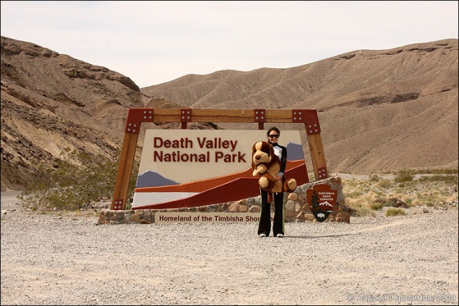
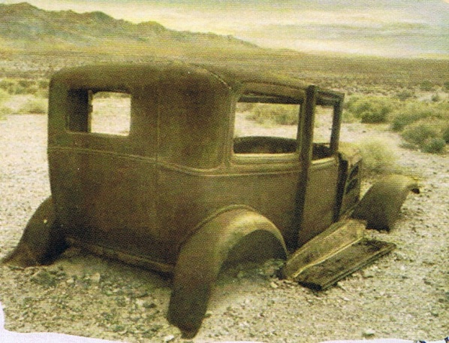
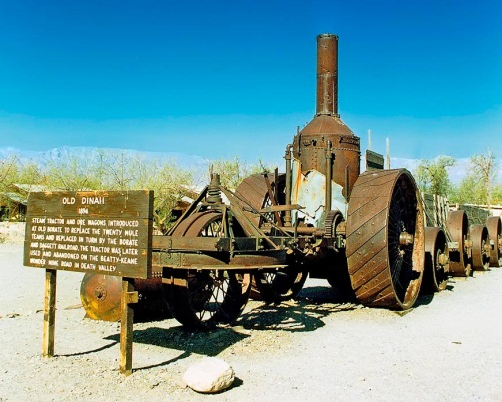
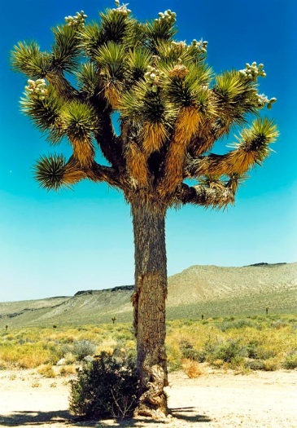
Do you know
what a Death Valley is?
Going to Death Valley once meant danger and even death. It’s the hottest place in the USA and summer temperatures there can reach 54 degrees ! Today it’s a national park and thousands of people drive there to enjoy the beauty of this strange land.
There are lots of ghost towns in Death Valley. In the 1800s people streamed to Death Valley looking for gold and silver. The terrible heat combined with hard work made people leave the towns.
Today, you can visit there eerie ghost towns and look inside old houses, prisons and banks to see how people lived back then.

Slide 65
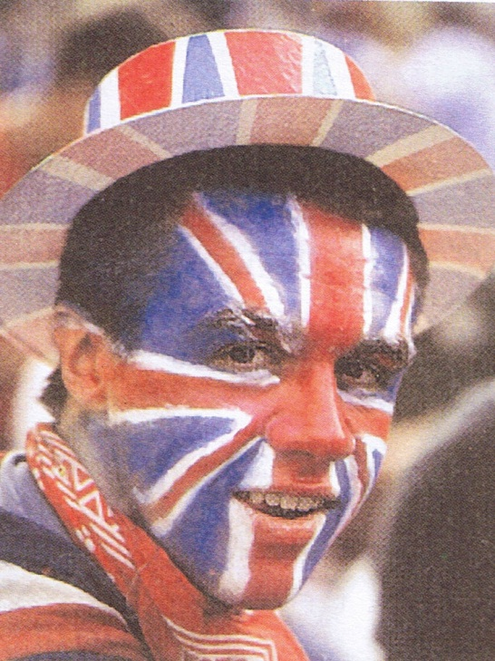
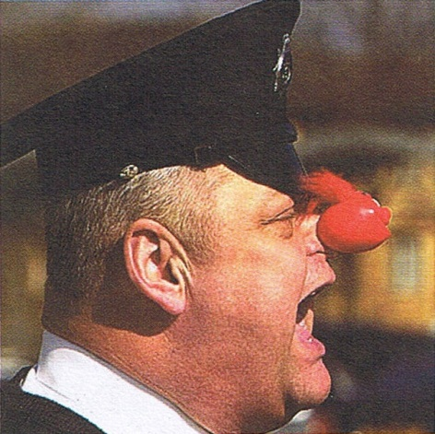
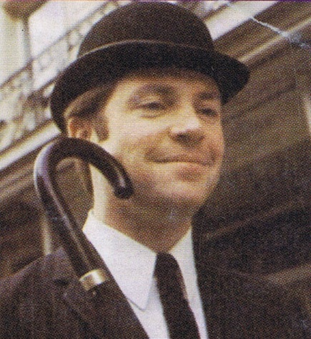
Task 4.
A CRAZY RACE
British Eccentricities
Speaking Quiz

Slide 66
Try your luck in this simple test.
The English police do not carry guns. They are the only police force in the world not to be armed. Why?
The BBC (British Broadcasting Corporation), channels of British TV do not show any adverts – only programmes. Why?
The United Kingdom (England, Wales, Scotland, Northern Ireland) has two currencies. What are they, and why have two different forms of money!?
The French eat frogs and snails, but in England they eat toads. Why?

Slide 67
Score

Slide 68
Task 5. Guess the melody.

Slide 69
Score

Slide 70
THANK YOU

