Slide 1
УРОК-ОБОЗРЕНИЕ
(обобщающий урок) по темам: «Времена года», «Английские традиции и праздники»
Учитель английского языка
МБОУ «Прогимназия» г. Сургута
Мальцева Эльвира Гаптулловна
238-847-140

Slide 2
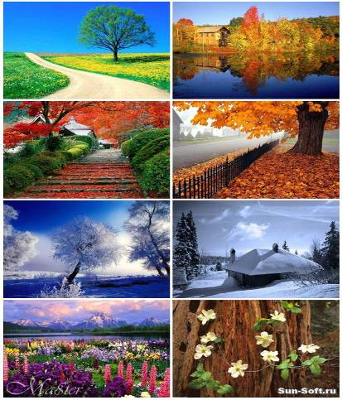
Seasons
The English Year

Slide 3
Our English lesson
Seasons and weather
English and Russian holidays
London’s parks
Crossword

Slide 4
Read the sounds & the words
[ u: ]
[ ei ]
[ai ]
say
day
May
April
too
tooth
school
pupil
June
eye
write
time
buy
July

Slide 5
Read the sounds & the words
[ æ ]
[ e ]
[α׃ ]
weather
September
November
December
February
can
man
January
grass
March

Slide 6
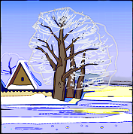

Answer the questions:
How many seasons are there in a year?
What are they?

Slide 7
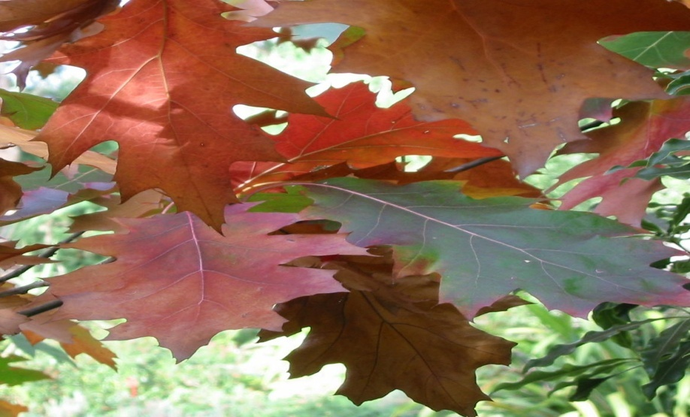
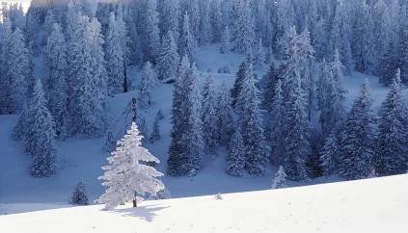
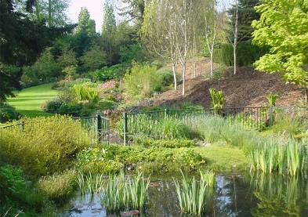
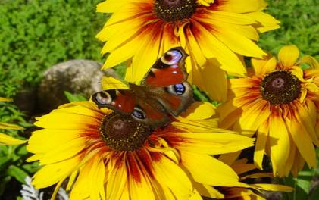
Autumn Winter Spring Summer

Slide 8
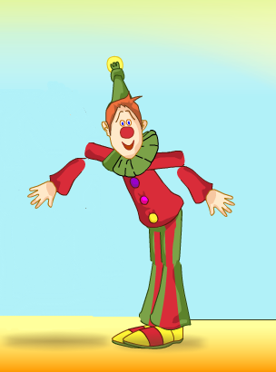
What season comes after autumn?

Slide 9
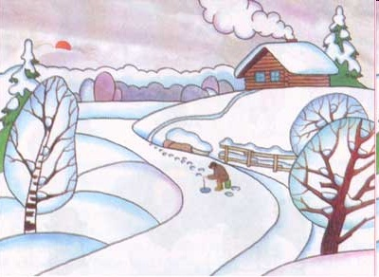
It’s winter

Slide 10
Winter months are…
December
January
February

Slide 11
What season comes after winter?

Slide 12
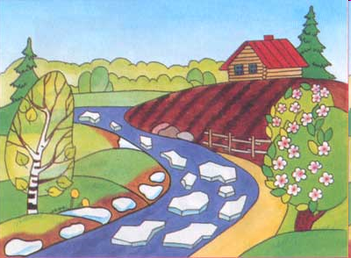
It’s spring

Slide 13
Spring months are…
March
April
May

Slide 14
What season comes after spring?

Slide 15
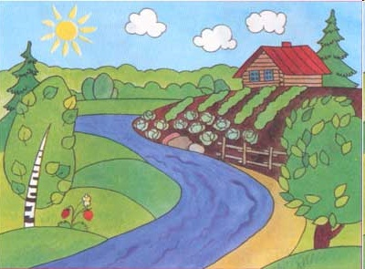
It’s summer

Slide 16
Summer months are…
June
July
August

Slide 17
What season comes after summer?

Slide 18
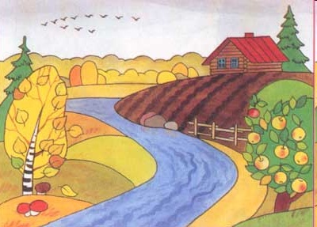
It’s autumn

Slide 19
Autumn months are…
September
October
November

Slide 20
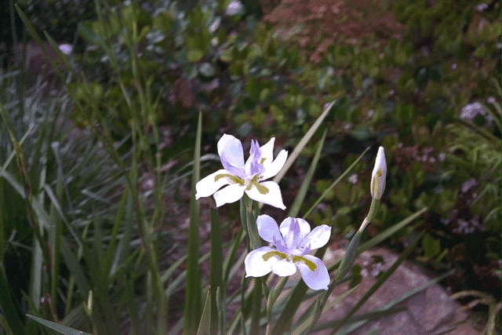
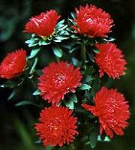
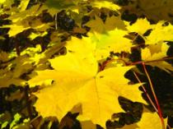
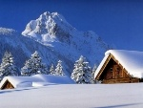

Spring is green,
Summer is bright,
Autumn is yellow,
Winter is white.

Slide 21



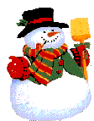


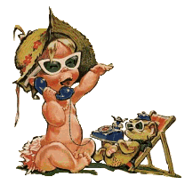




Guess the season
In this season children play snowballs, skate and ski.
People celebrate Christmas and New Year.

Slide 22
Guess the season
It often rains. It is cold. Children begin to go to school.
There are a lot of vegetables and fruit.

Slide 23
Guess the season
It is warm and hot. Days are long and nights are short.
The trees and grass are green. We can swim.

Slide 24
Guess the season
It is warm. There is a lot of water in the streets. We can
see the first flowers and green grass.

Slide 25




What is the weather like today?
sunny
rainy
cloudy
windy
snowy

Slide 26

Match and say
Example:
English (Russian) people celebrate Halloween on the 31st of October.
Russian and English holidays
St. Patrick’s Day
1 April
St. Valentine’s Day
25 December
May Day
31 December - 1 January
April Fool’s Day
31 October
Easter
1 September
Halloween
17 March
Christmas
14 February
New Year
March - April
The Day of Knowledge
May
«Old» New Year
7 January
13-14 January

Slide 27
Are the sentences true or false?
Tick the right answer (+)
 | True | False
1. There are ten big parks in London.
2. London’s famous Zoo is in St James’ Park.
3. There are different animals and birds from different countries and continents in London’s Zoo.
4. You can play games in the parks in London.
5. Londoners don’t like their parks.
6. You can give bananas to the monkeys in the Zoo.
+
+
+
+
+
+

Slide 28
Do the crossword
1. Summer comes spring.
2. Autumn is here. Look at this red on the ground.
3. People Christmas in winter.
4. Many birds live in this big green
is the first month of the year.
6. In spring the is green.
7. March, April and May are the months.
8. There are four seasons in the
after
c
 | e | b | r | u | a | r | y
e
J
leaf
l
f
a
g
s
celebrate
a
l
e
o
n
r
p
F
t
a
r
e
a
s
i
e
forest.
e
f
a
s
r
s
n
a
January
r
t
t
y
g
r
e
grass
spring
year.

Slide 29
What is your result?
5
4
2
3
7-8 words
5-6 words
3-4 words
2-3 words

Slide 30
Your home task:
Home reading
Lessons 13, 14 – texts “Halloween”, “Trick or treat”

Slide 31
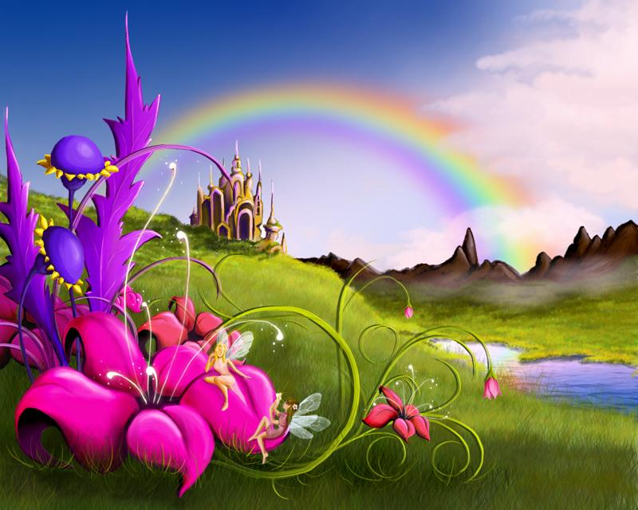
Thank you for your work

Slide 32
Используемые литература и ресурсы
Верещагина И.Н. Английский язык: учебник для 3 кл. шк. с углубл. изучением англ. яз., лицеев и гимназий
Верещагина И.Н. Английский язык: кн. для учителя к учеб. для 3 кл. шк. с углубл. изучением англ. яз., лицеев и гимназий
Касимова Г.Г., Князева А.Д. Поурочные разработки по английскому языку. 3 кл.
Воронова Е.Г. Английский язык. 3 класс. Тесты. Дидактические материалы: к учебнику И.Н. Верещагиной, Т.А. Притыкиной «English 3»
http://www.iloveways.com
http://images.yandex.ru
http://www.animashky.ru

