Slide 1
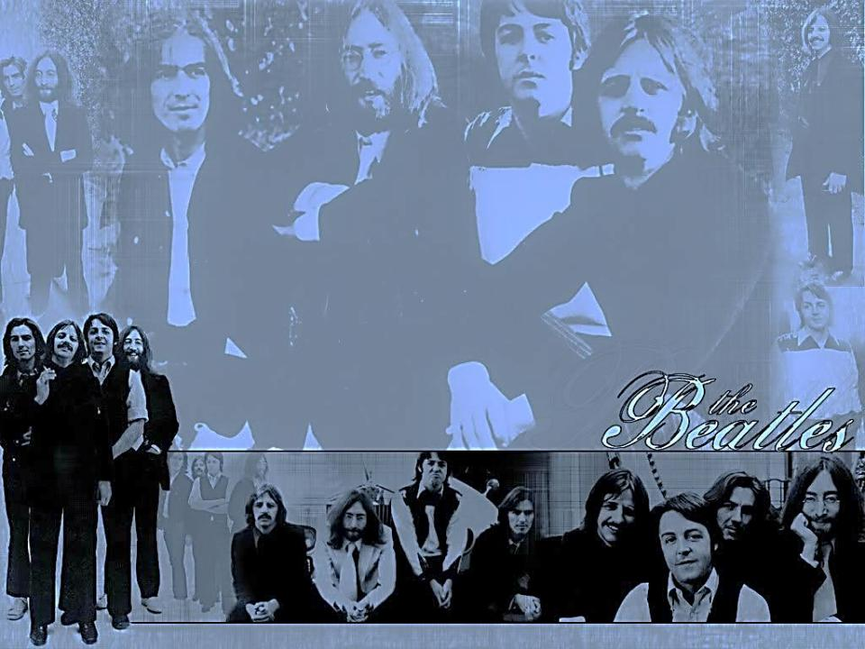
Half a century with The Beatles
Made by Makeeva Natalia,
the seventh form,
“Gymnasium 17 ”

Slide 2
Content:
I. Introduction
- The Beatles - forever
II. Half a century with The Beatles
- 1957-1959: Before they were The Beatles
- Pre-Beatlemania: 1960-1963
- Beatlemania: 1964-1965
- Beginning of the End: 1966-1968
- The End and Beyond
III. Conclusion
IV. Opinion poll on the Beatles

Slide 3
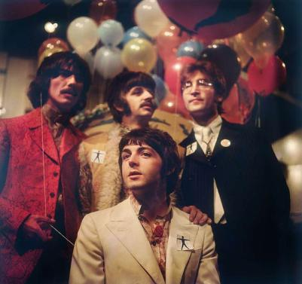
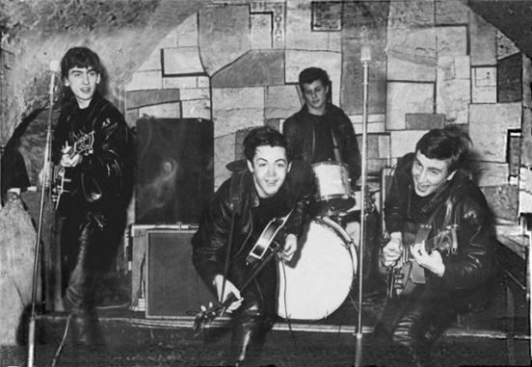
The Beatles - forever
Music is the greatest thing which connects people over the world. It hasn’t nationality or citizenship. I would like to tell you about my favorite music band. This group’s name is The Beatles.

Slide 4
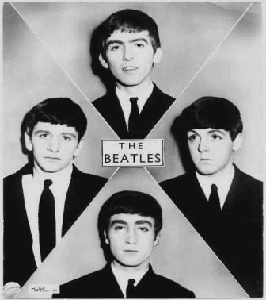
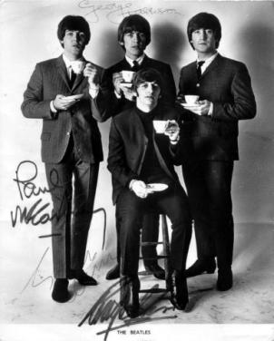
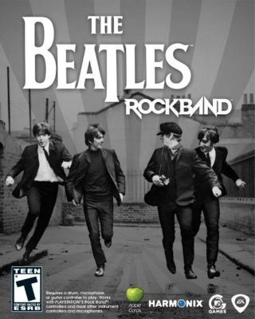
The Beatles - forever
Who are they? Some may say they are four young long-haired hooligans singing primitive tunes. The others may put them in the same rank with the greatest composers, such as Mozart, Beethoven and Bach.

Slide 5
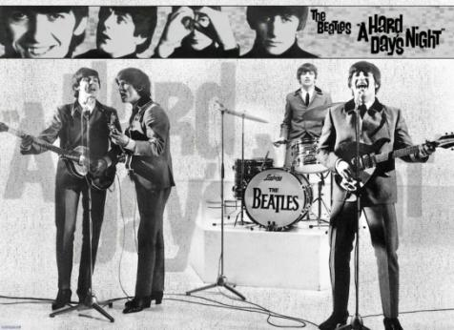
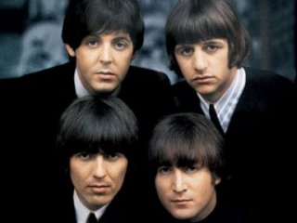
The Beatles - forever
They are four boys from Liverpool, who decided to play and sing together. None of them got any special musical education. Each has got his own strong and sometimes strange individuality. They are: energetic, always fighting John, romantic and fantastically talented Paul, philosophical and bit religious George, always smiling and friendly Ringo.

Slide 6
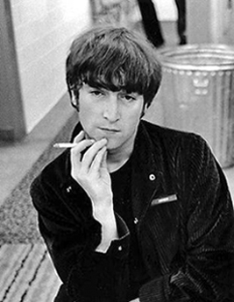
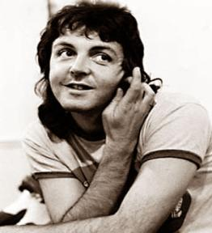
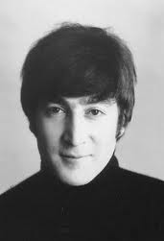
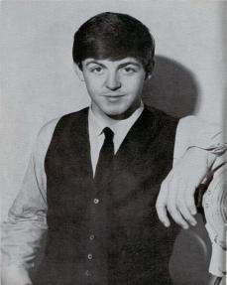
Before they were The Beatles
John Lennon was just 17 when he formed his first band, The Quarry men. In summer 1957 The Quarry Men were setting up for a performance in a church hall when another member of the band introduced Lennon to Paul McCartney. Paul was auditioned and immediately invited to join.

Slide 7
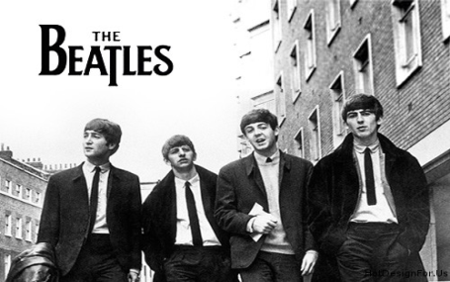
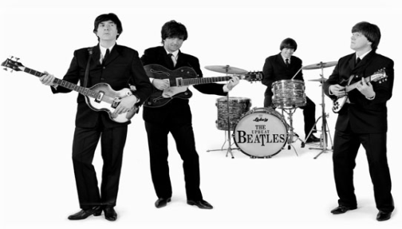
Before they were The Beatles
Paul McCartney introduced Lennon to his friend and former classmate George Harrison. The band, which then consisted of Lennon, McCartney, Harrison and other members recorded a demo consisting of «Buddy Holly's», «That'll Be the Day» and a Lennon-McCartney original, «In Spite of All the Danger».

Slide 8
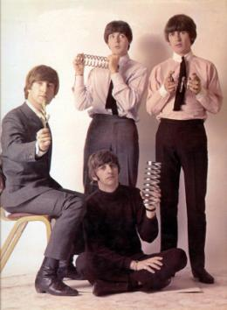
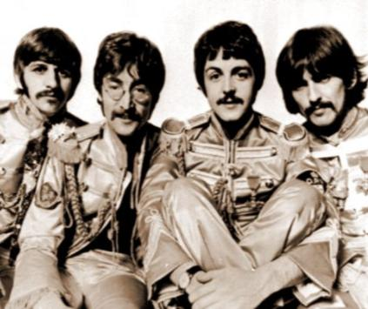
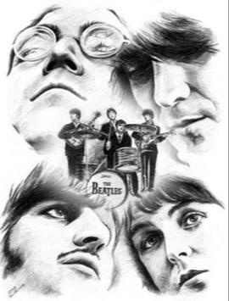
Pre-Beatlemania: 1960-1963
In 1960 Lennon, McCartney and Harrison were joined by drummer Pete Best. They went through a lot of names - Long John and The Beatles, The Silver Beetles, The Beat Brothers - before settling on The Beatles.

Slide 9
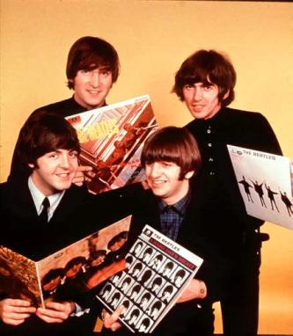
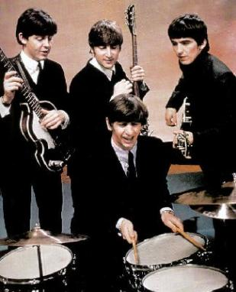
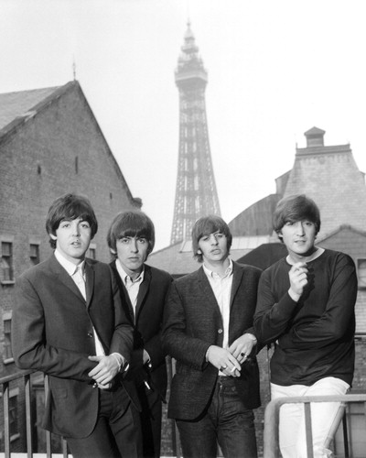
Pre-Beatlemania: 1960-1963
Their producer George Martin liked everything about the band except Best. Ringo Starr, the drummer of another popular Liverpool band was recruited to replace Best. In September 1962 the band's first single «Love Me Do» was released.

Slide 10
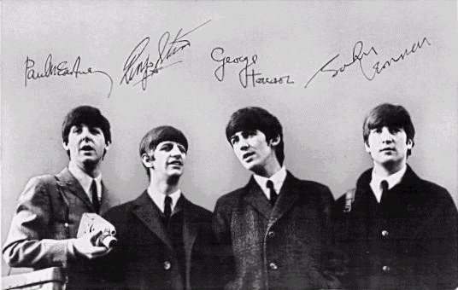
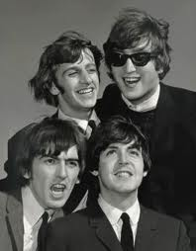
Pre-Beatlemania: 1960-1963
Their first album «Please Please Me» was released in the UK in March 1963. The second album «With The Beatles» became only the second album ever to sell a million copies in the UK.

Slide 11
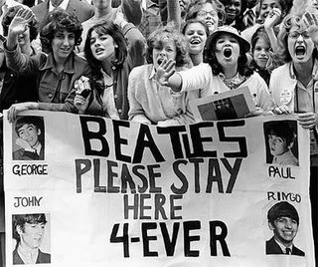
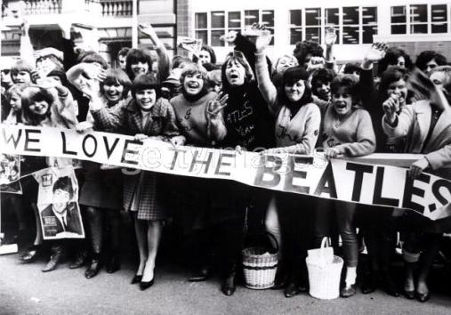
Beatlemania: 1964-1965
By April 1964 the band's singles occupied the top five spots on the Billboard Hot 100 chart. That summer they toured New Zealand and Australia, where their arrival was greeted by a crowd estimated at more than 300,000. The first Beatles movie “A Hard Day's Night” was released in 1964.

Slide 12
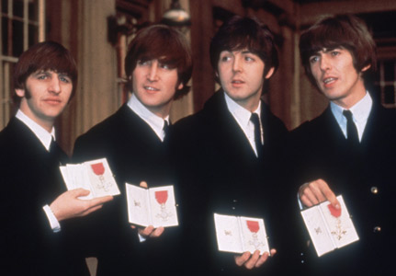
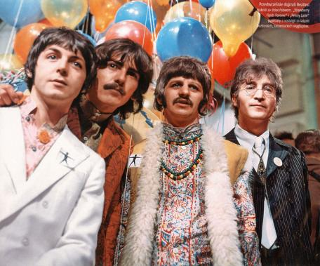
Beatlemania: 1964-1965
Beatlemania was responsible for the concept of the stadium concert. In 1965 the Fab Four became Members of the Order of the British Empire, one of the highest honors bestowed in the UK, usually to military and government officials.

Slide 13
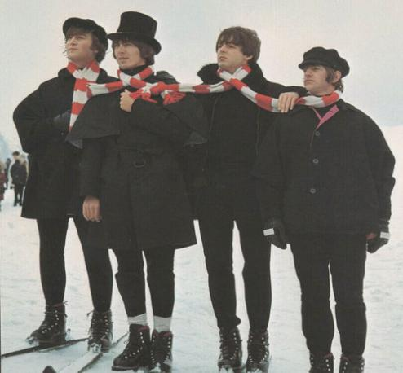
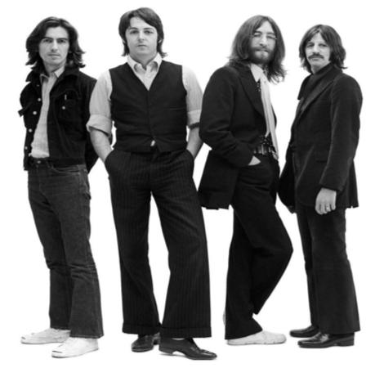
Beatlemania: 1964-1965
The Beatles' second movie, «Help!» came out in 1965, and the soundtrack was one of the four albums the band released that year.

Slide 14
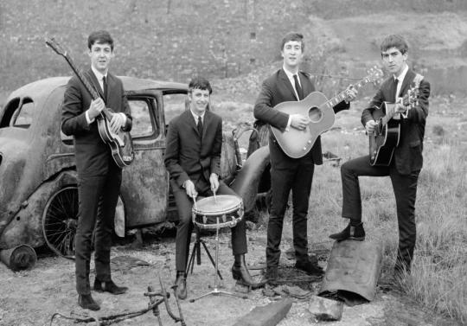
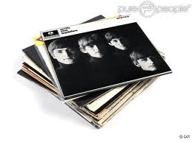
Beginning of the End: 1966-1968
The band released just two albums in 1966. One of them, «Revolver», is considered to be one of the Beatles' best albums. In1966 Lennon set off a huge wave of record burning protests when he suggested in an interview that «Christianity is dying» and that the Beatles «are more popular than Jesus now».

Slide 15
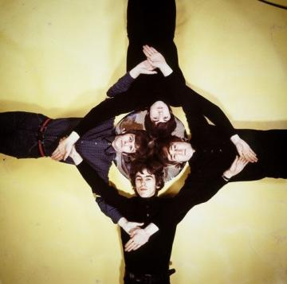
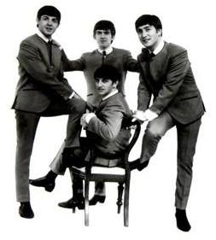
Beginning of the End: 1966-1968
Although they had lost some of their luster, The Beatles continued to produce critically and commercially successful albums. The band spent the first part of 1968 in India.When they returned, they announced the creation of their own label, Apple Records, and went to work on the double album, called «The White Album» which was released in November 1968.

Slide 16
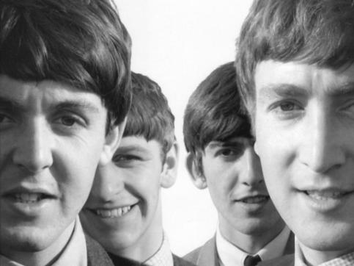
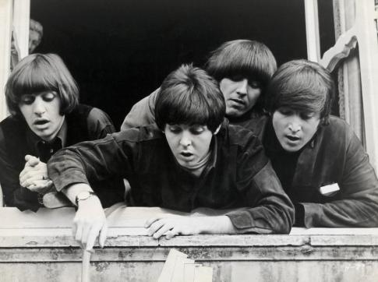
The End and Beyond
In September 1969 Lennon told the band that he was leaving. The others persuaded him not to go public until they made one more effort to get an acceptable version of their final album “Let It Be”. The band's breakup was announced in April 1970, a month before “Let It Be” was released.

Slide 17
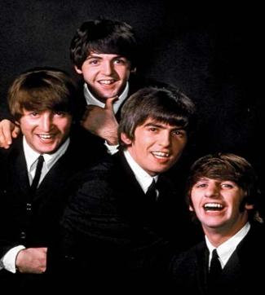
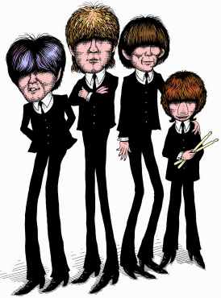
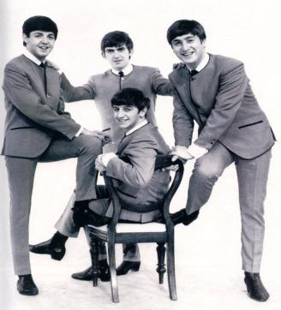
The End and Beyond
After the Beatles broke up, each of the band members followed separate creative paths. Paul McCartney formed a band called Wings with his wife, Linda; they recorded numerous hit songs, including "Live and Let Die". John Lennon achieved great success as a solo artist with classic songs like "Imagine." Tragically, he was killed by an obsessive fan Mark David Chapman in 1980. George Harrison recorded many solo albums over the years and died of cancer in 2001.

Slide 18
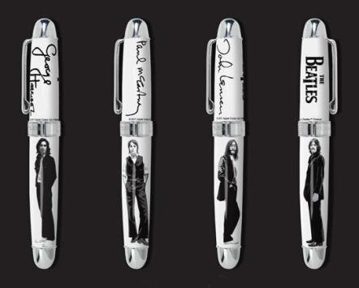
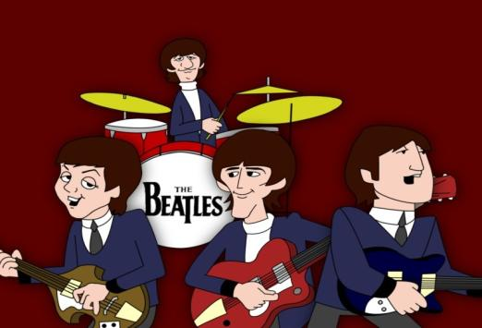
Conclusion
The Beatles changed the style of popular music in an unbelievable way and caused a new musical phenomenon in the sixties. Their music was fresh and original. They became a worldwide sensation. They wrote about day-to-day subjects, mainly love, which everyone could relate to. They also wrote songs about world issues, such as living in peace. Their songs were trying to encourage people to look on the bright side of life.

Slide 19
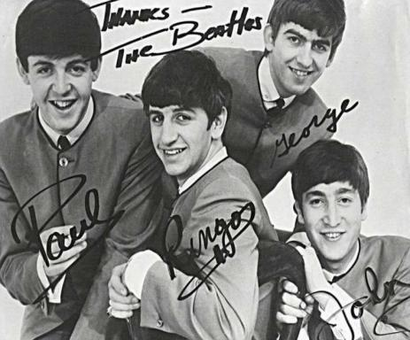
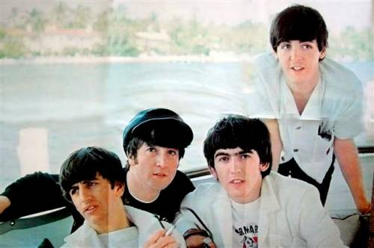
Conclusion
The Beatles have inspired thousands of artists. 50 years later, their music still has the power to unite millions of fans all over the world. The Beatles bring us together and show why Music Matters. The Beatles still exist, because their music is loved till our days. Part of themselves lives in our hearts and will remain there forever.

