Slide 1
Конкурсная презентация на фестиваль педагогических идей «Открытый урок» 2012-2013
Автор разработки: Панкова Марина Викторовна
учитель английского языка
МКОУ «Лузинская СОШ №2»
Омского района
Омской области

Slide 2
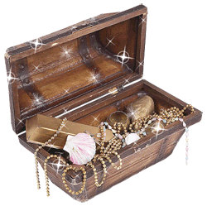
A Treasure Hunt

Slide 3
Where is the treasure hidden?
I | t |  | i | s |  | i | n |  | t | h | e |  | b | o | x

Slide 4
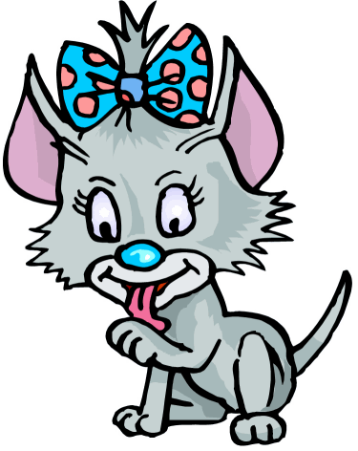
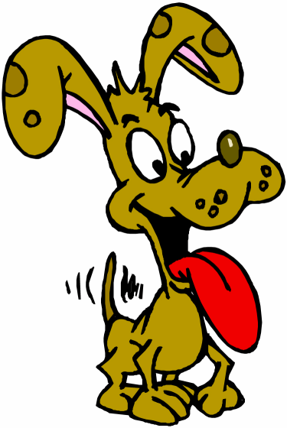
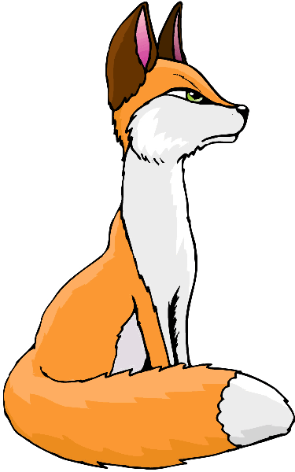
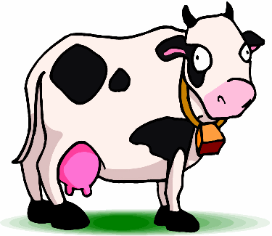
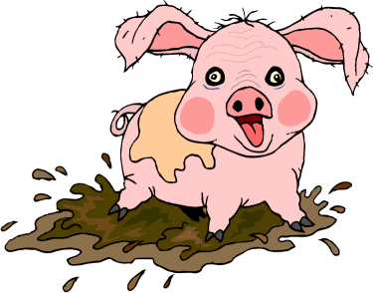
Who lives in the house?
c | a | t
d | o | g
f | o | x
c | o | w
p | i | g

Slide 5
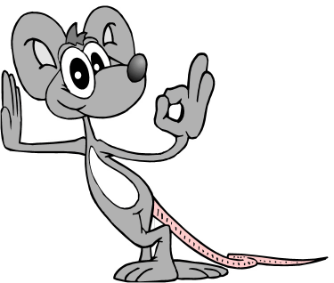
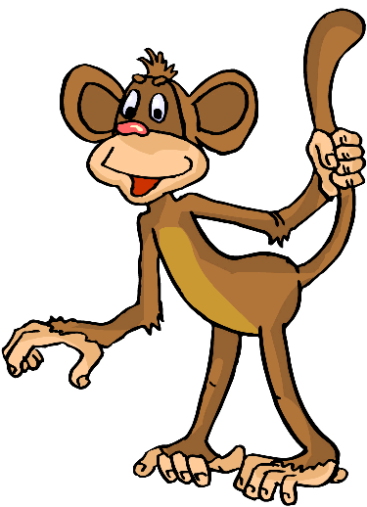
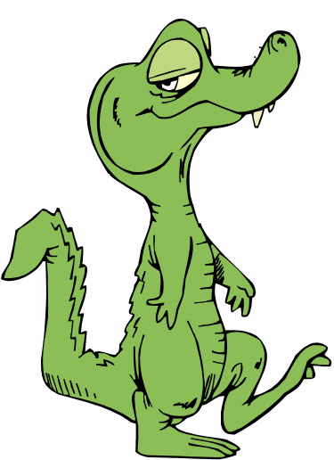
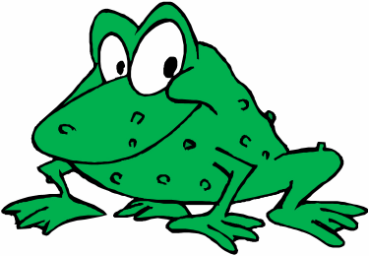
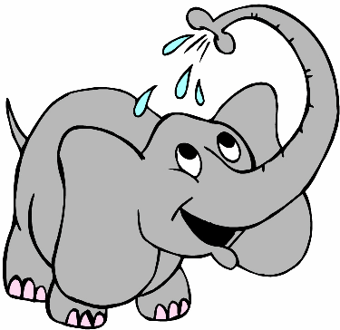
What animal is it?
1 2
3
4 5

Slide 6
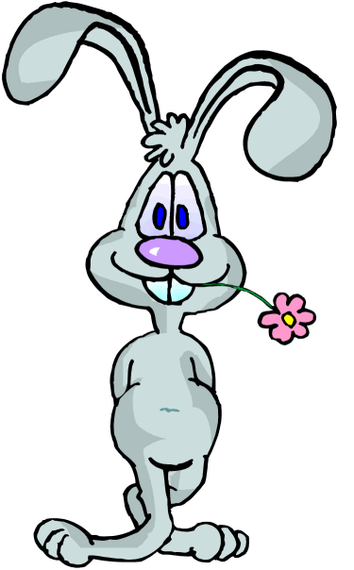
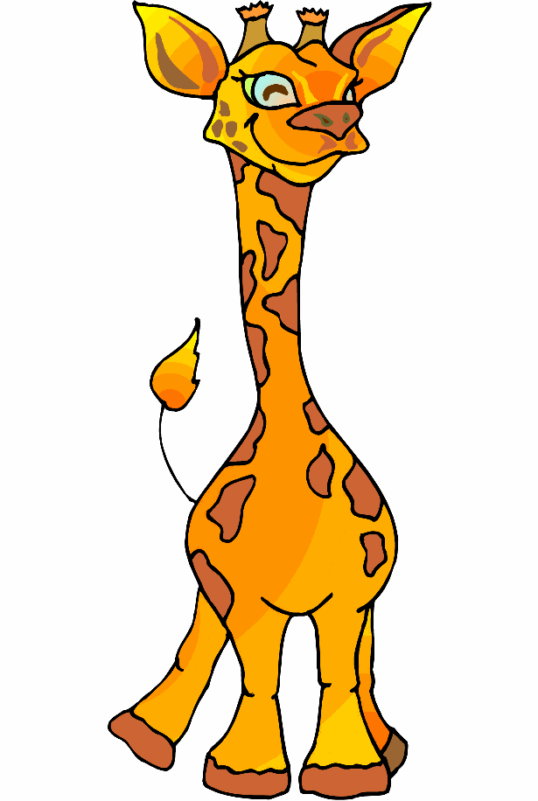
How many?
5 five lions
7 seven rabbits
2 two bears
4 four giraffes
10 ten ducks

Slide 7
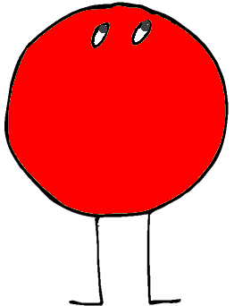
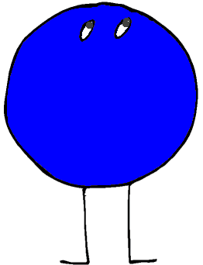
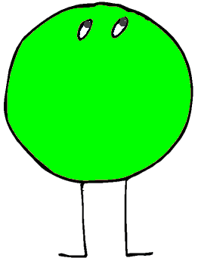
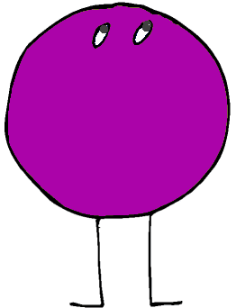
Colour funny fellows
red blue green
violet pink yellow
black brown grey
orange

Slide 8
The letters in the alphabetical order

Slide 9
Can you translate?
I |  | like

Slide 10
Your mark
green | a pen | a pencil | a school bag | ten
three | a rubber | draw | open | blue
mouse | a book | an exercise book | a ruler | hello
apple | read | Tricky | a pencil case | sister
dog | a day book | a sharpener | a felt tip pen | play

Slide 11
Hooray! You’ve found the treasure!

Slide 12
Resources
www.esl-kids.com
http://images.yandex.ru
http://kilat.ru>animirovannye-kartinki.htm

