Slide 1
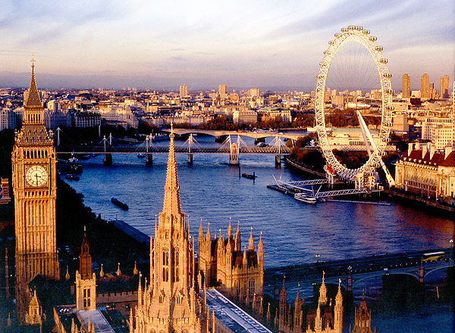
LONDON. TOWN LIFE. Created by I.N.Maximova, School №197
Created by I.N.Maximova, School №197

Slide 2
[з:] fur, burn, burnt, burning, church, dirty [Ʌ] come, become, but, just, London [i] build, built, building, bridge, rich, city [ei] rain, afraid, to be afraid of, wake, wake up

Slide 3
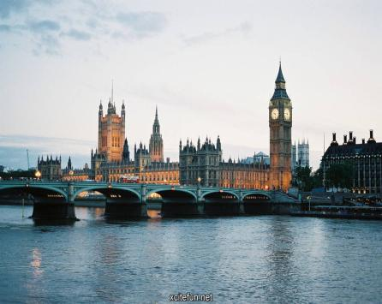
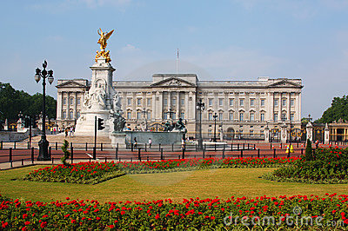
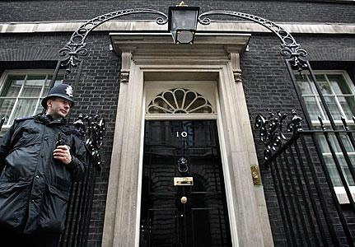

Slide 4
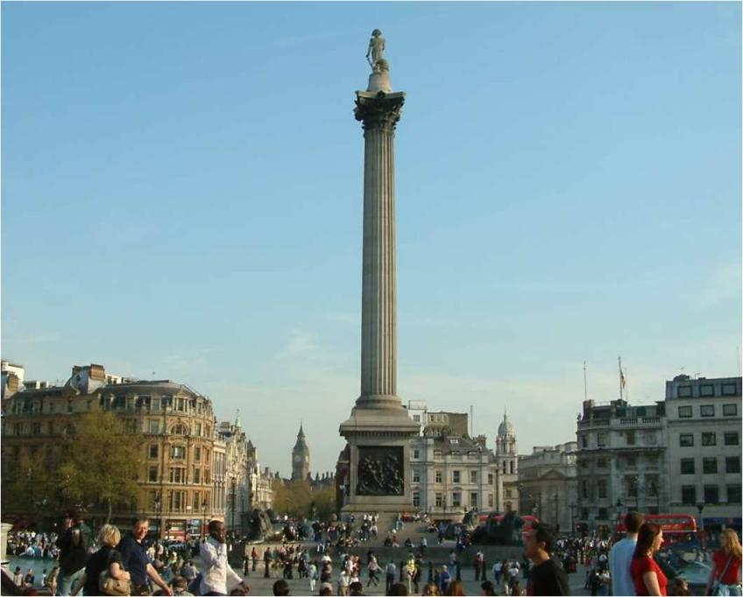

Slide 5
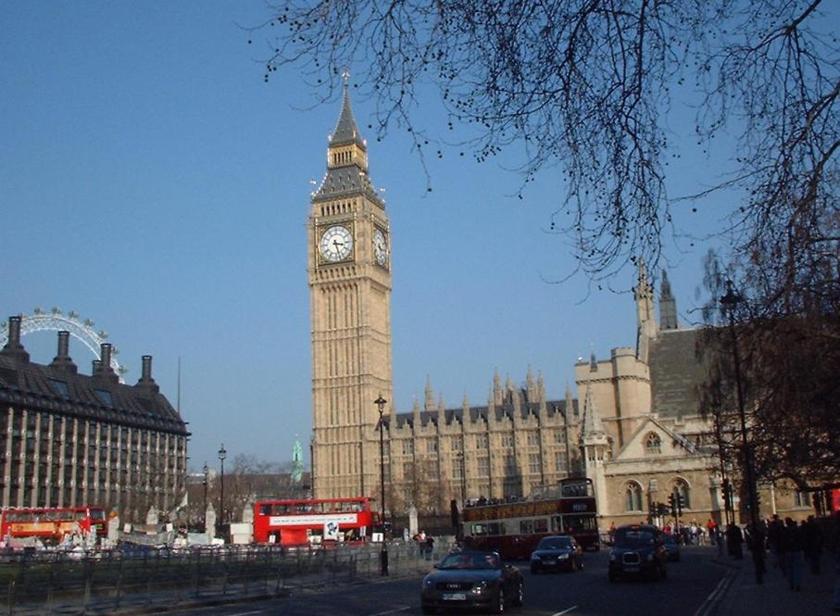

Slide 6
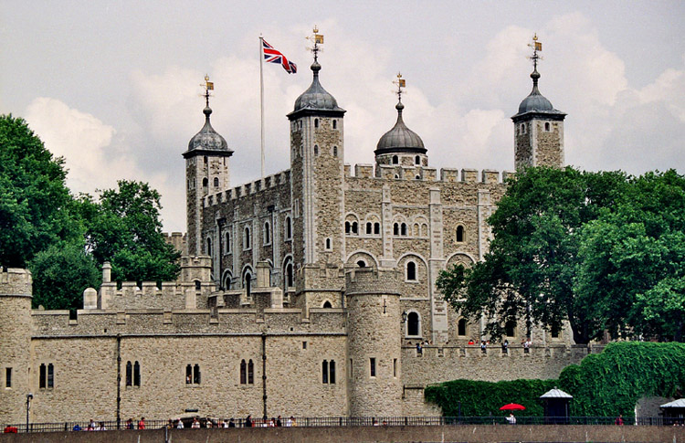

Slide 7
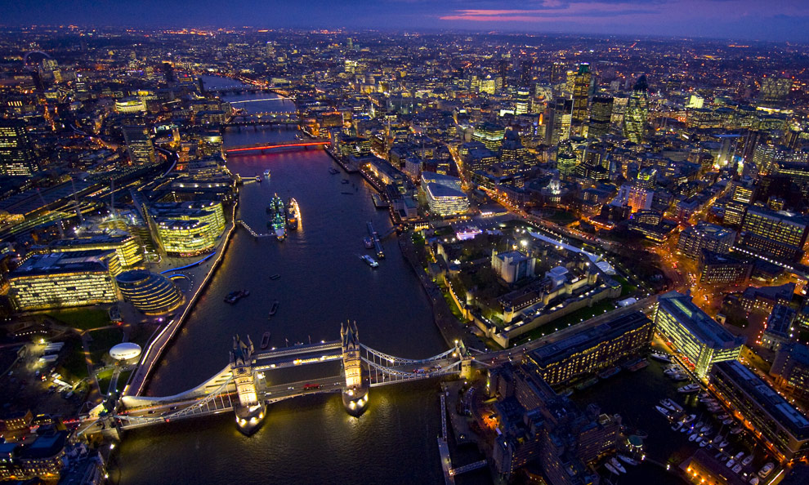

Slide 8
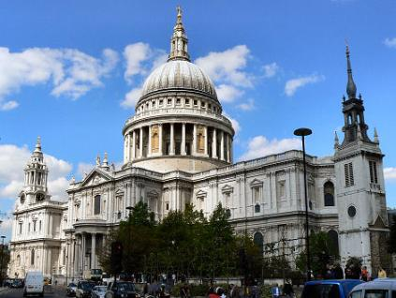
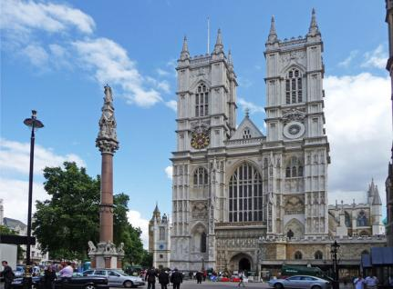
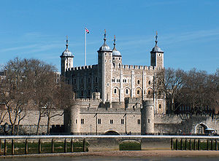

Slide 9
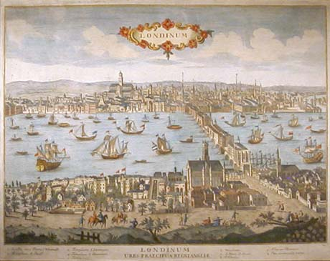

Slide 10
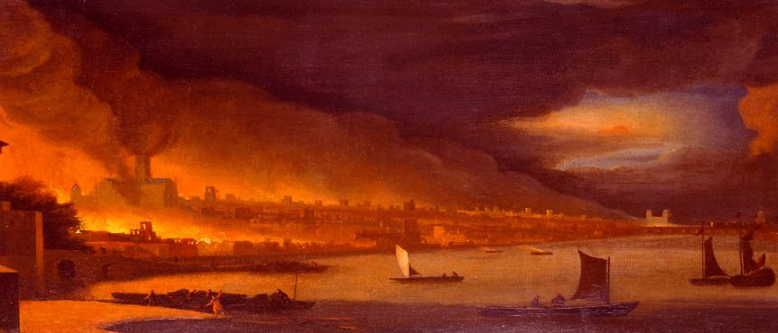
London's Burning London's burning, London's burning. Fetch the engines, fetch the engines. Fire, fire! Fire, fire! Pour on water, pour on water. London's burning, London's burning.

Slide 11
1.William the Conqueror built … 5. The fire burnt until … a) Buckingham Palace a) Wednesday b) the White Tower b) Tuesday c) the Houses of Parliament c) Thursday 2. In the 17th century people built houses of… 6. The fire burnt for… a) stone a) four days b) bricks b) five days c) wood c) seven days 3. The Great Fire began on … 7. The fire destroyed .. a) Sunday a) 70% of the city b) Monday b) 80% of the city c) Saturday c) 90% of the city 4. It started in the house of king’s … a) baker b) tailor c) butcher

Slide 12
1. People didn’t think of stopping the fire. They wanted to save their belongings. a)True b) False c) I don’t know 2. There was a fire brigade in London in 1666 and it helped people stop the fire. a)True b) False c) I don’t know 3. The best way to stop the fire was to ruin the burning house. a)True b) False c) I don’t know 4. People tried to stop the fire with buckets of water and fire hooks. a) True b) False c) I don’t know 5. In 1666 plague came to England. a) True b) False c) I don’t know 6. Many Londoners were not afraid of the plague. a)True b) False c) I don’t know 7. The Great Fire of London stopped the plague. a)True b) False c) I don’t know

Slide 13
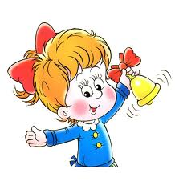
The lesson is over. Thank you very much for your work!

