Slide 1
GIVE SYNONYMS

Slide 2
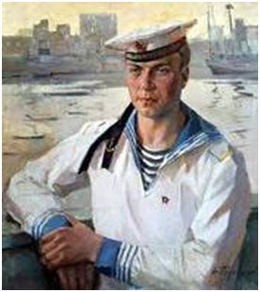
sailor

Slide 3
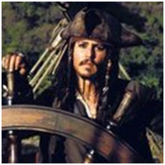
captain

Slide 4
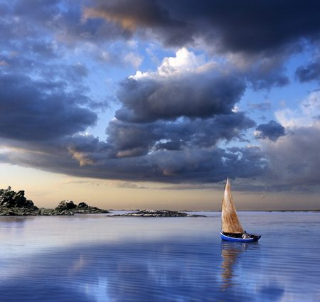
voyage

Slide 5
Small piece of land washed by water

Slide 6
Answers to synonyms
sailor – seaman
captain – master
voyage - trip, travelling
a small piece of land washed by water – an island

Slide 7
Give antonyms
island
South
round
to die
East
to cover

Slide 8
answers
island – continent
South – North
round – oval, square, flat
to die - to be born
East – West
to cover - to discover

Slide 9
Form other parts of speech
navigation
to know
to explore
spice
to prove
traveller

Slide 10
Parts of speech
navigation - to navigate, navigator
to know – known
to explore – an explorer, exploration
spice – spicy
to prove – proof
a traveller - to travel, travelling
Notes:
ответы

