Slide 1
TRAVELLING &TRANSPORT

Slide 2
TRAVELLING

Slide 3
TRAVELLING
rest
sightseeing
communication
airplane
ship
train
car
hitch-hiking
entertainment
new cuisine
landscapes
sport
health
business
knowledge
… etc

Slide 4
QUESTION LIST
Why do usually people travel?
Do you like travelling? Why?
With whom do you usually travel?
Have you ever been abroad?

Slide 5
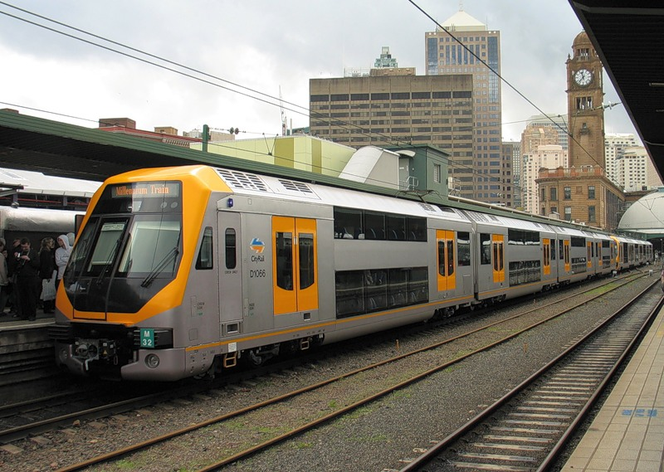
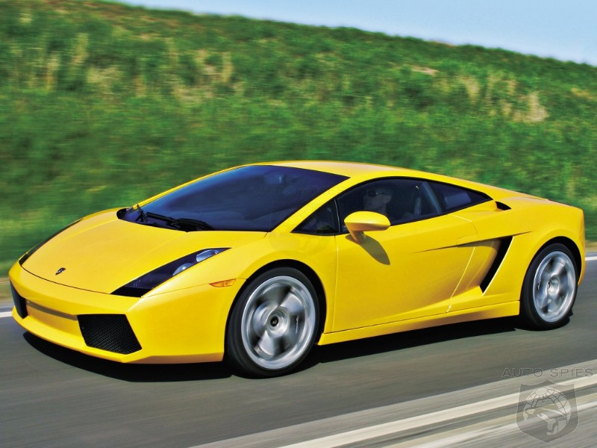
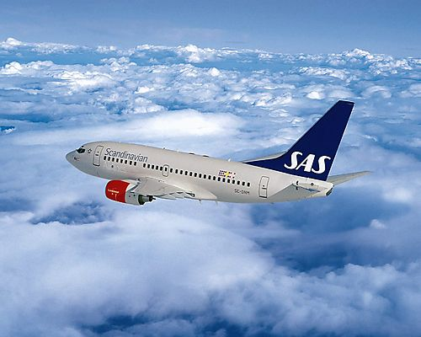
MEANS OF TRAVEL
plane
train
ship
car/bus
ferry
Hitch-hiking
Underground
…etc

Slide 6
LISTENING
By plane
By train
Hitch-hiking
By ferry
underground
2
1
5
4
3

Slide 7
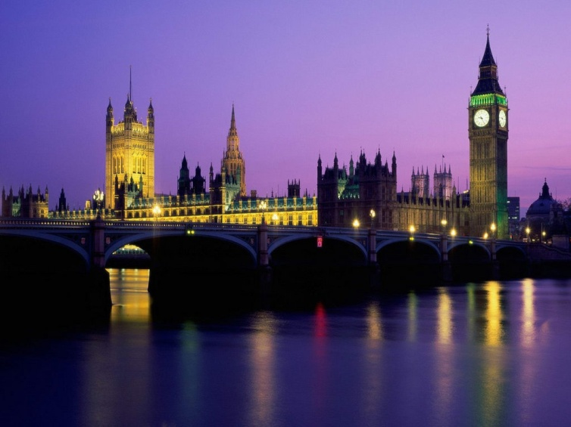
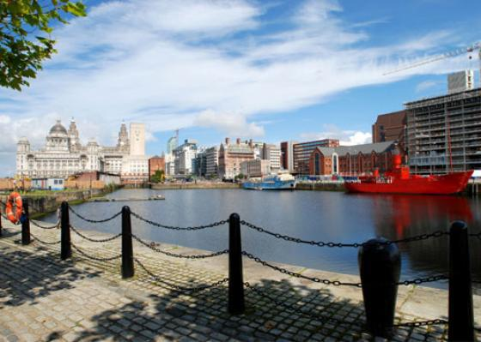
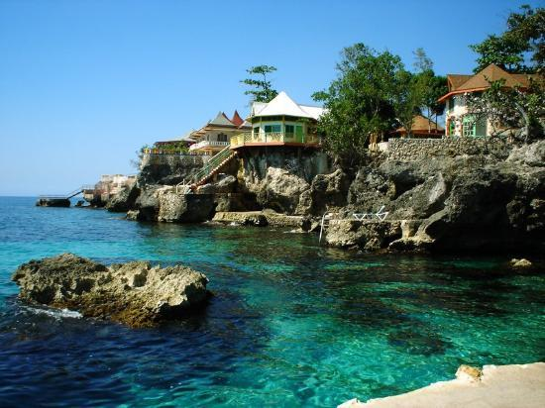
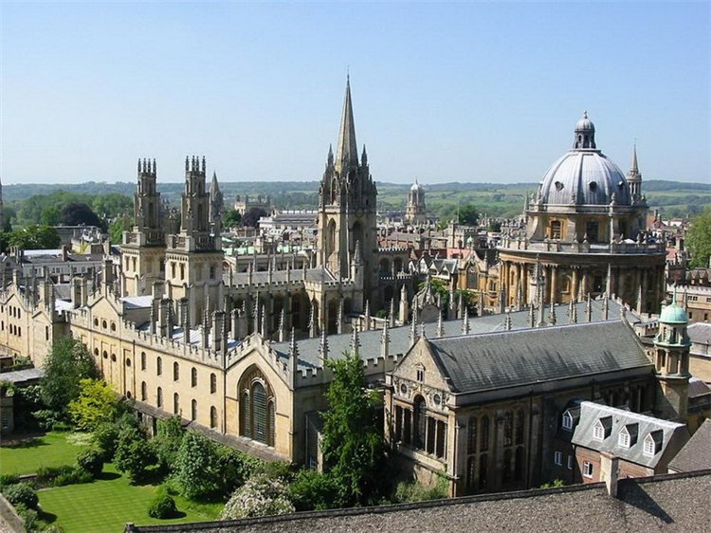
Which means of travel is …
the cheapest?
the most comfortable?
your personal favourite? Why?

Slide 8
IT’S HIGH TIME TO HAVE A … BREAK

Slide 9
WHICH COUNTRIES WOULD YOU MOST LIKE TO VISIT? WHY?

Slide 10
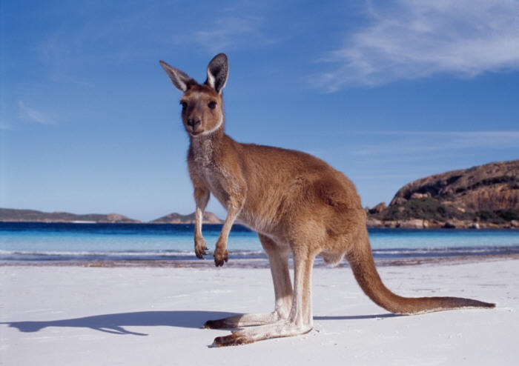
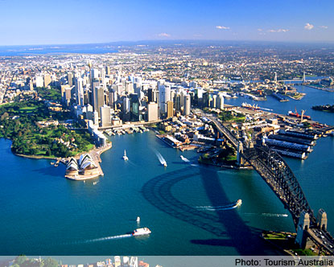
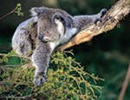
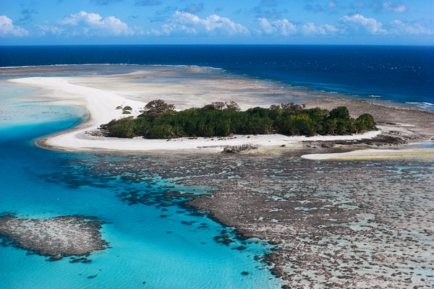
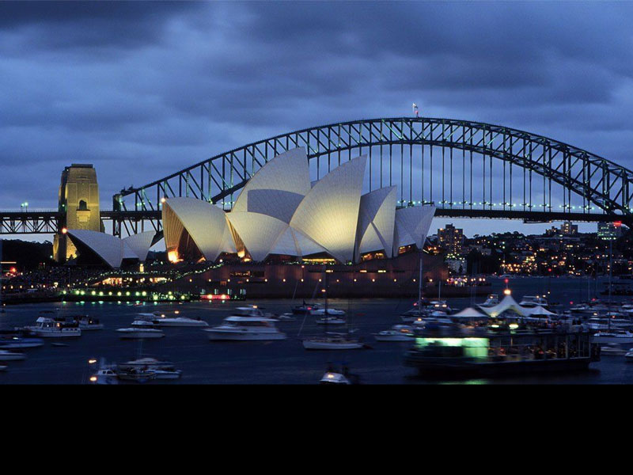
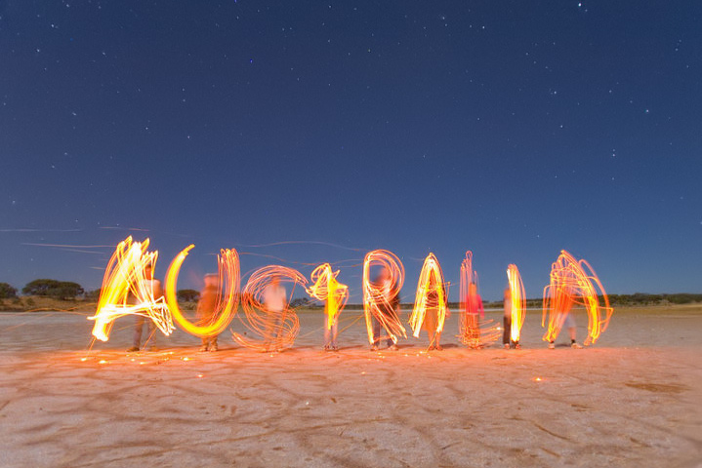
AUSTRALIA

Slide 11
VISITING RUSSIA
Places to go: It’s worth going to/visiting…
Transport: You can take…
Accommodation: You can stay at/in…
Food: If you want to eat well without spending a fortune,…
Things to do: Depending on what you like, you can…

Slide 12
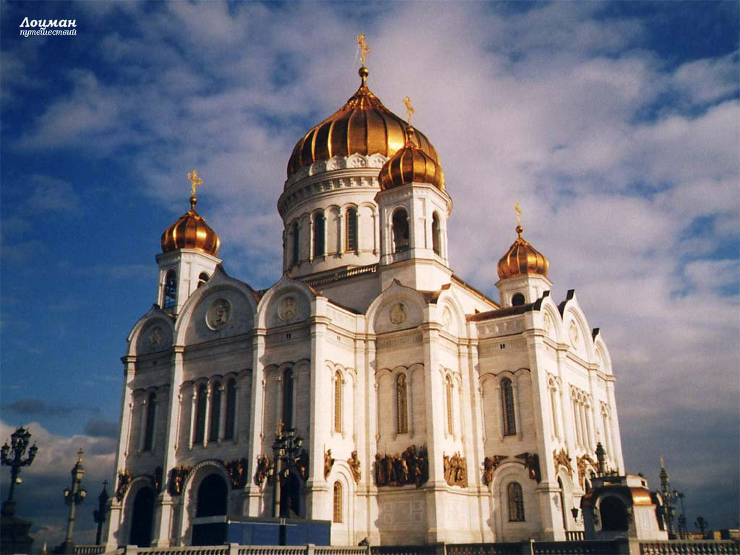
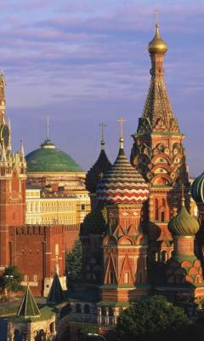
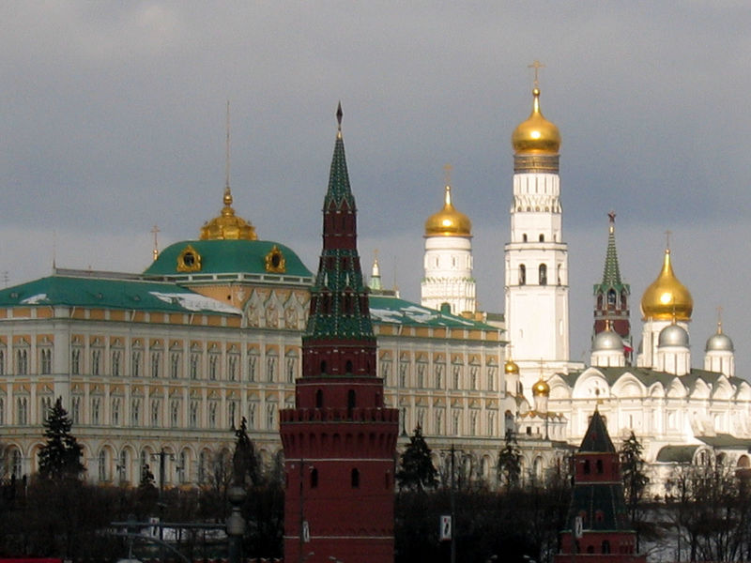
MOSCOW

Slide 13
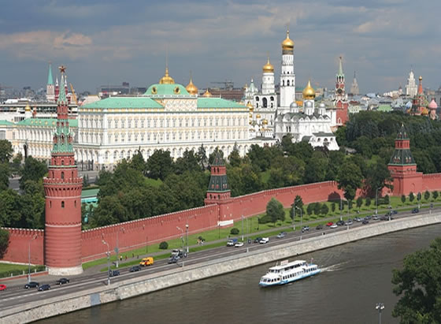
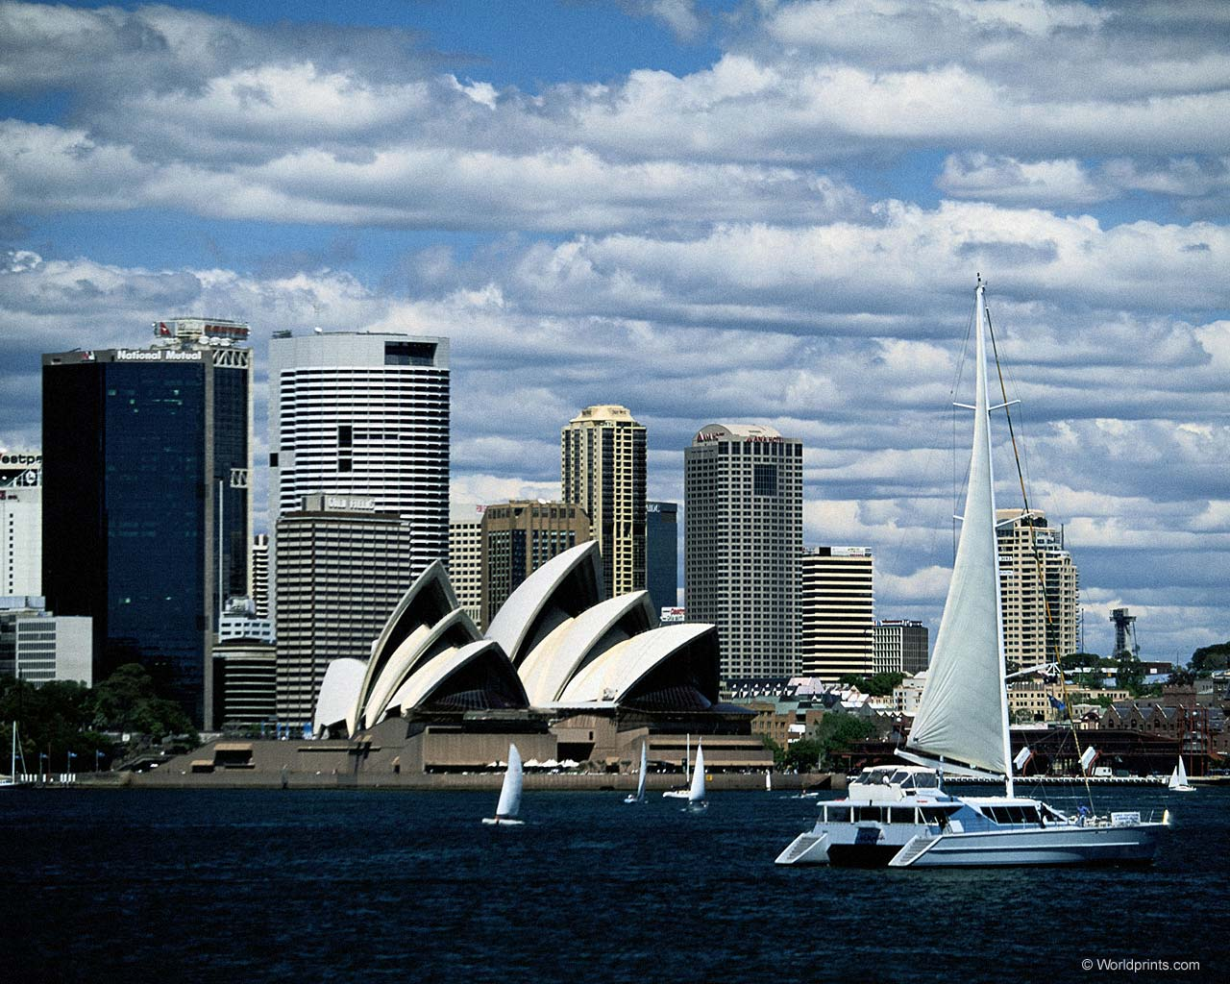
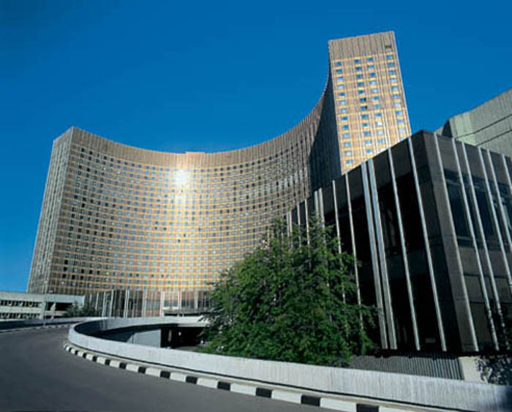
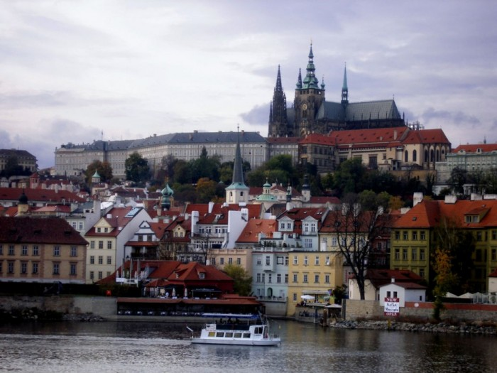

Slide 14
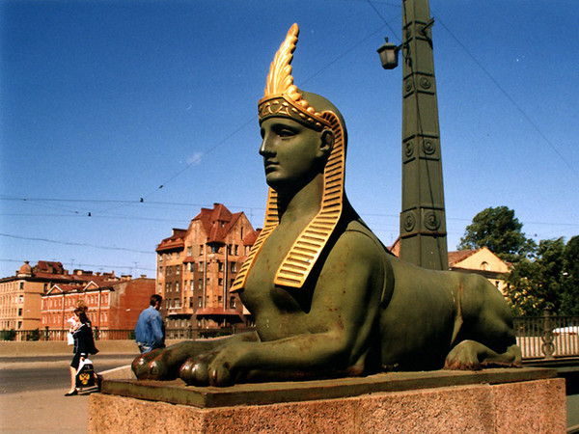
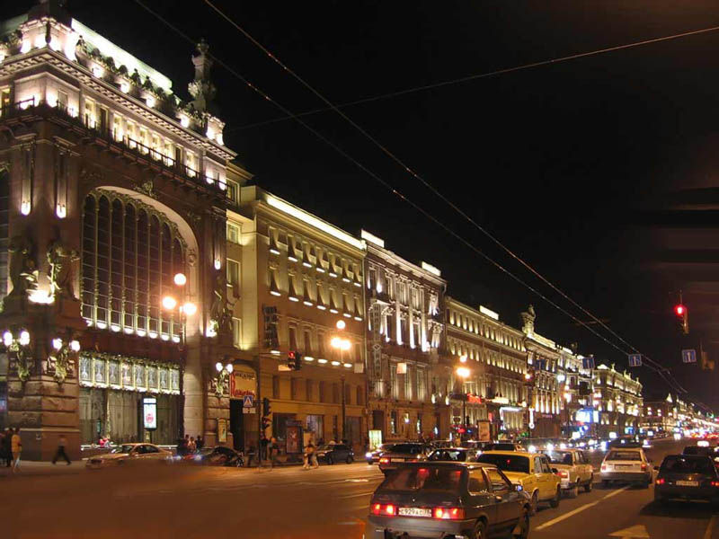
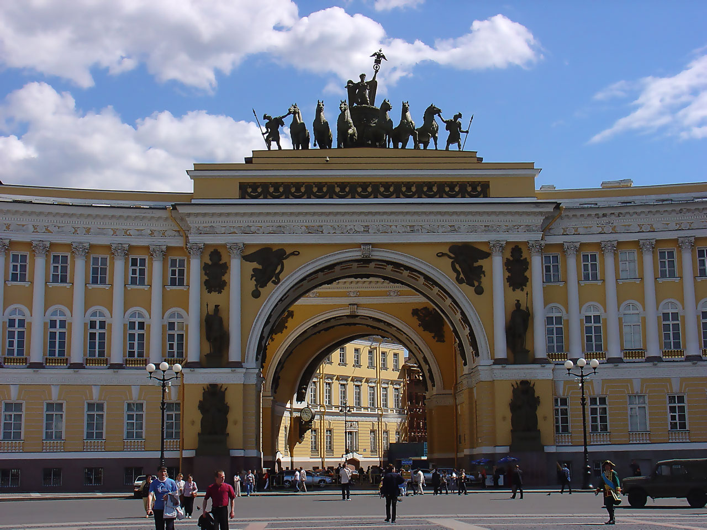
ST. PETERSBURG

Slide 15
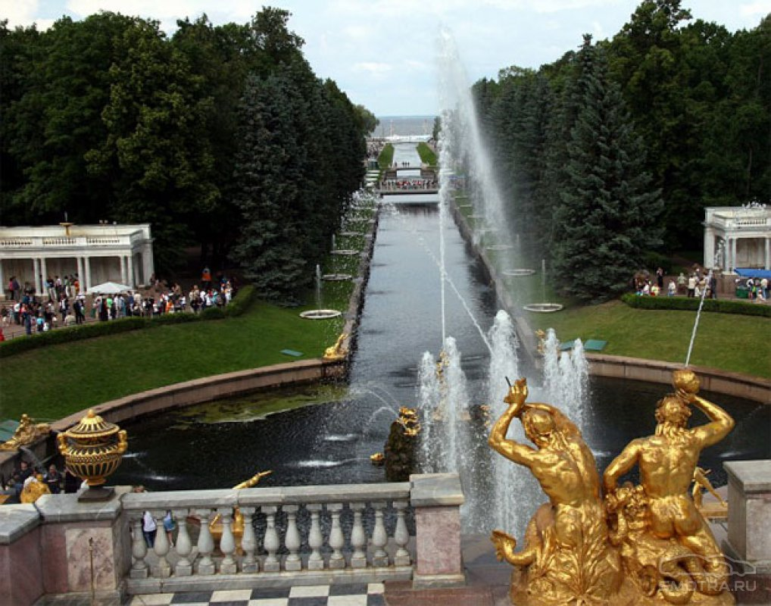
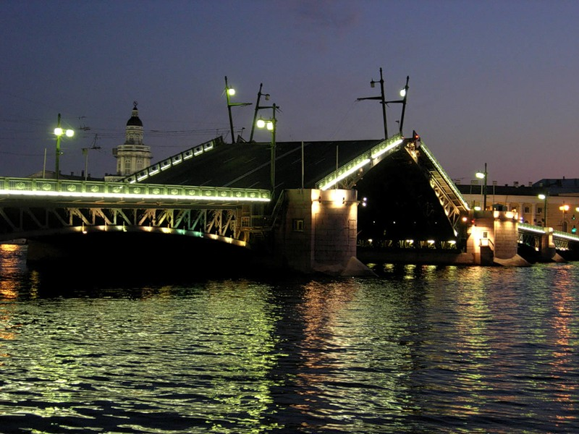
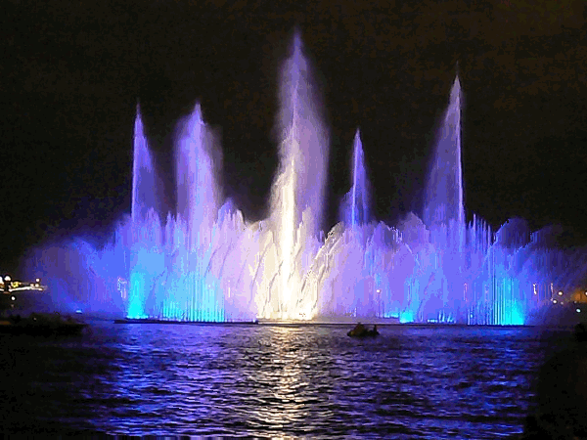
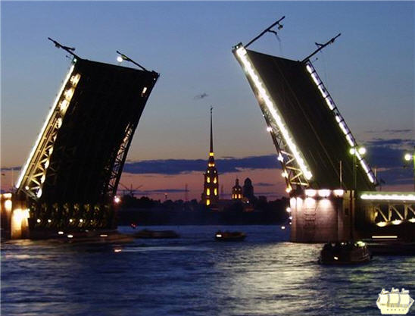
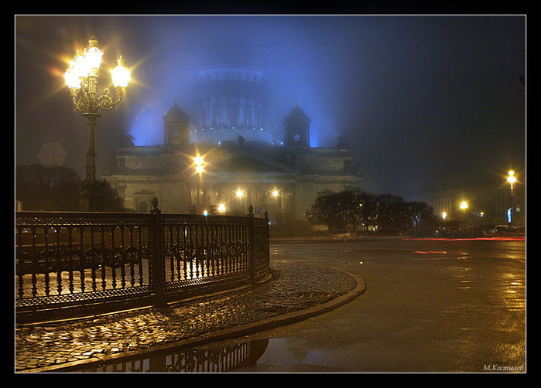

Slide 16
TRAVELLING

Slide 17
MAKE UP A DIALOGUE
STUDENT A: A tourist from a foreign country visiting Moscow, St. Petersburg, Kazan, etc …
STUDENT B: A native speaker who tries to help a foreigner

Slide 18
USE THE PHRASES
STUDENT A:
“Excuse me…”
“Can you help me…”
“How can I get to…?”
“Where is… situated?”
“Where is the nearest…?”
“What do you think of…?”
STUDENT B:
“You can take…”
“It is situated…”
“It’s worth visiting…”
“I suggest that you…”
“That’s a good idea…”
“Go past the…, then take…”

Slide 19
Do you agree with the following statement?
“THE WORLD IS A BOOK AND THOSE WHO DO NOT TRAVEL READ ONLY A PAGE”
ST. AUGUSTINE

Slide 20
THANK YOU FOR THE LESSON! GOOD-BYE!

