Slide 1
Scotland
Presentation of Alexeeva Ulyana

Slide 2
Emblem Of Scotland.

Slide 3
Flag Of Scotland

Slide 4
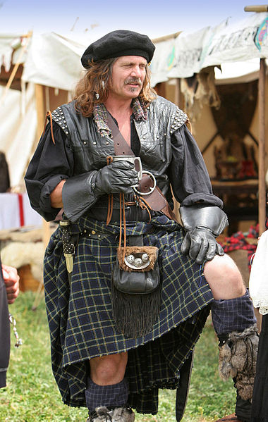
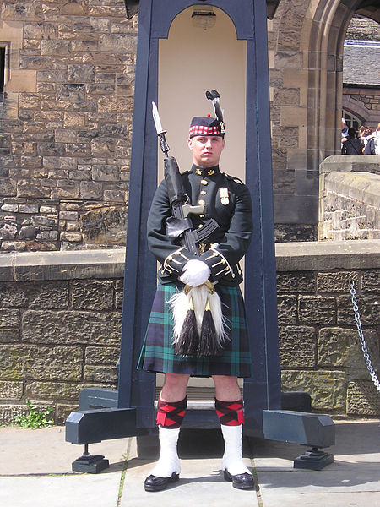
Kilt

Slide 5
Thank you for your attention!

