Slide 1
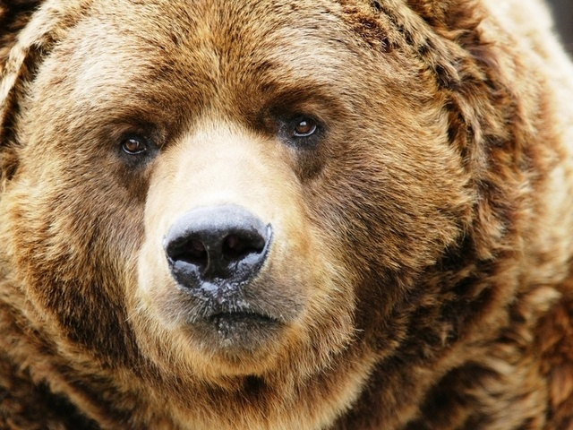
Brown bear

Slide 2
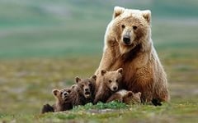
Бурые медведи
Bear is one of the most predatory animals. Brown bears are omnivores. Fur color from light fawn to black.

Slide 3
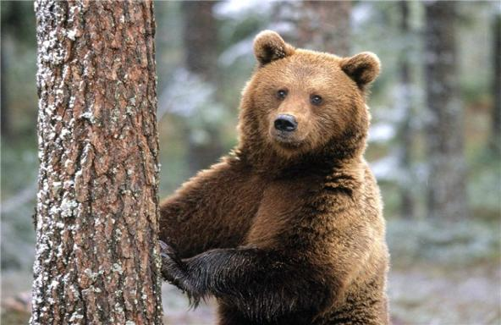
Где водятся медведи?
Bears are found in the Russian Kamchatka

Slide 4
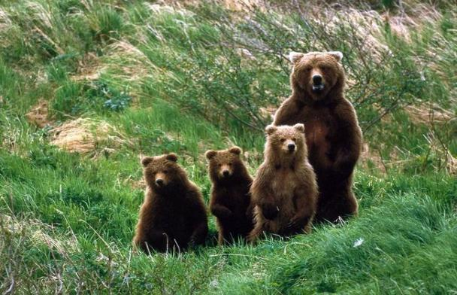
Вес и рост медведей.
brown bears weigh between 500 kg and more., length 1.2 m brown bear.

Slide 5
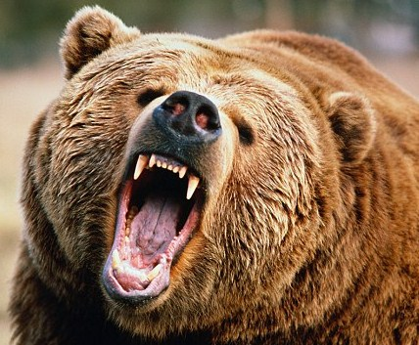
Какие они медведи?
They have small eyes and ears, paws powerful with strong claws 8-10 cm, short tail 65-210 mm.

Slide 6
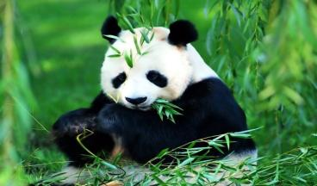
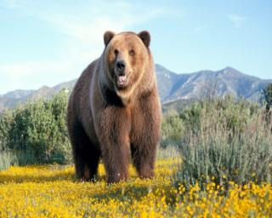
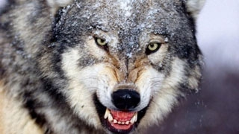
С кем можно сравнить медведя?
Brown bear more than a panda.; He is stronger than the wolf.

Slide 7
Thank you for your
attention

