Slide 1
Welcome to Brain Ring!
“My Favourite Sport”

Slide 2
Why do we need sport in our life?
Listen to a small poem about sports and answer the given question:
Sport is fun for boys and girls.
It’s much better than the toys.
You can sledge and ski, and skate
And play snowballs with Kate.
You can swim and play football,
Hockey, tennis, basketball.
You can jump and you can run.
You can have a lot of fun!

Slide 3
Now we are going to play Brain Ring!
You have seven tasks to do during the game:
1. All Kinds of Sports.
2. Warming Up.
3. Crossword Puzzle.
4. Listening.
5. Back Translation.
6. Reading.
7. Speaking (Monologue).

Slide 4
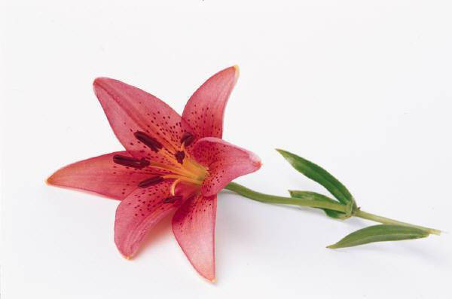
Introduction of Captains
We have two teams:
1.“The flowers ”
2. “The Friends”

Slide 5
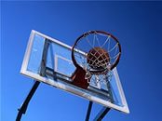
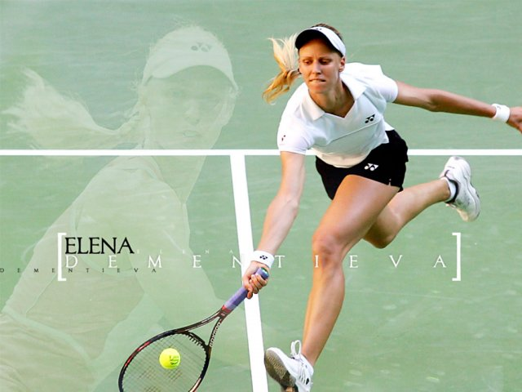
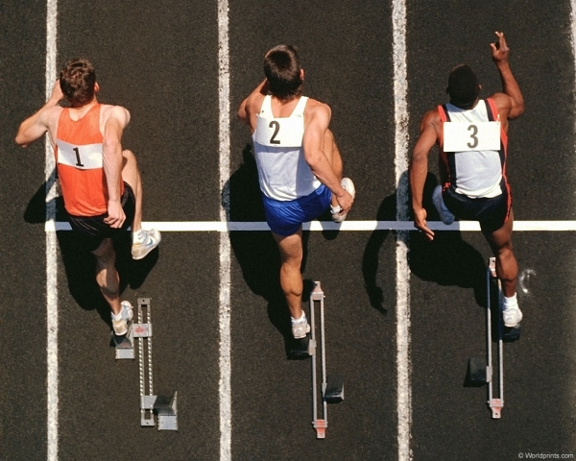
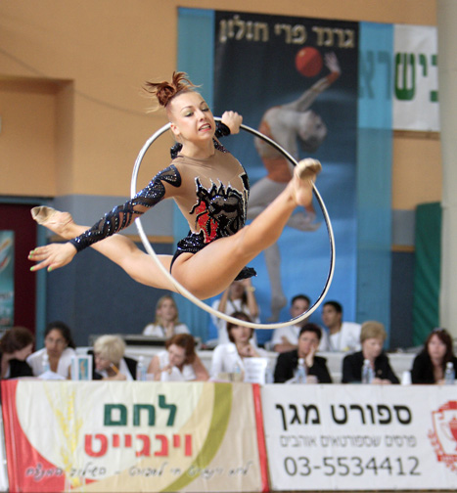
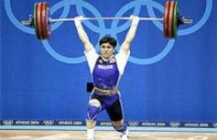
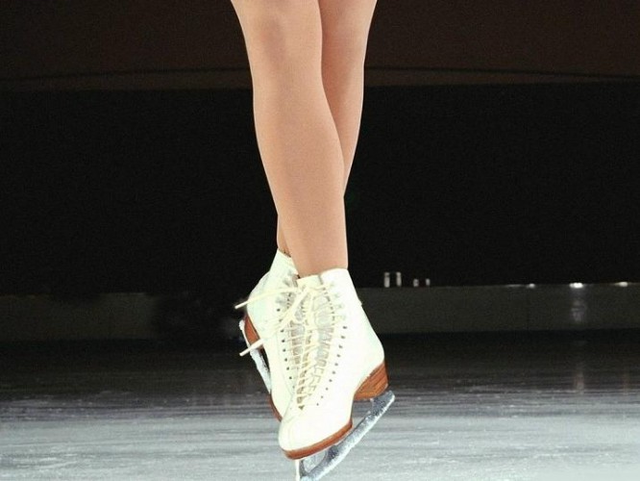
Task 1 All Kinds of Sports

Slide 6
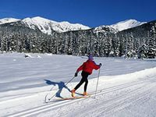
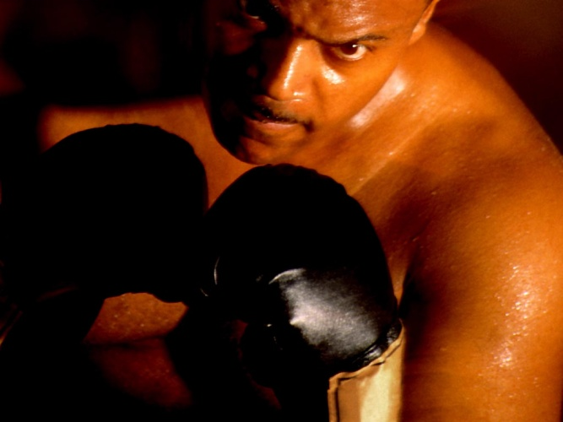
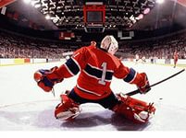
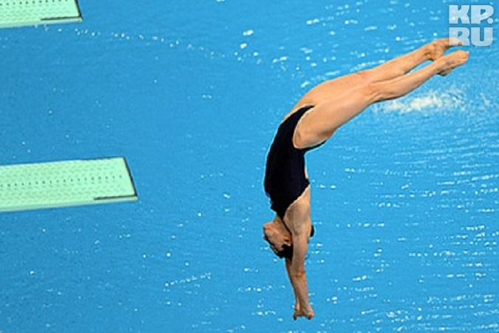
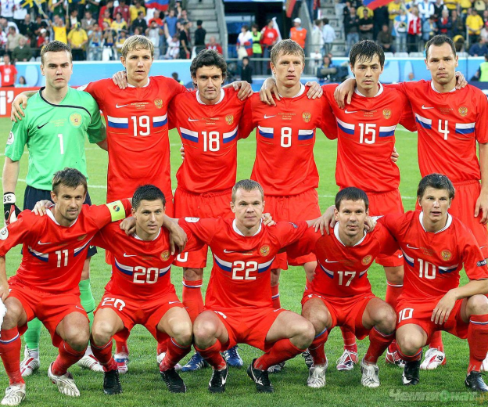
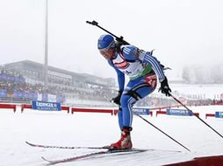
Task 1All Kinds of Sports

Slide 7
Task 2 Warming up
1. What is your full name? What are you?

Slide 8
Task 2 Warming up
2. What is your attitude to sport?

Slide 9
Task 2 Warming up
3. Do you go in for sports?

Slide 10
Task 2 Warming up
4. What is your favourite sport?

Slide 11
Task 2 Warming up
5. What sports are you fond of?

Slide 12
Task 2 Warming up
6. How many Physical training lessons a week do you have at the college?

Slide 13
Task 2 Warming up
7. What sport club do you attend?

Slide 14
Task 2 Warming up
8. What kinds of sports do you enjoy watching on TV?

Slide 15
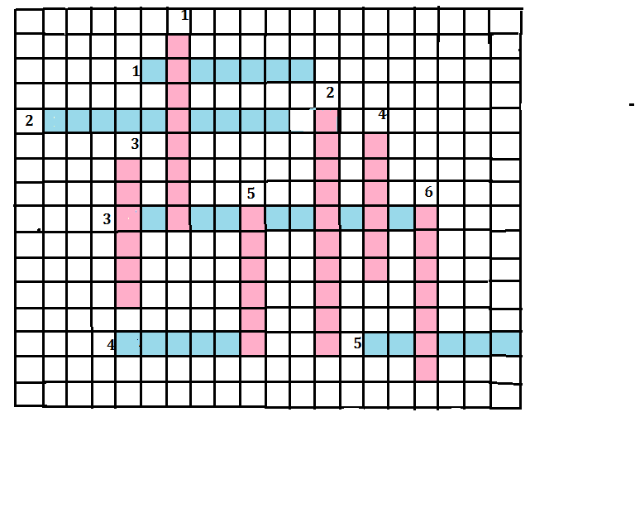
Task 3 Crossword Puzzle
Horizontal:
1. It is just like running, but here speed is not so important.
2. A game played by two teams of five players each who try to through a large inflated ball into a basket.
3. A kind of sport which consists of exercises to develop strong and graceful bodies.
4. Fight with the fists usually with thick gloves for sport.
5. A game for two or four players who hit a ball backwards and forwards across a net.
Vertical:
1. A game played by two teams which try to kick an inflated ball into their opponents’ goal.
2. A game in which players on each side of a high net try to keep a ball in motion by hitting it with their hands back and forth over the net without letting it touch the ground.
3. A game played on a field or on ice by two teams of 11 players with curved sticks and a rubber disk.
4. A sport of jumping or falling into water from a platform sometimes while performing acrobatics.
5. Winter sport in which the participants use skis to glade on snow.
6. A sport or recreational activity which consists of travelling on ice using skates.

Slide 16
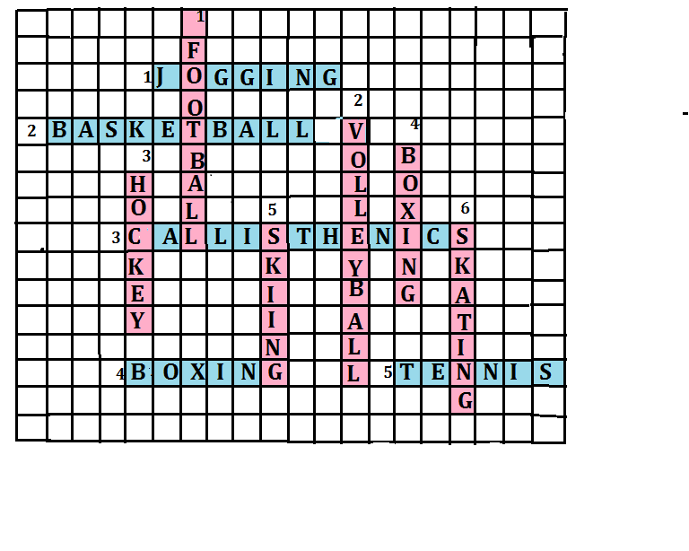
The Clue to the Crossword Puzzle

Slide 17
Task 4 Listening.
Listen to the dialogue and do the task
Question | Answer
1. What kind of sport does the woman prefer? | 1. The woman prefers…
2.What kind of sport does the man prefer? | 2. The man prefers…
3. Do they like to do sports or to watch sports on TV? | 3. They like to…

Slide 18
Task 5 Back Translation
Я люблю спорт и я занимаюсь спортом.

Slide 19
Task 5 Back Translation
2. Я активен в спорте и увлекаюсь легкой атлетикой.

Slide 20
Task 5 Back Translation
3. Я играю в настольный теннис и в волейбол.

Slide 21
Task 5 Back Translation
4. Мне нравится футбол и бег трусцой.

Slide 22
Task 5 Back Translation
5. Я посещаю уроки физкультуры в колледже.

Slide 23
Task 5 Back Translation
6. Я посещаю спортивную секцию по баскетболу.

Slide 24

Task 5 Back Translation
7. Я принимаю участие в спортивных соревнованиях.

Slide 25

Task 5 Back Translation
8. Я иногда смотрю спорт по телевизору.

Slide 26
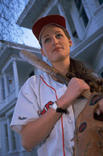
Task 5 Back Translation
9. Спорт – это здоровье, долголетие и приятный внешний вид.

Slide 27
Task 5 Back Translation
10. Спорт – это популярное времяпровождение.

Slide 28

Task 6 Reading
What is Tony’s attitude to sport? What kind of sports is his favourite?
Tony, 20
Oh, I love sport. I’m very active in sports. I go jogging every week, and besides that, I play tennis now and then. My favourite sport, however, is football. My life would be boring without it. I think, I love it, because it’s a team game and you need all kind of skills. You must be fit, you must look at what your teammates do, and you need a quick brain. I’m a member of our local football team. I make new friends. Last year we went on a big holiday trip to Italy together! Sport keeps you fit and healthy.

Slide 29
Task 7 Speaking (Monologue)
«My favourite Sport».
(ЛЛС )
I’d like to tell you about...It is…
… is my favourite because……
I’ve been doing/playing ….since
……is a winter/summer/all-season/team/individual..
This sport is popular because it…
Millions people throughout Russia play ….It is really popular.
As for me, I attend…. and take part in…..
…….

Slide 30
Finish the game
Count the balls you got for each task and determine the winner!

Slide 31







Express your attitude to the game and to your work at the lesson
I am ….. about the lesson, because…
I am not …. about the lesson, because…
I worked hard and I am ….
I learned to …
Sorry, I didn’t ….
I am sorry I didn’t work. I was lazy.

Slide 32
Literature
А. Хорнби, Э. Гейтенби, Х. Уэйкфилд. Толковый словарь английского языка.Издательство «Сигма-пресс», 2011.
Павлоцкий В.М. Ключ к успеху. Учебное пособие по английскому языку.- СПб.:КАРО,2009.-240с.
Тимофеев В.Г., Вильнер А.Б., Колесникова И.Л. и др. Учебник английского языка для 10 класса (базовый уровень) / под ред. В.Г. Тимофеева. – М.: Издательский центр «Академия», 2010. – 144 с.
Ширяева И.В. Разговорный английский в диалогах. – СПб.:КАРО, 2009. – 192 с.

