Slide 1
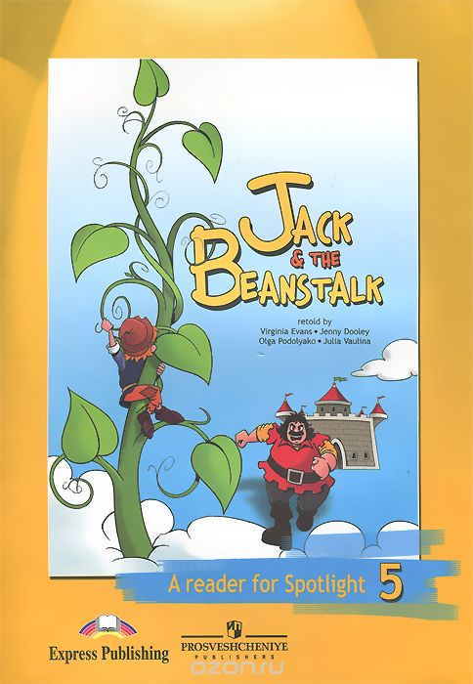

Slide 2
Put the events in the correct chronological order.
Jack runs home and gives the beans to his mother.
On the way into town Jack meets an old man.
The old man tells Jack that the beans are special.
The old man looks at Daisy and says that the cow is right.
Jack takes the beans and the old man takes the cow.
Mrs. Trott doesn’t want the beans, she wants money.

Slide 3
Fill in the gaps with the correct words from the box.
to sell food head to scream magic swap
___________ beans
to nod the _________
___________the cow
to do _____________
___________ at Jack
to buy ___________

Slide 4
Find the words related to the ones in the list.
cross shake begin exchange good shout
nod _______________
scream ____________
start ______________
right ______________
swap ______________
angry ______________

Slide 5
Say who the words in bold refer to: Mrs. Trott, Jack or the old man.
He went into the town to sell the cow.
He doesn’t want to give Daisy to him
He has a plan.
He takes the beans.
He gives the beans to her.
She is very angry.
She screams at him.

