Slide 1
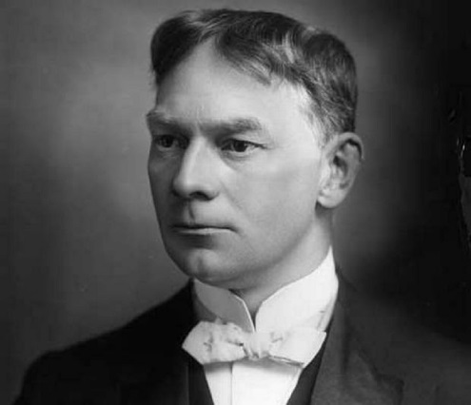
Jerome K. Jerome once said that we are never happy with the weather. The weather, like the government, is always in the wrong.
?
Who or what is responsible for
the so-called extreme weather events?
Jerome K. Jerome (1859-1927) a British writer of humorous novels

Slide 2
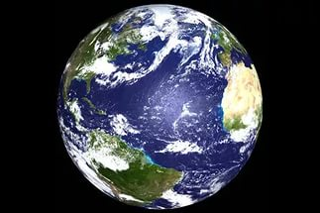
4,600 million years old
46 years old

Slide 3
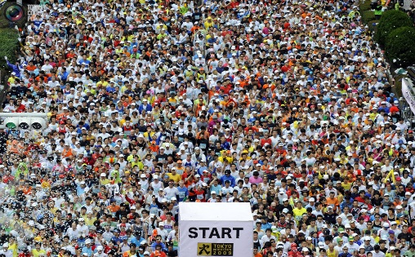
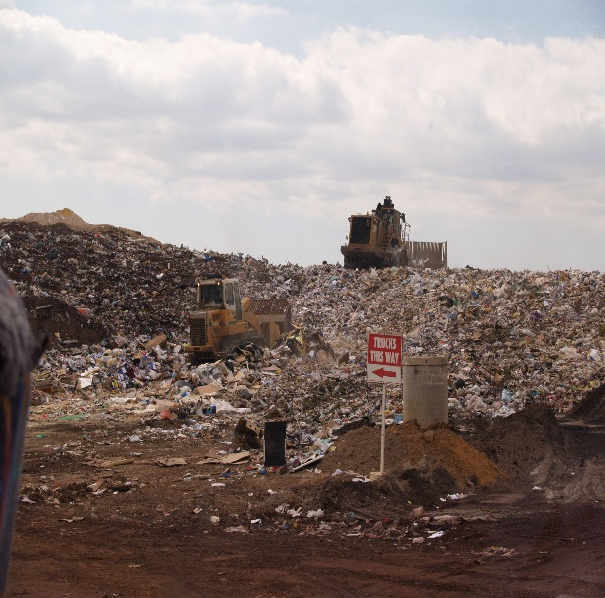
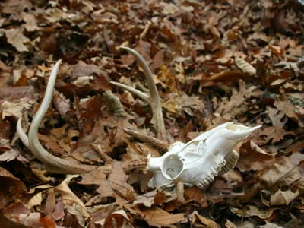
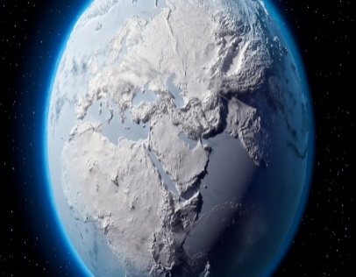
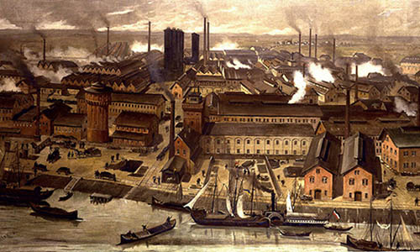
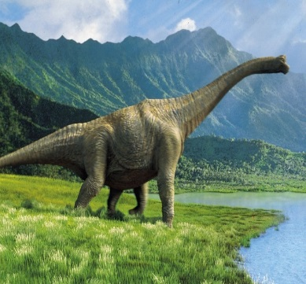
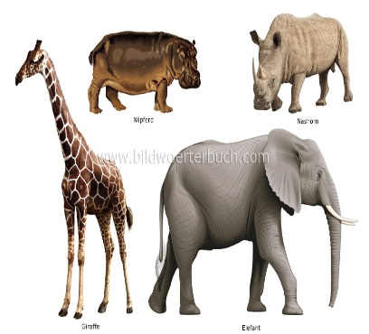
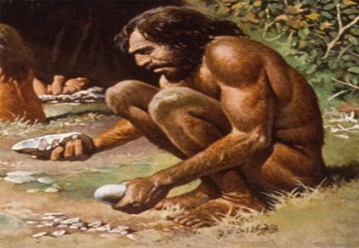
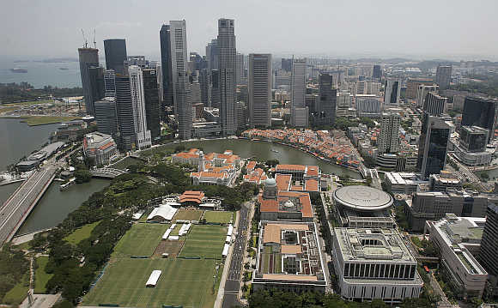
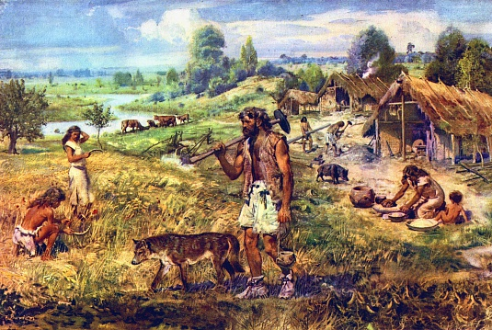
1 year ago
8 months ago
Last week
Last weekend
4 hours ago
1,2 hour ago
60 seconds ago
0
7
42
45
???
??
?

Slide 4
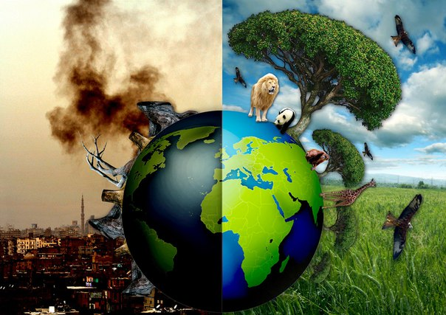
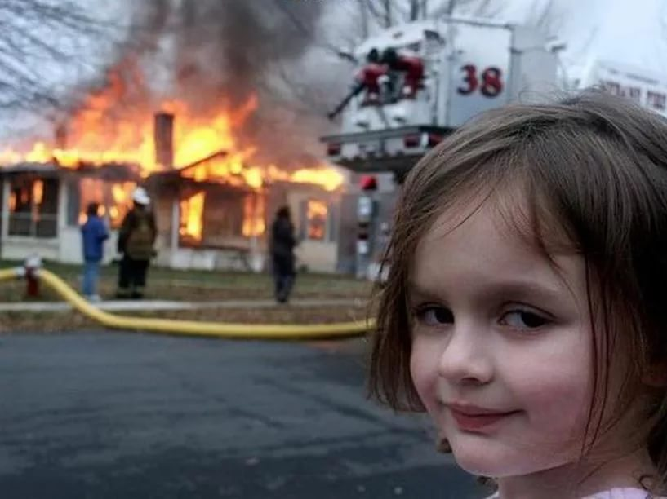
?

Slide 6
Step 1
Step 2
Step 3
?
solution to the problem/ problems
problem/
problems
what causes the problem/ problems

Slide 7
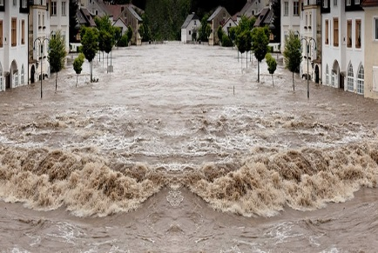
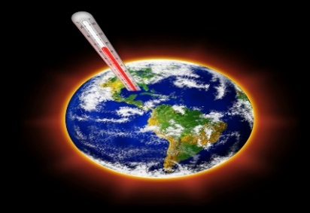
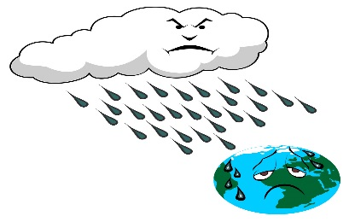
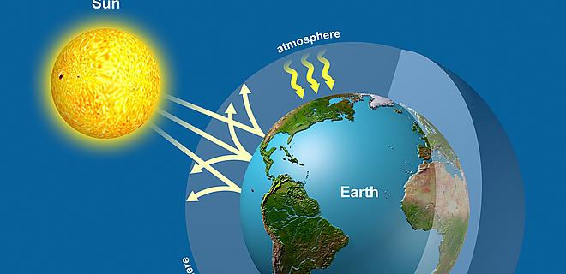
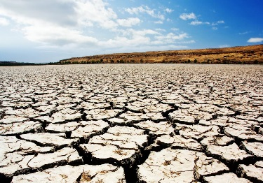
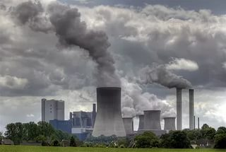
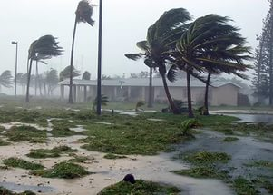
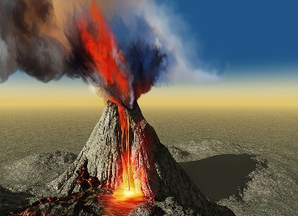
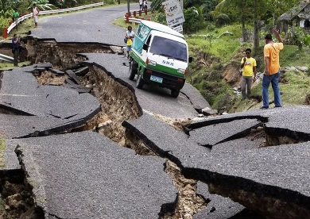
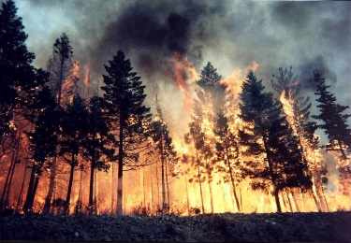
1
2
3
4
acid rain
global warming
greenhouse effect
flood
6
7
10
drought
air/water/soil pollution
5
8
9
volcanic eruption
earthquake
forest fire
hurricane

Slide 8
greenhouse effect
global warming
flood
hurricane
earthquake
Natural disasters
Environment
Environmental problems
drought
volcanic eruption
acid rain
air/water/soil pollution
forest fire

Slide 9
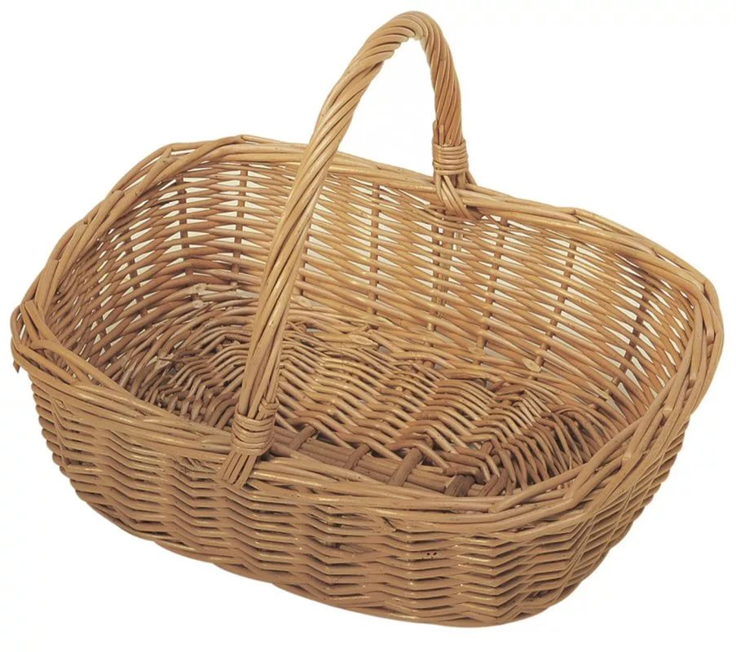
We should…
to save electricity
waste water
put on sweater when we’re cold
I try to…
use energy-saving light bulbs
instead of turning up the heater
plant more trees
turn lights off
walk or use public transport
buy a plastic bag in each shop
use our washing machine or dishwasher
save/conserve natural resources
I don’t try to…
turn up the heater
turn on/off the taps/water
throw away bottles and cans
We shouldn’t…
cut down rainforests
only when they are full

Slide 10
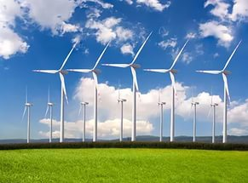
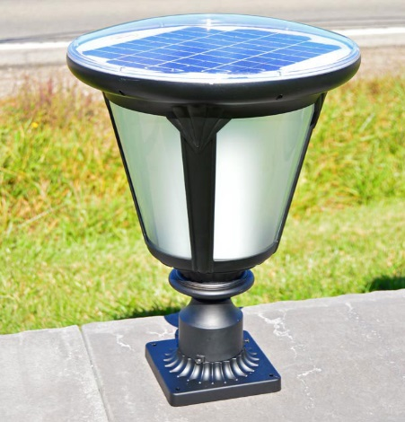
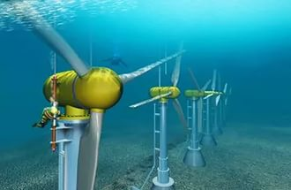
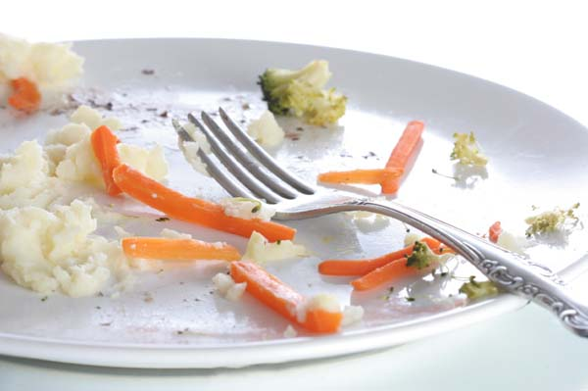
underwater turbines
wind farms
the left-over food
solar panels
wind farms
underwater turbines
solar panels
the left-over food

Slide 11
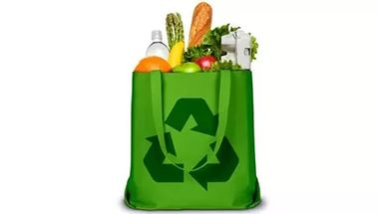
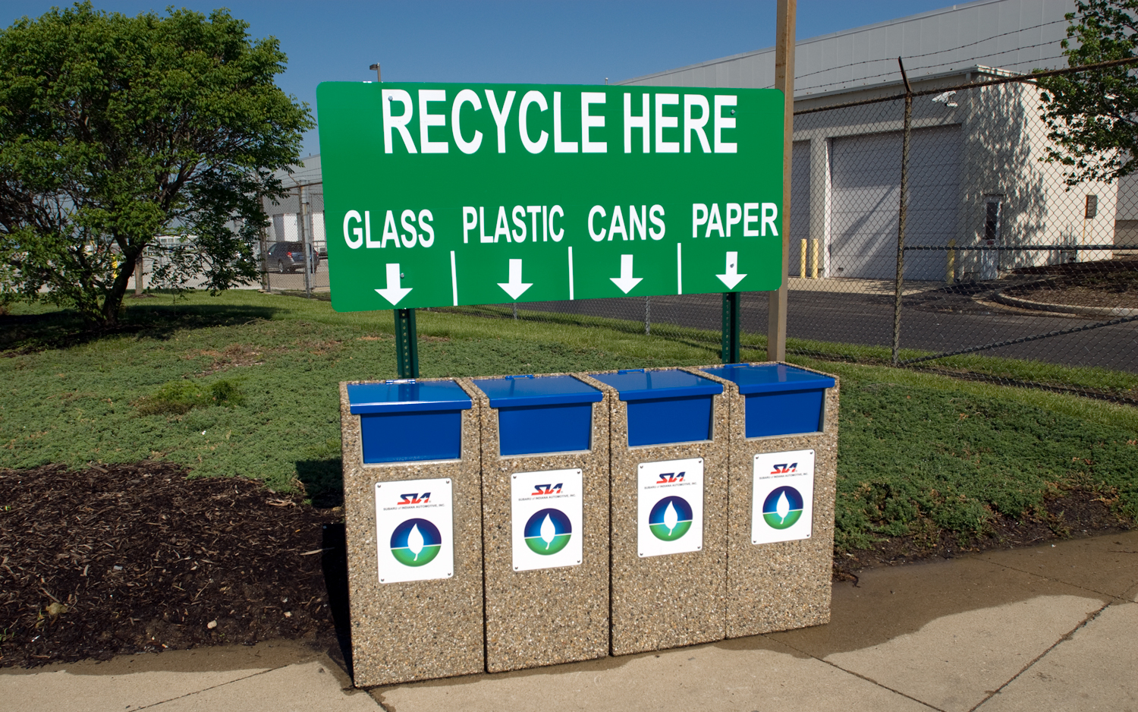
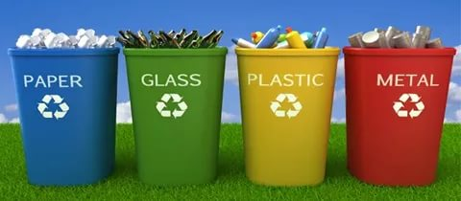
What things can we reuse?
What things can we reduce?
What things can we recycle?

Slide 12
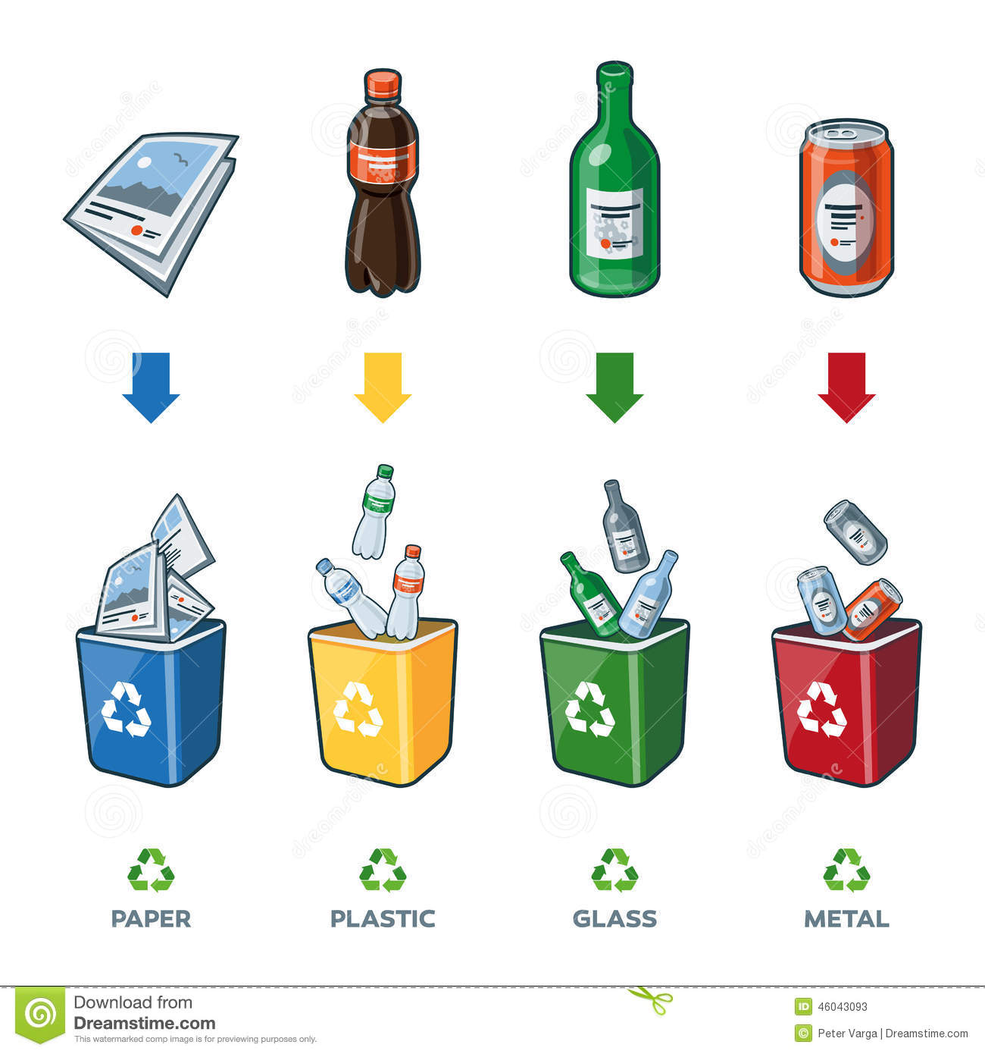
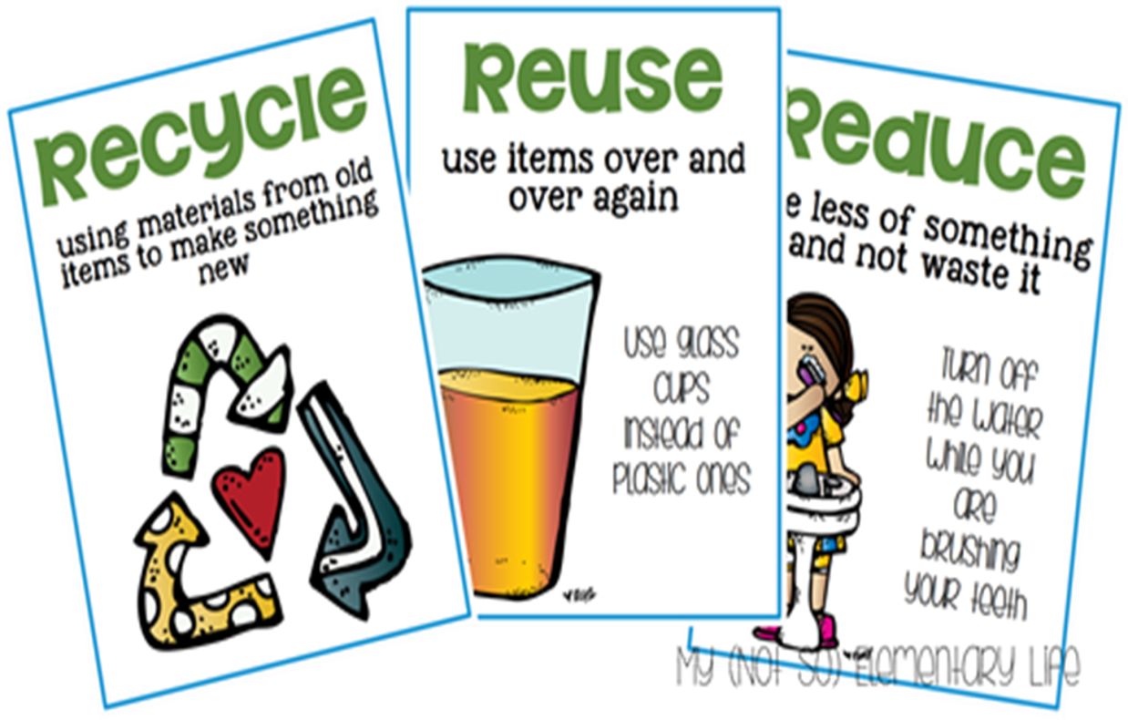

Slide 13
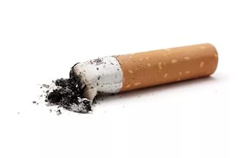
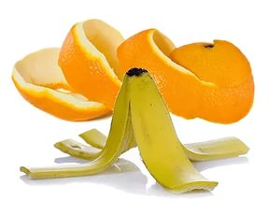
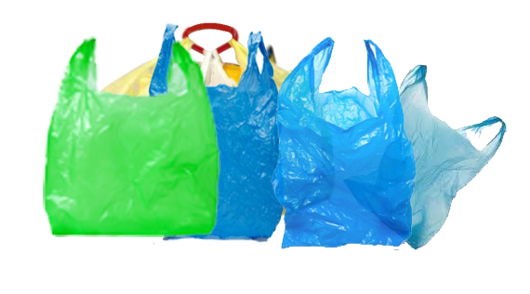
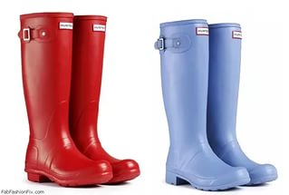
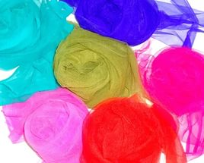
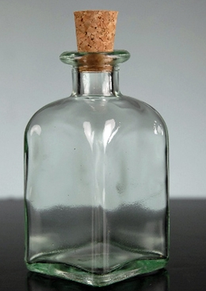
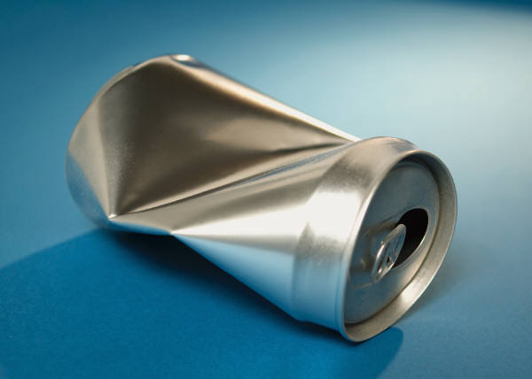
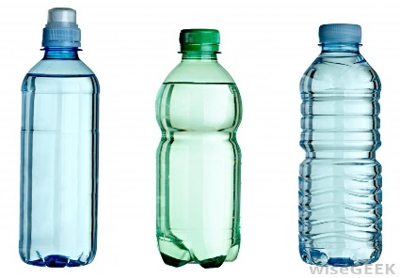
Here’re some facts you probably didn’t know
This is how long it takes for some rubbish left in park areas to disappear naturally:
1-5 years
About 2 years
orange and banana peels
Cigarette butts
plastic bags
10-20 years
50-80 years
Nylon fabric
rubber boots
30-40 years
500 years
1,000,000 years
Aluminium can
plastic bottles
indefinitely
glass bottles

Slide 14
Match the words to make word-combinations
underwater
energy
make
turbines
renewable
bag
a tree
carrier
hang out
your clothes
plant
problems
environmental
compost

Slide 15
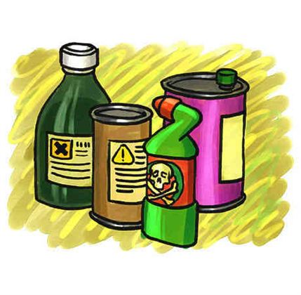
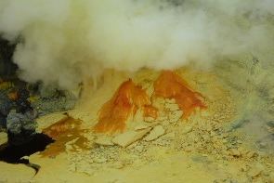
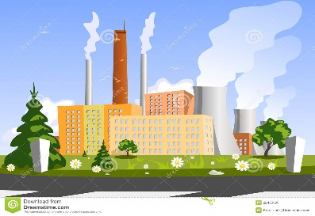
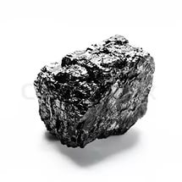
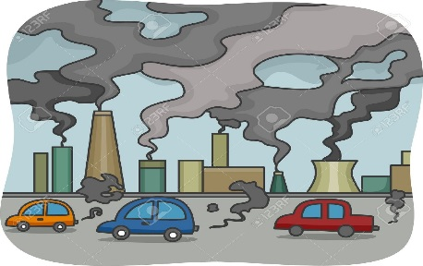
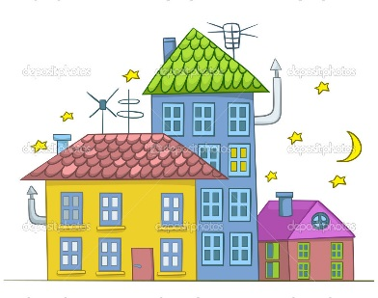
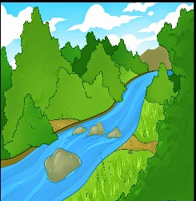
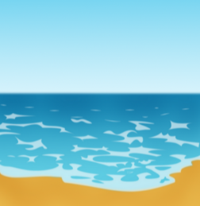
emit
lands on
burn
causes
falls into
burn
become
1
burn
and
emit
.
2
burn
3
This
causes
and
.
4
lands on
,
,
.
5
When
falls into
,
and
,
they
become
.

Slide 16
found out…
learnt…
During today’s lesson I have
known…
remembered…

Slide 17
Where are you?
I have learnt all new words and can express my own opinion on…
I have learnt a lot of new words and can speak about…
I haven’t learnt anything
I have learnt some new words but I think I still have some problems with explaining the problem.

