Slide 1
МОУ «Средняя школа №40» г. Ярославль
Презентация к уроку английского языка по теме «Mу family»
Подготовила
учитель иностранных языков:
Белова С.С.
Ярославль, 2020 год.

Slide 2


Slide 3


Slide 4
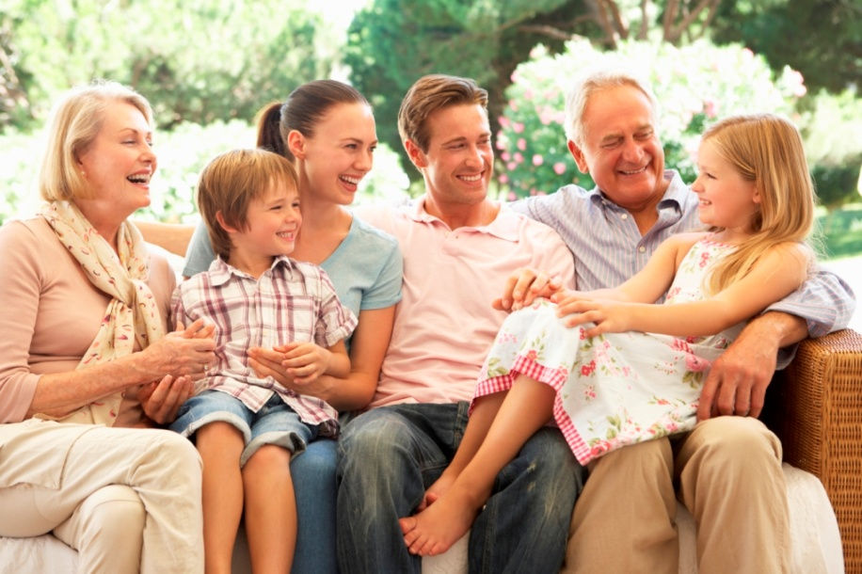

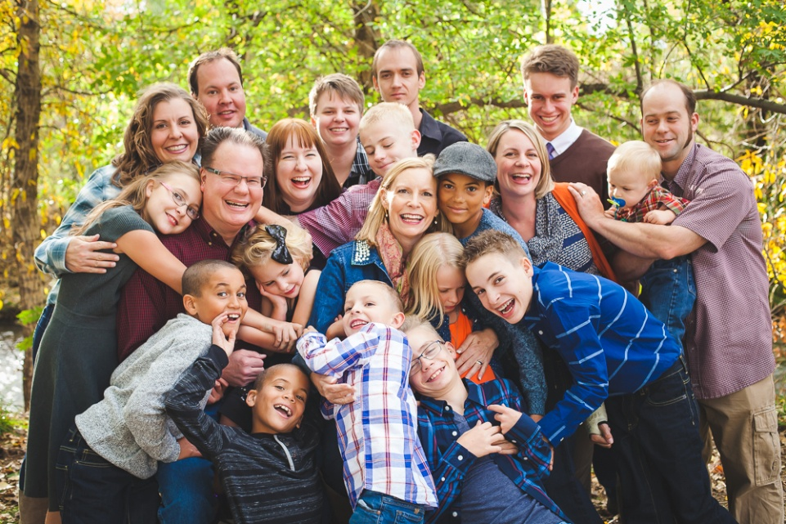
What can you see in the pictures?
What do these pictures have in common?
What will we speak today about?

Slide 5


What can you see in the pictures?
I can see….
What do these pictures have in common?
In all of these pictures I can see…
What will we speak today about?
We will speak today about…

Slide 6
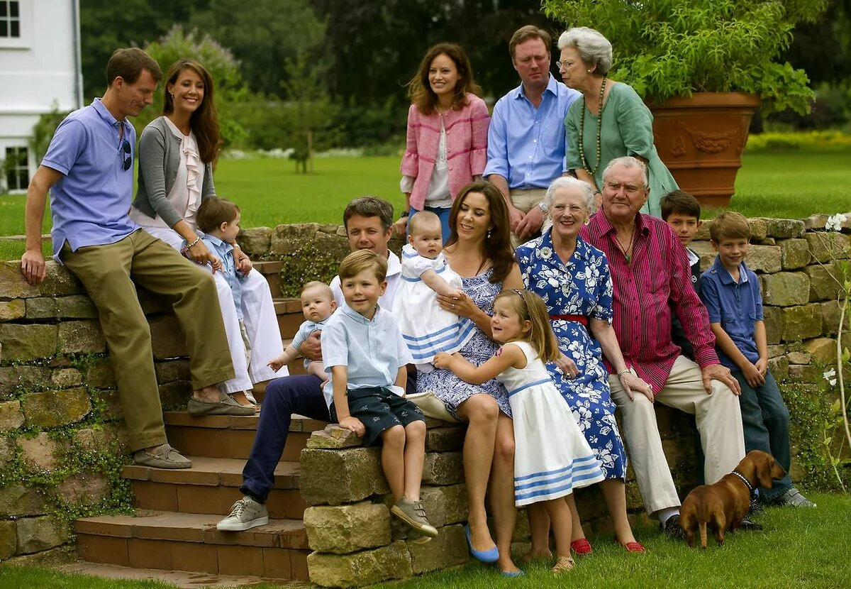
What is the topic of our lesson?
The topic of our today lesson is…
My family

Slide 7
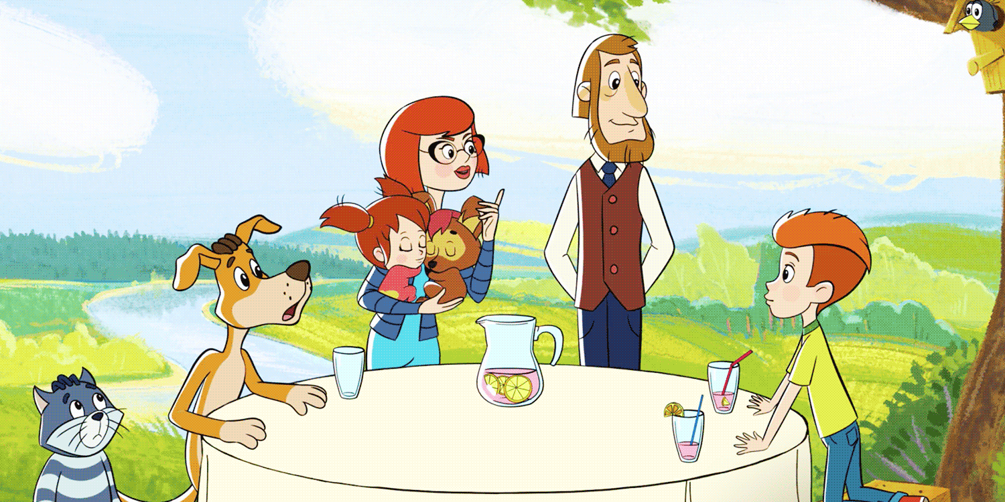
Whom can you see in the picture?
Do you know their names?
Name the members of this family.
A mother
A father
A daughter
A son
Their pets

Slide 8
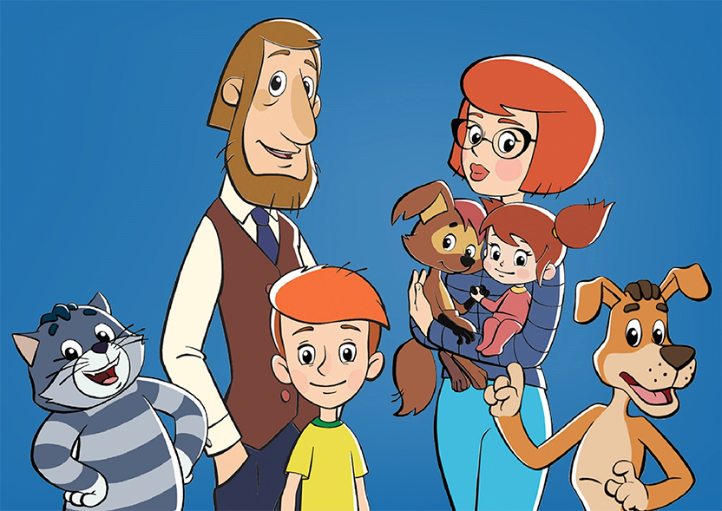
Answer the following questions:
1.Have you got a family?
Yes, I have. или No, I haven’t.
2.Is the family of Dyadya Fedor big or small?
His family is…
3.How many people are there in his family?
There are …. people in Dyadya Fedor’s family.

Slide 9
a mother
Make up the mind –maps in groups
a father
Family
Карточка №1
a niece
a grandfather

Slide 10
a mother
Make up the mind –maps in groups
a great-grandmother
a father
an aunt
a great-grandfather
an uncle
a stepfather
Family
a sister
a daughter
a cousin
a brother
a niece
a son
a nephew
a grandmother
a grandfather
a stepmother

Slide 11
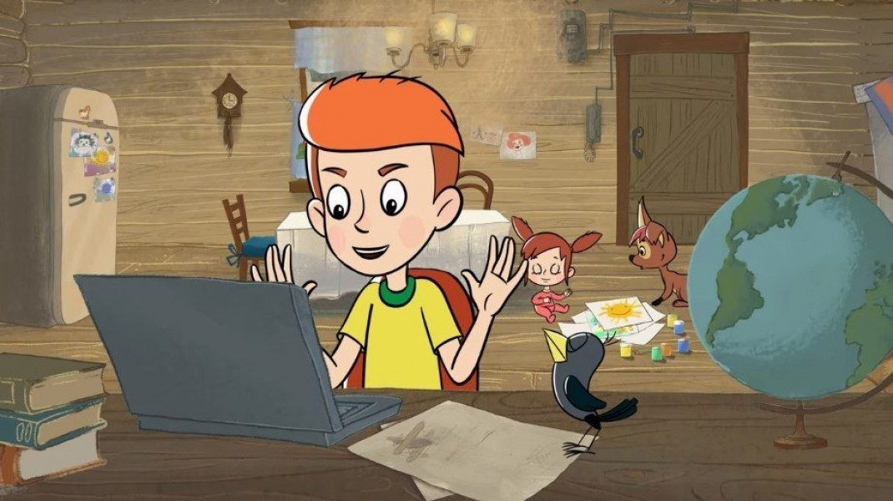
Dyadya Fedor has a very difficult task for his next lesson. He has to draw his family and write all his family members and their traits of character.
traits of character – черты характера
Let’s help him!

Slide 12
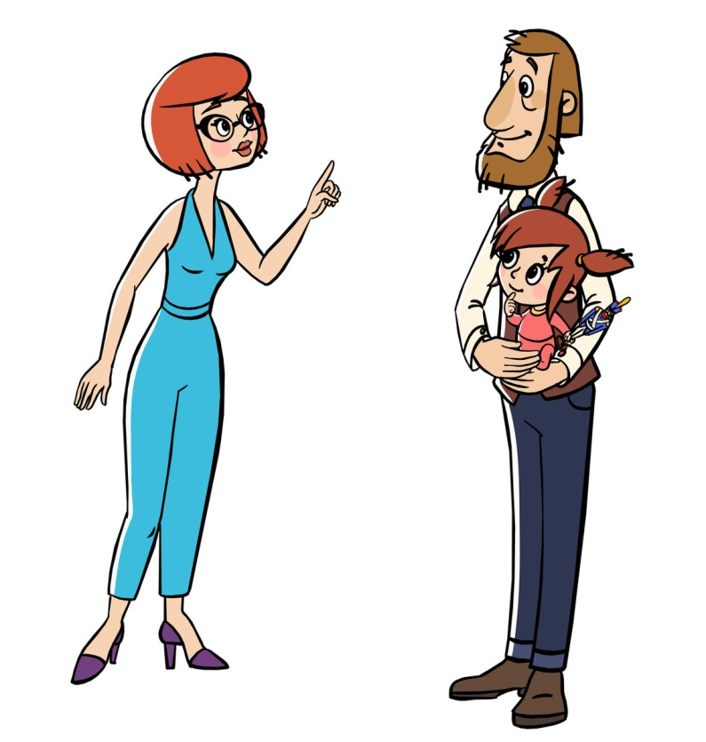
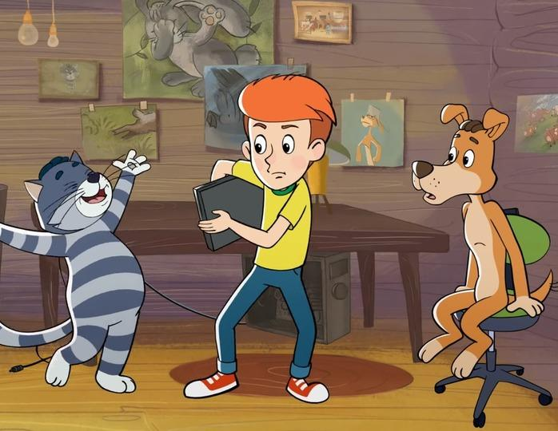
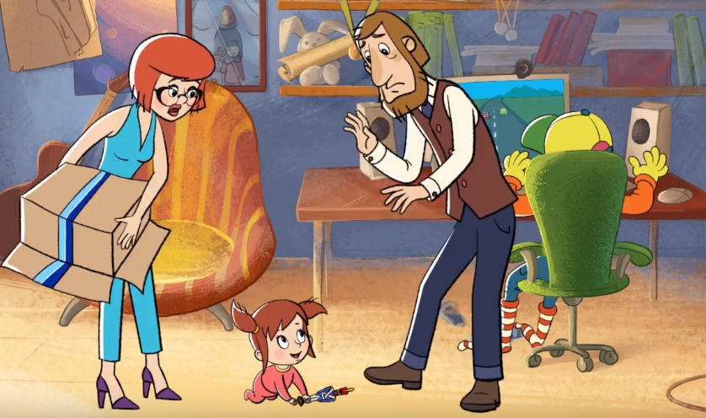
The father of Dyadya Fedor is….
The mother of Dyadya Fedor is …
Vera Pavlovna is …
Dyaya Fedor is …

Slide 13

Какие слова мы должны узнать?
Чему должны научиться?

Slide 14
К
Карточка №3

Slide 15
The father of Dyadya Fedor is….
The mother of Dyadya Fedor is …
Vera Pavlovna is …
Dyaya Fedor is …

Slide 16
Exercise №1 page 56
Work in pairs. Look at Kate’s secret diary (секретный дневник). Match words in a correct way. Who is her:
1.mother a. a baby
2.father b. a pilot
3.grandfather c.a music teacher
4.grandmother d.a pupil
5.brother e. a funny (забавный) man
6.sister f.a housewife
Карточка №4

Slide 17
Let’s check your answers:
Kate’s mother is a music teacher. 1-c
Kate’s father is a pilot. 2-b
Kate’s grandfather is a funny man. 3-e
Kate’s grandmother is a housewife. 4-f
Kate’s brother is a pupil. 5-d
Kate’s sister is a baby. 6-a

Slide 18

Read and listen to the text about Kate’s diary.
1.What is this text about?
This text is about…

Slide 19
Exercise 2b page 56. Work individually.
Read the text and decide if the sentences are T (True), F (False) or DS (Doesn’t say)
Карточка №5
1.Kate plays the violin.
2.Jane can dance.
3.David can speak another language (какой-то другой язык кроме родного языка ).
4.Kate’s got a baby brother.
5. Kate visits her grandparents every weekend.

Slide 20
Let’s check your answers:
Read the text and decide if the sentences are T (True), F (False) or DS (Doesn’t say)
1.Kate plays the violin. DS
2.Jane can dance. F
3.David can speak another language. T
4.Kate’s got a baby brother. F
5. Kate visits her grandparents every weekend. DS

Slide 21
Assess your work.
no mistakes (нет ошибок) – mark «5»
1 mistake – mark «4»
2 mistakes – mark «3»
3 and more mistakes –mark «2»

Slide 22
What adjectives (прилагательные) does Kate use to describe the members of her family? Work in pairs.
Let’s make a list of them in pairs.

Slide 23
-clever
-cool
-naughty
-caring
-kind
-friendly
-funny
-noisy
Who is clever in Kate’s family?
Who is cool?
Who is naughty?
Who is caring?
Who is kind?
Who is friendly?
Who is funny?
Who is noisy?

Slide 24
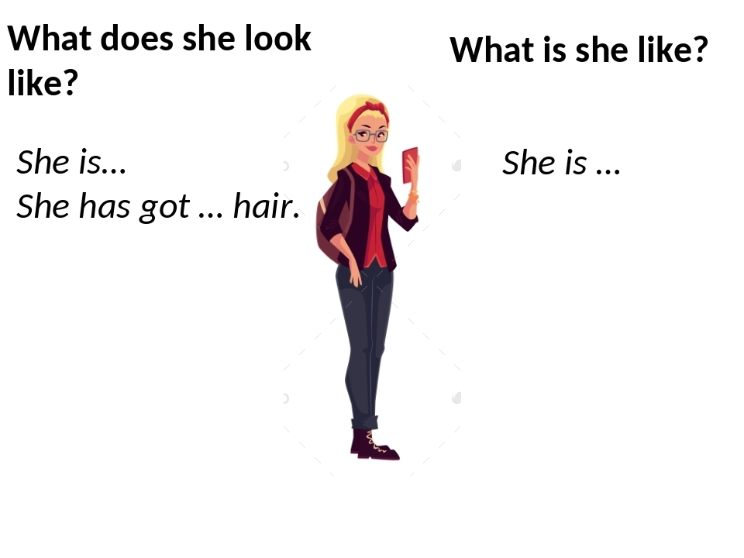
What is …. like?
Don’t forget about it!

Slide 25
Answer your partner’s questions? Work in pairs.
What is your mother like? (Пример ответа: My mother is…)
What is your father like?
What is your sister like?
What is your grandfather like?
What is your grandmother like?
What is your aunt like?
What is your uncle like?

Slide 26
1.What can you tell Kate about your family?
2.What do we know about
Dyadya Fedor’s family?

Slide 27
Answer the questions:
С какой трудностью вы столкнулись в начале урока? Какую цель вы поставили?
Что вы узнали в ходе урока?
Чему научились?

Slide 28
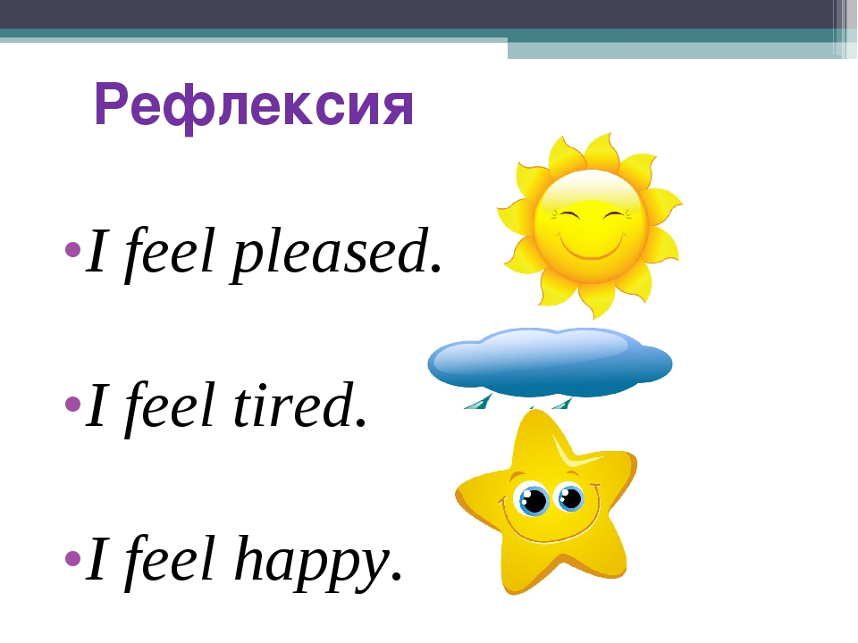

Slide 29
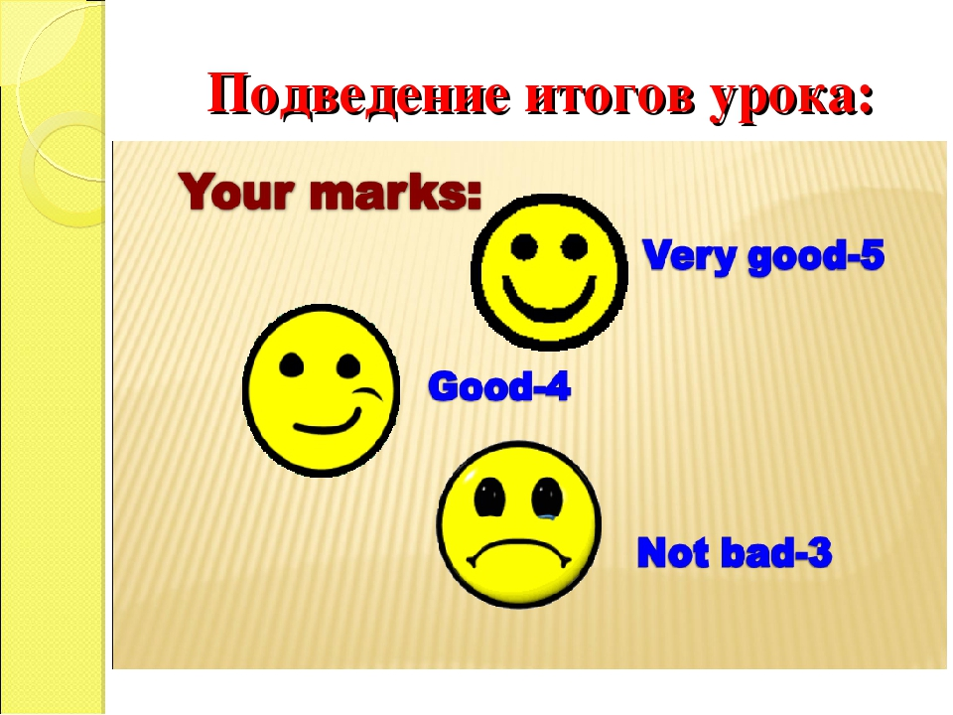

Slide 30
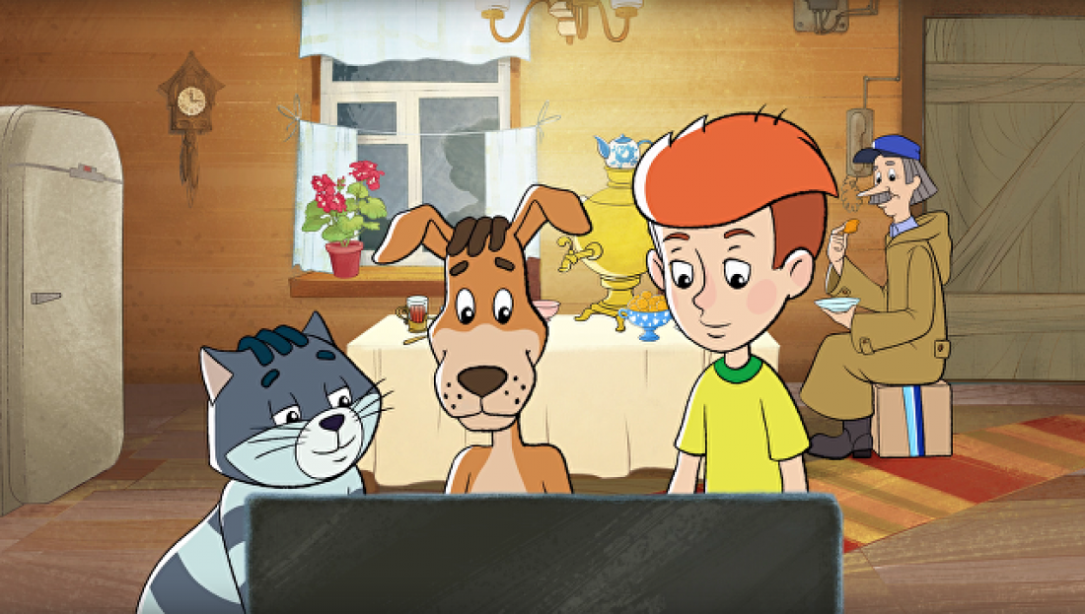
At home you should…
Write down a secret diary about the members of your family on a sheet of paper (10-15 sentences). Draw your family tree.
Learn the words on the topic «Traits of character» by heart.
Do an interactive task.
https://learningapps.org/14070229

Slide 32


