Slide 1
Иностранный язык
ФИО преподавателя: Горяинова Виктория Викторовна,
e-mail: goryainova_v@mirea.ru
Online-edu.mirea.ru

Slide 2
Тема занятия: «Problems of Ecology» («Проблемы экологии»)
Тип учебного занятия: метапредметный
Цель учебного занятия: изучить и найти способы сократить объем электронного мусора.
Задачи:
1. ознакомить студентов с новой лексикой учебного занятия;
2. прослушать текст и получить общую информацию о содержании текста;
3. прочитать текст и извлечь специфическую информацию об электронном мусоре;
3. выполнить тренировку лексико-грамматических навыков учащихся;
4. просмотреть видео по теме урока и найти пути сокращения объема электронного мусора.

Slide 3
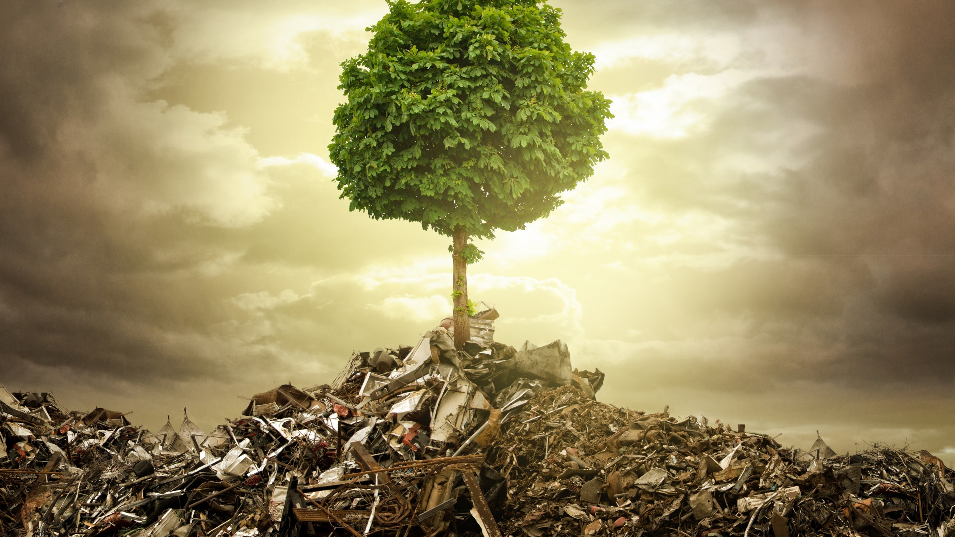
Theme 1.14
Humans and nature
Ecological problems

Slide 4
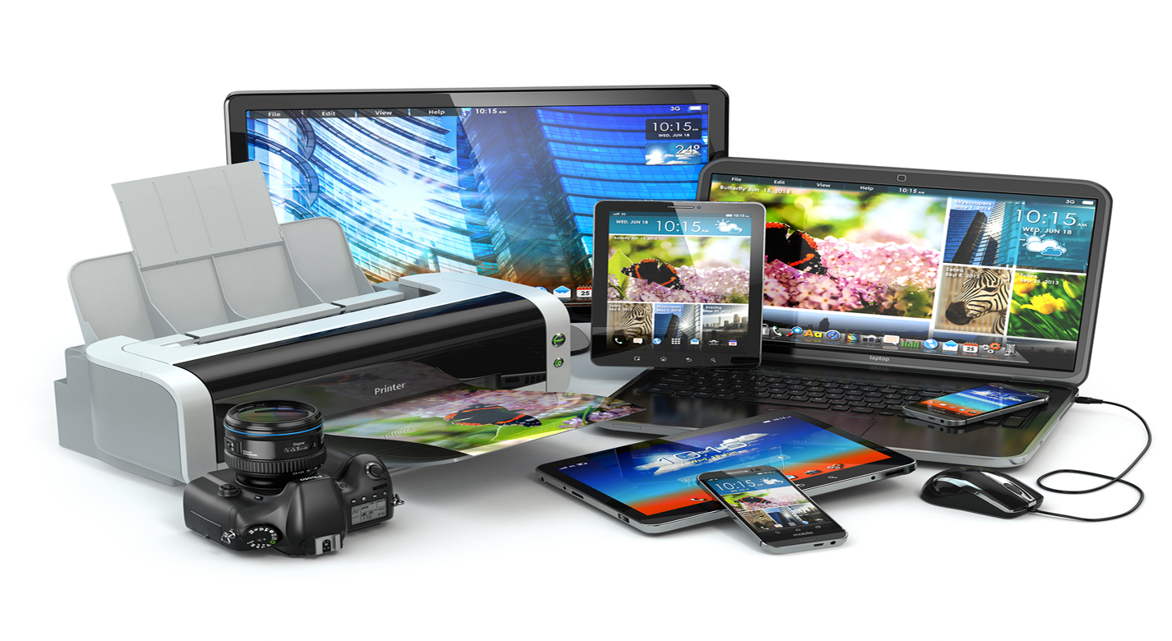
What devices have you bought recently? What was it?
What did you do with old ones?

Slide 5
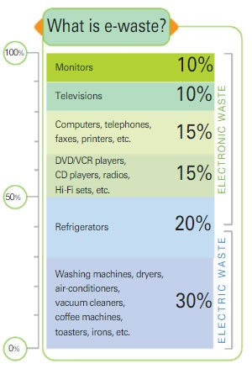
Look at the graph. Name the parts of it. What
devices are very often replaced?
Answer the question «What is the e-waste»?

Slide 6
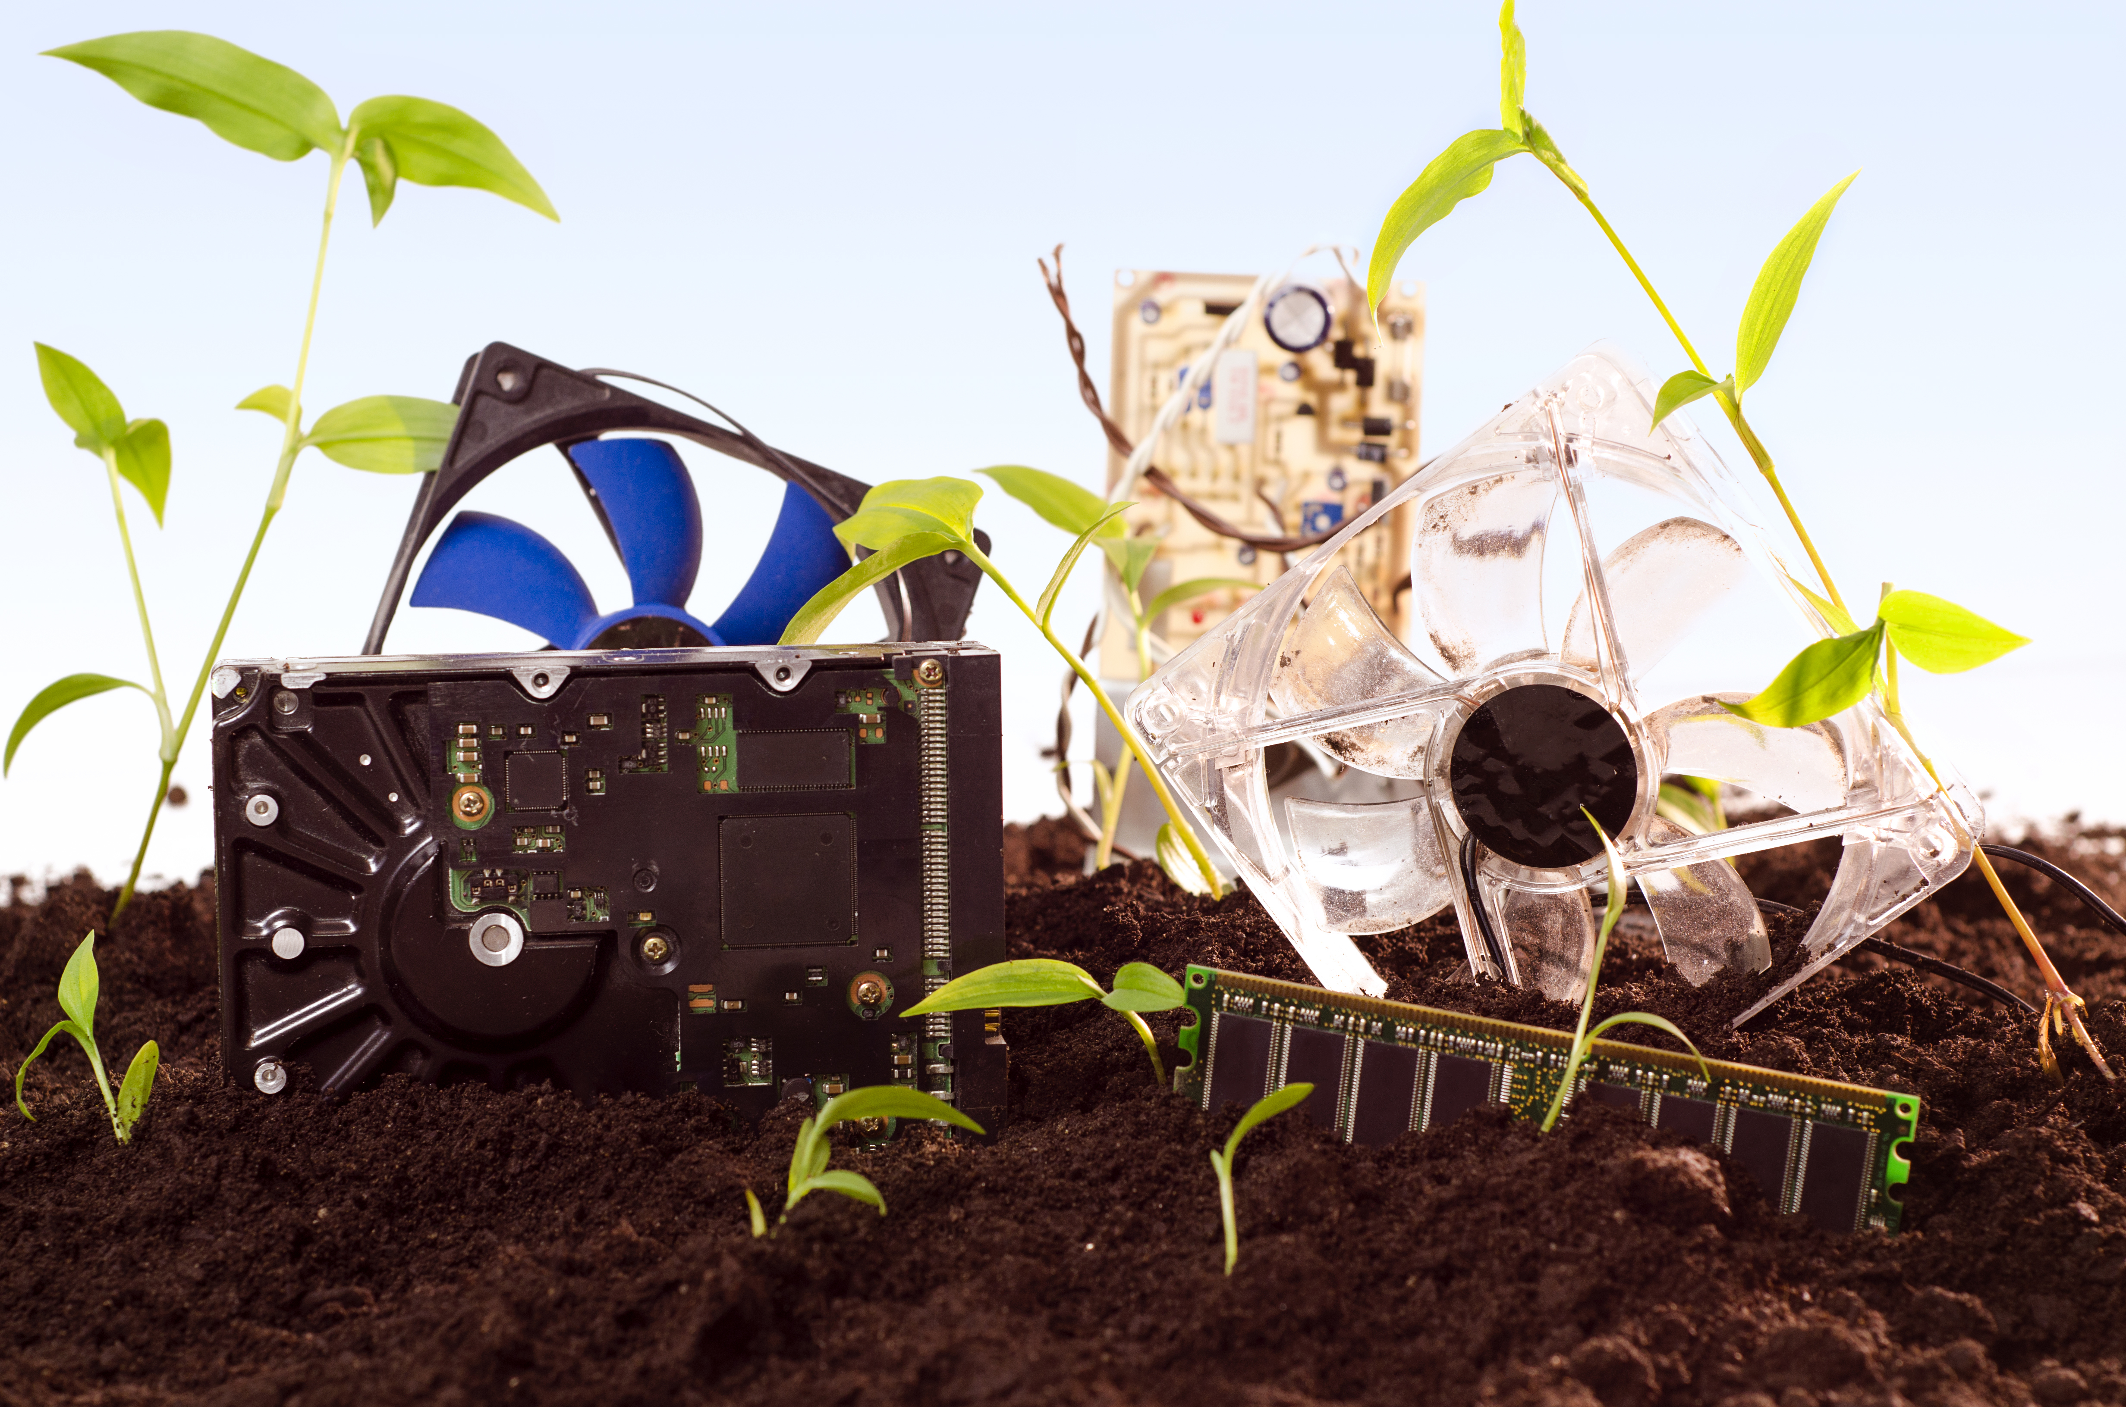
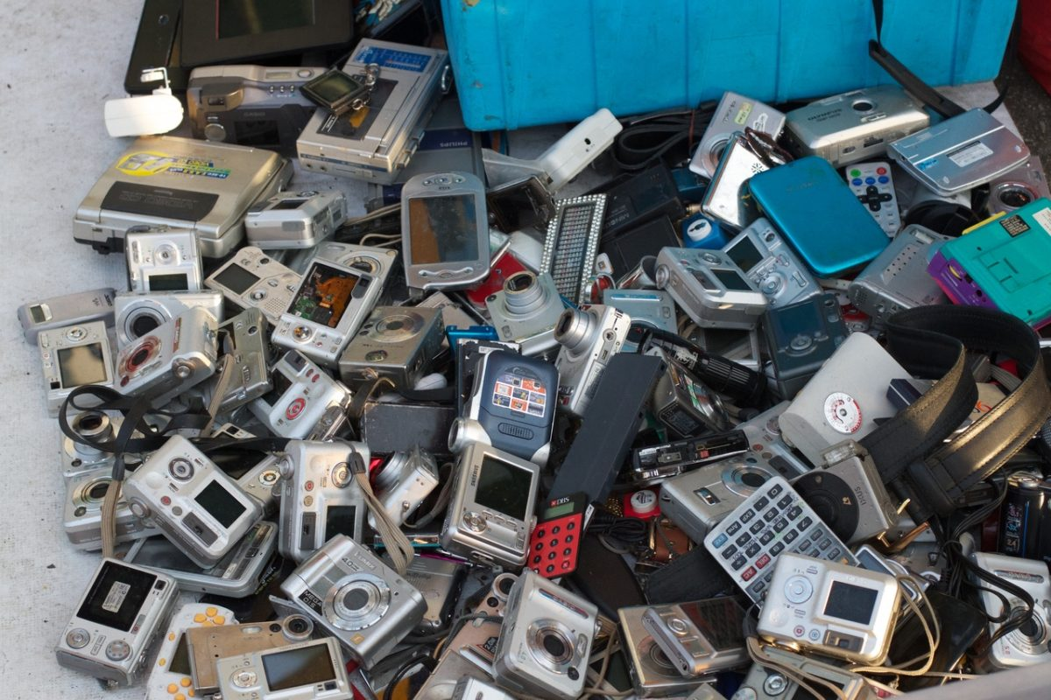
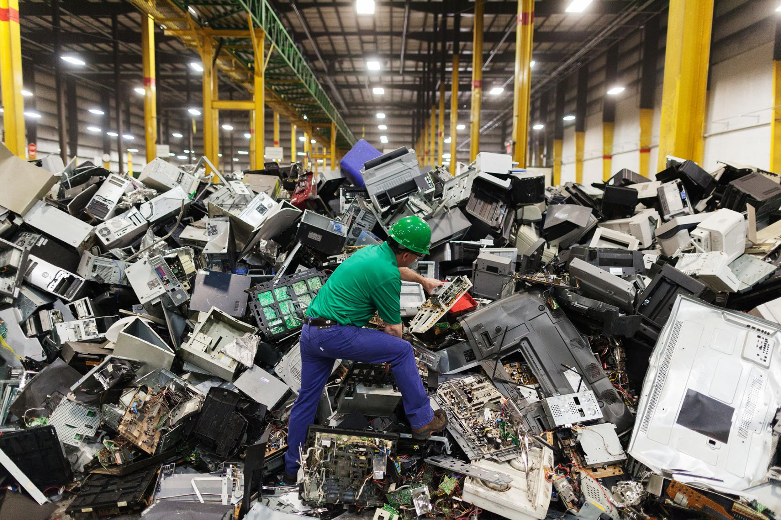

Look at these pictures. What can you see there? What problem is there? What is our theme today? Name it.

Slide 7
The aim of our lesson is to find the ways of reducing the volume of electronic garbage.
Task 1: learn new words
Task 2: read the text and get more information about e-waste. Why it is damage for the environment and people
Task 3: watch the video and find the ways how to protect our planet

Slide 8
Match the words and definitions
gadget
outdated
poisonous fumes
E-waste
reuse
dump
harm
recycle
reduce
toxic gases
1. computers, phones and other electronic products that are thrown because they are old
2. To use something again for a different purpose
3. To sort and collect rubbish in order to treat it and produce useful materials
4. A small device or machine with a particular purpose
5. Old-fashioned
6. Poisonous substances in a form like air
7. Become or make something become smaller in size, amount
8. Drop something in a careless way
9. Physical or other injury or damage
10. Strong, unpleasant, dangerous gas

Slide 9
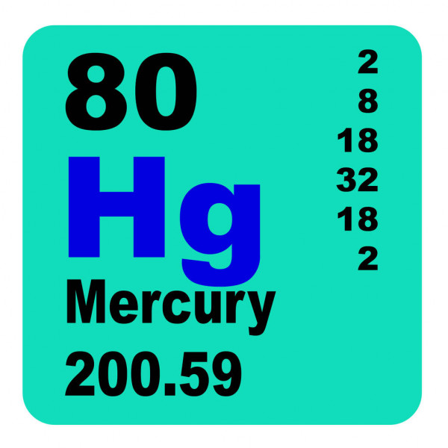

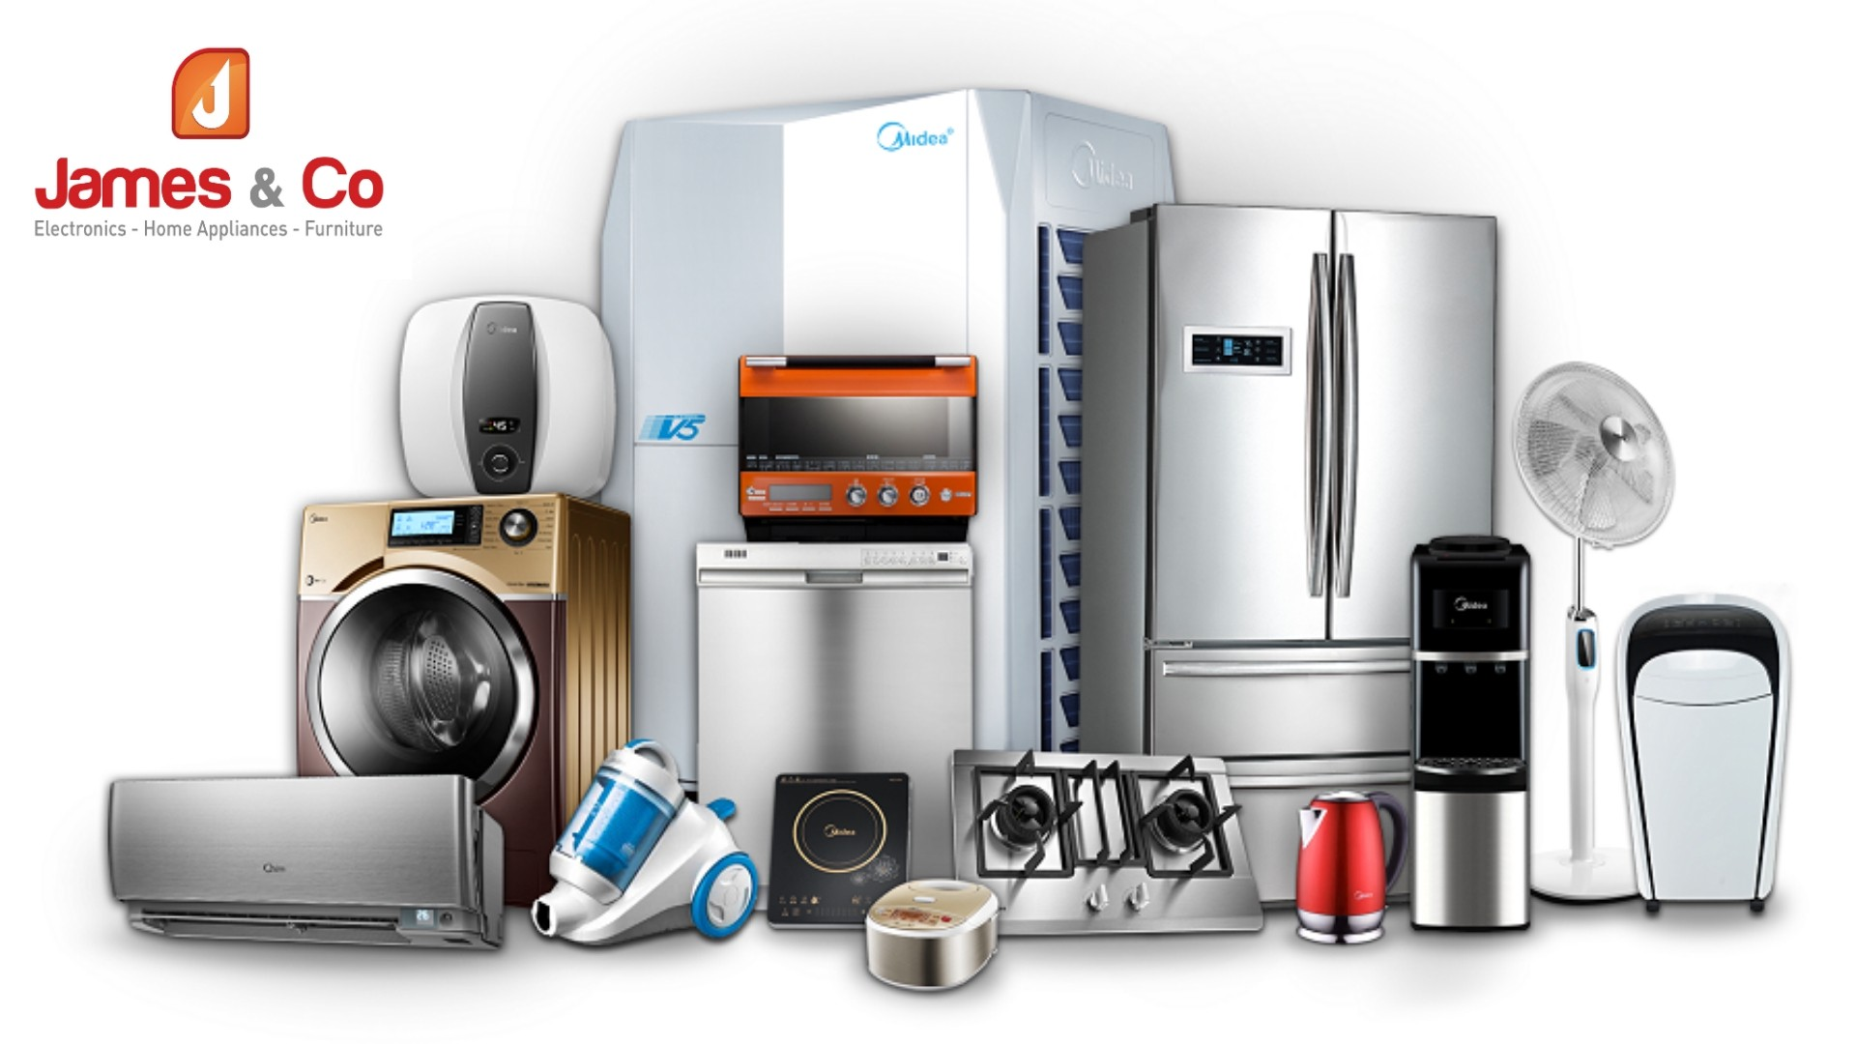
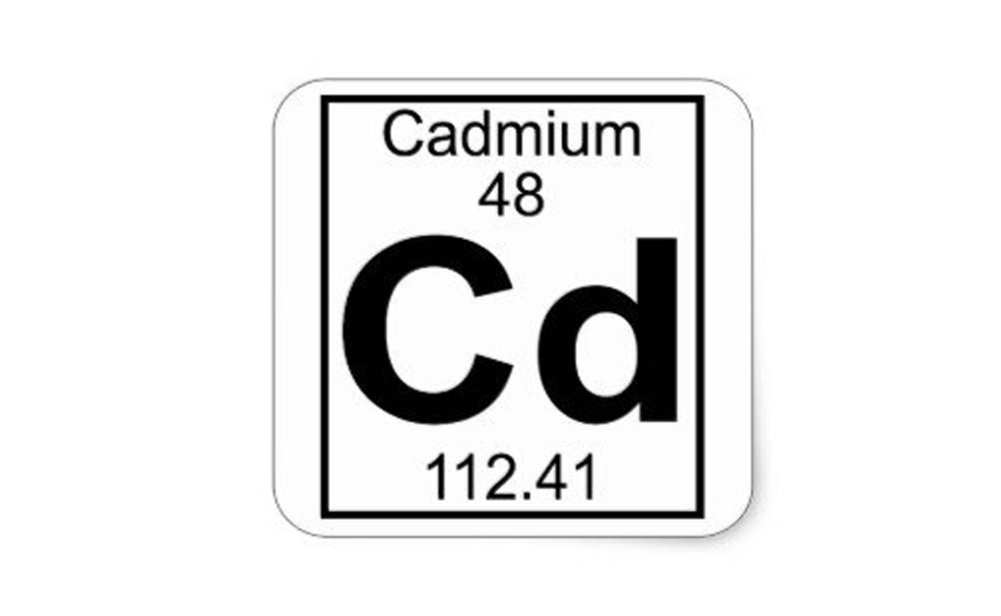

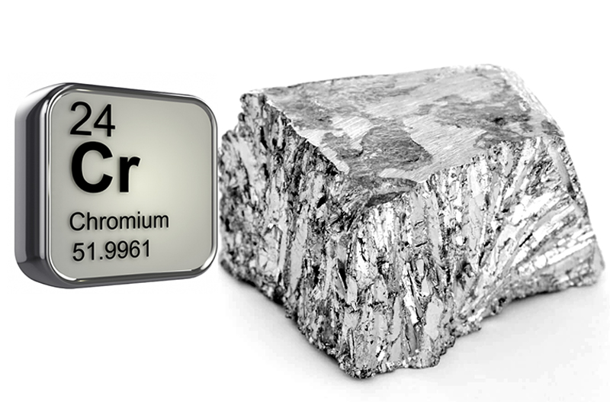
Find a picture for each word
3
1
2
4
5
6
Electrical goods
metal
lead
mercury
chromium
cadmium

Slide 10
Use the words to complete the spidergram

Slide 11
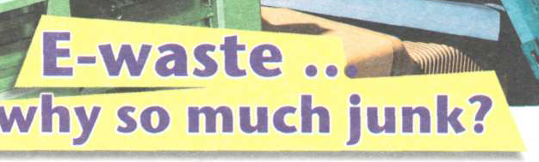
Listen to the text. What is the main idea of it?

Slide 12
Read the text. Choose the best word for each gap.

Slide 13

Match the headings and paragraphs. Find extra one.

Slide 14
Find the words in bold with their meanings.
Pace, outdated, what’s the big toxic, currently, gradually, harm, dumped, treaties, donate, components

Slide 15
Find sentences in the text
1. Технологии совершенствуются с большей скоростью каждый год.
2. Приборы и гаджеты быстро становятся устаревшими.
3. Электронный мусор содержит более тысячи химикатов, большинство из которых очень токсичны.
4. Когда электронный мусор просто выбрасывают на свалку, он может выделять ядовитые испарения.
5. Многие страны подписали соглашение об остановке экспорта электронных отходов в другие страны.

Slide 16
Complete the sentences

Slide 17


Explain what reduce, reuse, recycle mean?

Slide 18
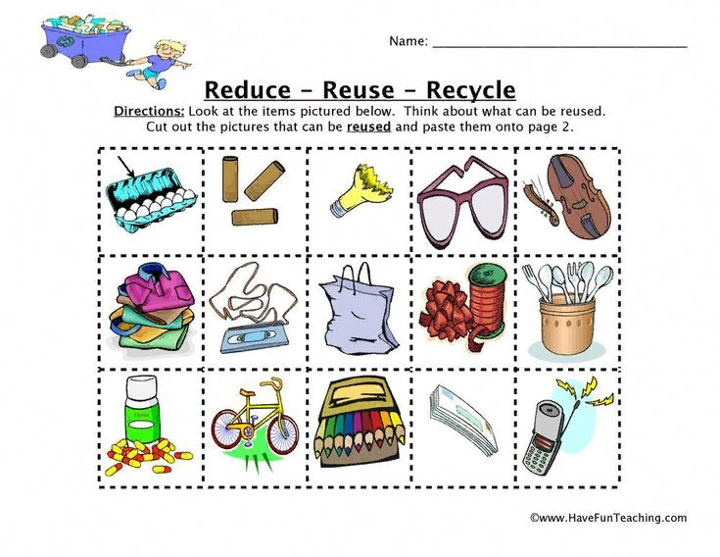

Slide 19
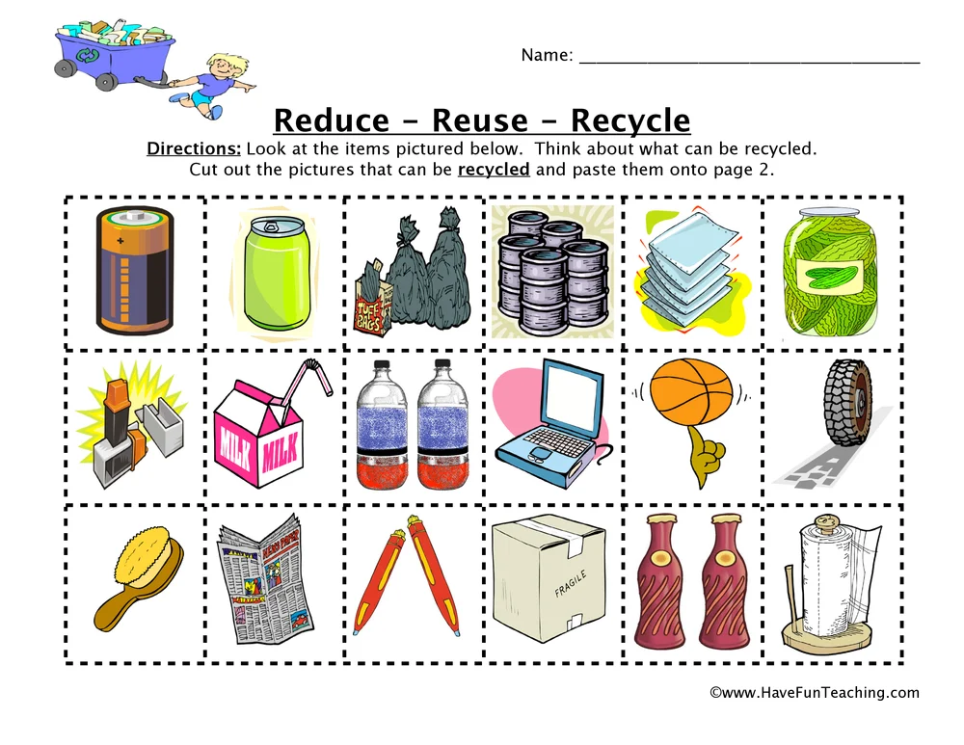

Slide 20
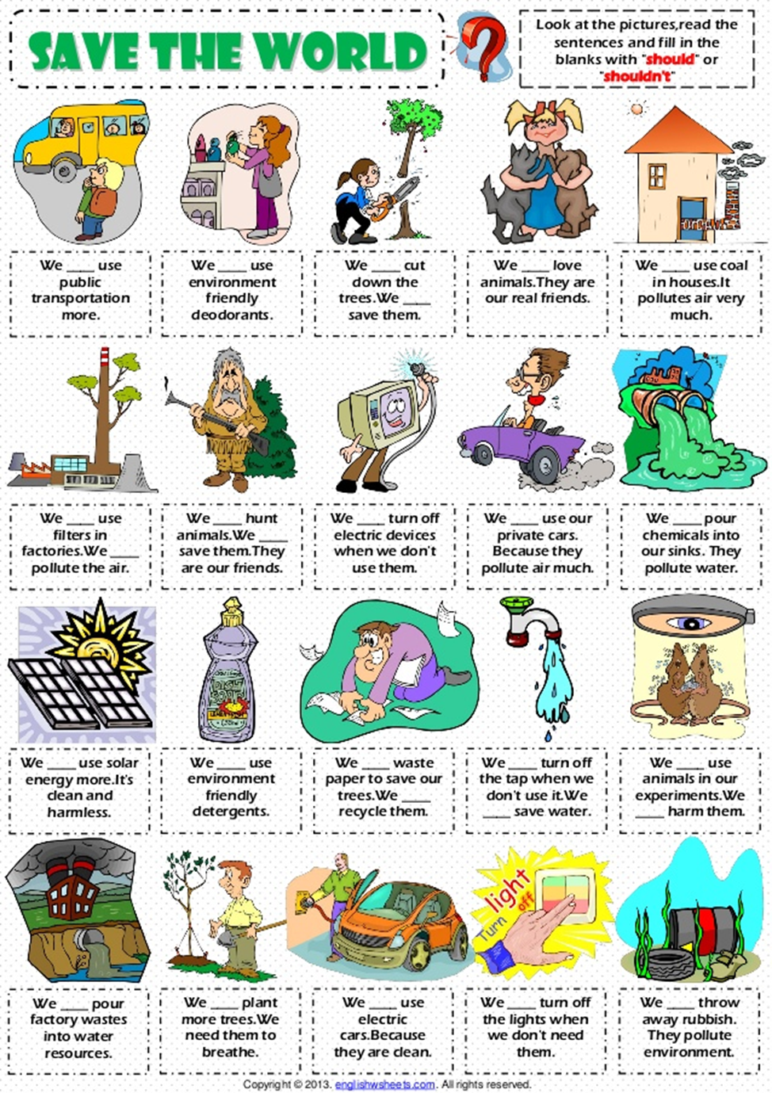
Describe the pictures and use verbs
should/shouldn’t

Slide 21
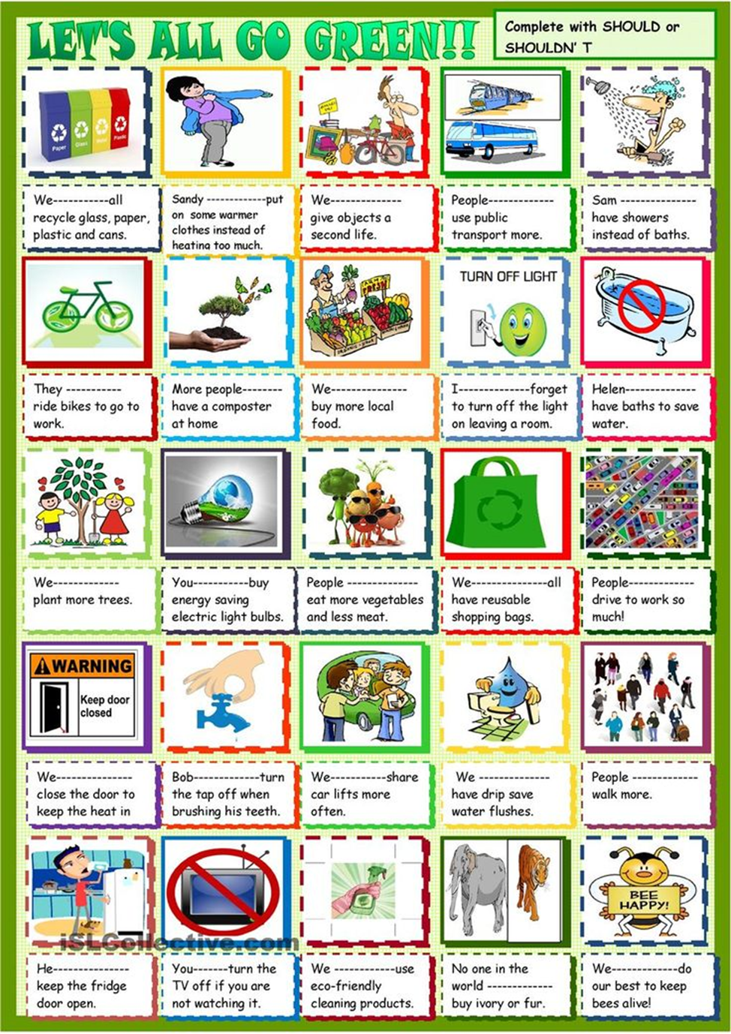
Complete with should/shouldn’t

Slide 22
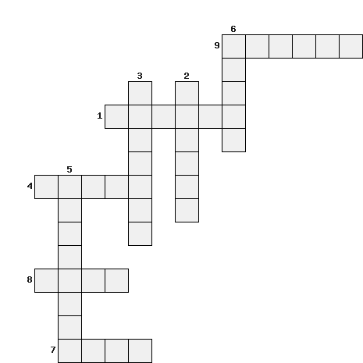
Solve a crossword puzzle. Work in groups.
9. Use smth. again.
2. A small device.
3. Sort and collect rubbish in order to produce
other things.
5. Old-fashioned.
6. Make smth. become smaller in size, amount.
1. Hard and shiny chemical elements such as iron, gold
8. damage
4. poisonous
7. drop smth.

Slide 23

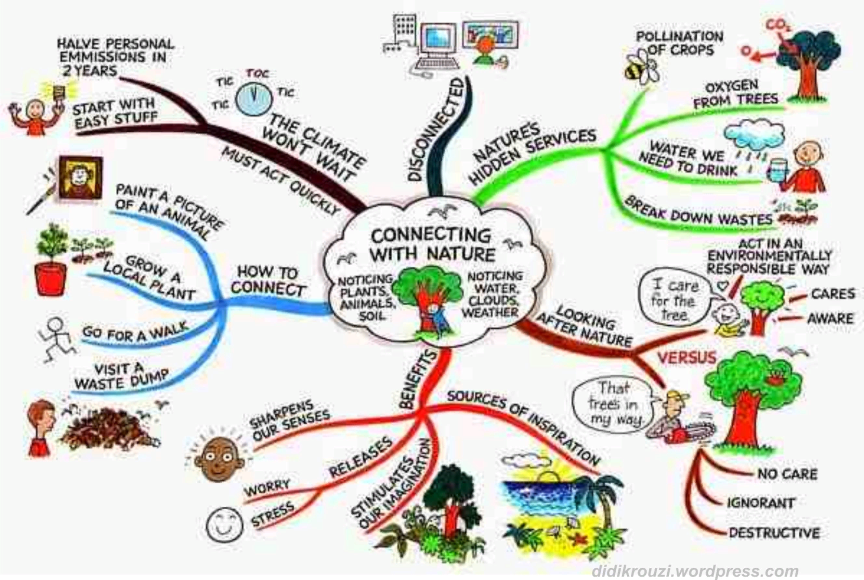
Watch the video. In groups make a poster «No more e-waste!» Write ways how can we help a planet. Present your poster.

Slide 24
Read the saying. What does it mean to you? Discuss. Write.

Slide 25
Hometask:
Make notes under the headings in the table.
* Use your notes to give a two-minute talk about e-waste.

Slide 26
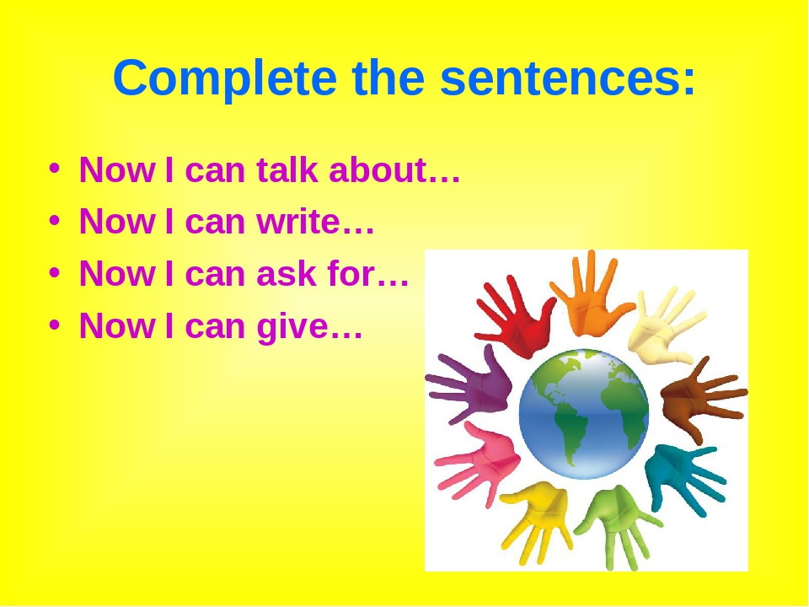


Slide 27
Thank you for attention!

