Slide 1
Irish Contest
Party for Classes 6-7

Slide 2
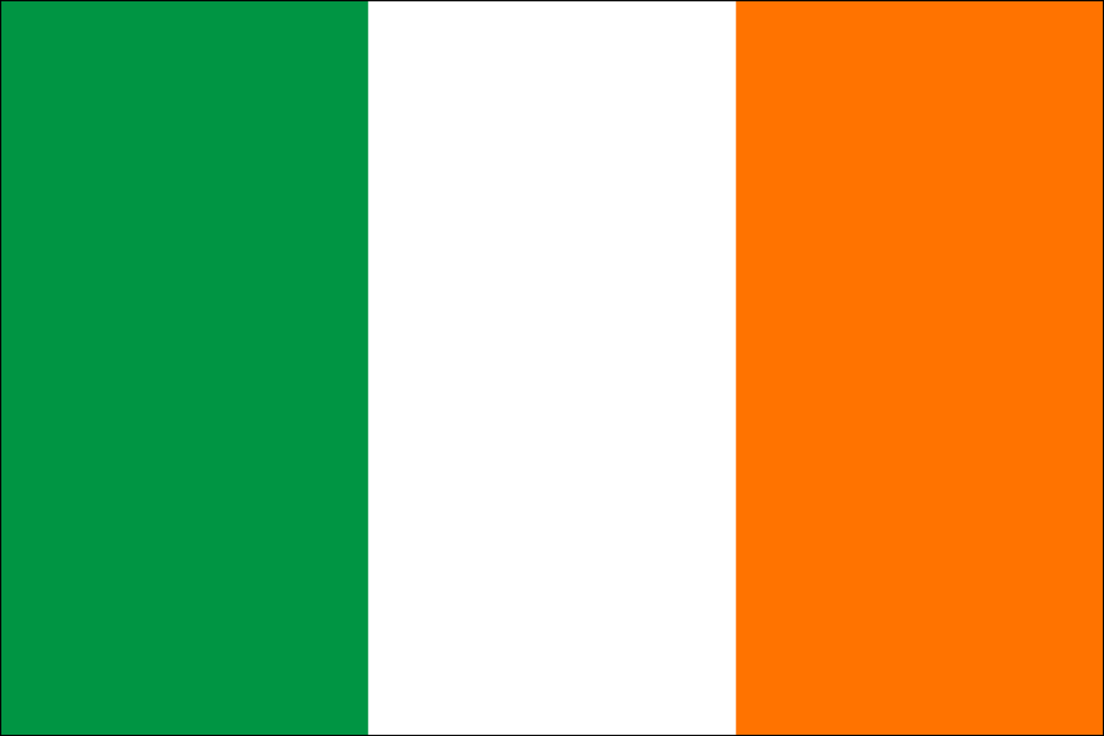

Slide 3
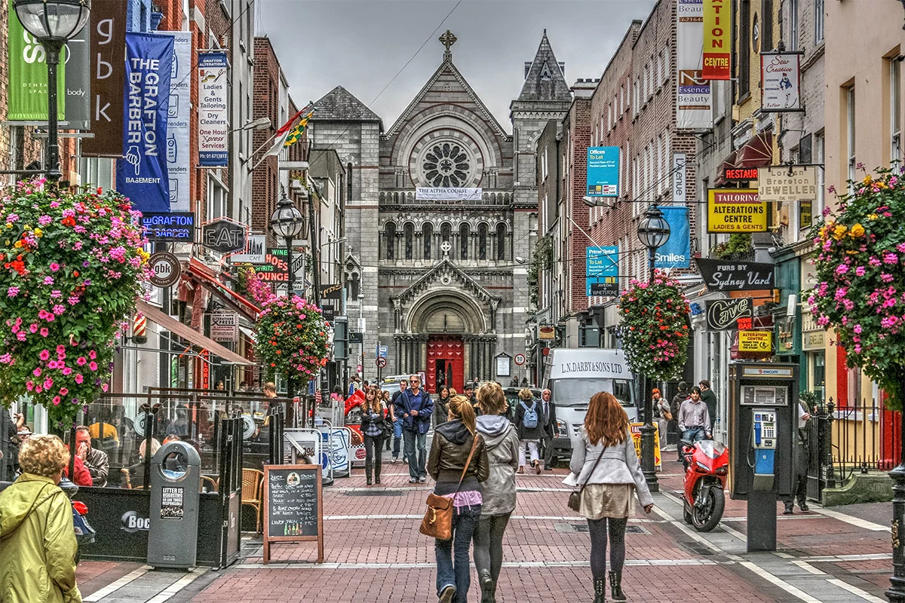
1. What is the capital of Ireland?
Cork
Dublin
Galway
Belfast

Slide 4
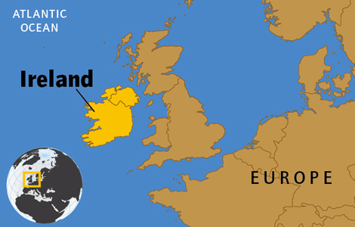
2. Which continent is Ireland located on?
Asia
Australia
Europe
Africa

Slide 5
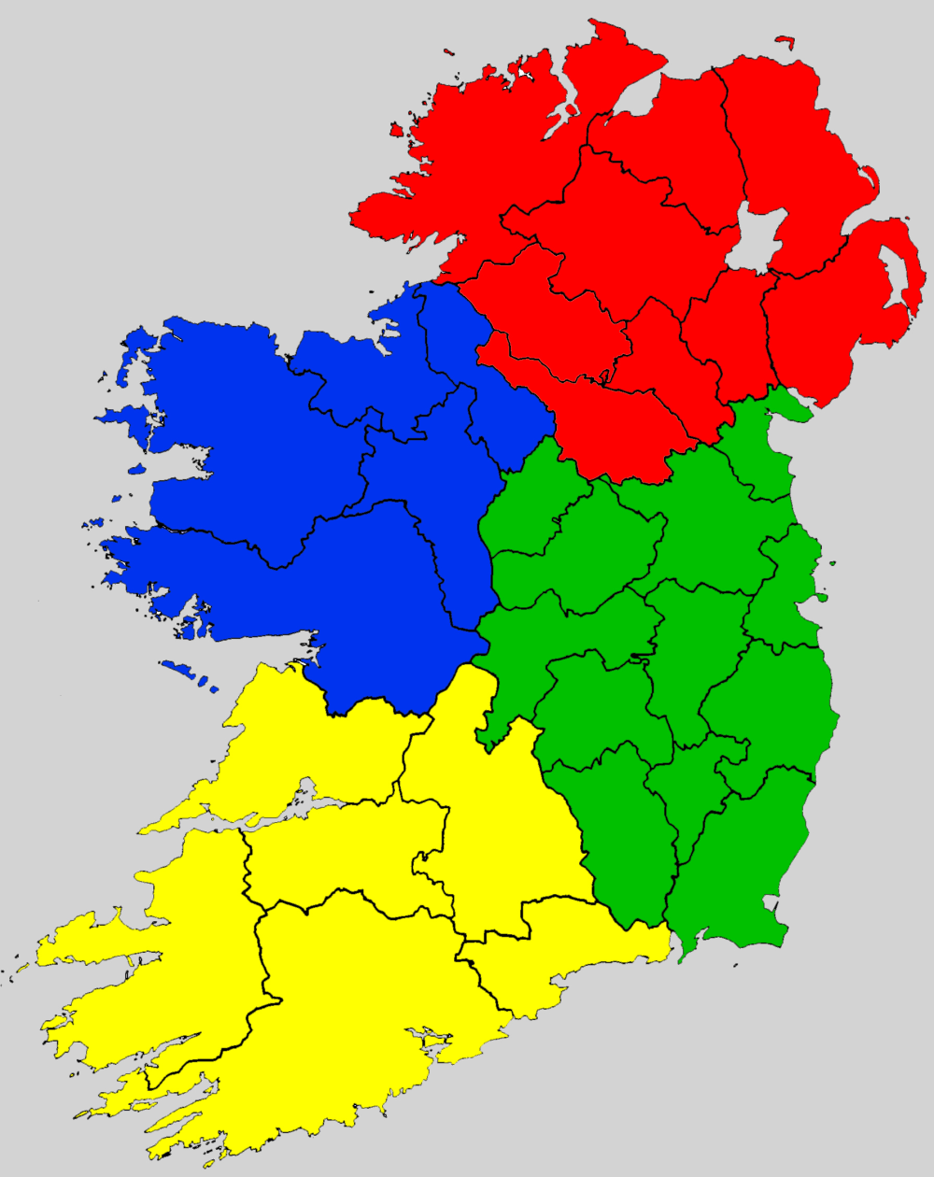
3. How many provinces are there in Ireland?
1
2
3
4

Slide 6
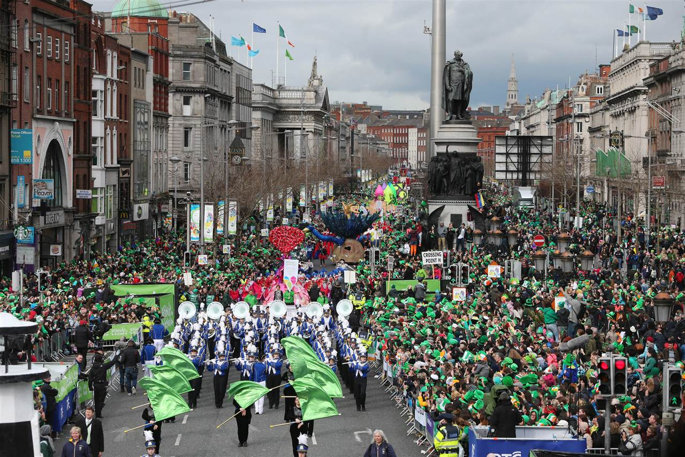
4. What is the approximate population of Ireland?
5 million
6 million
10 million
14 million

Slide 7
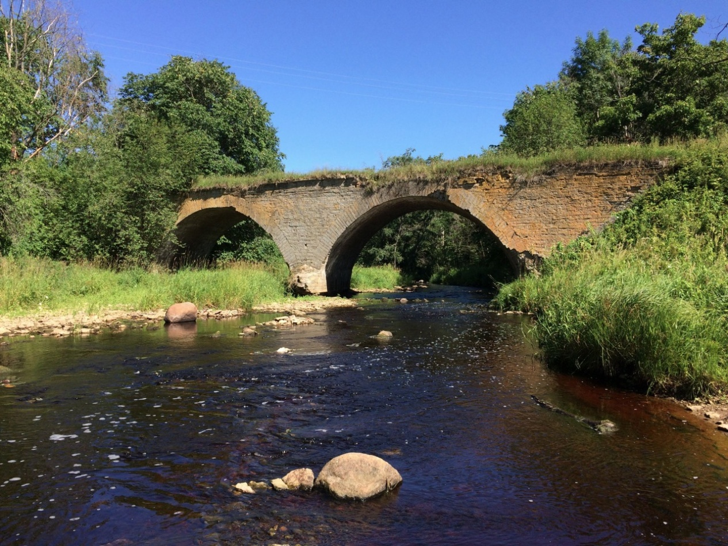
5. The longest river in Ireland is
The Liffey
The Sur
The Lee
The Shannon

Slide 8
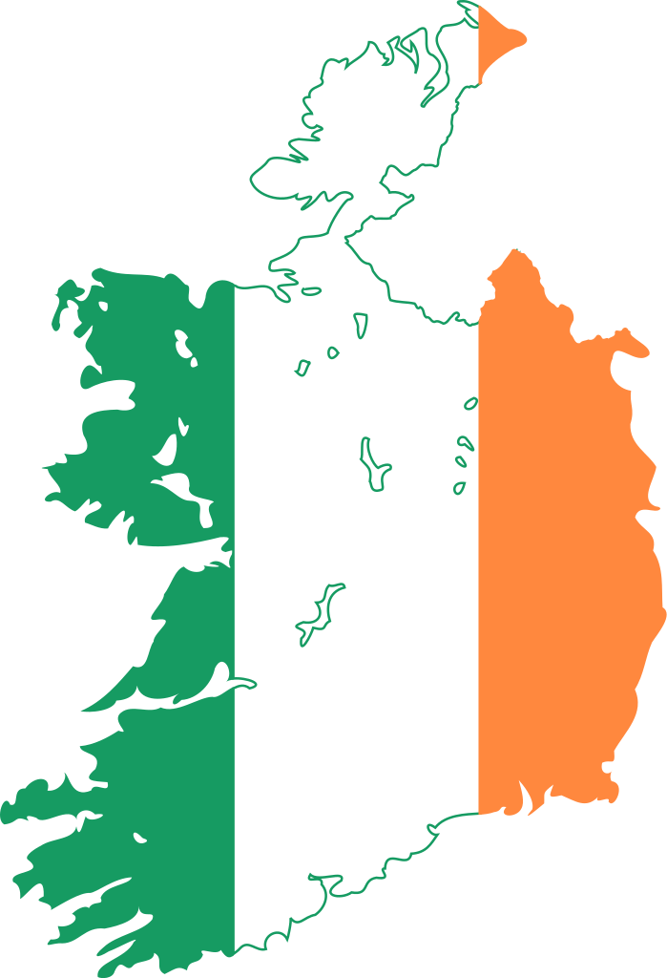
6. How many official languages does Ireland have?
1
2
3
4

Slide 9
7. Which of the following is NOT the symbol of Ireland?
The Union Jack
The harp
The four leaf clover (shamrock)
The Celtic Cross
A Leprechaun

Slide 10
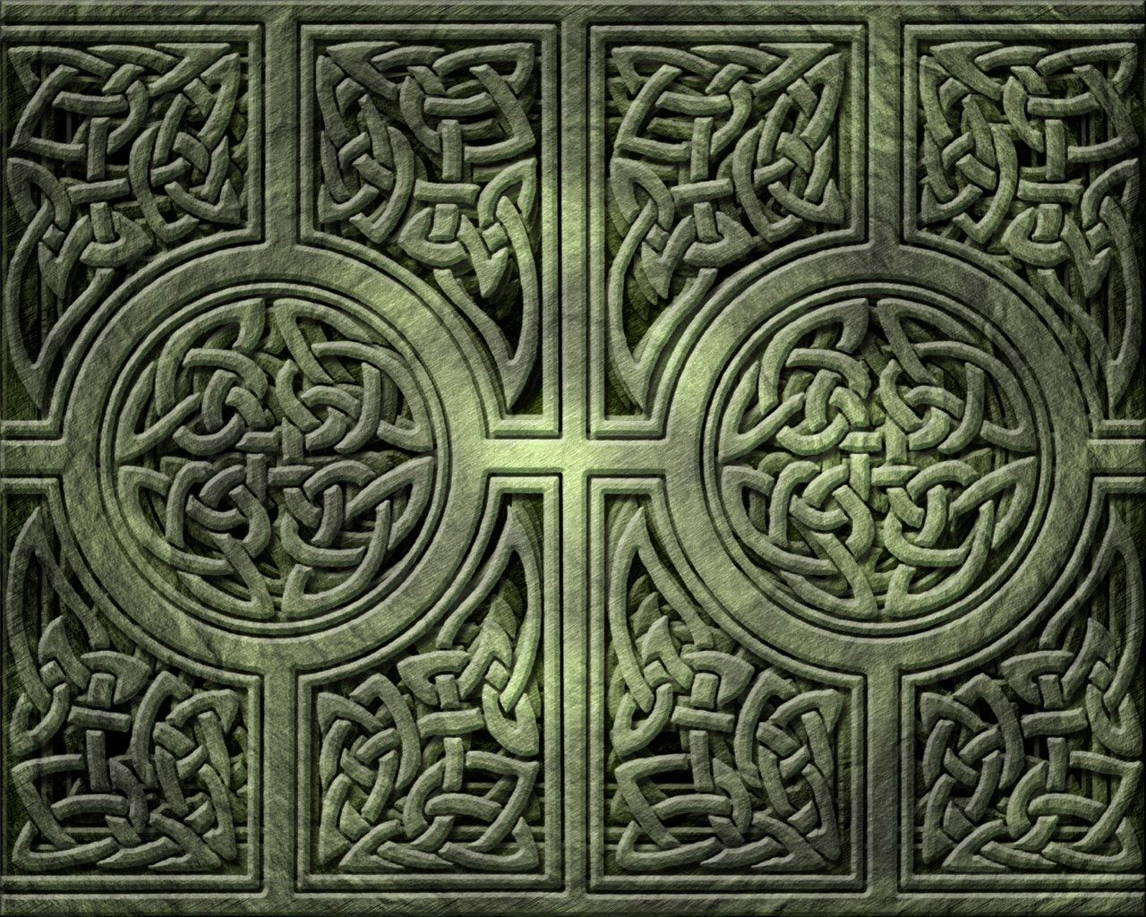
Irish patterns

Slide 11
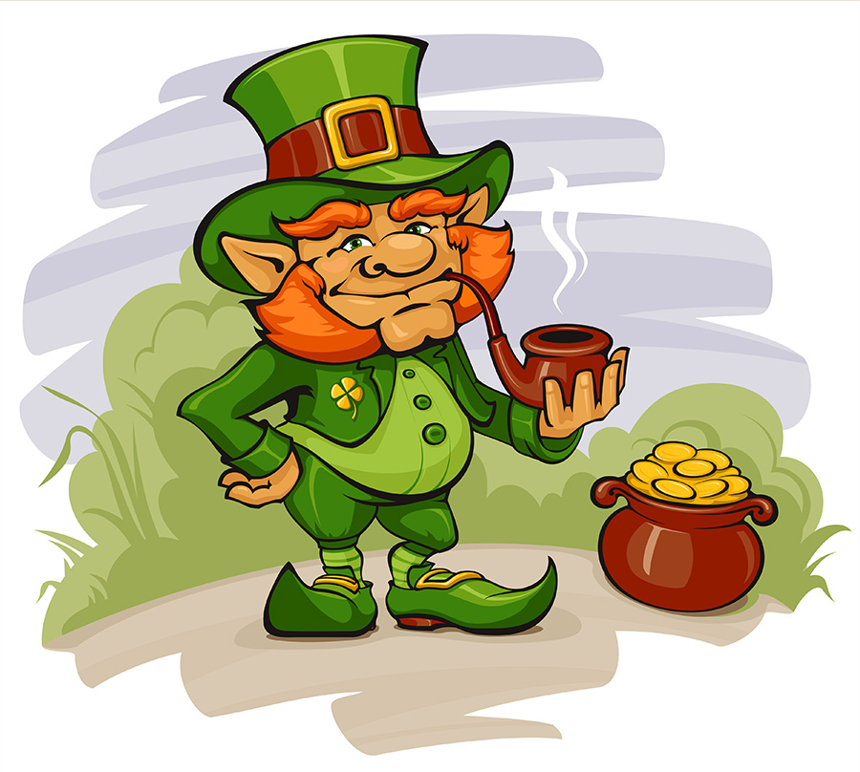
8. It is a type of fairy in Irish folklore. They are usually described as little men with a beard, wearing a green coat and a hat. These men are fond of playing jokes on people.
Elves
Dwarves
Leprechauns
Ogres

Slide 12
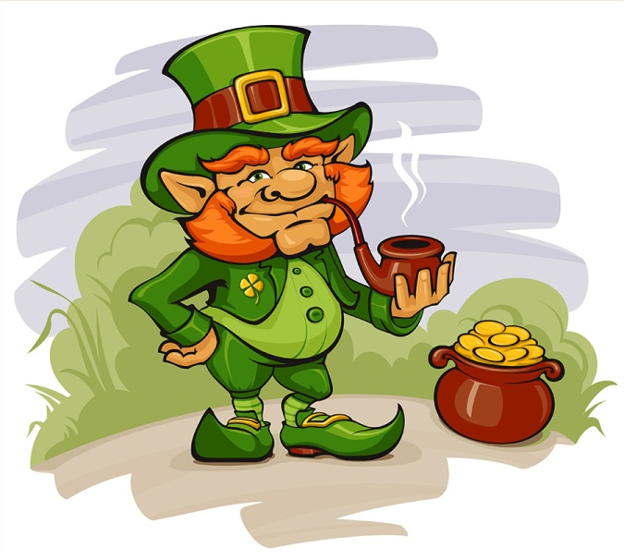
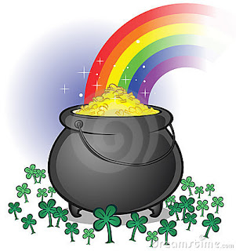
9. Where does a Leprechaun hide the pot of gold?
On a Swiss bank account
At the end of the rainbow
On the top of a hurricane
At the bottom of the ocean

Slide 13
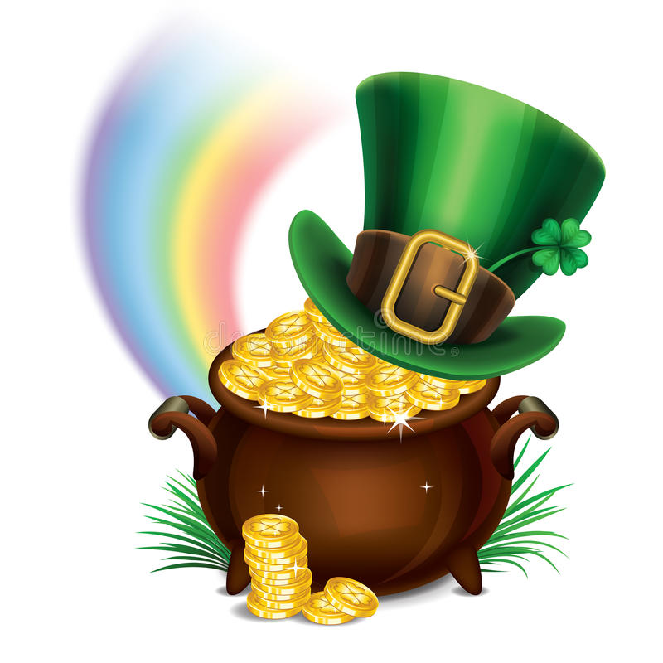
Treasure Hunt

Slide 14
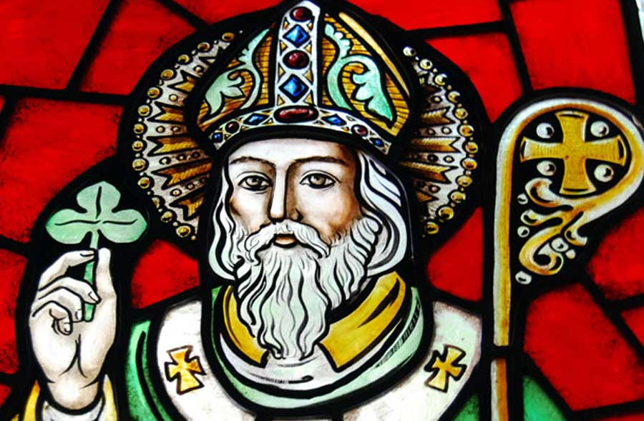
10. Who is the patron saint of Ireland?
St. Patrick
St. George
St. Francis
St. Andrew

Slide 15
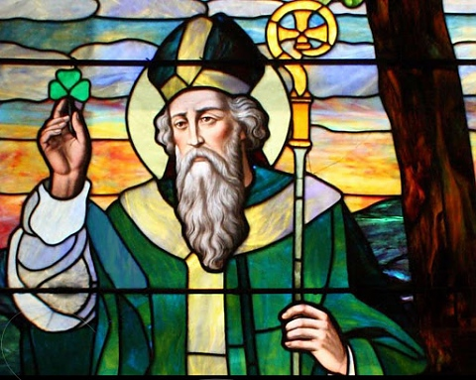
11. When did Saint Patrick live?
In the 5th century AD
In the 7th century AD
In the 9th century AD
In the 5th century BC

Slide 16
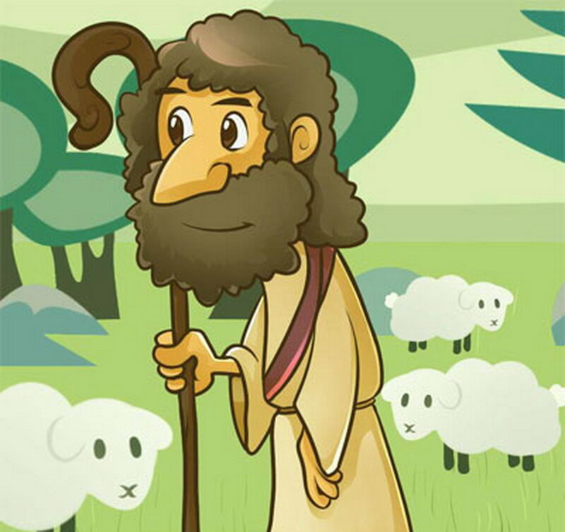
Shepherd Game

Slide 17
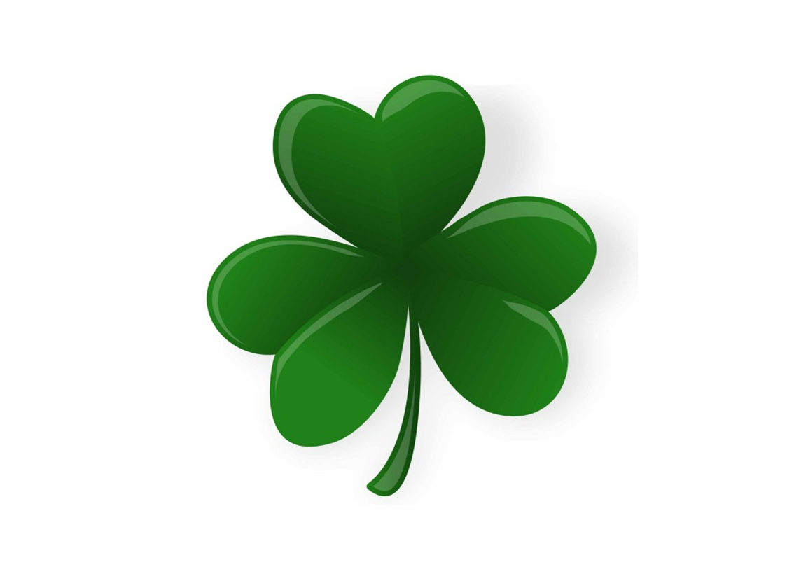
12. Which plant is an Irish symbol?
The pine tree
The oak
The thistle
The shamrock

Slide 18
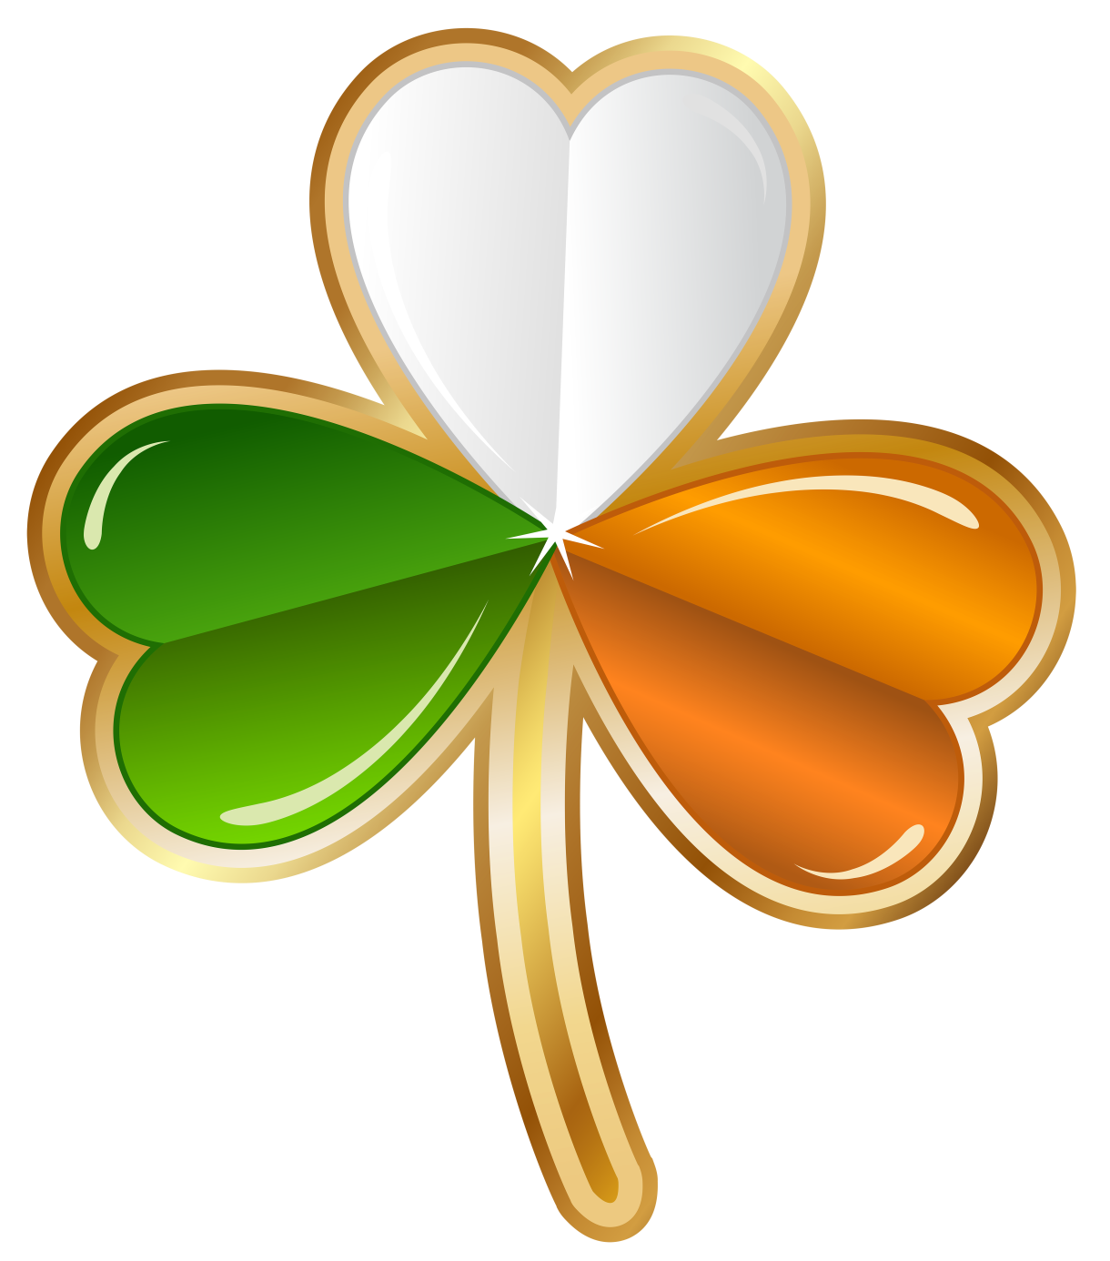

Slide 19
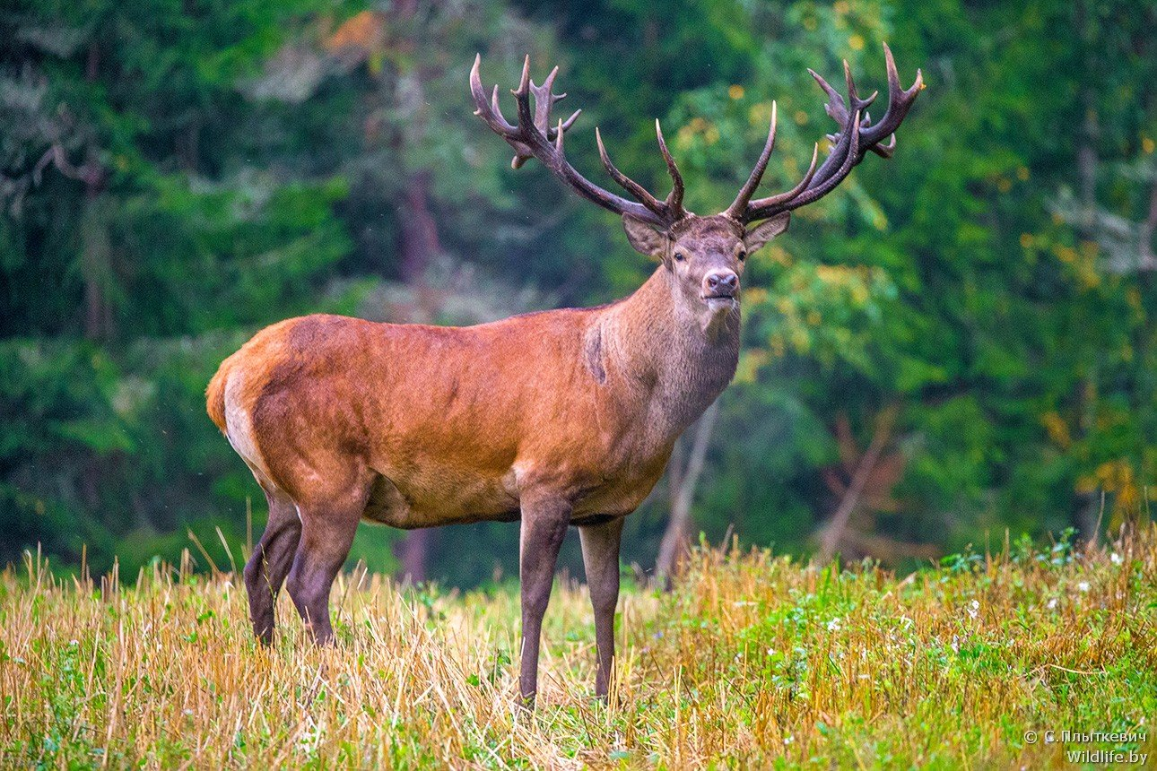
13. What is the largest wild mammal in Ireland?
Irish hare
Red fox
Red deer
Badger

Slide 20
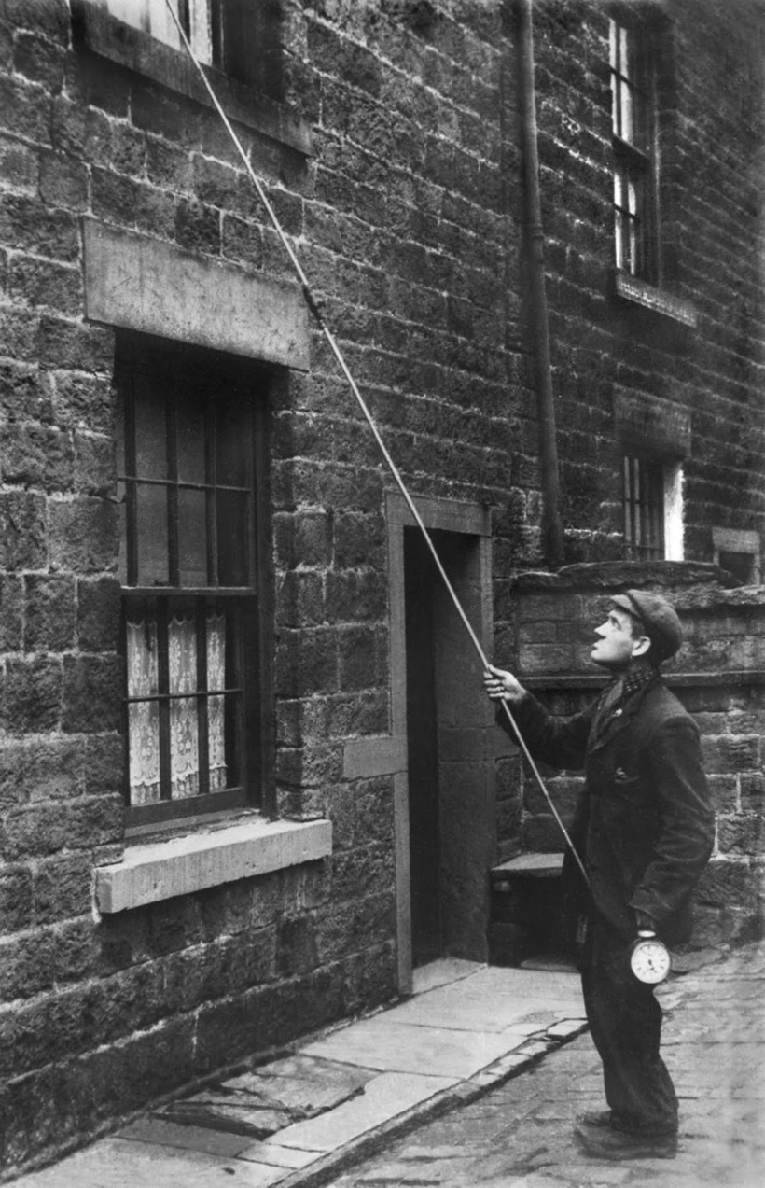
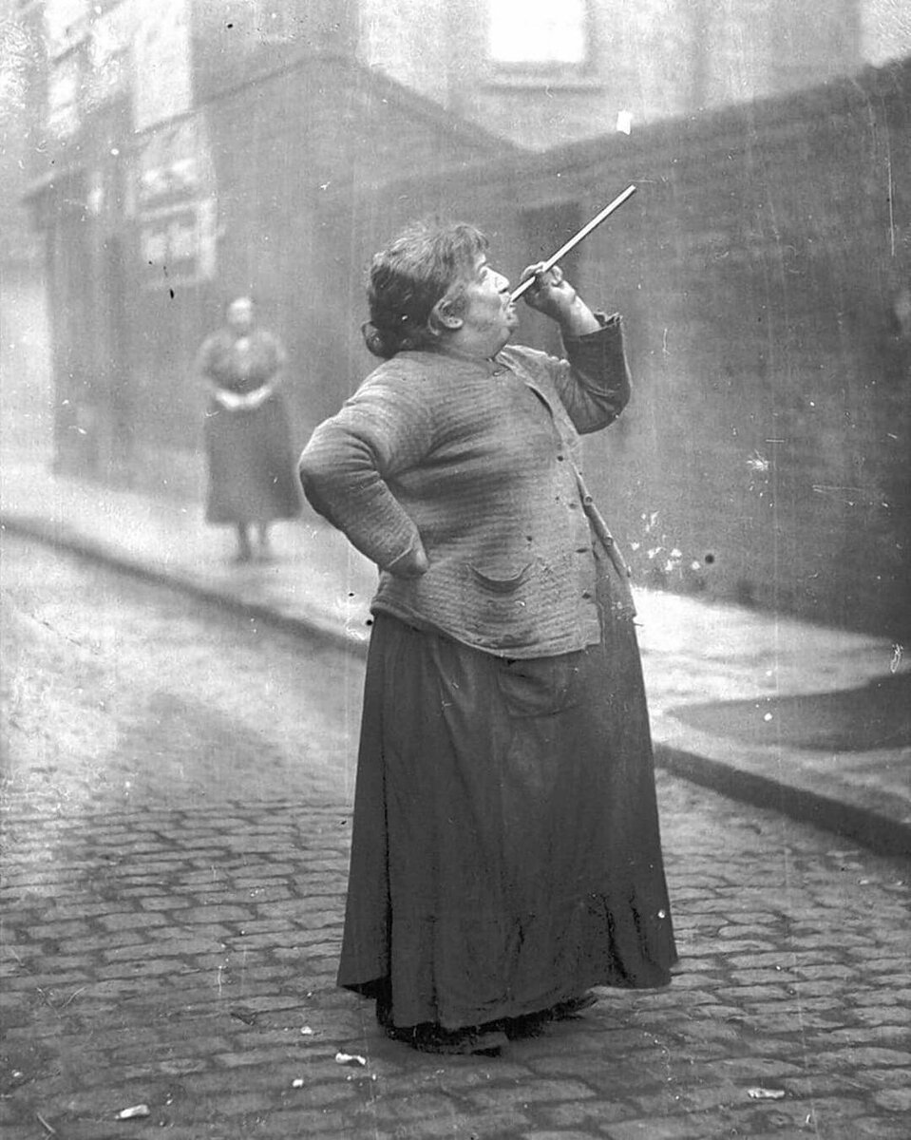
Irish alarm – clock☺

Slide 21
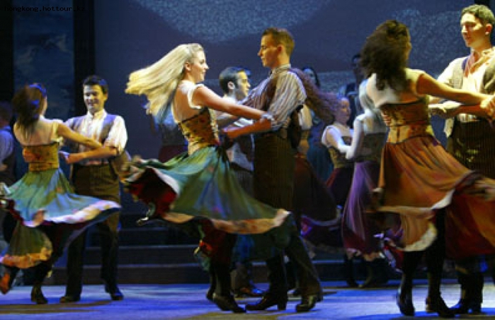
14. The most popular Irish theatrical show is
Patrice Pavis
A Country Night
Riverdance
Flashdance

Slide 22
Riverdance video

Slide 23
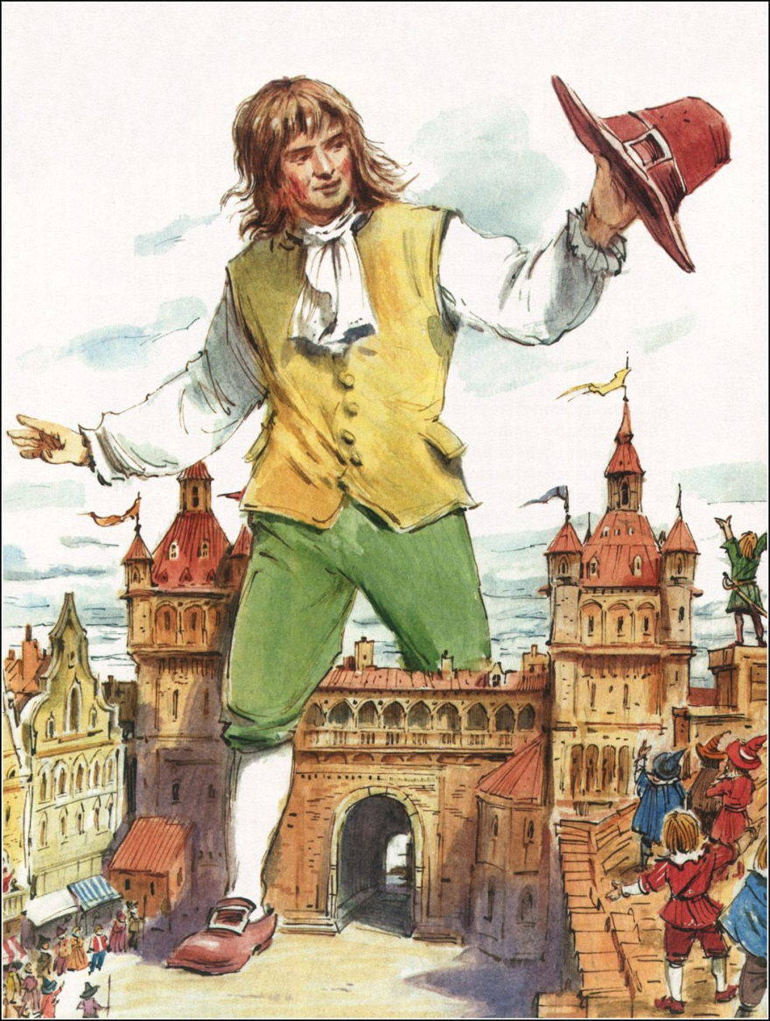
15. Who wrote “Gulliver’s Travels”?
Oscar Wilde
James Joyce
George Bernard Shaw
Jonathan Swift

Slide 24
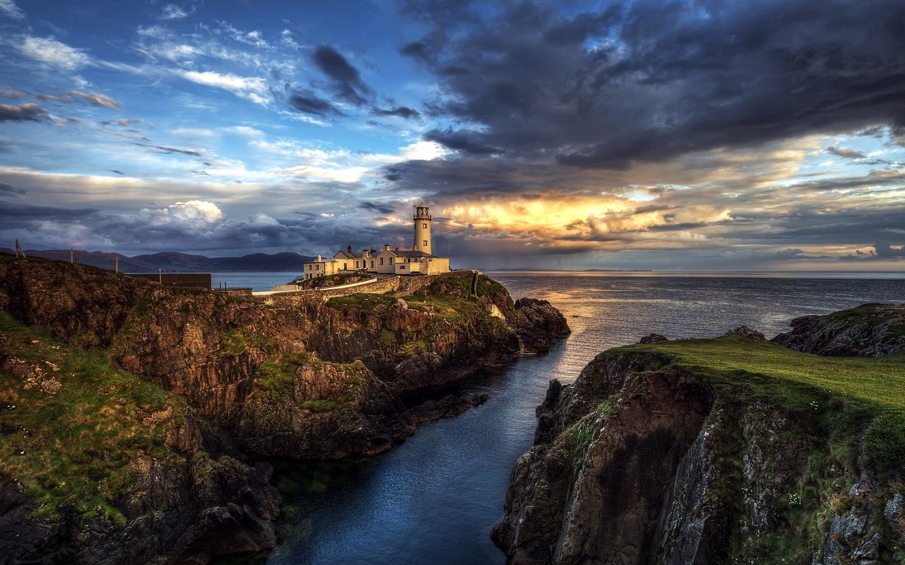

Slide 25
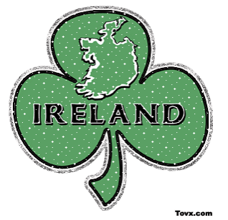

Slide 26
