Slide 1
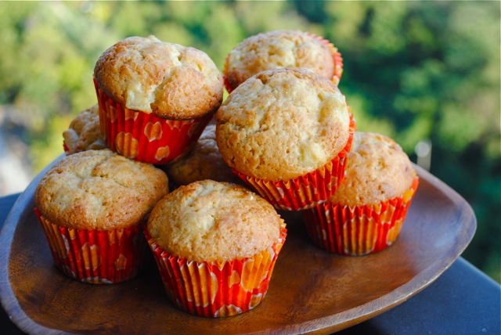
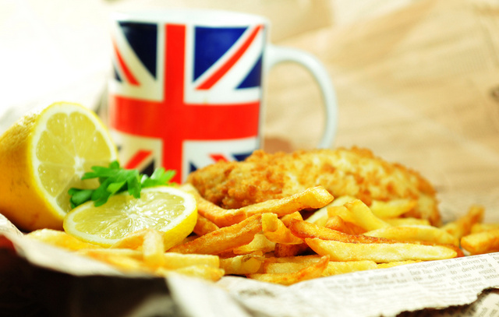
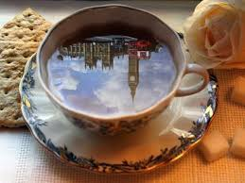
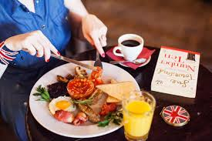
Food & Drink

Slide 2
Aim and objectives:
Review names of food and its containers
Learn new grammar and use it in speech
Read and make up a summary of the text

Slide 3
Dairy products
ice c_eam
chee_e
y_gh_rt

Slide 4
Fruit
ap_les
b_n_n_s
or_ng_s

Slide 5
Vegetables
to_atoes
on_ons
c_rr_ts

Slide 6
Meat & Poultry
b_con
sa_s_ge
ch_ck_n

Slide 7
Drinks
w_t_r
c_ffee
juic_

Slide 8
Bakery
b_scuits
c_ke
b_ead

Slide 9
Classify the names of food
Bakery:
Fruit:
Vegetables:

Slide 10
Classify the names of food
Dairy:
Meat:
Drinks:

Slide 11
Countable
bananas
sweets
potatoes
Uncountable
oil
sugar
honey

Slide 12
Group the words in the box into two groups:
Cheese, tomatoes, water, bread, apples, biscuits, juice, carrots
Countable
Uncountable

Slide 13
Containers
a jar of honey
a bar of chocolate
a cup of coffee

Slide 14
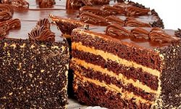
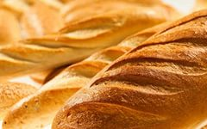
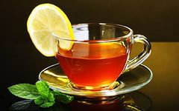
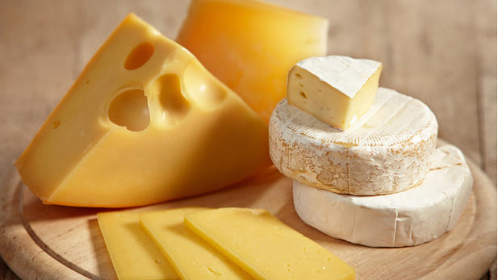
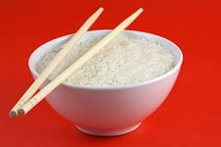
Match the pictures to the containers in the list.
A bottle of water
A piece of cake
A cup of tea
A slice of cheese
A loaf of bread
A bowl of rice

Slide 15
What’s your idea of British food ?
British food

Slide 16
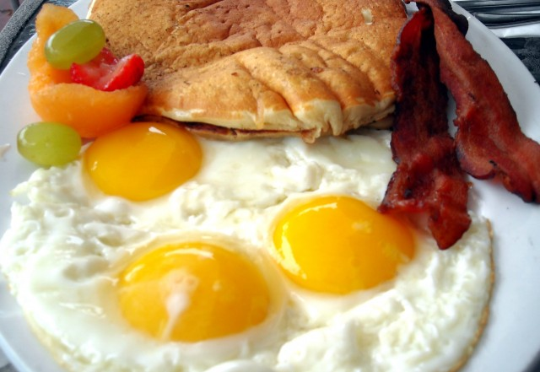
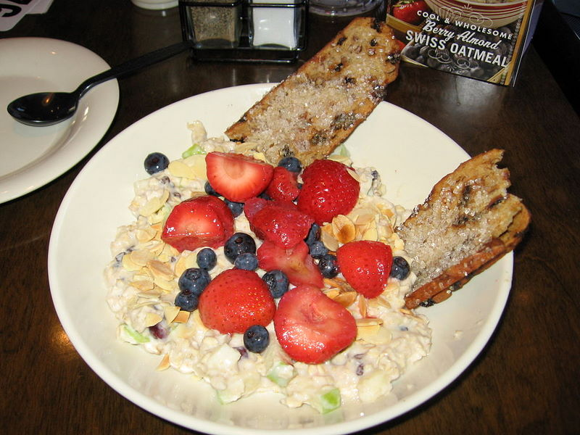
Eating the British Way

Slide 17
Key Words
Bacon and eggs – яичница с беконом
Fish and chips – рыба с жареным картофелем
Cereal – крупа
A ‘packed lunch’ – ланч с собой
Crisps – чипсы
Spaghetti bolognaise – спагетти под соусом Болонез
Shepherd’s pie – «пастуший пирог» (картофельная запеканка с мясом)
Takeaways – блюдо с доставкой на дом
Roast beef or lamb – ростбиф
Gravy - подливка
Dessert - десерт
Homemade – домашнего приготовления
Trifle – трайфл (старинный английский десерт, состоящий из бисквита со взбитыми сливками)

Slide 18
English breakfast
Most people in the UK rush to work in the morning. This means they don’t have time to make the traditional English breakfast of eggs, bacon and sausages. They may have one at the weekends though. During the week, they choose a breakfast of cereal or toast with tea, coffee or fruit juice.

Slide 19
Lunch
Many children at school and adults at work bring a ‘packed lunch’ from home. This is a sandwich, a packet of crisps, a piece of fruit and a drink.

Slide 20
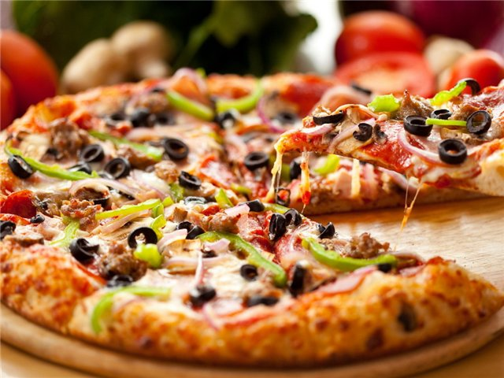
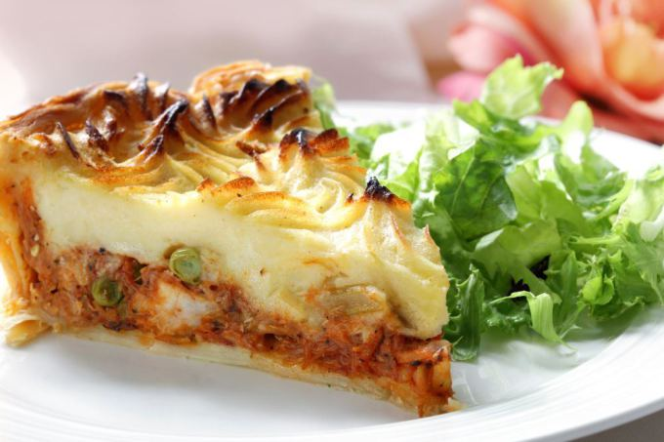
Dinner
Dinner is a meal for the whole family. Spaghetti bolognaise and shepherd’s pie are favourites. Many British order takeaways as well. Indian, Chinese food and pizzas are all very popular.

Slide 21
Sunday roast
On Sundays, the British get together for a traditional Sunday roast. This is a roast beef or lamb with potatoes, vegetables and gravy.

Slide 22
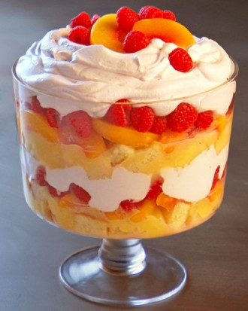
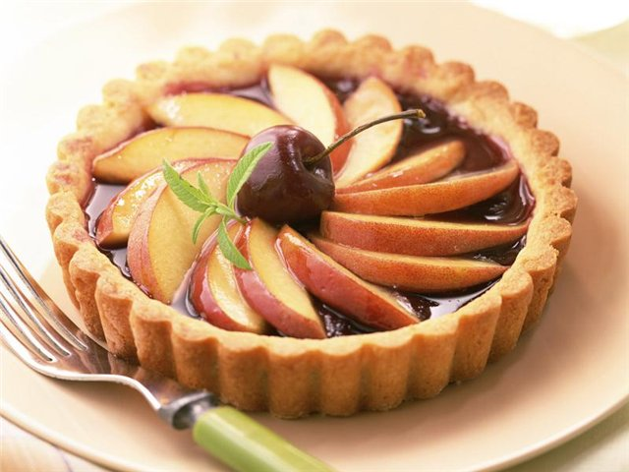
Dessert
But … is there anything for dessert? Homemade puddings like bread and butter pudding, apple pie and trifle are all delicious British desserts. Without them no meal is complete!

Slide 23
Breakfast
Lunch
British food
Dinner
Dessert
Sunday Roast

Slide 24
Hometask
WB: ex. 1,3 p. 53; learn new words Module 9a
Think of your favourite dish. What do you need to make it? Make a shopping list.

Slide 25
Reflect your emotions after the lesson: 1. I like it. It was great. 2. I haven’t understood something. It was difficult for me. 3. I don’t like it. It was boring.

