Slide 1
РЯЗАНСКИЙ СТРОИТЕЛЬНЫЙ КОЛЛЕДЖ имени Героя Советского Союза В. А. Беглова «Стили интерьера»
Подготовила преподаватель иностранного языка
Кирюхина Т.А.

Slide 2
Key Words
Interior- интерьер
Luxury - роскошь
Period- период
Decor-декор
Furniture- мебель
Era- эпоха
The effect of something - эффект чего-либо
Finishing- отделка
luxury and wealth – роскошь и богатство
Functionality - функциональность
distinctive features – отличительные черты
decor items – элементы декора

Slide 3
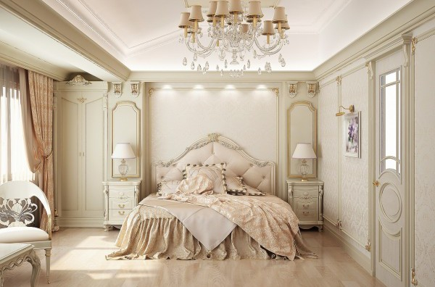
Classical style
Classic interior style is a direction that combines sophistication, luxury and symmetry.

Slide 4
Classic interior style is a direction that combines sophistication, luxury and symmetry.

Slide 5
a classic interior is not complete without luxurious decor, such as paintings in gold frames, figurines, vases and mirrors.

Slide 6
This style is ideal for decorating spacious rooms with high ceilings and large windows.

Slide 7
Medieval Style
Medieval style in the interior is a style that is characterized by the use of natural materials, an emphasis on simplicity and functionality.

Slide 8
Medieval interior design is characterized by the use of natural materials such as wood, stone and leather, and an emphasis on simplicity and functionality.

Slide 9
This style often uses rough fabrics for furniture and wall upholstery, as well as metal elements for decoration.

Slide 10
The color palette typically includes dark tones such as brown, black and grey, with accents of red and gold.

Slide 11
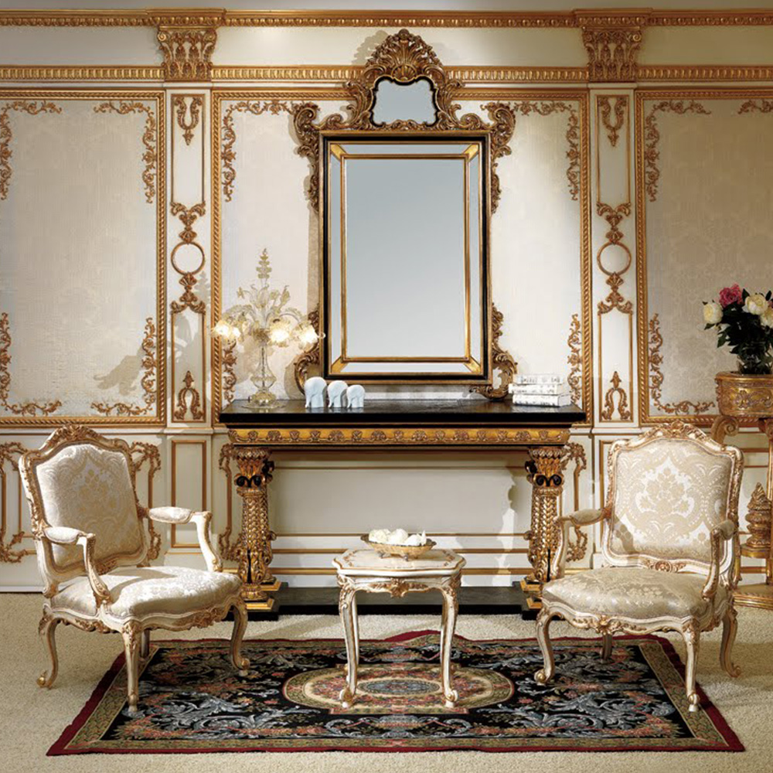
Baroque
Baroque is a style of art and architecture that originated in Italy at the end of the 16th century and spread throughout Europe.

Slide 12
It is characterized by pomp, theatricality and dynamic forms.

Slide 13
Baroque interiors are dominated by rich and vibrant colors such as gold, red and blue.

Slide 14
Furniture and decor are often decorated with carvings, stucco and inlays made of precious metals and stones.

Slide 15
Romanticism
Romanticism is a style of art and literature that emerged in Europe in the late 18th and early 19th centuries.

Slide 16
The interior of romanticism is dominated by soft and delicate colors such as pink, blue and green.

Slide 17
Furniture and decor are usually made from natural materials such as wood and textiles.

Slide 18
Romantic interiors are often decorated with paintings of nature, as well as candles and flowers.

Slide 19
Modernism
Modernism is a style of architecture and art that emerged in Europe and the United States at the beginning of the 20th century.

Slide 20
Interiors in the modernist style are dominated by straight lines and geometric shapes, as well as neutral colors and materials. The furniture and decor are simple and functional, with an emphasis on minimalism.

Slide 21
The decor in the modernist style is minimalist and functional. The paintings are often abstract or geometric, while the vases and figurines are simple and modern.

Slide 22
Conclusion
We can draw the conclusion that all styles have their own peculiarities and may be adjusted to the particular space, purpose and the customer

Slide 23
Match the style and the description
Classical style | lines and geometric shapes, as well as neutral colors and materials.
Medieval Style | combines sophistication, luxury and symmetry.
Baroque | decorated with paintings of nature, as well as candles and flowers.
Romanticism | dark tones such as brown, black and grey, with accents of red and gold.
Modernism | pomp, theatricality and dynamic forms.

Slide 24
Guess the style by the picture
Classical style

Slide 25
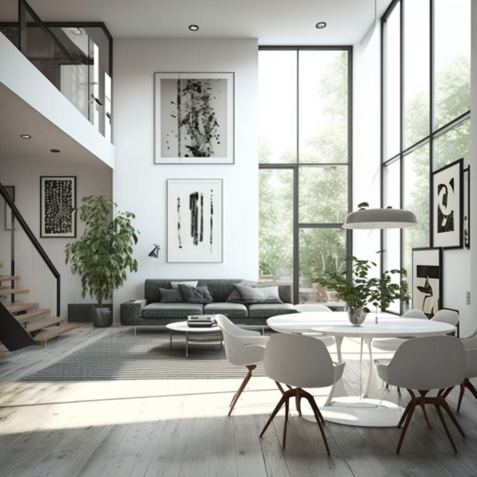
Guess the style by the picture
Modern style

Slide 26
Guess the style by the picture
Medieval style

Slide 27
Guess the style by the picture
Baroque

Slide 28
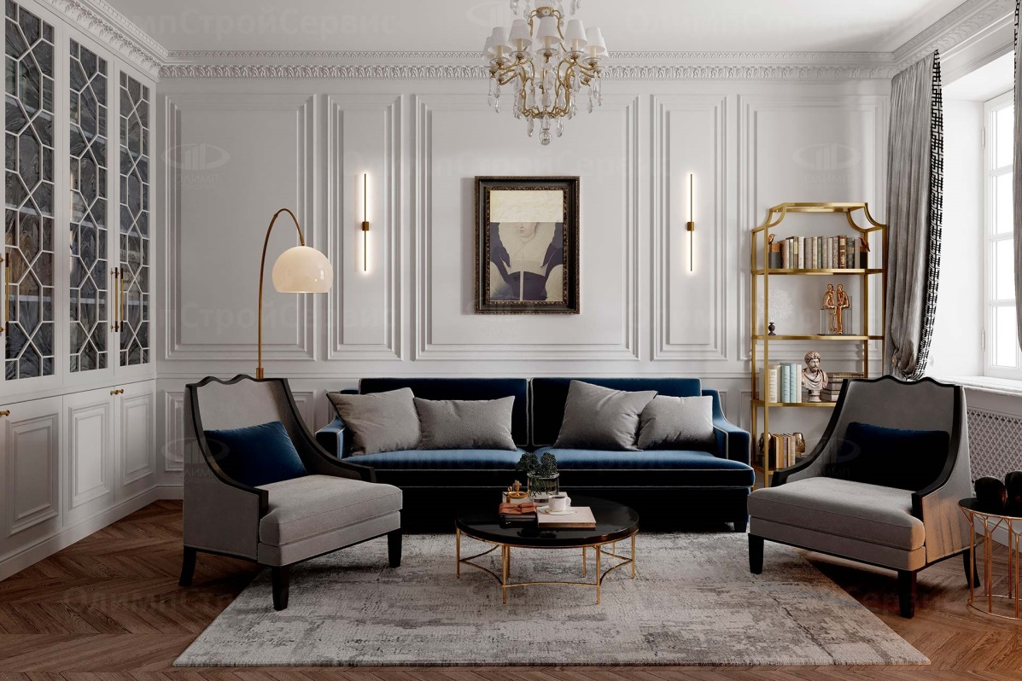
Guess the style by the picture
Modern style

Slide 29
Guess the style by the picture
Modern style

Slide 30
Guess the style by the picture
Romantic style

