Slide 1
Vitamins

Slide 2
People need vitamins to stay healthy.
“Vita” –
means life in Latin.

Slide 3
People get vitamins from the food they eat.
There are a lot of vitamins in fruit and vegetables.

Slide 4
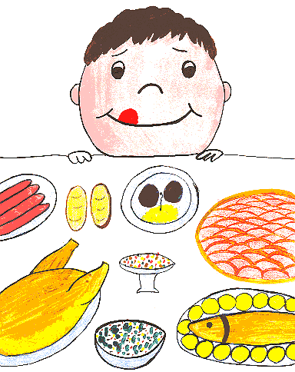
But you can hardly find any useful vitamins in Coke, chips and other fast food.

Slide 5
Each vitamin is responsible for different things in the human body. There are about ten major vitamins. They are usually named by a letter of the alphabet (A, B, C, D, etc.)

Slide 6
Vitamin A is in green and yellow vegetables, milk and eggs.
It`s necessary for seeing in the dark.

Slide 7
Vitamin B1 is in meat, porridge and bread.
B1 is responsible for the nervous system. Lack of this vitamin leads to serious illnesses and even death.

Slide 8
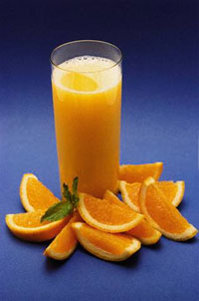
Vitamin C is in every fruit and vegetable.
Vitamin C is important for building bones and teeth. It helps to prevent colds.

Slide 9
Vitamin D is in eggs.
People can also get it from sunlight.
It makes our bones strong.

Slide 10
Vitamins make people healthy,
optimistic and strong.

Slide 11
THANK YOU!

