Slide 1
Schools in England
Грязнова Валентина Сергеевна,
учитель английского языка
МБОУ «Лицей №1»
п.Тюльган Оренбургской области
2011

Slide 2
Read and translate the text
Schools in England
is free and compulsory
for all children.
At the age of 5 children
go to primary school.
Boys and girls study
together. When children
are 11.
Primary school is
over. From 12 to 16
Children go to
secondary school.
Students go to school
From Monday to Friday
and have classes from
08.55 till 15.15

Slide 3
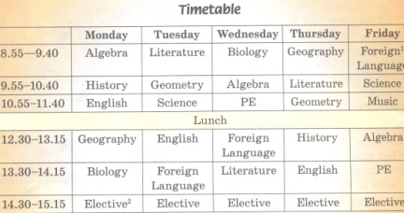

Slide 4
1
t
h
r
e
e
ответ
s
i
x
2
ответ
f
i
v
e
3
ответ
How many terms are there in a school year?
How many days do they go to school?
How many times are there the main school holidays?

Slide 5
Match the pairs
primary
перемена
secondary
бесплатная
free
средняя
compulsary
начальная
term
обязательная
break
четверть

Slide 6
Complete the sentences
1. Mary is 9, she goes to the
primary school
?
2. George is 15, he goes to the
?
secondary school
3. In most schools children wear
?
school uniform
4. Teachers at primary schools are always called by
their
?
surname, Mr, Mrs or Miss.
5. At secondary schools teachers are always called
?
Miss or Sir

Slide 7
Usefull Phrases
to be over
to take exams
twice a week
Дважды в неделю
заканчиваться
сдавать экзамены
three times a week
три раза в неделю
интересоваться
to be interested in
Well Done!

Slide 8
Schools in the USA
Презентация

Slide 9
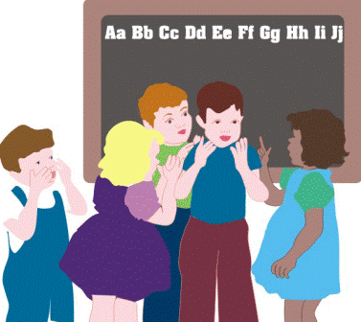
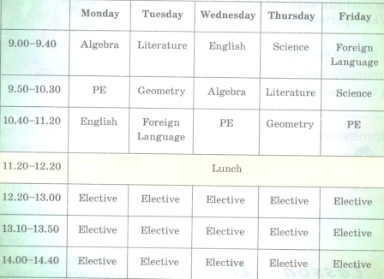
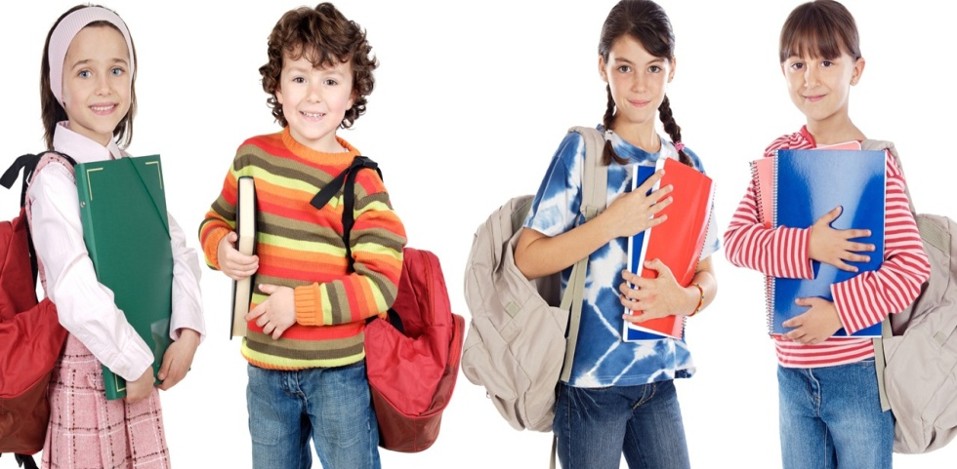
Сlassrooms are large and
Every student has his or her own table and chair.
There are special computer classrooms for different lessons.
School is free and compulsory for all children. Children go to school when they are 7 and finish when they are 19. Students study 6 years in elementary school. They study 2 years in middle school and 4 years in high school.
A school year has 2 terms. After every term students have to take exams. They can get A, B, C, d or F grade. The best students get A, good students have B, and students, who don’t study well, have C. If a student gets D or F, he will study a year again.
There are 30 to 38 students in one class. Uniform is not worn at school. But some schools have their own dress code
Timetable
Do you like English?

Slide 10
1
What do some schools have?
ответ
2
ответ
ответ
3
ответ
4
s
t
u
d
e
n
t
s
ответ
5
a
r
t
ответ
e
l
e
m
e
n
t
a
r
y
ответ
6
c
o
m
p
u
l
s
a
r
y
ответ
7
ответ
t
e
r
m
s
8
s
c
h
o
o
l
9
t
w
o
g
r
a
d
e
e
x
a
m
s
In what school do children study 6 years?
Children who go to American school are called …
A school year has 2 … …
When children like Music and Painting they can choose …
They study … years in middle school
After every term students have to take…
School in the USA is free and …
They can get A, B, C, D or F …
They study six years in high …

Slide 11
Schools in Australia

Slide 12
Hi! My name is Krosh.
I’ve got a pen-friend in Australia.
Her name is Susan.
She has sent me a letter.
But I don’t know English well.
Help me to read it, please

Slide 13
Hello, Krosh!
How are you? I’m fine. I’m at secondary school now.
We have a lot of new subjects: History, Geography,
Biology and two foreign languages.
The fourth term has just begun. Remember that a school year in Australia begins in the end of January and
finishes in December.
I’m looking forward to my summer holidays, they are the
longest school holidays. We don’t go to school for some weeks. We also have small breaks between terms: usually 10 or 14 days in April, July and September.
I have six lessons a day. They are given from Monday to
Friday. Usually the school day begins at 8.45am and ends at 3pm. There are breaks for lunch between lessons. We have lots of different school clubs. My parents have bought me a great bicycle! Now I go to school by bike.

Slide 14
Bicycles are very popular in Australia. Lots of students use them. For those who live far from school there are special school buses, they bring children to school.
All students wear school uniform. The colour of the
uniform is chosen by the school.
See you!
Susan
P.S.
Do you now this animal?

Slide 15
Now, do my tasks! Choose the right ending
In Australia all students
wear the same uniform
wear different uniform
c) don’t wear school uniform
The longest school holidays are
In April and May
in December and January
In July and August
A school year in Australia has
two terms
six terms
four terms
A school year in Australia begins
In September
In January
In May
Students go to school
by bus
by bicycle
on foot
Thank you!
Thanks!
wear different school uniform
Well!
in December and
January
You are right!
by bike and by bus
Great!
four terms
OK!
in January

Slide 16
Информационные источники
Schools in England
http://img1.liveinternet.ru/images/attach/c/2/66/618/66618578_0a0bca85fa0503857927ec08f958fb80.jpg - 1 слайд картинка
http://funforkids.ru/pictures/school2/school0243.gif - 1 слайд доска
http://funforkids.ru/pictures/school2/school0246.gif - 2 слайд доска
http://funforkids.ru/pictures/school4/school0451.gif - книга
http://www.edu54.ru/node/55471 - cмайлик
http://gif2000.narod.ru/collection_birds.htm - уточка
http://gif.vukogurt.ru/images/lica/67.gif - смайл думает

Slide 17
Schools in America
Информационные источники
http://funforkids.ru/pictures/school17/school1702.gif - 1 слайд
http://funforkids.ru/pictures/school25/school2540.jpg - 1 слайд
http://funforkids.ru/pictures/school23/school2360.gif - 2 слайд http://funforkids.ru/pictures/school25/school2543.jpg - 2слайд
http://funforkids.ru/pictures/school25/school2521.jpg - 2 слайд
http://funforkids.ru/pictures/school25/school2534.jpg - 2 слайд http://funforkids.ru/pictures/school23/school2359.gif - 2 слайд http://funforkids.ru/pictures/school21/school2128.gif - 2 cлайд http://funforkids.ru/pictures/school21/school2138.gif - 2 слайд http://funforkids.ru/pictures/school25/school2516.jpg - 2 слайд http://funforkids.ru/pictures/school25/school2511.jpg - 2 слайд http://allforchildren.ru/pictures/school3_s/school0301.jpg - 2 cлайд
http://best-animation.ru/lanim/smiles/lubov/2.gif - 3 слайд смайлик
http://best-animation.ru/lanim/smiles/animals/9.gif -
-

Slide 18
Использованные источники
Schools in Australia
http://allforchildren.ru/pictures/school23_s/school2314.jpg - рисунок 1 слайда
http://teacherdo.ru/moodle/file.php/151/flag/flag_files/australian_flag.jpg - флаг
http://www.liveinternet.ru/users/4094208/post152451784/ - 2 слайд, макет письма
http://animated-images.su/_ph/21/2/189224884.gif - 2 слайд, картинка Кроша
http://www.study-abroad-australia.com/uploads/pics/Whoof_297_01.jpg - картинка 4 слайда

