Slide 1
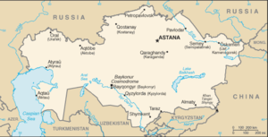
Kazakhstan is the first neighbor country of Russia

Slide 2
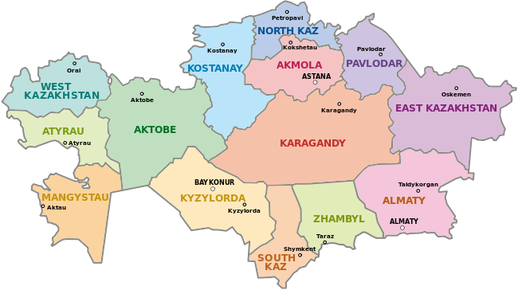
Kazakhstan is divided into 14 regions

Slide 3
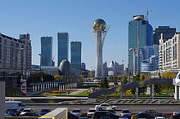
Astana is the capital of Kazakhstan

Slide 4
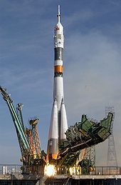
Baikonur Cosmodrome

Slide 5
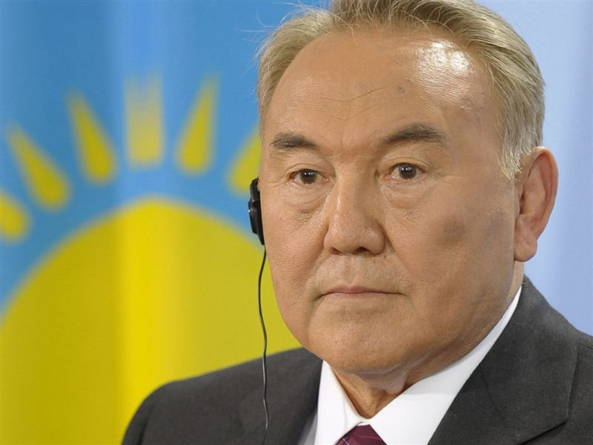
Nursultan Nazarbaev

Slide 6
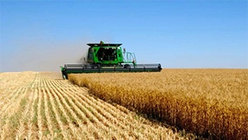
Wheat is a major source of hard currency.

Slide 7
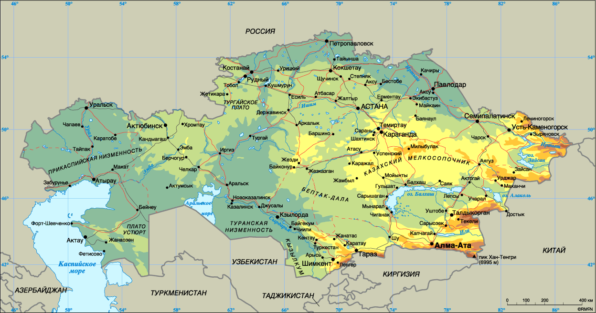

Slide 8
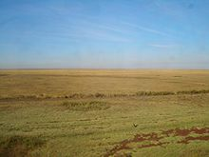
Kazakhstan’s steppe(plain)

Slide 9
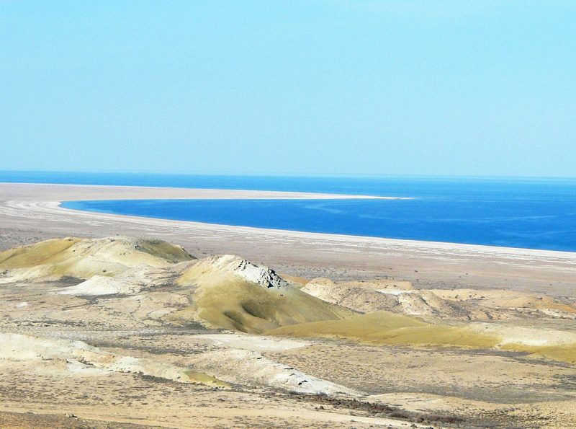
Aral Sea

Slide 10
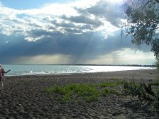
The biggest lake is Lake Balkhash

Slide 11
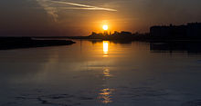
The longest river is Syr Darya

Slide 12
1 | Almaty | 1,507,737
2 | Astana | 825,401
3 | Shymkent | 683,273
4 | Karaganda | 484,855
5 | Aktobe | 427,719
6 | Taraz | 351,476
7 | Pavlodar | 350,998
8 | Oskemen | 344,421
9 | Semey | 312,136
10 | Oral | 278,096

