Slide 1
Финляндия
Рыбак Мария
Аверин Георгий

Slide 2
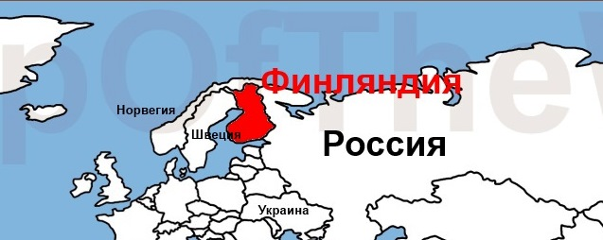
Finland borders Russia. Finland is washed by the Baltic Sea.

Slide 3
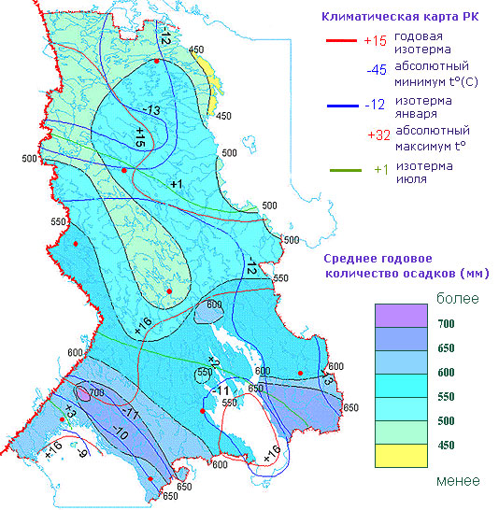
The climate of Finland is rather cold. From -45 to +32

Slide 4
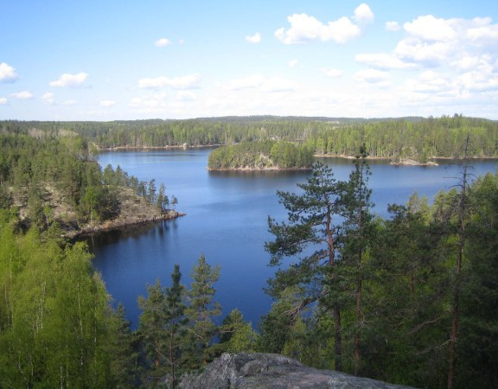
Finland is a country of thousands of lakes and islands.

Slide 5
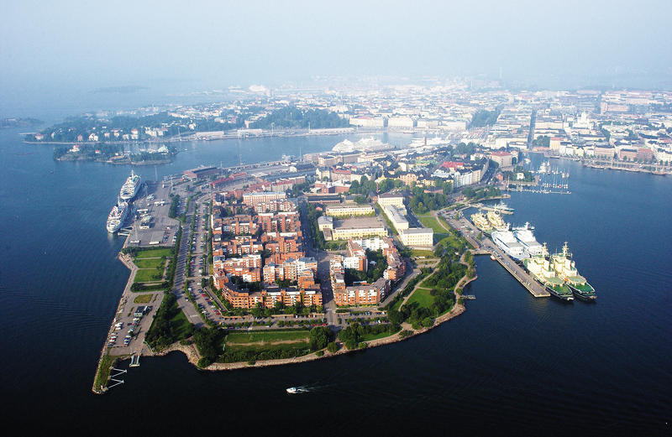
The capital of the country is Helsinki. The population of the country is 5 and a half million people.

Slide 6
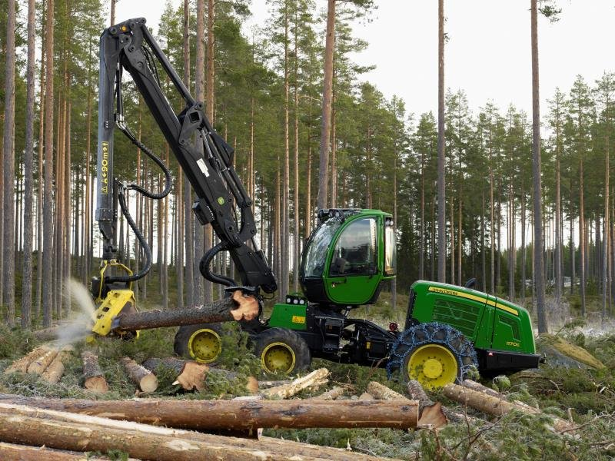
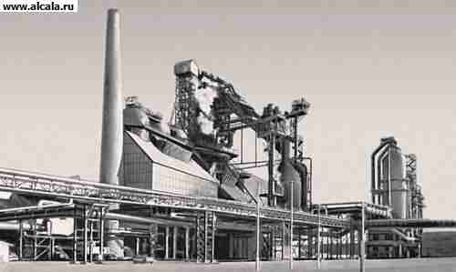
The main industrial branches are metal industry and forest industry.

Slide 7
Thank you for your attention.

