Slide 1
220-901-205

Slide 2
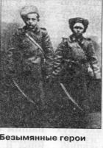
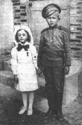
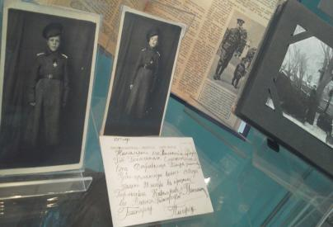
Moscow Suvorov Military School Competition "Patriots of Russia in World War I"
Project
"Children of the First World War"
Project manager:
English Teacher Nataliya Onikiychuk
Aims:
Survey and study of little-known facts involving children in World War I.
Survey and study of their frontline merits and motives that led the children to the front.
Patriotic education of the suvorovites on the feat of arms of children – the participants of the First World War.
Education of pride and the sense of belonging to the history of the Fatherland.
Objectives :
Subjective
To develop language, learning, cognitive and socio-cultural competence and compensatory competence.
Intersubjective
To facilitate the integration of academic and educational work.
Personal
To motivate cadets to learn by doing the research work.
Subject area:
History
Literature
English

Slide 3
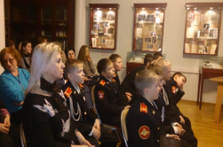
The Project can be used at the lessons of history, literature, English language and at the lessons of courage.
Stages of work:
Step 1-Motivation-November 2013.
Step 2 - Registration: November 2013
Stage 3-Decision making : December 2013.
Step 4 - Formation of working groups: December 2013.
Step 5 - Collection and processing of information: December-January 2014.
Step 6 - Discussion of collected materials: January-February 2014.
Step 7 - Making the project January-February 2014.
Step 8 - Discussion and Conclusion: March - April 2014.
Activities:
1. Survey of the materials about the history of World War I.
2.Creative work. The involvement of suvorovites in creative activity and in the development of their creative abilities.
3.Survey. The destiny of children of the First World War.
4.The aesthetic and artistic education in the course of the project work.

Slide 4
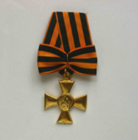
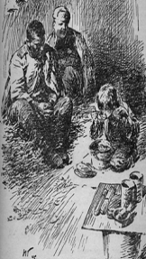
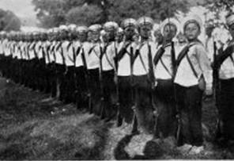
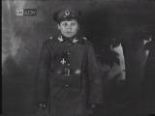
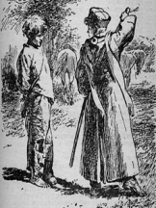
«We have nothing except our own life to help the motherland, and we are willing to sacrifice it.» (From a letter of Omsk seminary students)
"Russian to hosts"
Thematic exhibition in the Russian State Library of Arts.

Slide 5
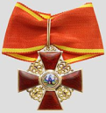
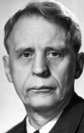
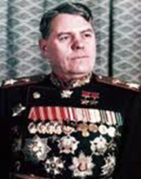
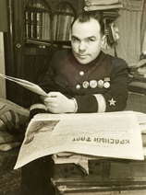
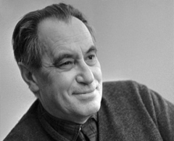
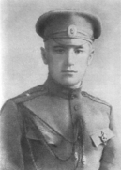
Children - participants of the First World War.
Ivan Pyryev,
Soviet film director and screenwriter, People's Artist of the USSR
Rodion Malinovsky
Marshal of the Soviet Union
Vsevolod Vishnevsky
A Soviet dramatist and prose writer.
He was born in 1900 in Saint Petersburg and educated at a Petersburg gymnasium. During World War I he enrolled in Baltic Fleet as sea cadet.
Valentin Kataev
A Russian novelist and playwright. He did not finish the gimnaziya but volunteered for the army in 1915, serving in the artillery. He received two George Crosses and the Order of St. Anne IV .

Slide 6
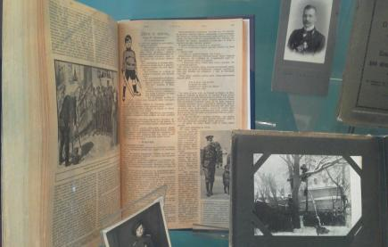
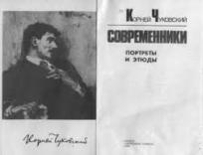
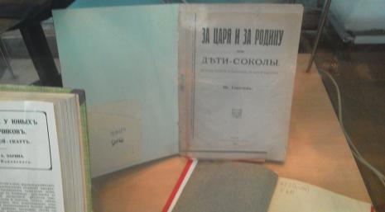
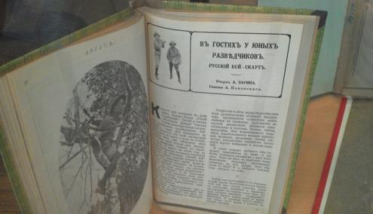
The play in four parts "Children- Falcons' (by Ivan Sokolov) 1916.
The story "Children and War“ (by Korney Chukovsky) was published in magazine "Niva» № 51(1915).
The story “Visiting young scouts.“ (by Alexander Zarina) was published in the journal" Argus ", 1916

Slide 7
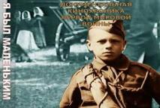
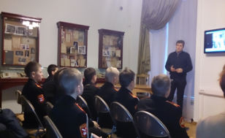
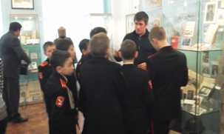
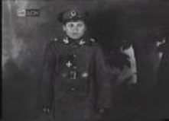
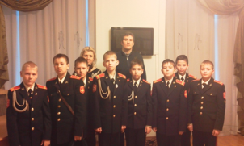
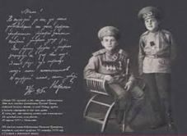
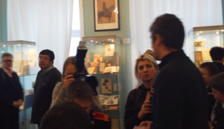
«Before the war I was a little boy »
documentary( film)
Meeting the director of the film
Denis Fedorin

Slide 8
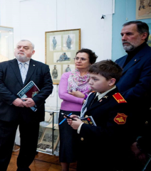
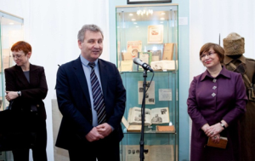
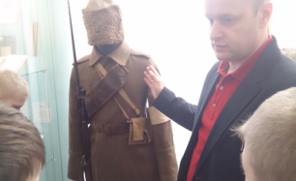
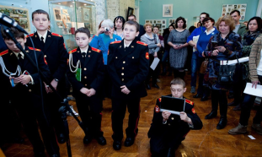
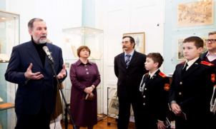
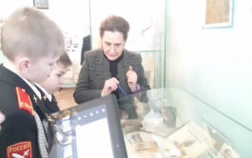
And when the war ends and we will reflect the reasons of our victory over the enemies of mankind, we must not forget that we had a powerful ally: the multimillion tightly-knit army of Soviet children.
"Russia to hosts"
Thematic exhibition in the Russian State Library of Arts.

Slide 9
Authors of the project :Suvorovites of the 7 Training Course
1. Igor Kamkin 5/2
2. Arseny Lobachov 5/2
3.Valery Ivanov 5/4
4. Misha Alekseev 5/1
5. Ivan Zorikhin 5/3
6.Nikolai Zaitsev 5/3
7. Maxim Yevtushenko 5/3
8.Andrei Nechayev 5/2
9. Kostya Balandin 5/4
10. Vladislav Volkov 5/4
11.Vladislav Volkov 5/1

