Slide 1
CONVERSATIONS WITH PARENTS
220-901-205

Slide 2
Патриотическое воспитание
Беседы с родителями
Patriotic education.
Conversations with parents.

Slide 3
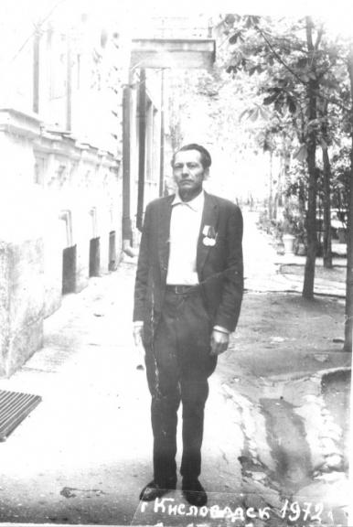
Grandfather
Dmitry Osipovich Shcherbakov
Infantry Regiment
1st Belorussian Front
awarded the medal
"For the capture of Berlin"

Slide 4
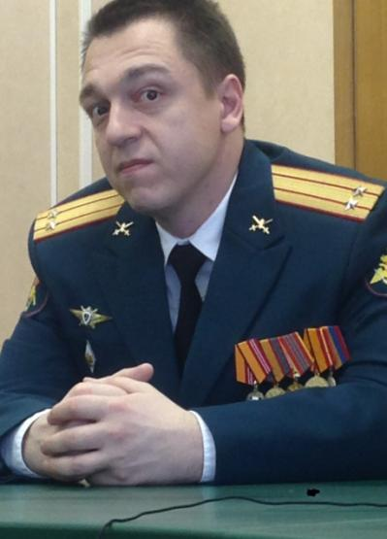
Подполковник Гришин Сергей Александрович - участник специальных операций по принуждению к миру
Colonel Sergey Grishin
Participant of the special peace enforcement operations
Представлен к ордену «За военные заслуги» и медали «За боевое отличие»
Имеет 5 медалей Министерства обороны
Presented to the Order "For Military Merit" and the medal "For Military Merit".
He has 5 medals of the Ministry of Defence

Slide 5
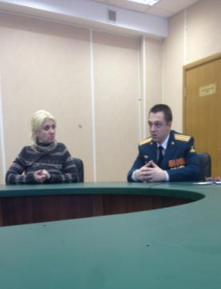

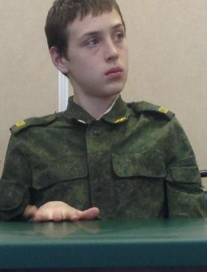
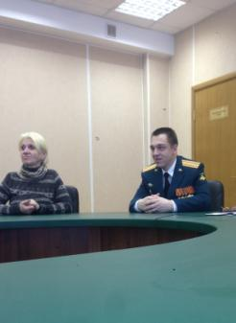

Slide 6
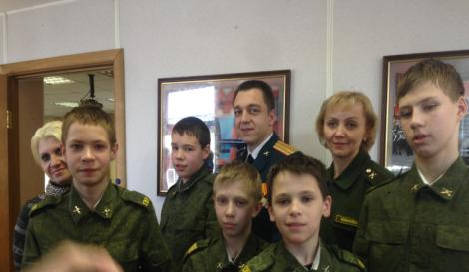
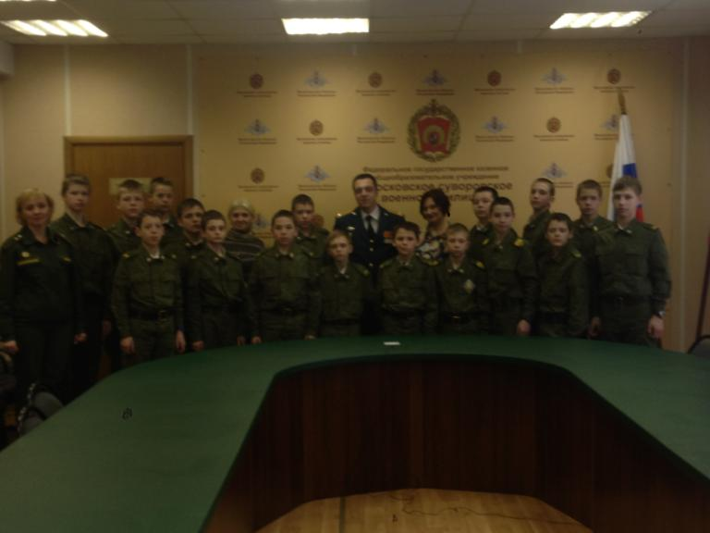
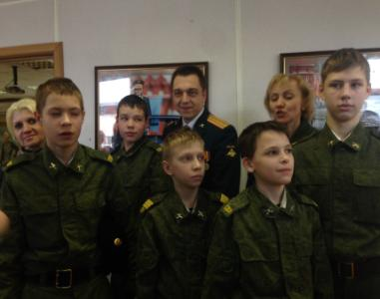

Slide 7
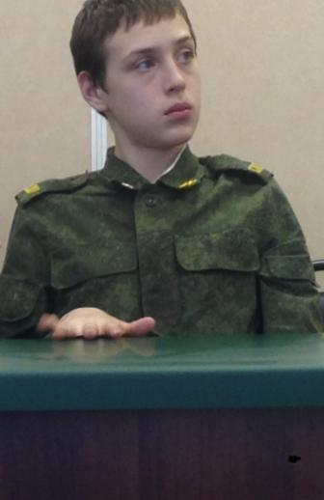
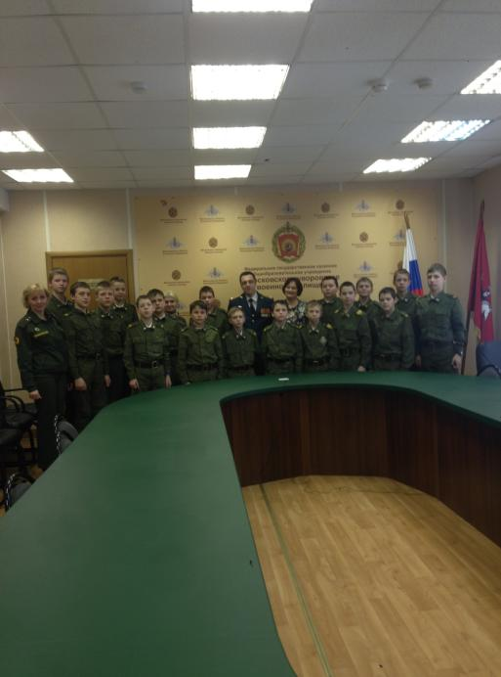
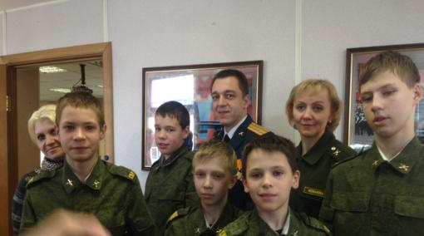

Slide 8
Agryzkov Athanasius Ivanovich
Agryzkov Athanasius Ivanovich Totski was my great-grandfather. On the first day of the war he went to the recruiting office, recruitment office (the draft board) to leave as a volunteer for the front. He fought his way forward to Berlin. Athanasius Ivanovich was wounded in November 1941 in the Battle of Moscow and in 1942 in the Battle of Kursk.

Slide 9
Agryzkov Athanasius Ivanovich
He participated in the battle for Berlin.
For his feat of arms he was awarded with the "Order of the Red Star", the medals "For Courage," For the liberation of Warsaw, "For the liberation of Berlin", "For Victory over Nazi Germany".
He also received thanks "for the liberation of Lodz, Vlotslavsk, Sahochev, Altdamm" from the Supreme Commander Stalin.

Slide 10
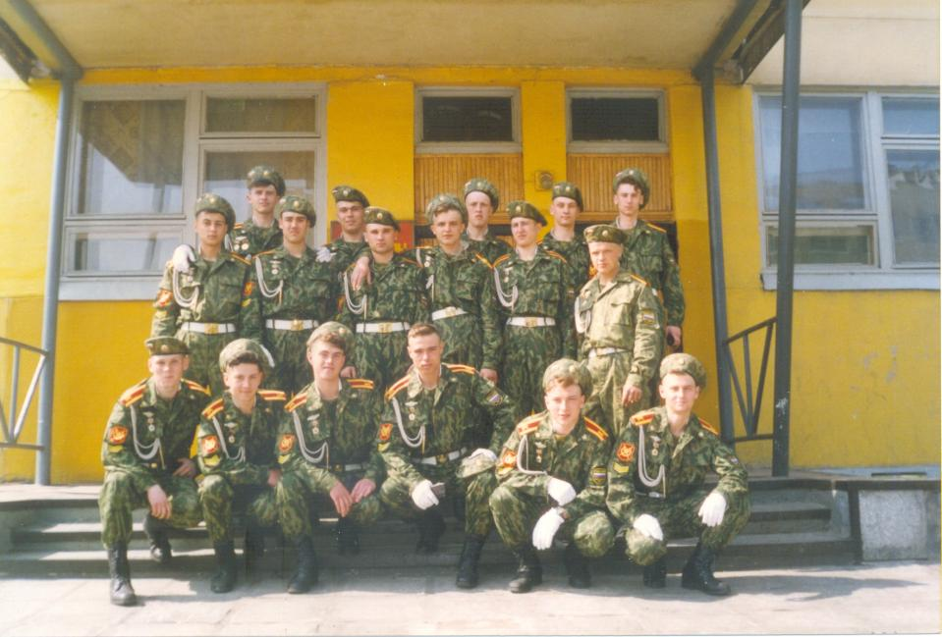

Slide 11
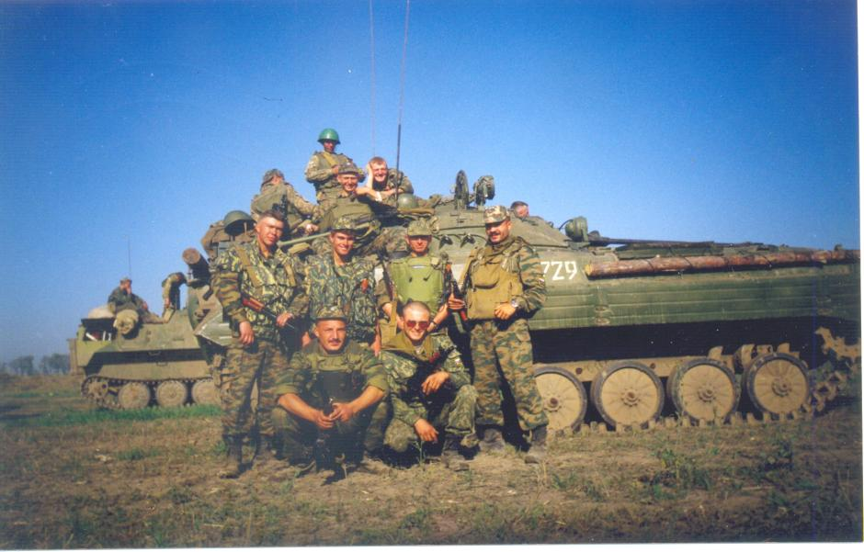
The Chechen–Russian conflict

Slide 12
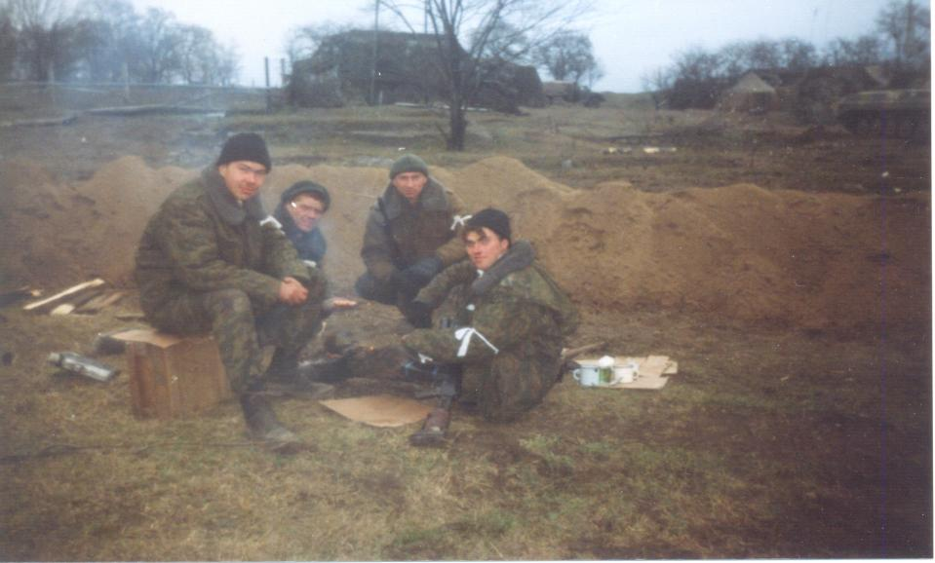
The Chechen–Russian conflict

Slide 13
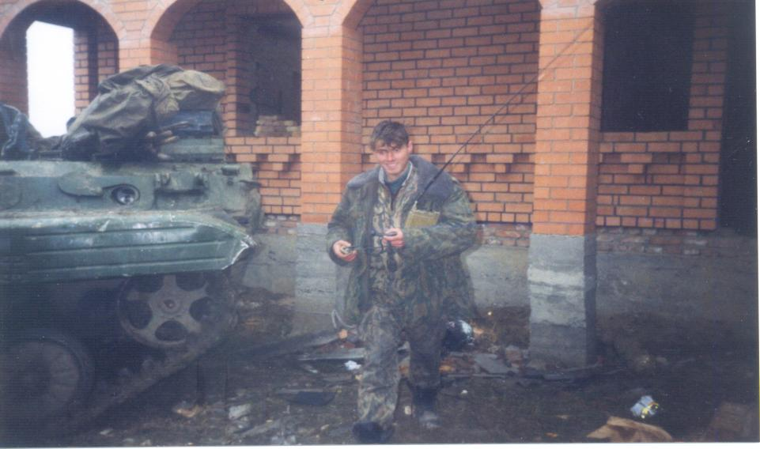
The Chechen–Russian conflict

Slide 14
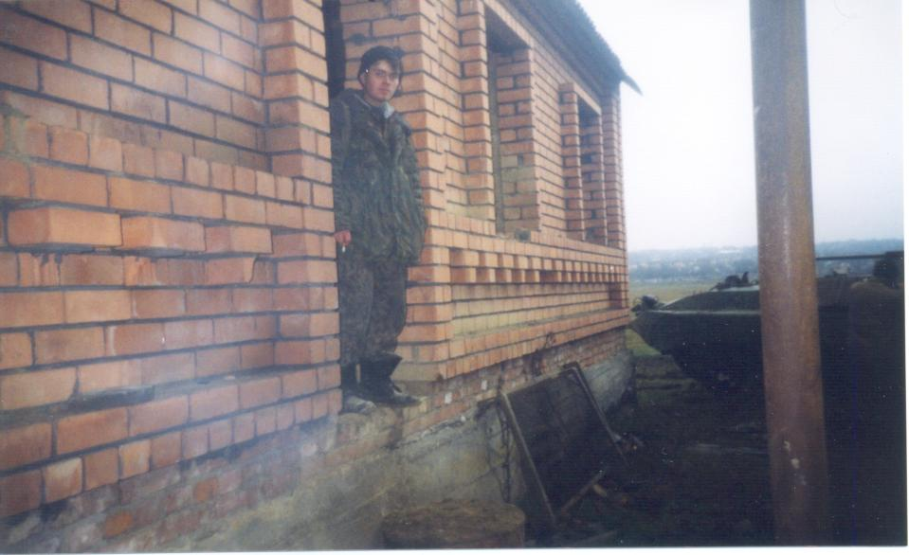
The Chechen–Russian conflict

Slide 15
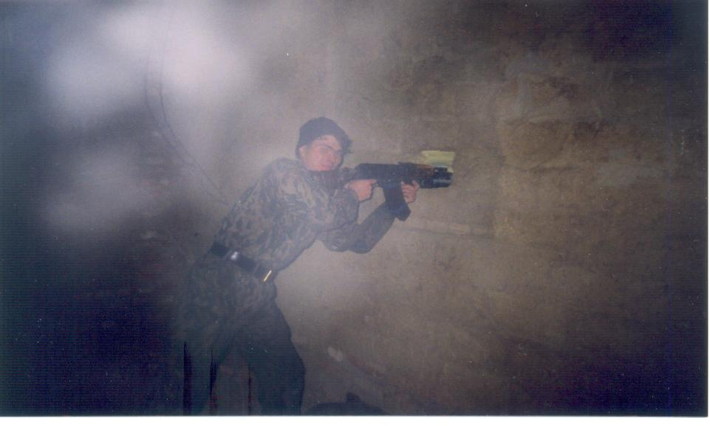
The Chechen–Russian conflict

Slide 16
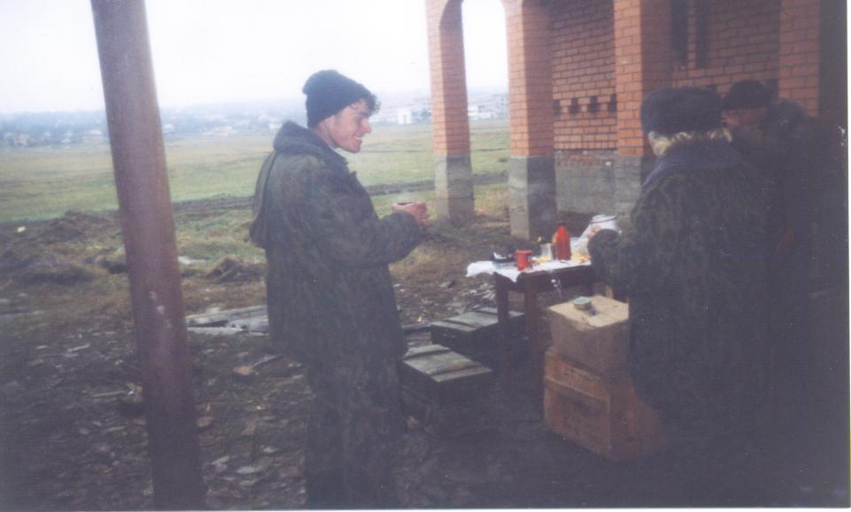
The Chechen–Russian conflict

Slide 17
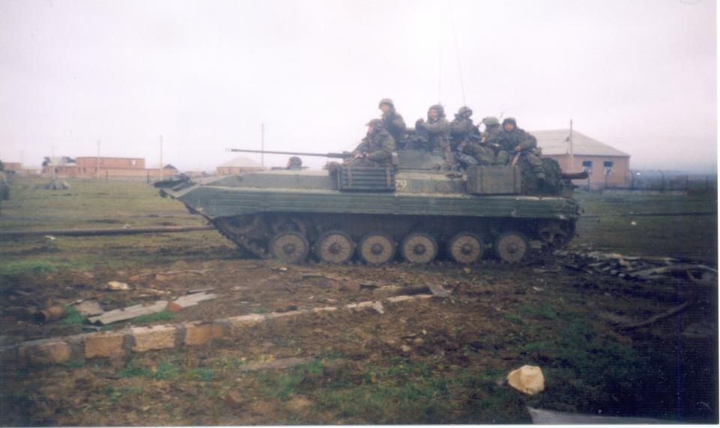
The Chechen–Russian conflict

Slide 18
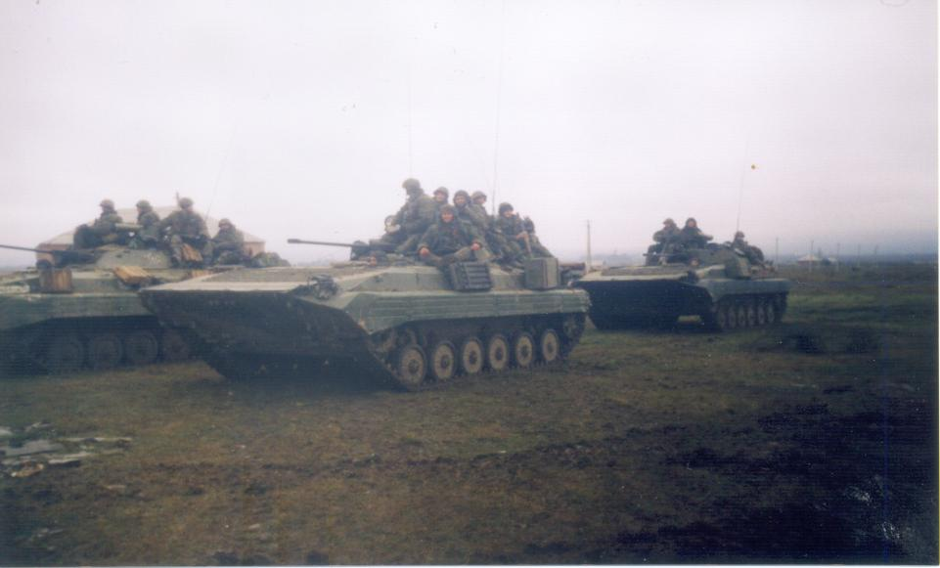
The Chechen–Russian conflict

Slide 19
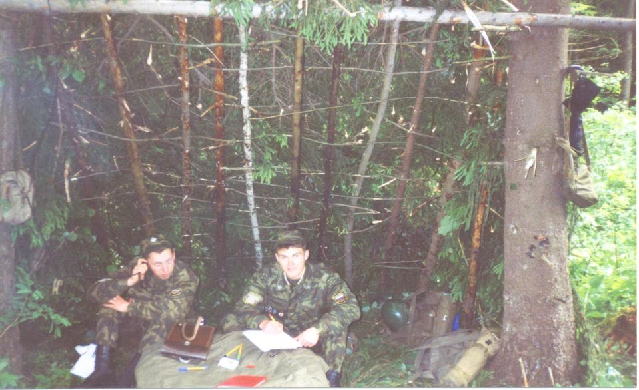
The Chechen–Russian conflict

Slide 20
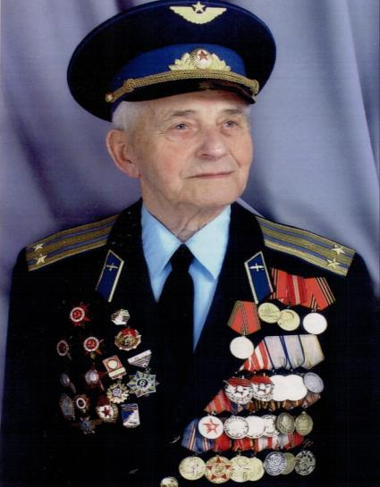
Gennady Trofimovich Konobeev
During the Great Patriotic war Gennady Trofimovich Konobeev was piloting such aircrafts as Po-2, I-15 bis, I-15, I-16, IL-2, Pe-2 and Tu-2.
The Orders and Medals were awarded to Lieutenant Colonel Gennady Trofimovich Konobeev for his personal bravery during the Great Patriotic war against Nazi army.
The Orders and medals are:
Three "Orders of the Red Banner”, two "Medals of Honour", the "Medal of Military Merit", four "Orders of the Patriotic War 1st class and 2nd class, " two "Orders of the Red Star."
.

Slide 21
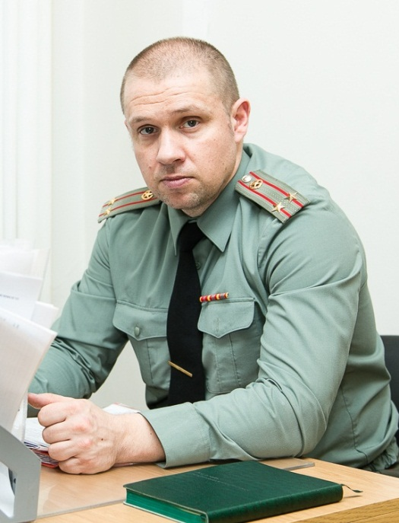
Roman
Аnatolyevich
Тimofeyev
Military University Lieutenant Colonel

Slide 22
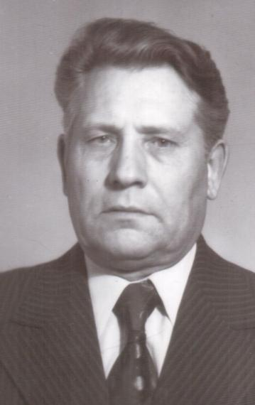
Shavernovsky Mikhail was born in 1922.
He took the oath of allegiance at Podolsk Infantry Military School in March in 1941.
He ( grandfather) became a military cadet of Podolsk infantry military school in March in 1941.
Shavernovsky M.D. participated in the defence of Moscow as a military cadet of Podolsk infantry military school.
He took part in the defence of Stalingrad from July to September 1942.
He served in the regimental military reconnaissance.
In September in 1942 he was seriously wounded.
From September to July 1944 he was treated at hospital
Shavernovsky M.D.

Slide 23
Both the “Order of the Patriotic War 1st class” and the “Order of the Patriotic War 2nd class” were awarded to him for heroic deeds during the Great Patriotic War.
The “Medal for Courage" and the Medal "For the Defence of Moscow" were awarded to him for the defence of Moscow during the battle of Moscow.
The Medal "For the Defence of Stalingrad" was awarded to Shavernovsky M.D. for the the defence of Stalingrad against Nazi army.
He was a disabled Great Patriotic war veteran.

Slide 24
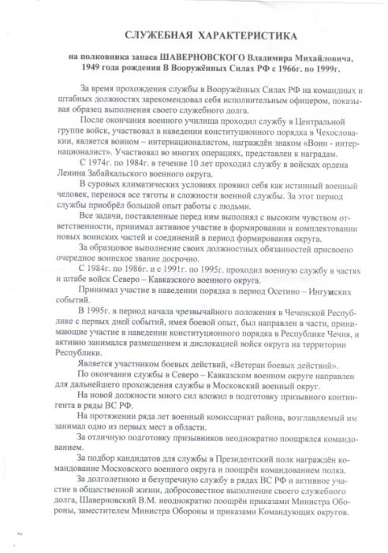
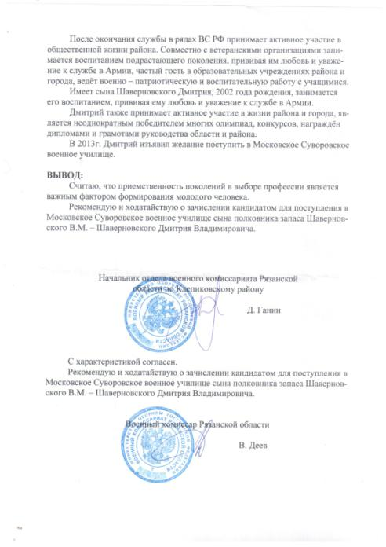

Slide 25
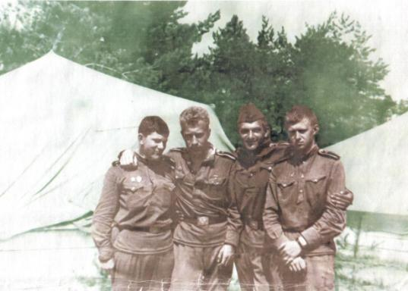
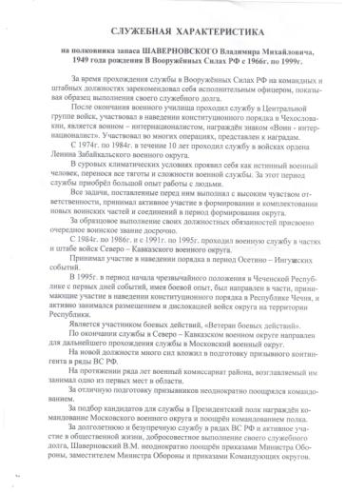

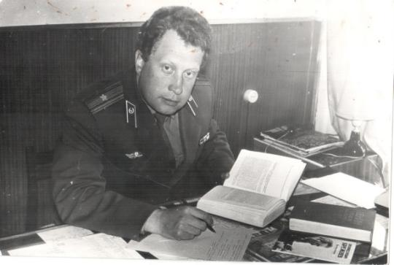

Slide 26
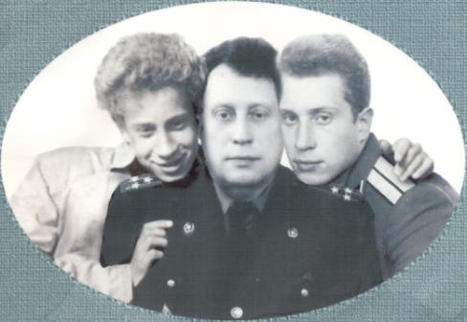
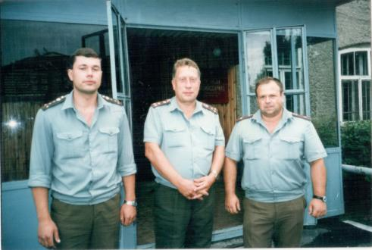
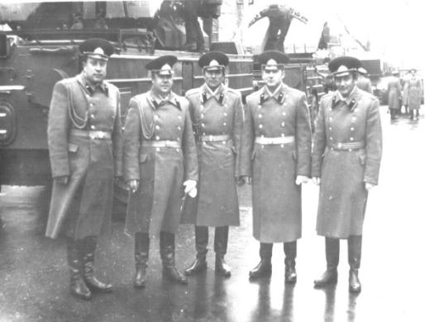
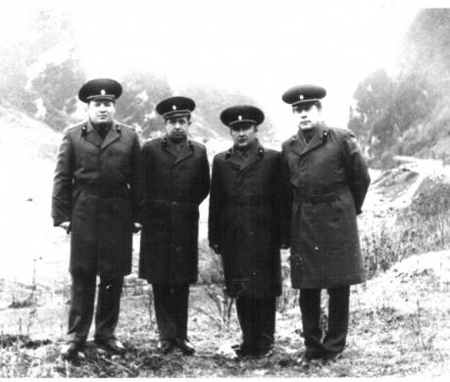

Slide 27
Checheta Grigoriy Michaylovich (1913-1992)
Kotelnikova Sofiya Borisovna (1922-1991)
Kurnishov Konstantin Nikolayevich (1920-1997)
Чечета Григорий Михайлович (1913-1992)
Жеребчевская (Котельникова) Софья Борисовна (1922-1991)
Курнышов Константин Николаевич (1920-1997)

Slide 28
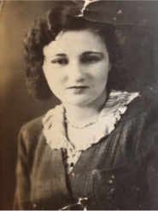
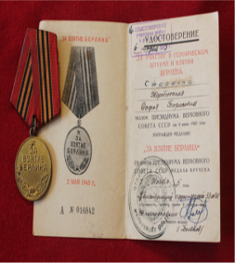
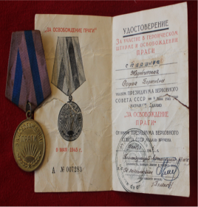

Slide 30
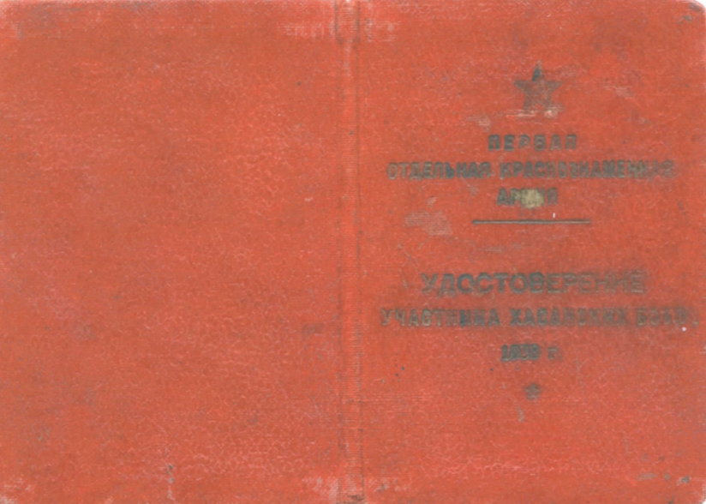

Slide 31
