Slide 1
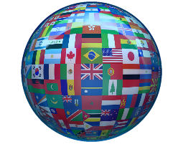
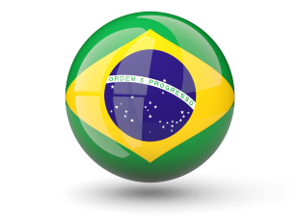
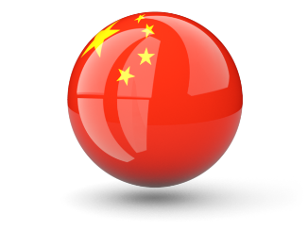
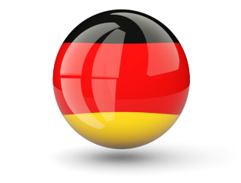
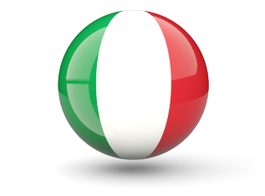
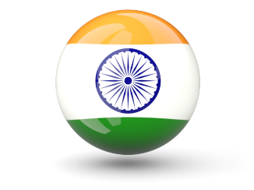
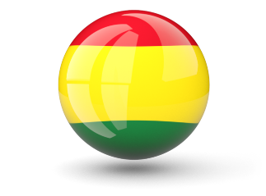
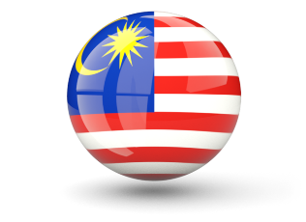
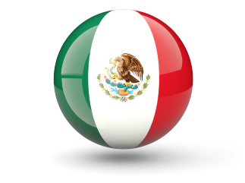
new year’s
Parade
Of countries

Slide 2
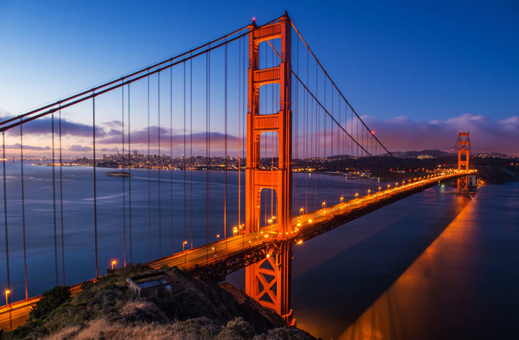
Guess the country
U
S
A

Slide 3
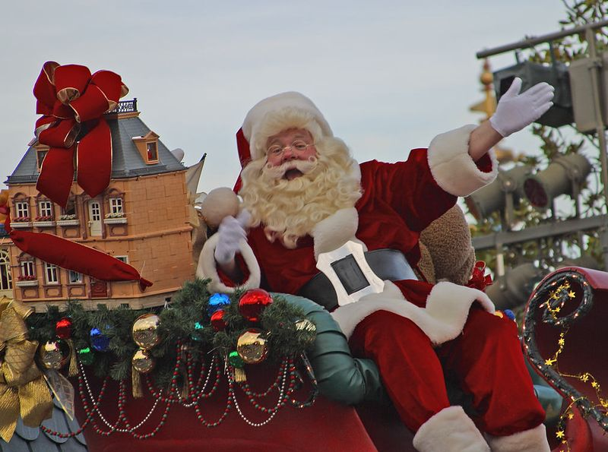
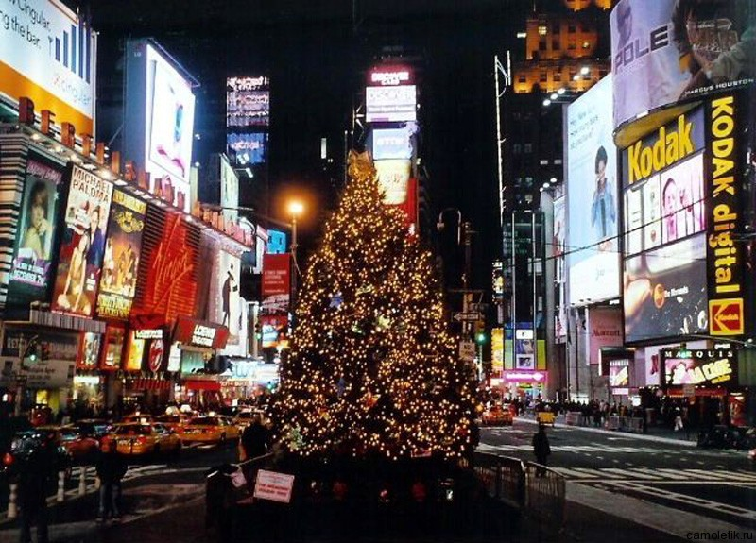
The New Year in the USA is celebrated from the evening of December 31st into January 1st .
The date was declared as the New Year in 1752.

Slide 4
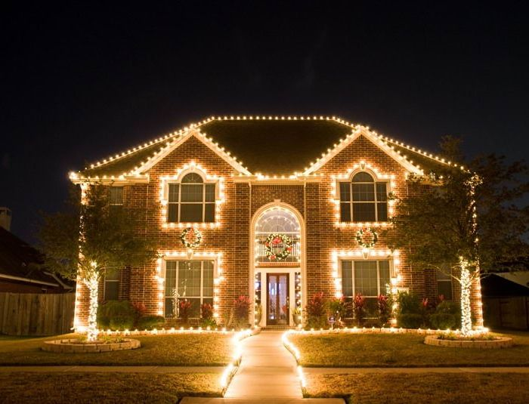
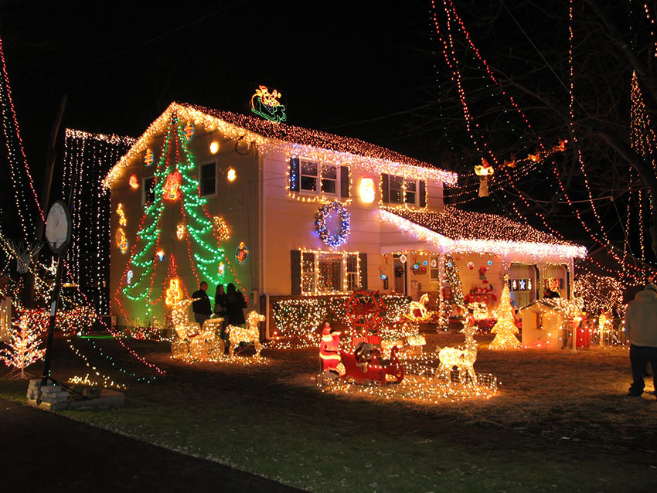
Americans decorate their houses and trees with lanterns, flash lights and colored papers. Flags are also adorned to express happiness.

Slide 5
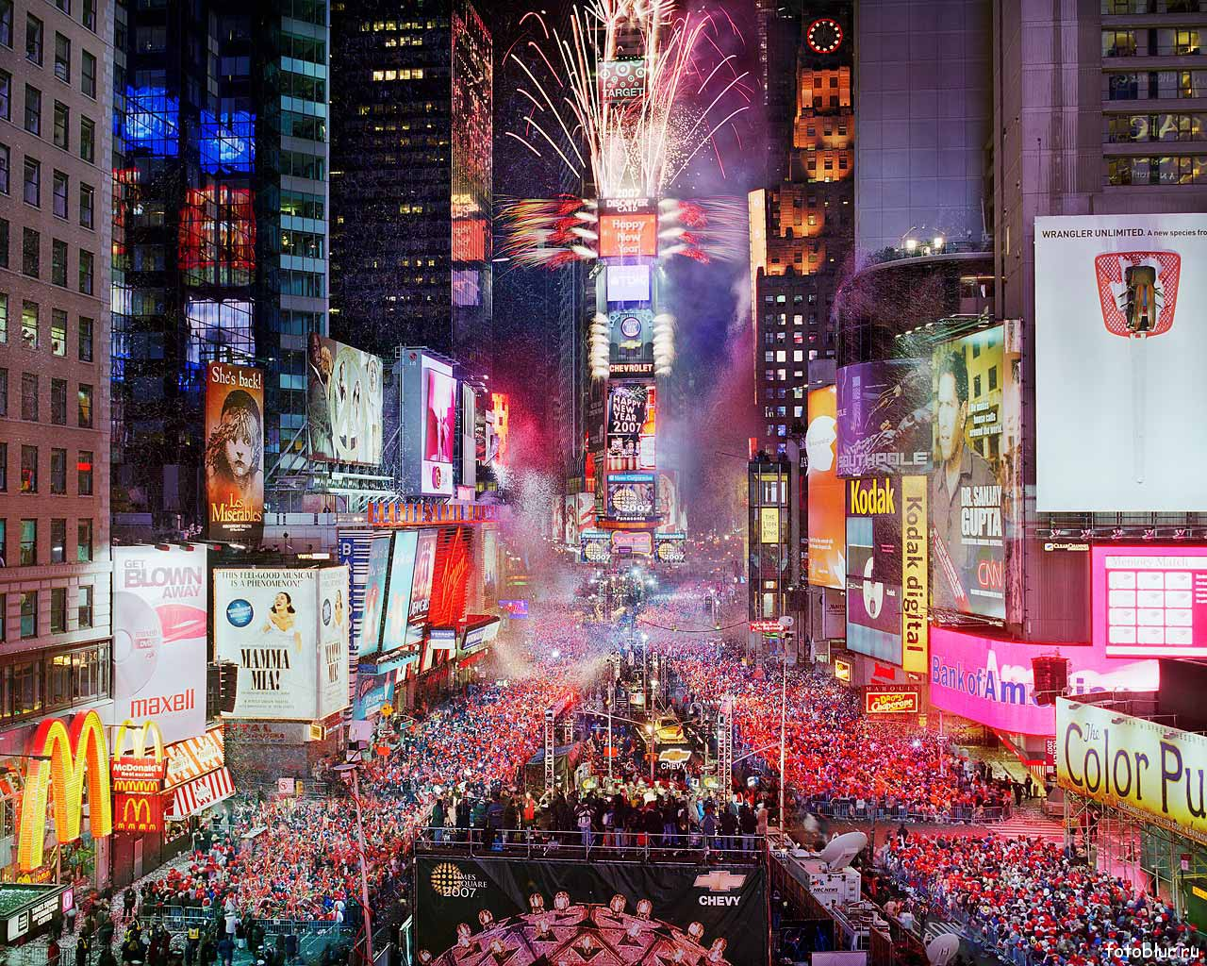
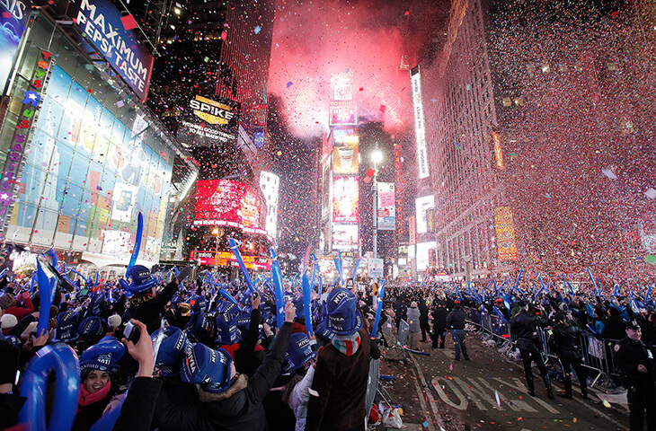
Thousands of Americans and visitors from around the world celebrate the New Year in a famous Times-Square.

Slide 6
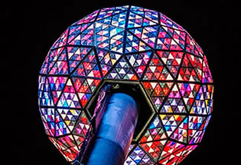
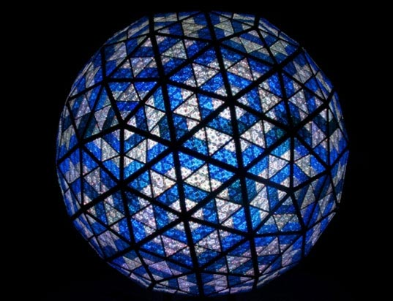
The Times Square Ball is a time ball located in New York City's Times Square. The ball drops from 43 m in 60 seconds down a specially designed flagpole, beginning at 11:59:00 p.m. and resting at midnight to signal the start of the new year.

Slide 7
Say in English:
Happy new year!
[hæpi nju: jiə]

Slide 8
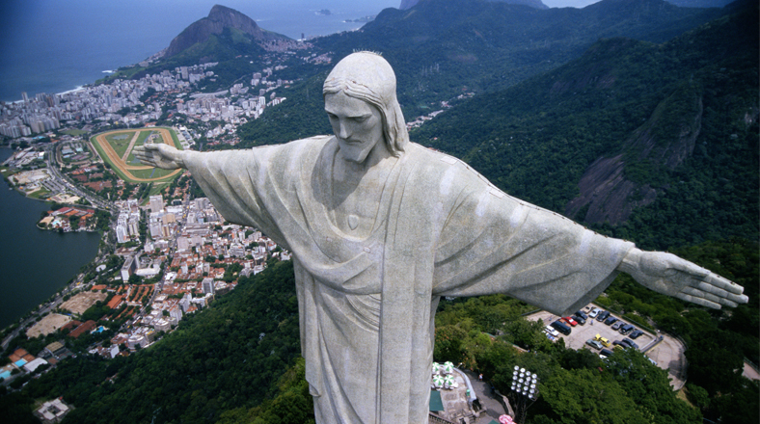
Guess the country
B
R
A
Z
I
L

Slide 9
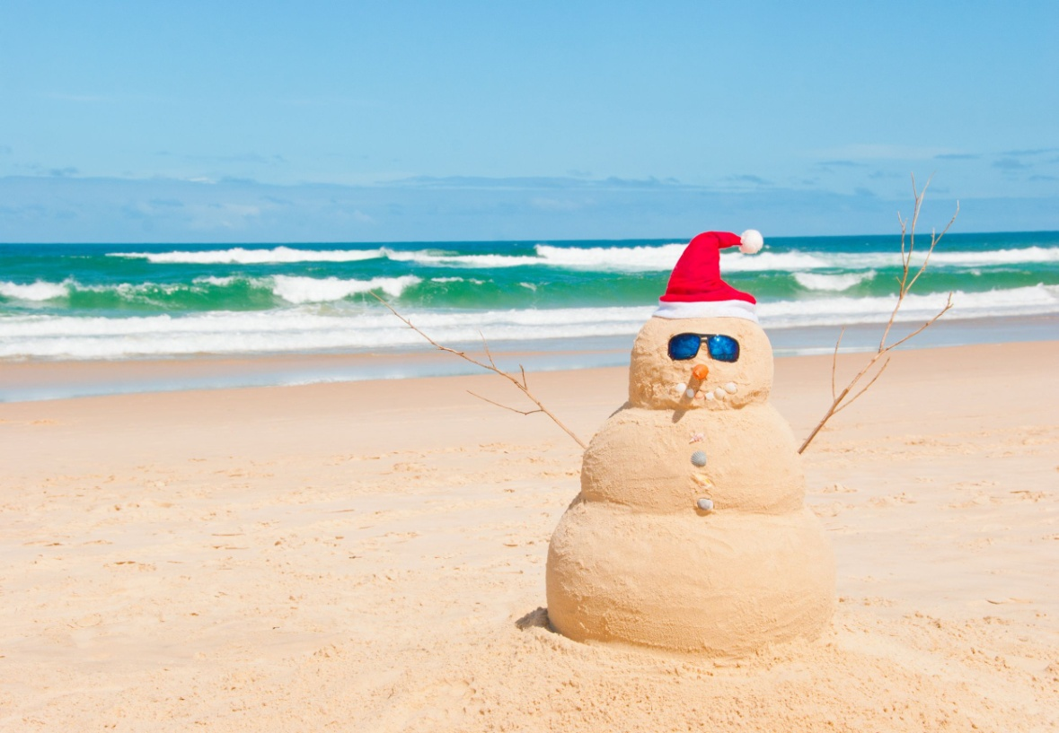
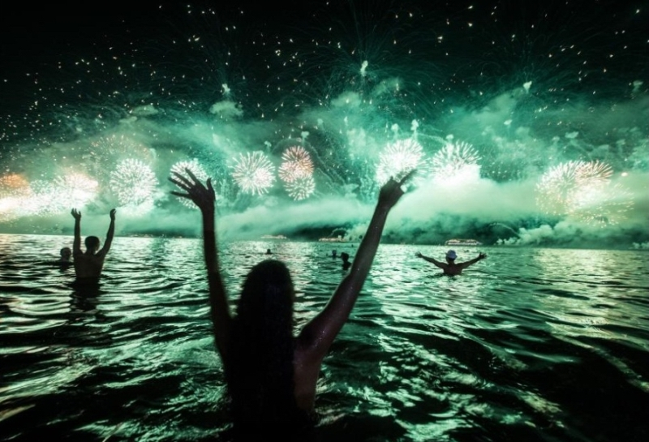
New Year in Brazil is summer holiday. Brazilians celebrate the New Year dancing and singing.

Slide 10
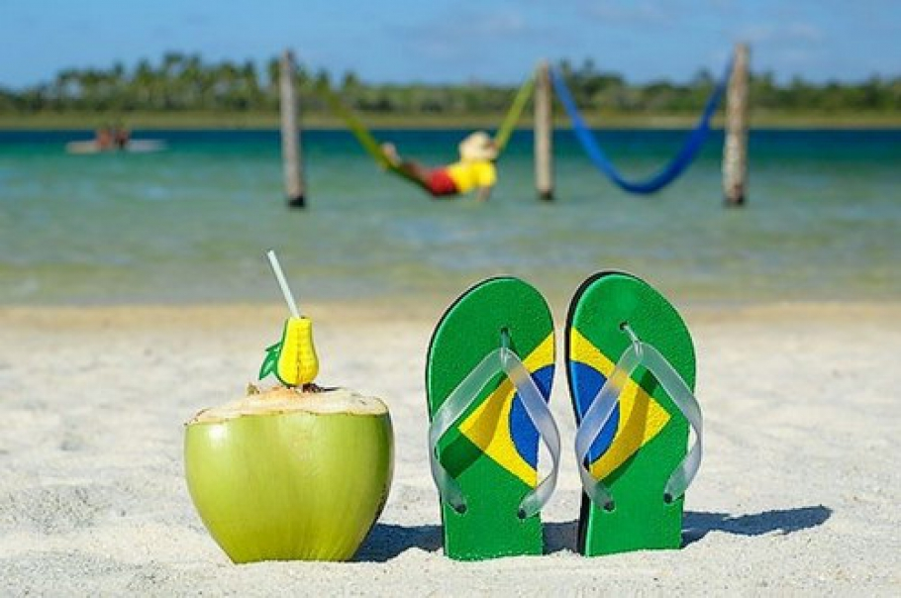
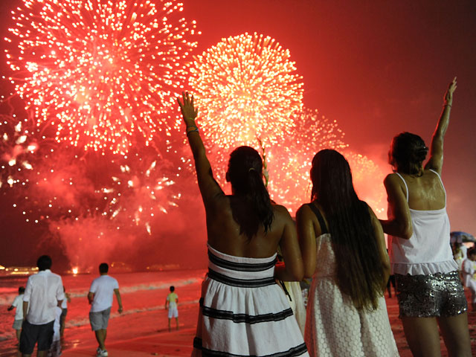
New year in many countries is a family holiday, but not in Brazil. They gather in large noisy companies and go to cafes, night clubs.

Slide 11
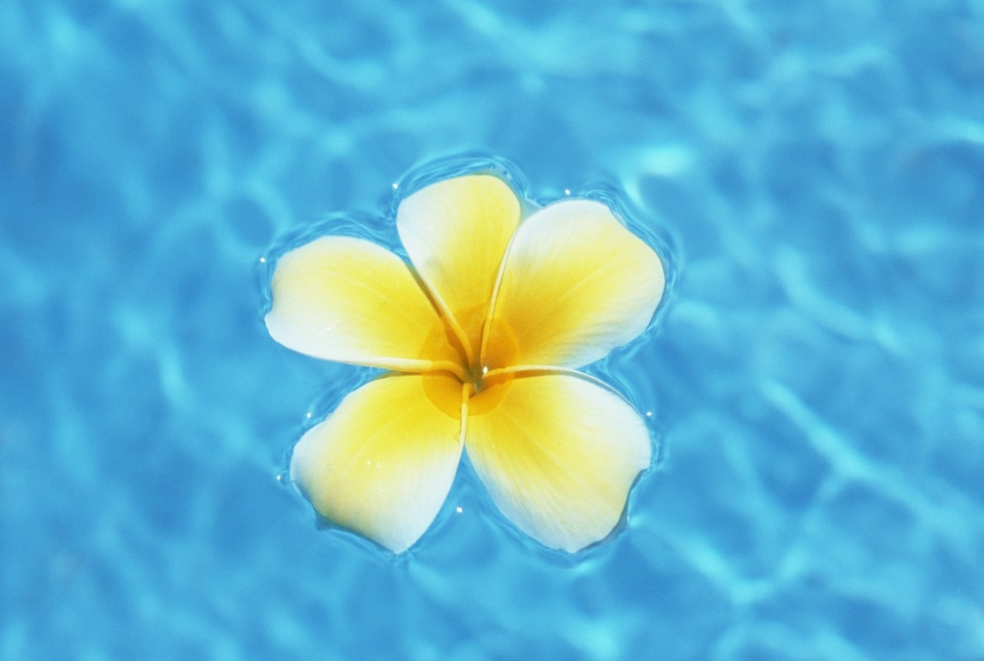
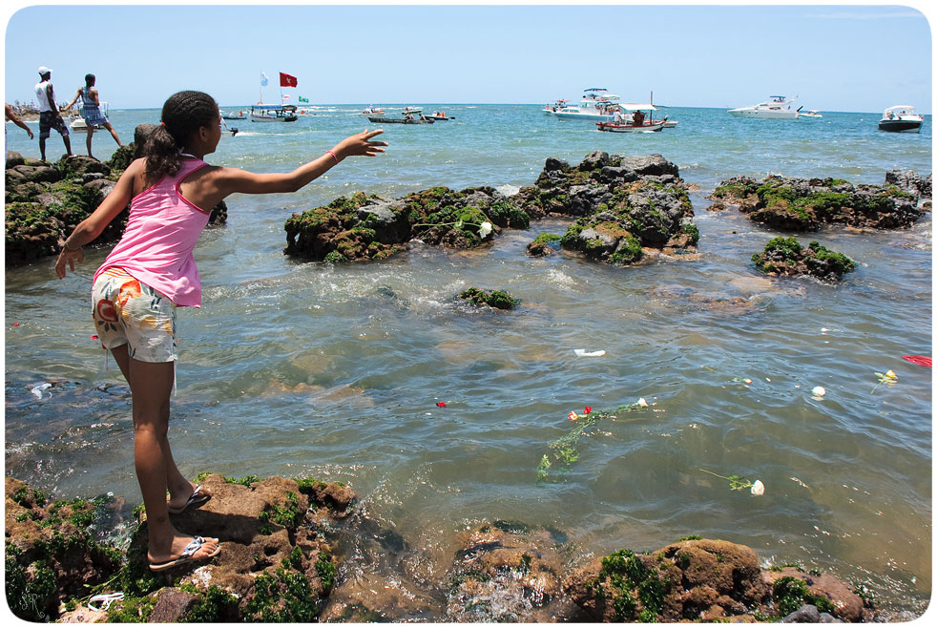
People throw flowers, soap, candles and any other objects in the ocean as a gift to the goddess of the Sea and jump over seven waves.

Slide 12
Say in Spanish:
Feliz Ano Nuevo!
[feliz ano nuevo]

Slide 13
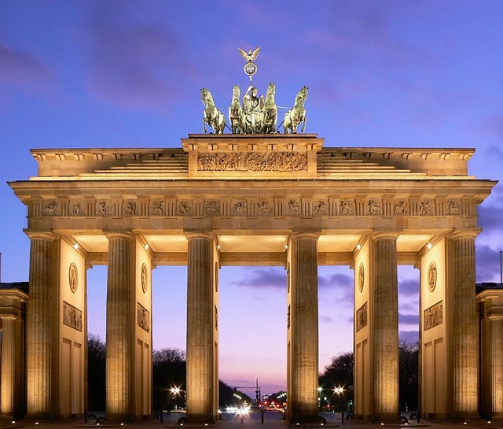
Guess the country
G
E
R
M
A
N
Y

Slide 14
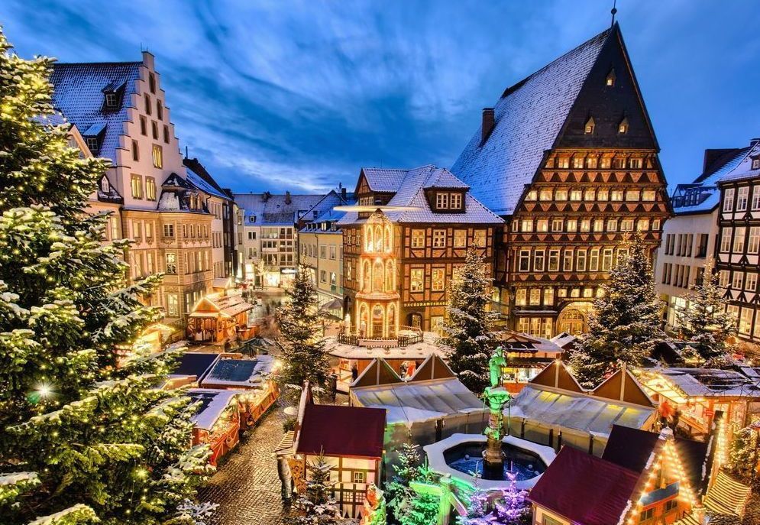
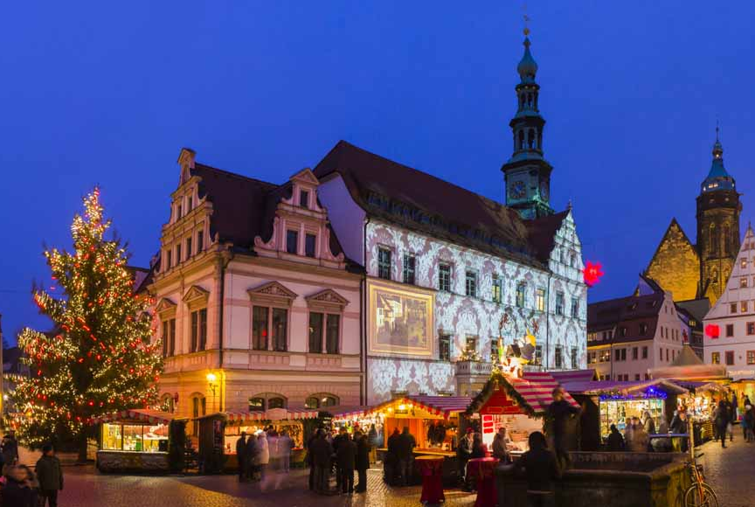
New Year is popularly called as “Neujahr” in Germany. It is celebrated on January 1st.

Slide 15
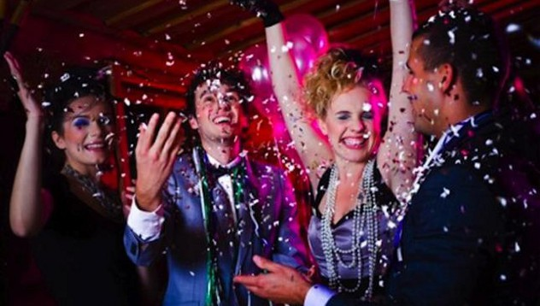
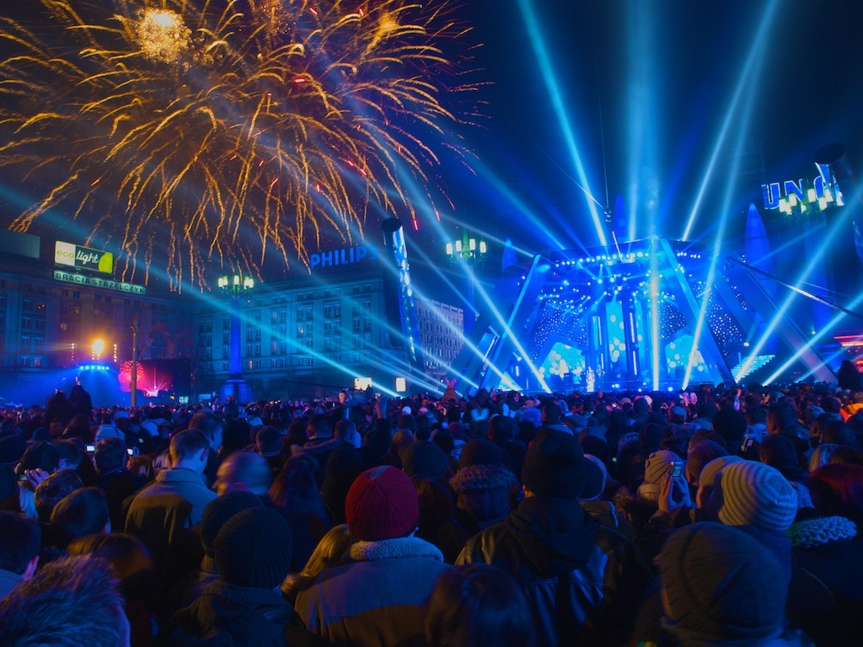
In many cities there are big public celebrations that often begin in the evening and last throughout the night.

Slide 16
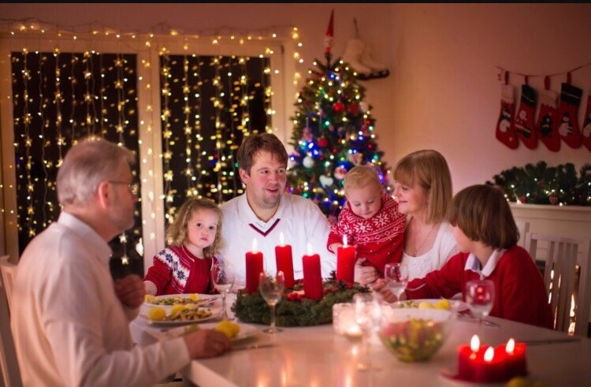
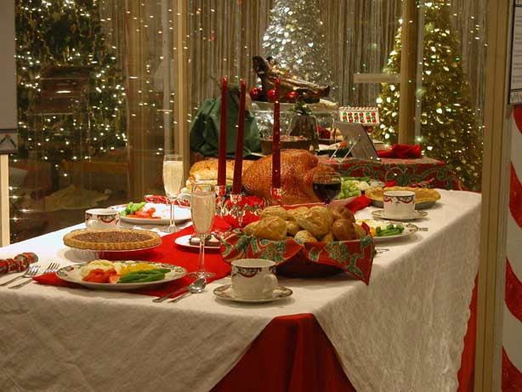
Some people hold private celebrations at home. They invite friends and family members and prepare a festive meal, often in the form of a buffet.

Slide 17
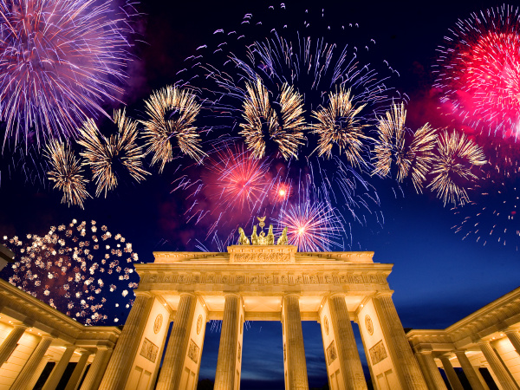
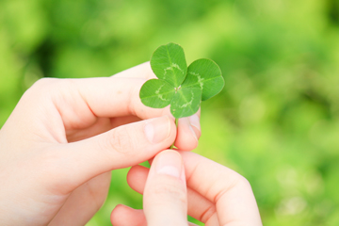
Midnight is often marked by fireworks and fire crackers. People may give each other gifts of four-leaf clover as a symbol of good luck for the New Year.

Slide 18
Say in German:
Frohes Neues Jahr!
[froes noes yar]

Slide 19
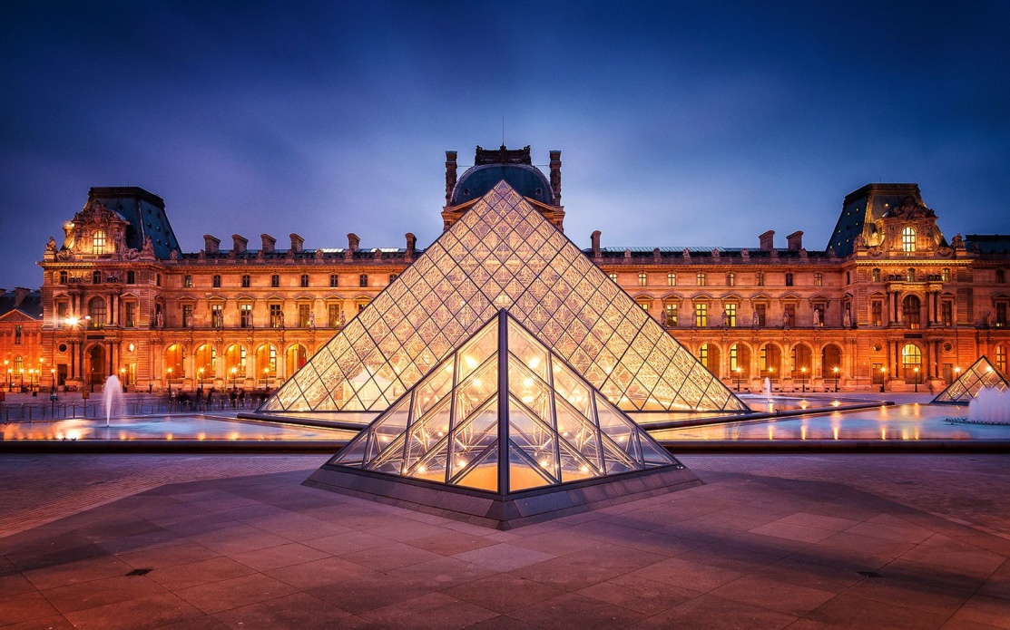
Guess the country
F
R
A
N
C
E

Slide 20
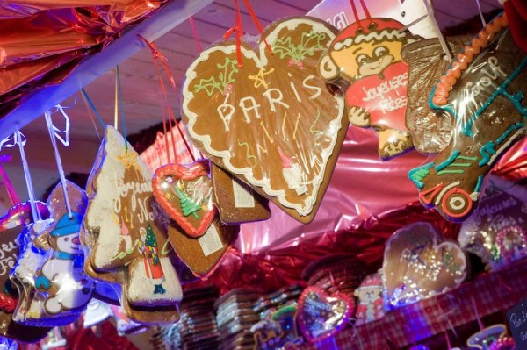
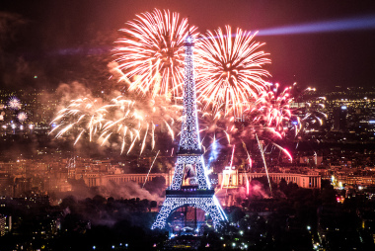
People in France celebrate New Year on January 1st. The French call New Year's Eve “la Saint-Sylvestre”

Slide 21
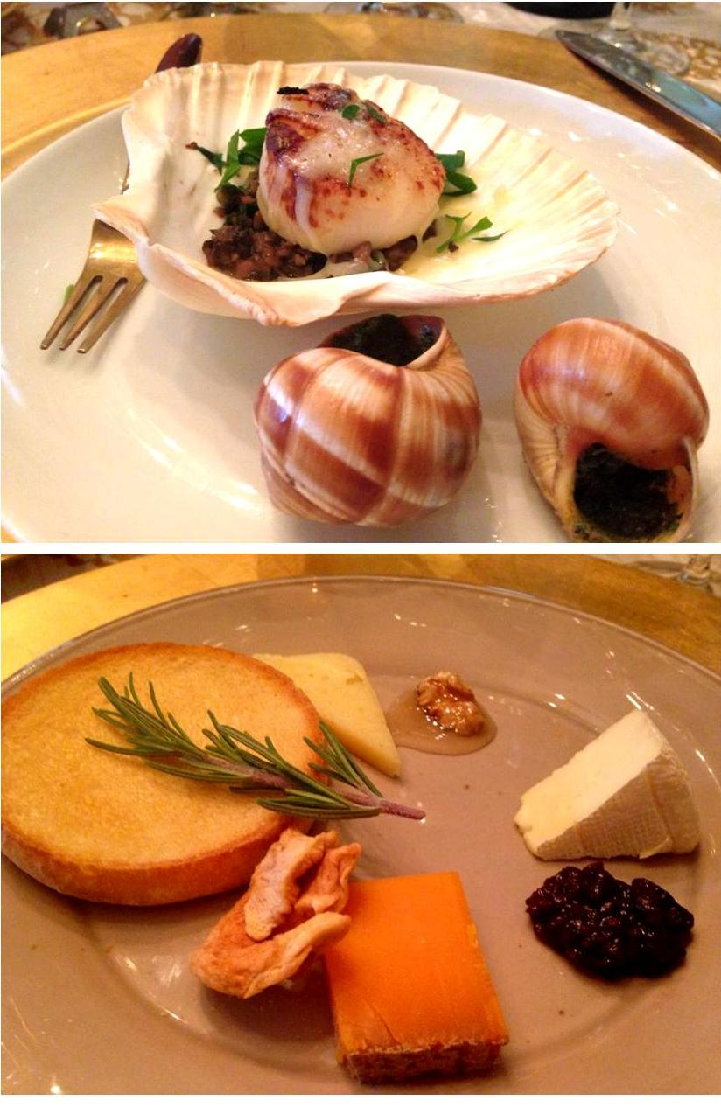
New Year's Eve is usually celebrated with a feast, called “le Réveillon de Saint-Sylvestre”. The feast consists of traditional dishes like pancakes and foie gras. According to French traditions, this special dinner brings prosperity and good luck.

Slide 22
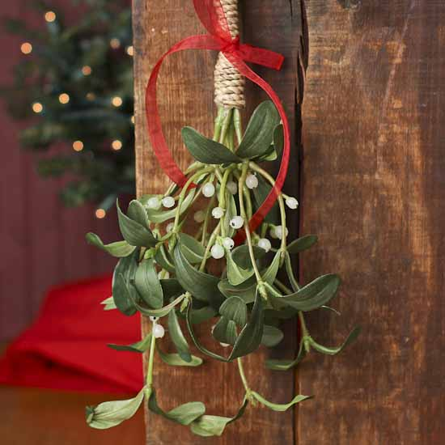
French love to decorate their homes and banquet tables with bouquets of flowers and twigs of mistletoe. People believe that the mistletoe branch brings good luck to the house for the whole year.

Slide 23
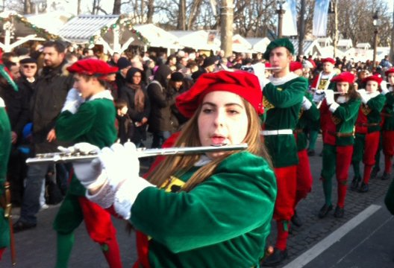
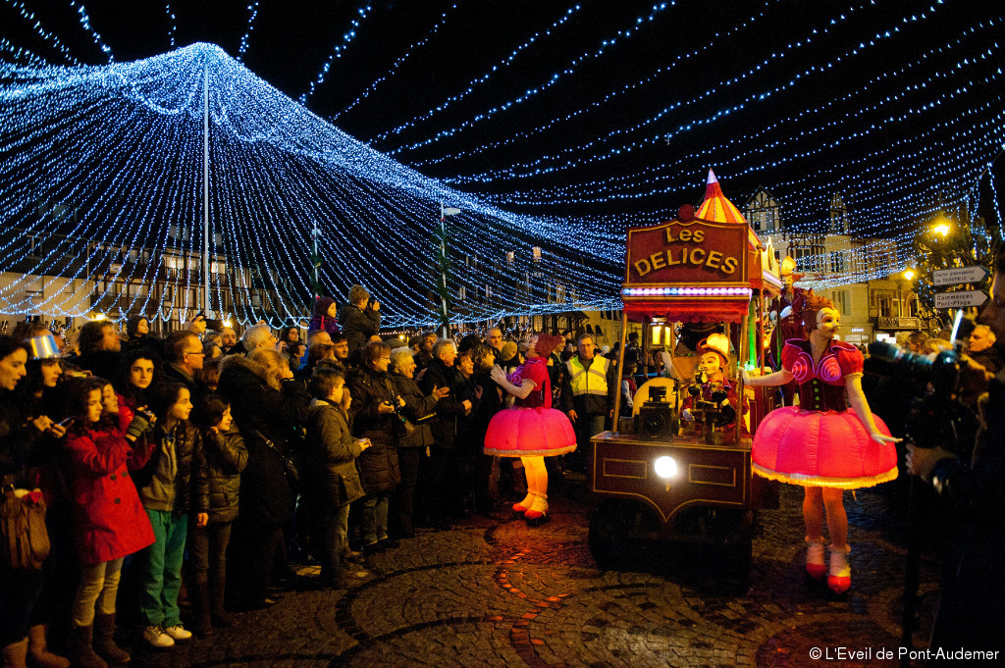
The French prefer to celebrate the New Year in restaurants, wearing funny pointed hats, and confetti showering each other. On New Year’s Day – “le jour de l’an” – parades fill the streets.

Slide 24
Say in French:
Bonne Année!
[bon ane]

Slide 25
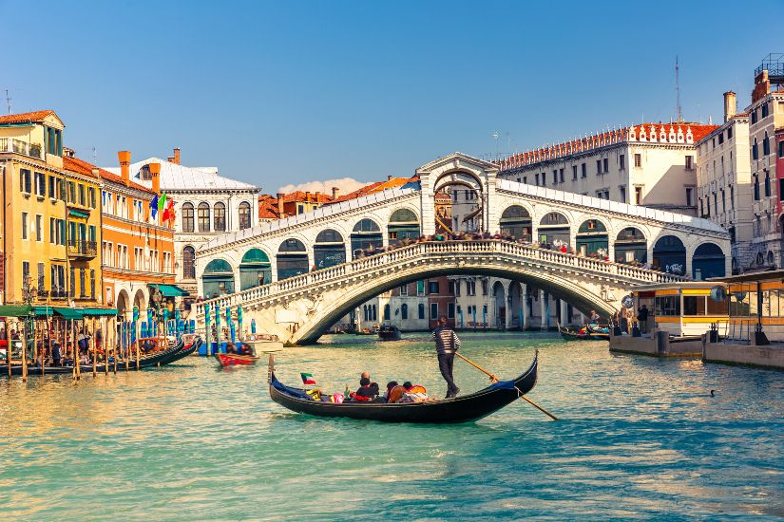
Guess the country
I
T
A
L
Y

Slide 26
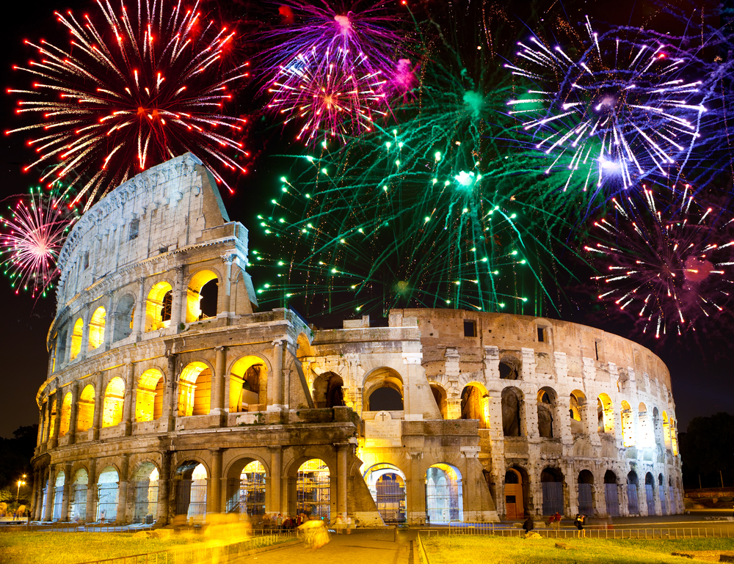
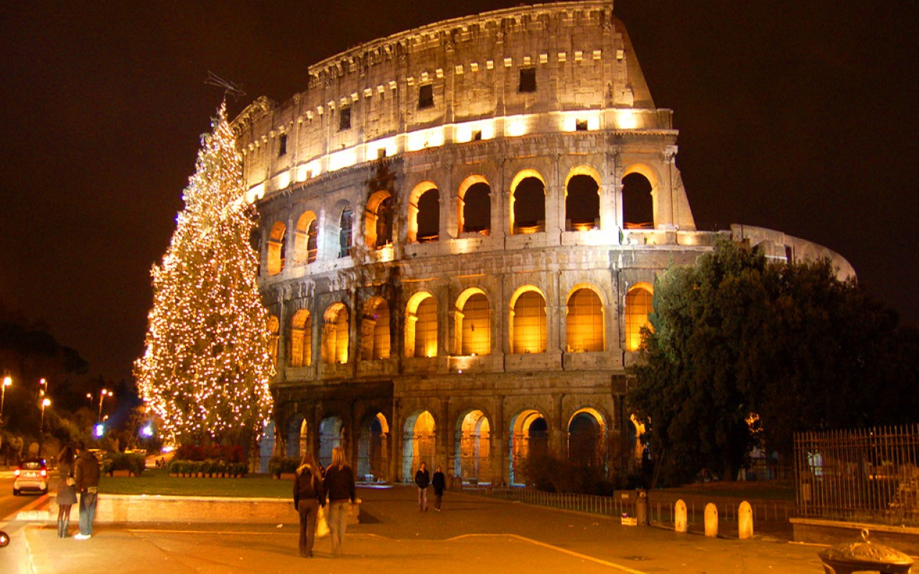
In Italy the New Year is celebrated on January 1st. It is known as ‘January Kalends’. The preparations start with decoration of houses. Italians wear new clothes and exchange gifts on these days.

Slide 27
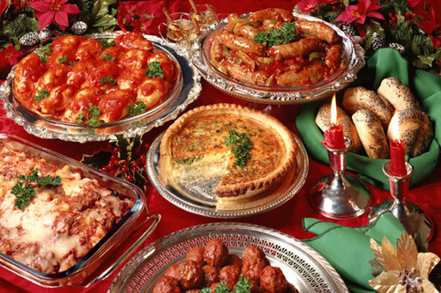
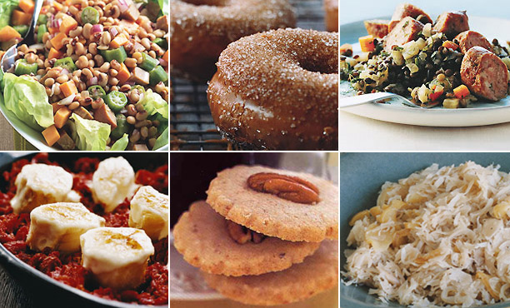
Italians like to eat very much especially on New Year's Eve. There are usually nuts, pork dishes, caviar and grapes on New Year’s tables.

Slide 28
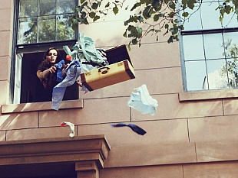
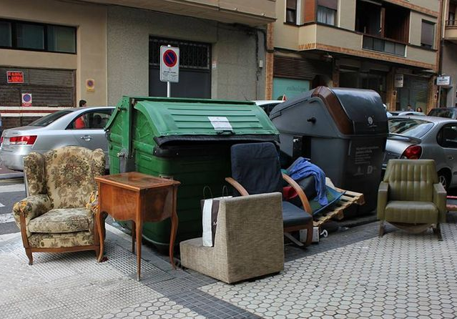
The most popular Italian tradition is to throw away old things. Italians throw out old things directly from a window.

Slide 29
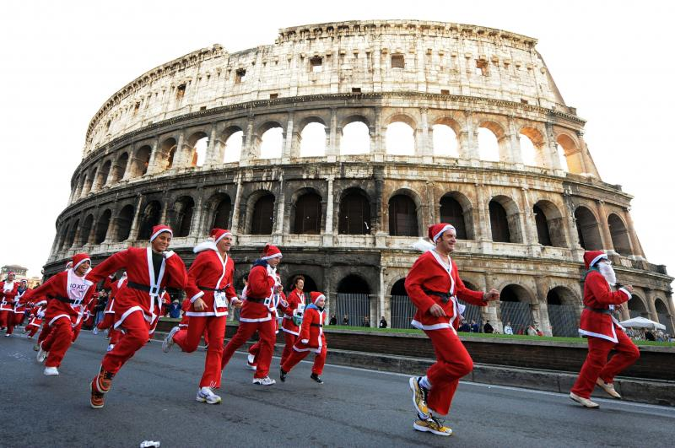
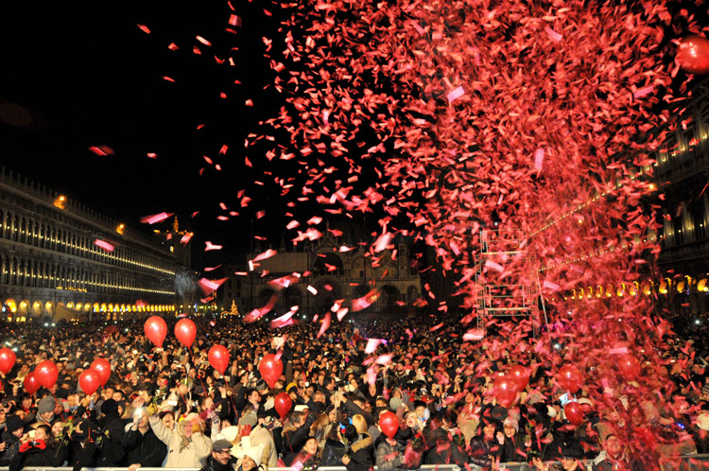
Another funny tradition in Italy on New Year is to wear something red. Many Italians claim it will bring them good luck.

Slide 30
Say in Italian:
Buon Anno Nuovo!
[buone anno nuovo]

Slide 31
Guess the country
S
W
E
D
E
N

Slide 32
The longest New year holiday is in The Kingdom Of Sweden. It begins on the 13th of December (St. Lucia Day) and ended on the 13 of January.

Slide 33
St. Lucia's Day is the beginning of New Year holiday. Early in the morning on December 13th the oldest daughter puts on a white robe with a red belt and lighted candles. Further the girl needs to wake up her parents and give them coffee and buns.

Slide 34
«Advent» is a period after St. Lucia's Day. One of the most known traditions is "the advent wreath" a wreath of fir branches, which bears four candles. The first Sunday one candle is lit, on the second — two and so on, so every week is becoming brighter.

Slide 35
The Swedes like to decorate their New Year's trees by wooden toys and ornaments made of straw. The straw goat is one of the oldest national attributes. The goat helps to give children presents.

Slide 36
Say in Swedish:
Gott Nytt År!
[got nyut or]

Slide 37
Guess the country
C
H
I
N
A

Slide 38
Chinese New Year, also known as Spring Festival in China, is China's most important traditional festival. Chinese New Year's Day is the first day of the Chinese lunar calendar. The date is different each year on the Gregorian calendar, but is always between January 21th and February 20th.

Slide 39
Streets and houses are decorated with red. Red is the main color for the festival. Red lanterns hang in streets. Red couplets and pictures of prosperity are pasted on doors.

Slide 40
Many cultural activities are arranged during the festival such as firecrackers, ancestor worship, lion and dragon dances.

Slide 41
Like Christmas in the West, people exchange gifts during the Spring Festival. The most common gifts are red envelopes. Red envelopes have money in, and are given to children and seniors.

Slide 42
Say in Chinese :
新年好!
[sin nian haо]

Slide 43
Guess the country
I
N
D
I
A

Slide 44
In different parts of India the New Year is celebrated at different times of the year. But apart from the regional new years, India also celebrates the 1st day of January as a new beginning with the rest of the world.

Slide 45
The Festival of Lights, known as ‘Deepawali’ or ‘Diwali’ marks the beginning of the Hindu New Year. Its celebration includes millions of lights shining on housetops, outside doors and windows.

Slide 46
In the east, the festival is devoted to Goddess Lakshmi, the deity of wealth. Goddess Lakshmi brings gifts to children.

Slide 47
In the south, mothers place sweets, flowers and small gifts on a special tray. In the morning, children get their presents.

Slide 48
Say in Hindi :
नये साल की हार्दिक शुभकामनायें!
[naie saal ki haardik shubh-kaam-naien]

Slide 49
The New Year’s
quiz
?
?

Slide 50
1. When the New Year is celebrated in America ?
Yes!
a) on December 31st into January 1st
NO!
b) on the 26th to the 28th of December
NO!
c) on the 22th to the 23th of December

Slide 51
2. What signals the start of the New Year in New York City?
NO!
a) Egg dropping
Yes!
b) Ball dropping
NO!
c) Star dropping

Slide 52
3. Americans decorate their houses with…
NO!
a) colorful ribbons
NO!
b) flowers
Yes!
c) flash lights

Slide 53
4. The New year in Brazil is a … holiday
NO!
a) winter
Yes!
b) summer
NO!
c) spring

Slide 54
5. In Brazil people celebrate New year with…
NO!
a) family
Yes!
b) friends
NO!
c) alone

Slide 55
6. Brazilians throw flowers into the ocean…
Yes!
a) as a present for goddess
NO!
b) just for fun
NO!
c) as a decoration

Slide 56
7. People in German give each other four-leaf clover…
NO!
a) as a symbol of wealth
Yes!
b) as a symbol of good luck
NO!
c) as a symbol of love

Slide 57
8. How the New Year is called in Germany?
NO!
a) Geschenk
NO!
b) Kühle
Yes!
c) Neujahr

Slide 58
9. French love to decorate their homes and banquet tables with…
Yes!
a) twigs of mistletoe
NO!
b) twigs of burdock
NO!
c) twigs of rosemary

Slide 59
10. What are traditional New Year’s dishes in France?
NO!
a) turkey and pumpkin pie
NO!
b) roast beef and ice cream
Yes!
c) pancakes and foie gras

Slide 60
11. What is the most popular Italian New Year’s tradition?
NO!
a) to buy new furniture
Yes!
b) to throw away old things
NO!
c) to wash shoes

Slide 61
12. Italians believe that wearing something red on New Year’s Day will bring them …
NO!
a) a lot of money
Yes!
b) good luck
NO!
c) good health

Slide 62
13. Where is the longest New Year holiday?
Yes!
a) in the Kingdom of Sweden
NO!
b) in the United Kingdom
NO!
c) in the Russian Federation

Slide 63
14. The Swedes like to decorate their New Year's trees by…
NO!
a) candles
NO!
b) candies
Yes!
c) straw toys

Slide 64
15. What is one of the oldest Swedish national attributes?
NO!
a) a straw horse
Yes!
b) a straw goat
NO!
c) a straw donkey

Slide 65
16. Chinese New Year is also known as…
NO!
a) Winter Festival
NO!
b) Summer Festival
Yes!
c) Spring Festival

Slide 66
17. Chinese New Year's Day is the first day of…
Yes!
a) Lunar calendar
NO!
b) Gregorian calendar
NO!
c) Solar calendar

Slide 67
18. What is the main color for the Chinese New Year?
NO!
a) yellow
NO!
b) pink
Yes!
c) red

Slide 68
19. ‘Diwali’ that marks the beginning of the Hindu New Year is also known as…
NO!
a) The Festival of Flowers
Yes!
b) The Festival of Lights
NO!
c) The Festival of Lanterns

Slide 69
20. Who brings gifts to children in India?
NO!
a) Father Frost
NO!
b) Goddess Saraswati
Yes!
c) Goddess Lakshmi

Slide 70
Well Done!
Happy new year!

