Slide 1
Famous streets

Slide 2
Once a fellow met a fellow
In a field of beans.
Said a fellow to a fellow,
“If a fellow asks a fellow,
Can a fellow tell a fellow
What a fellow means?”

Slide 5
 |  |  |  | C | A | F | E

Slide 7
 |  |  |  | C | A | F | E
 |  |  |  |  | B | A | N | K

Slide 9
 |  |  |  | C | A | F | E
 |  |  |  |  | B | A | N | K
 | S | U | P | E | R | M | A | R | K | E | T

Slide 11
 |  |  |  | C | A | F | E
 |  |  |  |  | B | A | N | K
 | S | U | P | E | R | M | A | R | K | E | T
 |  |  |  |  | P | O | S | T | O | F | F | I | C | E

Slide 13
 |  |  |  | C | A | F | E
 |  |  |  |  | B | A | N | K
 | S | U | P | E | R | M | A | R | K | E | T
 |  |  |  |  | P | O | S | T | O | F | F | I | C | E
 | R | E | S | T | A | U | R | A | N | T

Slide 15
 |  |  |  | C | A | F | E
 |  |  |  |  | B | A | N | K
 | S | U | P | E | R | M | A | R | K | E | T
 |  |  |  |  | P | O | S | T | O | F | F | I | C | E
 | R | E | S | T | A | U | R | A | N | T
 |  |  | N | E | W | S | A | G | E | N | T | ‘ | S

Slide 17
 |  |  |  | C | A | F | E
 |  |  |  |  | B | A | N | K
 | S | U | P | E | R | M | A | R | K | E | T
 |  |  |  |  | P | O | S | T | O | F | F | I | C | E
 | R | E | S | T | A | U | R | A | N | T
 |  |  | N | E | W | S | A | G | E | N | T | ‘ | S
B | A | K | E | R | ‘ | S

Slide 19
 |  |  |  | C | A | F | E
 |  |  |  |  | B | A | N | K
 | S | U | P | E | R | M | A | R | K | E | T
 |  |  |  |  | P | O | S | T | O | F | F | I | C | E
 | R | E | S | T | A | U | R | A | N | T
 |  |  | N | E | W | S | A | G | E | N | T | ‘ | S
B | A | K | E | R | ‘ | S
 |  |  |  |  |  | T | O | Y | S | H | O | P

Slide 21
 |  |  |  | C | A | F | E
 |  |  |  |  | B | A | N | K
 | S | U | P | E | R | M | A | R | K | E | T
 |  |  |  |  | P | O | S | T | O | F | F | I | C | E
 | R | E | S | T | A | U | R | A | N | T
 |  |  | N | E | W | S | A | G | E | N | T | ‘ | S
B | A | K | E | R | ‘ | S
 |  |  |  |  |  | T | O | Y | S | H | O | P
 |  |  | L | I | B | R | A | R | Y

Slide 23
 |  |  |  | C | A | F | E
 |  |  |  |  | B | A | N | K
 | S | U | P | E | R | M | A | R | K | E | T
 |  |  |  |  | P | O | S | T | O | F | F | I | C | E
 | R | E | S | T | A | U | R | A | N | T
 |  |  | N | E | W | S | A | G | E | N | T | ‘ | S
B | A | K | E | R | ‘ | S
 |  |  |  |  |  | T | O | Y | S | H | O | P
 |  |  | L | I | B | R | A | R | Y
 |  |  |  |  | P | E | T | S | H | O | P

Slide 25
 |  |  |  | C | A | F | E
 |  |  |  |  | B | A | N | K
 | S | U | P | E | R | M | A | R | K | E | T
 |  |  |  |  | P | O | S | T | O | F | F | I | C | E
 | R | E | S | T | A | U | R | A | N | T
 |  |  | N | E | W | S | A | G | E | N | T | ‘ | S
B | A | K | E | R | ‘ | S
 |  |  |  |  |  | T | O | Y | S | H | O | P
 |  |  | L | I | B | R | A | R | Y
 |  |  |  |  | P | E | T | S | H | O | P
 |  |  |  | C | H | E | M | I | S | T | ‘ | S

Slide 27
 |  |  |  | C | A | F | E
 |  |  |  |  | B | A | N | K
 | S | U | P | E | R | M | A | R | K | E | T
 |  |  |  |  | P | O | S | T | O | F | F | I | C | E
 | R | E | S | T | A | U | R | A | N | T
 |  |  | N | E | W | S | A | G | E | N | T | ‘ | S
B | A | K | E | R | ‘ | S
 |  |  |  |  |  | T | O | Y | S | H | O | P
 |  |  | L | I | B | R | A | R | Y
 |  |  |  |  | P | E | T | S | H | O | P
 |  |  |  | C | H | E | M | I | S | T | ‘ | S
F | L | O | R | I | S | T | S | H | O | P

Slide 28
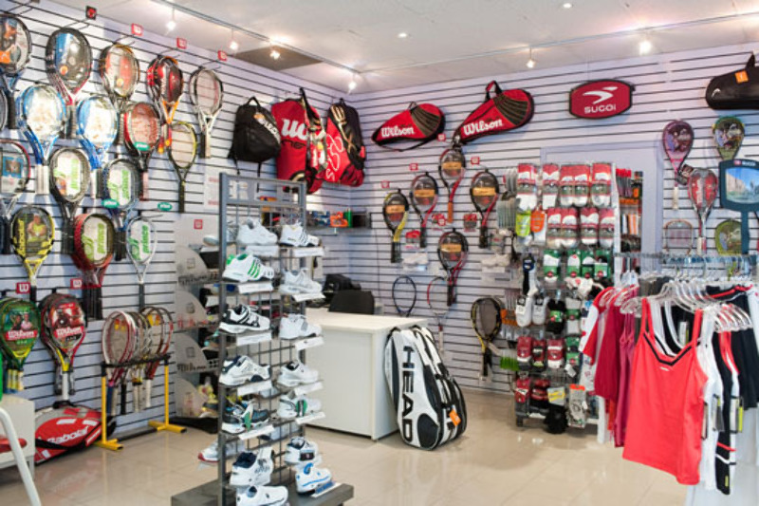

Slide 29
 |  |  |  | C | A | F | E
 |  |  |  |  | B | A | N | K
 | S | U | P | E | R | M | A | R | K | E | T
 |  |  |  |  | P | O | S | T | O | F | F | I | C | E
 | R | E | S | T | A | U | R | A | N | T
 |  |  | N | E | W | S | A | G | E | N | T | ‘ | S
B | A | K | E | R | ‘ | S
 |  |  |  |  |  | T | O | Y | S | H | O | P
 |  |  | L | I | B | R | A | R | Y
 |  |  |  |  | P | E | T | S | H | O | P
 |  |  |  | C | H | E | M | I | S | T | ‘ | S
F | L | O | R | I | S | T | S | H | O | P
 |  |  |  |  |  | S | P | O | R | T | S | S | H | O | P

Slide 30
Find 10 places in town
r | s | u | p | e | r | m | a | r | k | e | t | u | j
f | g | h | e | c | a | c | h | e | m | i | s | t | s
e | r | y | j | b | f | t | y | s | f | t | u | m | p
n | e | w | s | a | g | e | n | t | s | u | k | b | o
z | e | n | a | l | i | b | r | a | r | y | t | o | r
w | n | u | g | e | q | m | o | u | c | t | i | r | t
z | g | x | v | b | n | g | y | r | j | k | l | p | s
q | r | s | c | f | r | t | g | a | n | h | j | o | s
t | o | y | s | h | o | p | s | n | z | c | f | d | h
t | c | y | h | n | b | p | e | t | s | h | o | p | o
p | e | b | g | d | s | a | z | a | b | r | w | q | p
a | r | e | p | o | s | t | o | f | f | i | c | e | u
b | s | e | h | j | k | i | u | t | e | w | s | z | a

Slide 31
Find 10 places in town
r | s | u | p | e | r | m | a | r | k | e | t | u | j
f | g | h | e | c | a | c | h | e | m | i | s | t | s
e | r | y | j | b | f | t | y | s | f | t | u | m | p
n | e | w | s | a | g | e | n | t | s | u | k | b | o
z | e | n | a | l | i | b | r | a | r | y | t | o | r
w | n | u | g | e | q | m | o | u | c | t | i | r | t
z | g | x | v | b | n | g | y | r | j | k | l | p | s
q | r | s | c | f | r | t | g | a | n | h | j | o | s
t | o | y | s | h | o | p | s | n | z | c | f | d | h
t | c | y | h | n | b | p | e | t | s | h | o | p | o
p | e | b | g | d | s | a | z | a | b | r | w | q | p
a | r | e | p | o | s | t | o | f | f | i | c | e | u
b | s | e | h | j | k | i | u | t | e | w | s | z | a

Slide 32
Boulevard |ˈbuːləvɑːd| бульвар, проспект
Avenue |ˈav(ə)njuː| авеню, дорога или аллея, обсаженная деревьями
Lane |leɪn| дорожка, тропинка
Pavement |ˈpeɪvm(ə)nt| тротуар
Handprint |ˈhændprɪnt| отпечаток руки
Footprint |ˈfʊtprɪnt| след, отпечаток

Slide 33
David can find Wall Street interesting
because he is an economist,
he is interested in money.

Slide 35
Lombard Street, San Francisco

Slide 36
Abbey Road, London

Slide 37
La Rambla, Barcelona

Slide 38
Orchard, Singapore

Slide 39
Khao San Road, Bangkok

Slide 40
Via Dolorosa (Latin for Way of Grief), Jerusalem

Slide 41
Las Vegas Strip, Las Vegas

Slide 42
Champs-Elysées, paris

Slide 43
Write a tourists guide poster about a famous street in your city/country.
Write about:
its location (centre, south, north, …)
what you can find there (shops, cafes, …)
what you can do there (relax, walk, …)
Decorate your tourist guide poster with photographs.

Slide 44
Thank you for your work.

