Slide 1
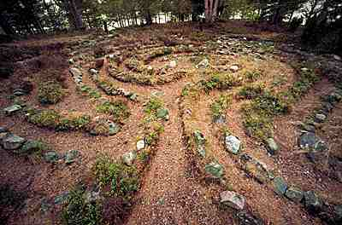
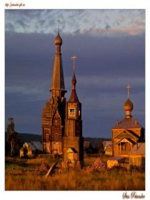
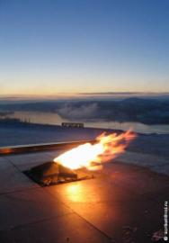
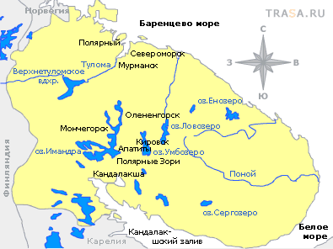
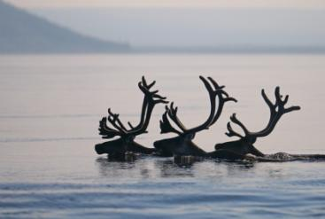
The Kola Land Wonders

Slide 2
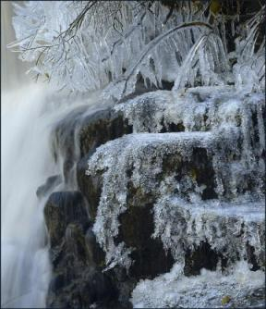
What Is “Wonder”?
“Wonder” -
is a thing or a person that makes you feel admiration mixed with surprise.

Slide 3
What types of wonder do you know?
Wonders of engineering
Wonders of art Natural wonders Architectural wonders Tourist travel wonders

Slide 4
The Kola Super Deep

Slide 5
The Kola Land Wonders The Kuzomen Sand Desert
The Sand Desert in Tundra

Slide 6
The Kola Land Wonders
The Sand Desert in Tundra

Slide 7
The Kola Land Wonders
Ancient Mazes Dated Back to 2-3 Millennia BC

Slide 8
The Kola Land Wonders
The Lenin – the First Atomic Ice - breaker

Slide 9
The Kola Land Wonders
The Non – Freezing Kola Gulf

Slide 10
The Kola Land Wonders
The Lapland National Reserve – the Biggest in Europe

Slide 11
The Kola Land Wonders
The Mud Volcano in the Barents Sea

Slide 12
The Kola Land Wonders
Polar Alpine Botanic Garden - Institute

Slide 13
The Kola Super Deep
The Deepest Borehole in the World

Slide 14
The Kola Land Wonders
Ancient Petroglyphs – Dated 2-3 Millennia BC

Slide 15
Lake Mogilnoe
The Only Six-Layered Lake in the World

Slide 16
The Kola Land Wonders
The Assumption Church

Slide 17
The Kola Land Wonders
The Kuyva – Sacred Sami Rock

Slide 18
Making dialogues
Remember to:
-make arrangements
-ask for your partner’s point of view
-give reasons for your choices
-be active in the conversation
-agree/ disagree with your partner
- take turns
-come to an agreement
You’ve got 2 minutes to prepare and 2 minutes to act out. Don’t forget to use the adjectives.

Slide 19
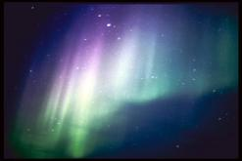
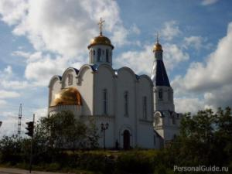
Wish You Good Luck!
Don’t forget:
we have much more to see on the Kola Peninsula!

