Slide 1
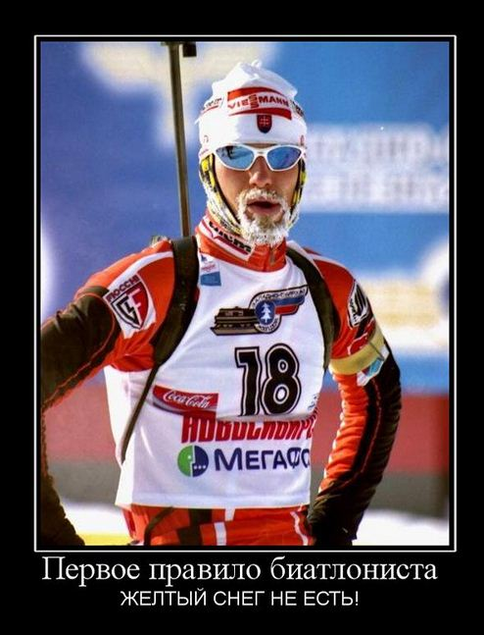
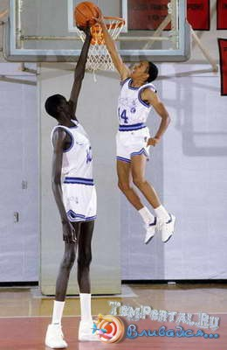
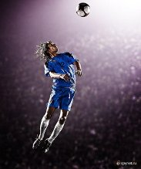
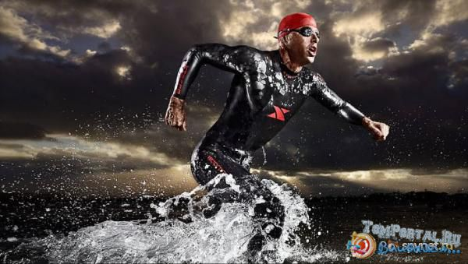

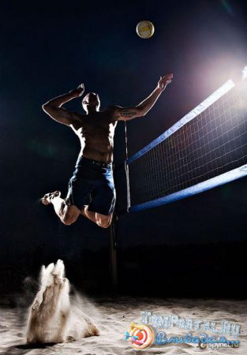


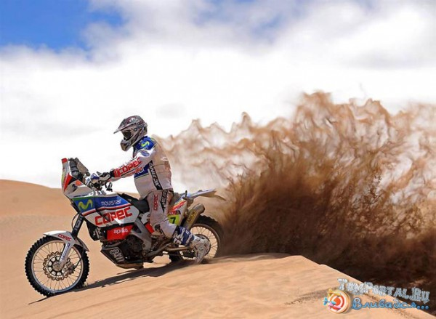
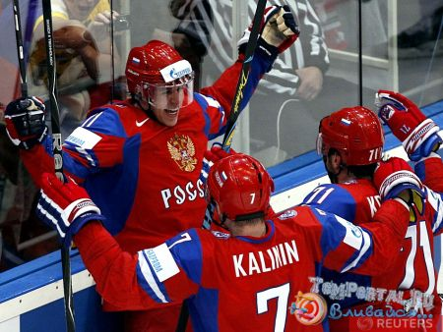
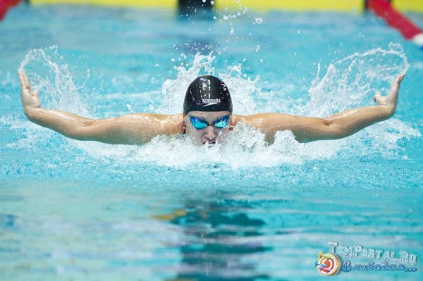
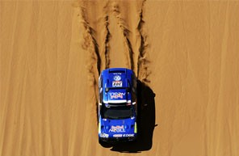
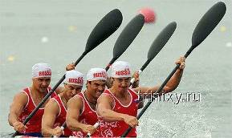
Sport in our life

Slide 2
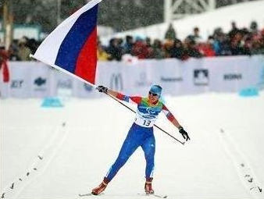
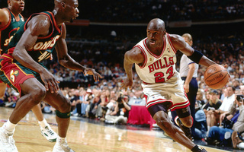
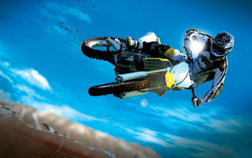
Who is engaged in sports, the power is dialed.

Slide 3
Practice makes perfect
[ Ŋ ] [ θ ] !
Cheerleading athletics be fond of
Jumping discus throwing be popular with
Surfing hammer throwing take part in
Swimming javelin throwing go in for
Wrestling be good at

Slide 4
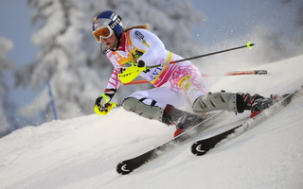
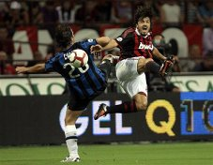

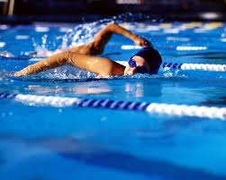

What sports are popular in Russia?
Skiing
Football
cycling
Swimming
Hockey

Slide 5
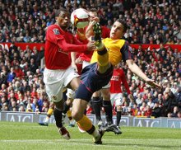
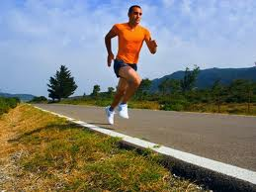
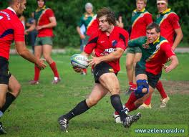
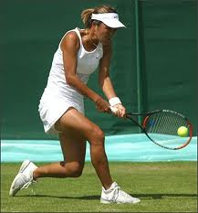
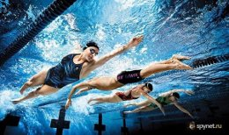
What sports are popular in Britain?
football
Running
Rugby
swimming
Tennis

Slide 6
Sport in Our Life.
People all over the world are fond of sports and games. Sport makes people healthy, keeps them fit, more organized and better disciplined. It unites people of different classes and nationalities. Many people do sports on their personal initiative. They go in for skiing, skating, table tennis, swimming, volley-ball, football, body-building, etc.
All necessary facilities are provided for them: stadiums, sport grounds, swimming pools, skating rinks, skiing stations, football fields.
Sport is paid much attention to in our educational establishments. Gymnastics is a part of children's daily activities in the kindergartens. Physical culture is ч compulsory subject at schools and colleges.
Professional sport is also paid much attention to in our country. In city, where I live, there are diferent sporting societies, clubs and complexes.
Practically all kinds of sports are popular in our country, but football, gymnastics and tennis enjoy the greatest popularity.
As for me, I go in for table tennis (ping-pong). It needs mobility, liveliness and much energy. It keeps a person in a good form. I have been playing tennis for five years, but the more I play, the more I like it. I get a real joy taking part in competitions or simply playing with my friends. Sometimes, I go to tennis courts. Certainly, there's a great distance between my manner of playing and such favourites as Jim Courier, Stephan Edberg, Pete Sampras, Boris Becker, Per Korda, but I do my training with great pleasure and hope to play as well as our best players do.

Slide 7
DRILLS FOR SKILLS
1.Type of sport with using the gloves.
2. Popular kind of sport in our country (using a ball).
3. A Kind of sport, when sportsmen move on skates.
4. Type of sport, where you must throw the ball in a basket.
5. Rhythmical gymnastics.
6. Sport in which, two teams try to hit hockey goal in the gate.
7. Kind of sport, where playing with rackets.
8. The sport of jumping into water.
9. The use of bicycles for sport.
10. The sport involving performance of exercises requiring flexibility, agility, coordination, and balance

Slide 8
S
K
A
2. F
T
1. B
O
X
I
N
G
O
N
9. C
T
G
Y
B
5. A
C
7. T
4. B
A
S
K
E
T
B
A
L
L
E
L
R
8. D
I
V
I
N
G
N
L
O
N
N
B
10.G
Y
M
N
A
S
T
I
C
S
I
S
6. H
O
C
K
E
Y
S

