Slide 1
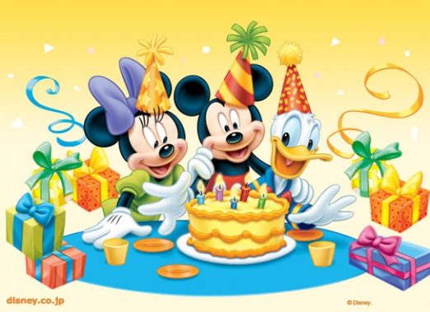
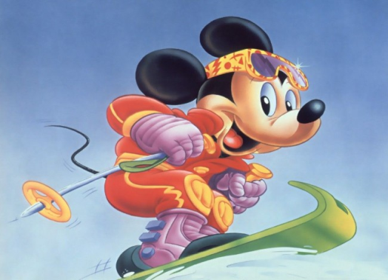
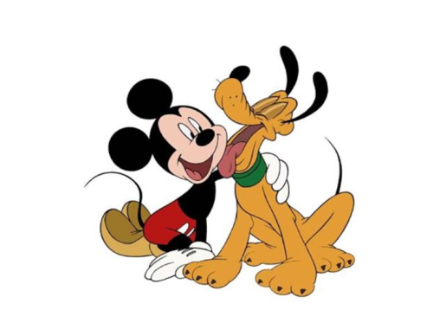
What do you like to do on Sundays?
Презентация
для урока №26 в 3 классе по УМК Биболетовой М. З.
подготовлена учителем
английского языка
Пигульской Е.А.,
МОУ СОШ №44
2013

Slide 2
PHONETIC EXERCISES
[u]
book
good
look
football
[u: ]
zoo
school
too
do

Slide 3
PHONETIC EXERCISES
[w]
with
walk
homework
[ʌ]
run
jump
Sunday

Slide 4
PHONETIC EXERCISES
[e]
friend
tennis
spend
[ei]
play
eight
skate

Slide 5
PHONETIC EXERCISES
[i: ]
ski
read
meet
speak
[i]
hockey
visit
sing
Sunday

Slide 6
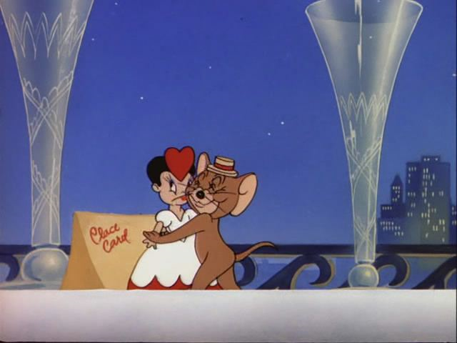
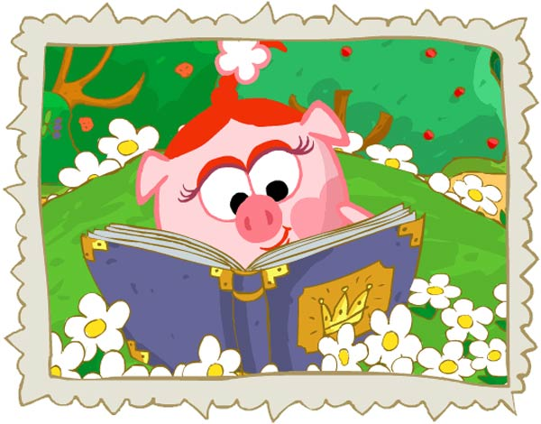
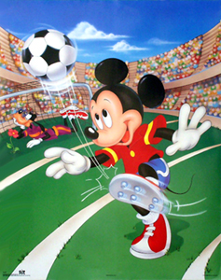
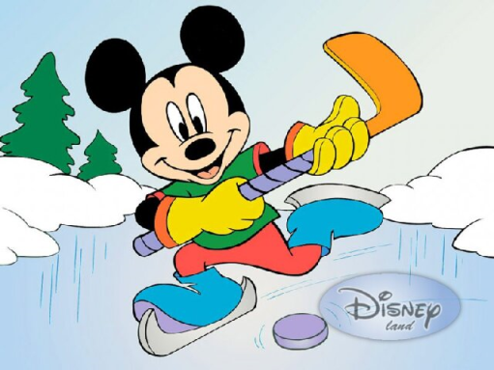
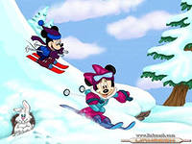
What do you like to do on Sunday?

Slide 8
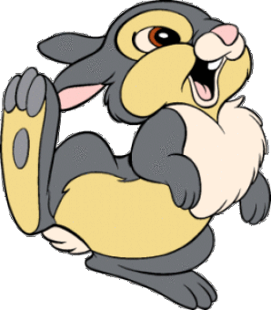
It’s
time
to have
a rest.

Slide 9
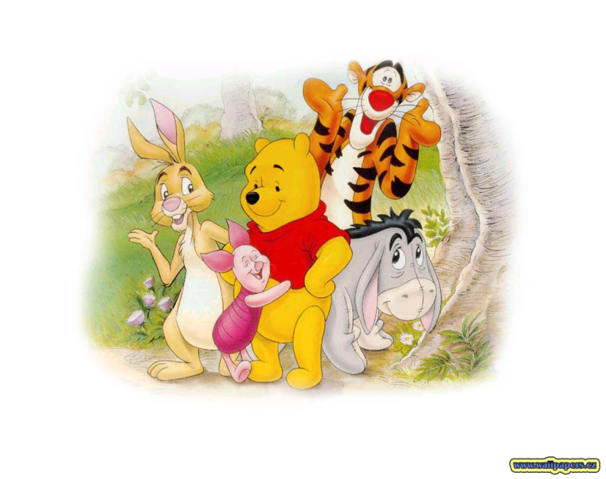
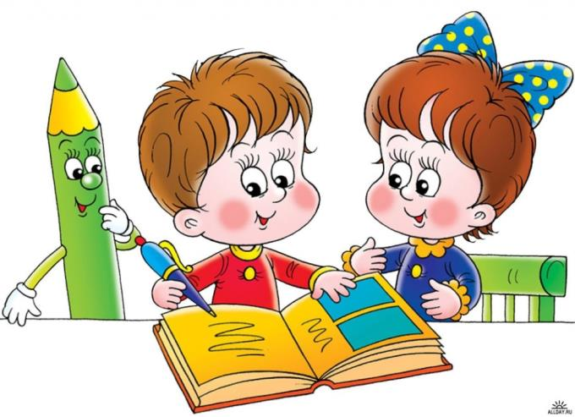
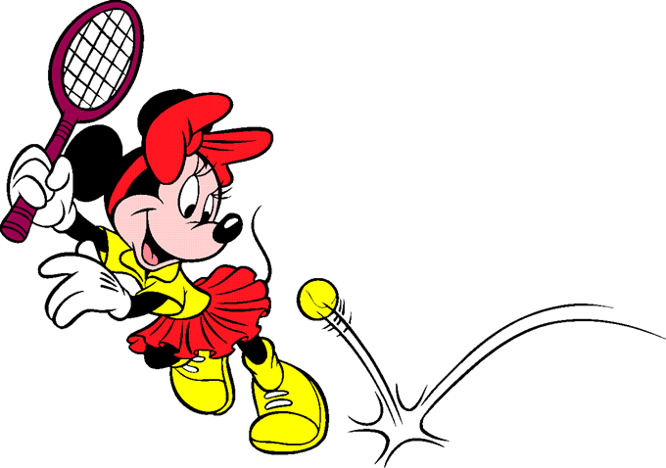
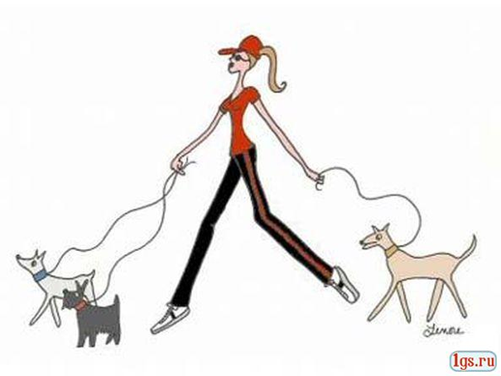
play with friends
do homework
walk with a dog
play tennis

Slide 10
Make a dialogue
What do you like to do on Sunday?
I …to … on Sunday.
2) What does your mother like to do on Sunday?
She …… to … on Sunday.
3) What does your father like to do on Sunday?
He …… to …on Sunday.

Slide 11
YOUR HOMEWORK:
SB p. 46 learn words
WB p. 30 ex. 2, 3.

Slide 12
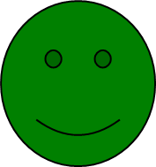
A success light signal
Choose:
if you understood everything
if you understood almost everything
if you understood little

Slide 14
Resources:

