Slide 1
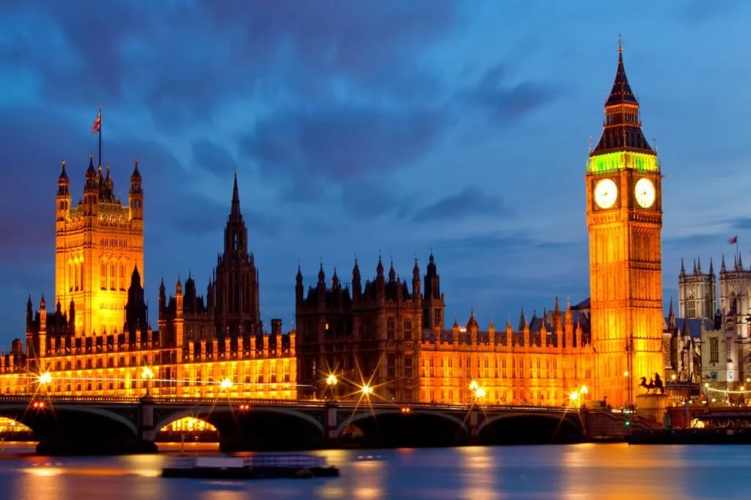
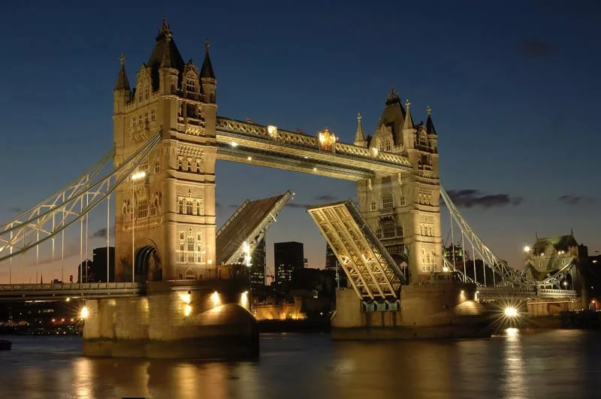
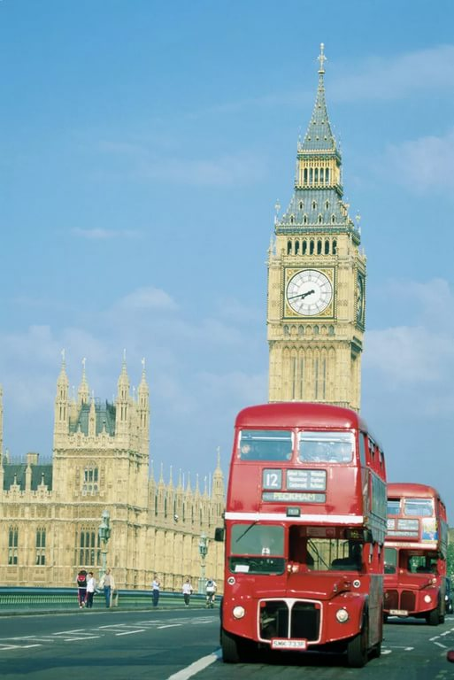
THE THEME:
“ACROSS THE SIGHTS OF LONDON”

Slide 2
Цель урока: развитие социокультурной компетенции, расширение и углубление знаний по теме «Посещение достопримечательностей Лондона»
Задачи урока:
Образовательные:
а) практика речевой деятельности: чтение, аудирование, письмо;
б) активизация лексики по теме «Посещение достопримечательностей Лондона», расширение словарного запаса;
в) развитие коммуникативной компетенции учащихся;
г) закрепление грамматического материала по теме «Страдательный залог»
Воспитательные:
а) развитие интереса к изучению иностранного языка;
б) знакомство учащихся с достопримечательностями столицы Великобритании;
в)приобщение к культурному и историческому наследию народа страны изучаемого языка.

Slide 4
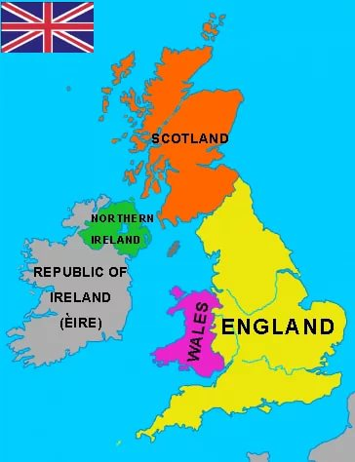
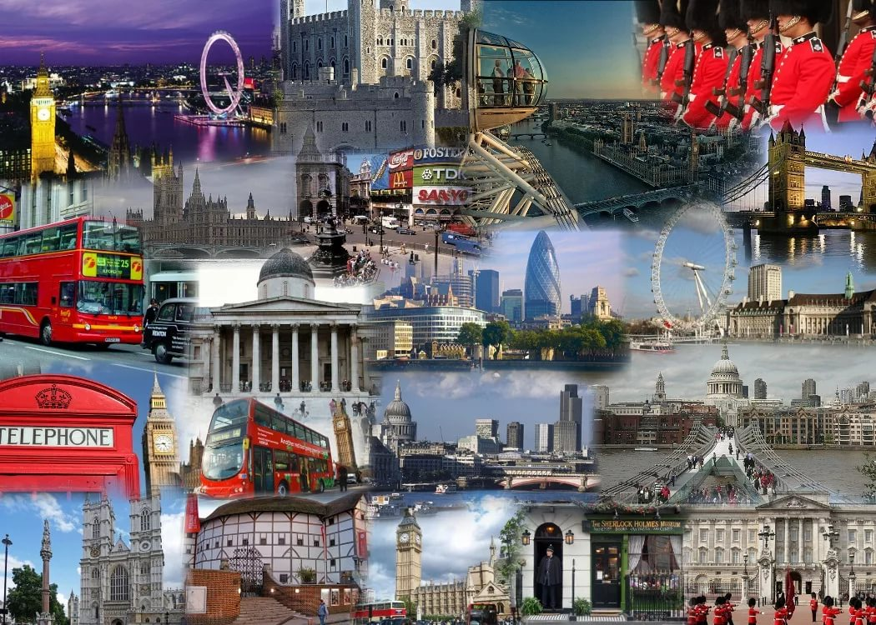
the United Kingdom
Great Britain
Northern Ireland
the British Isles
the United Kingdom of Great Britain and Northern Ireland
England, Scotland, Wales
London
Big Ben
The Tower of London
St. Paul’s Cathedral
Westminster Abbey
the Houses of Parliament
Buckingham Palace
Trafalgar Square

Slide 5
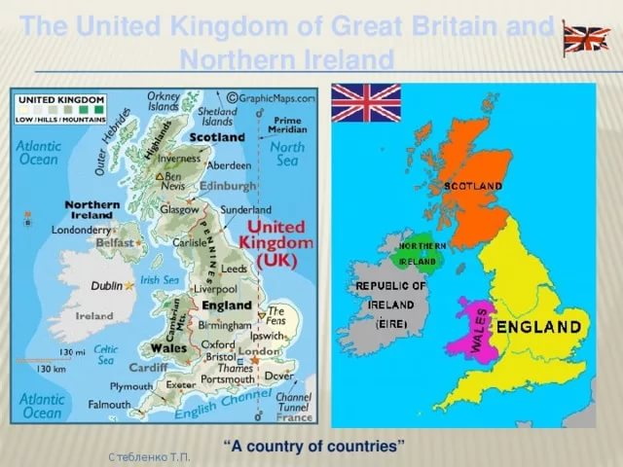
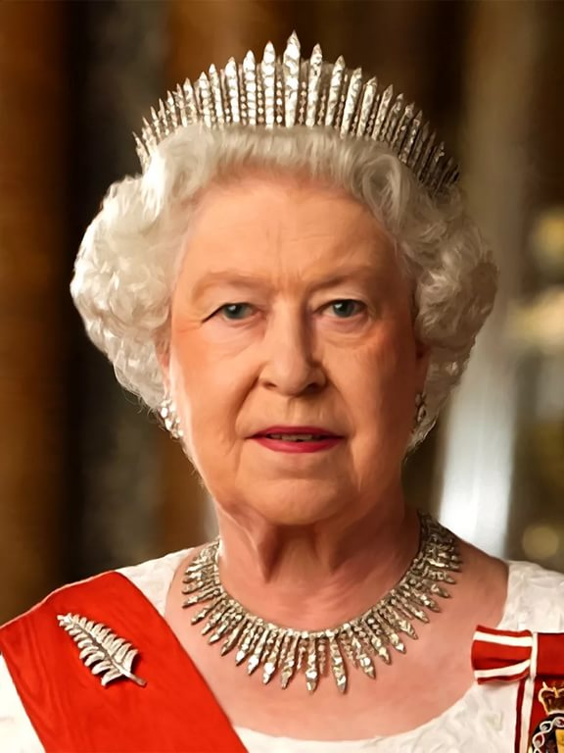
Answer the following questions:
What is the official name of Great Britain?
What parts of Great Britain do you know?
Where is Great Britain located?
What are the main cities of the country?
Who is the head of Great Britain?
What's her name?

Slide 6
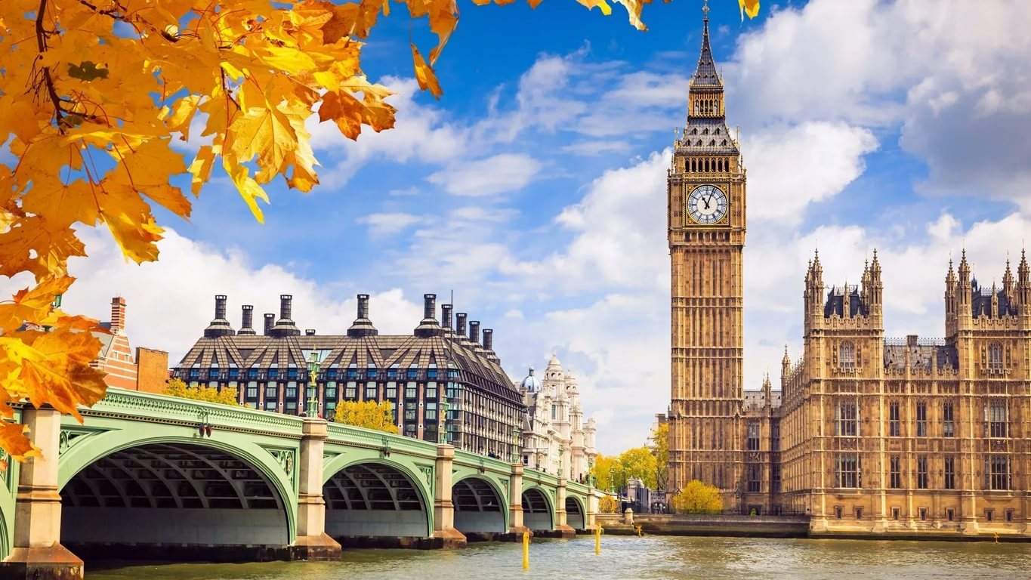
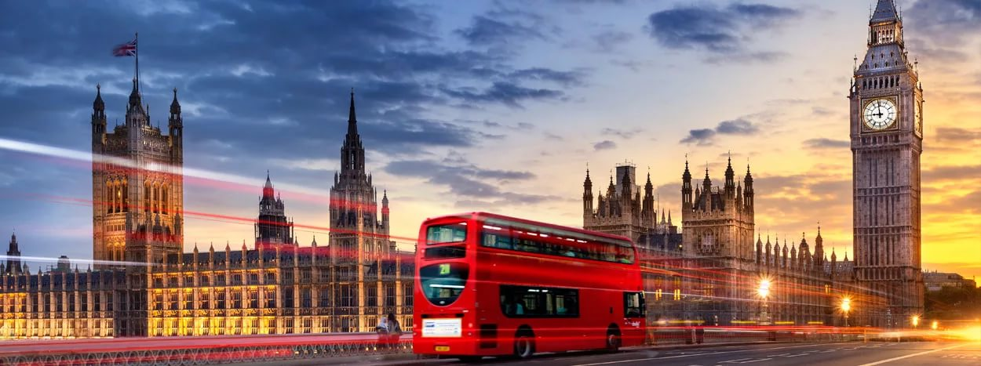
LONDON

Slide 7
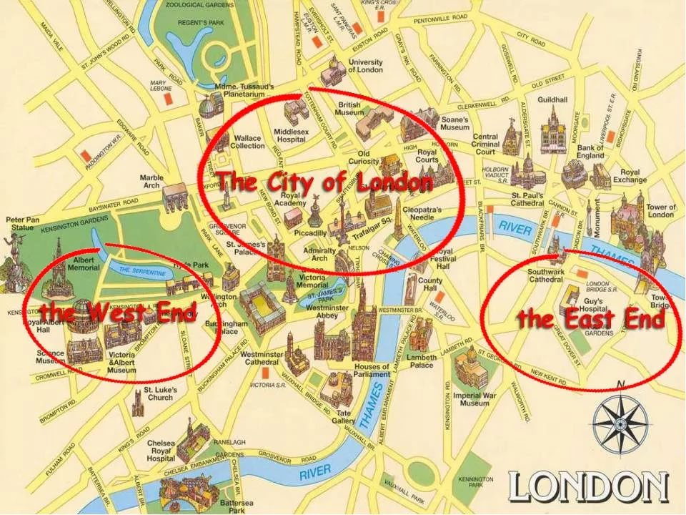

Slide 9
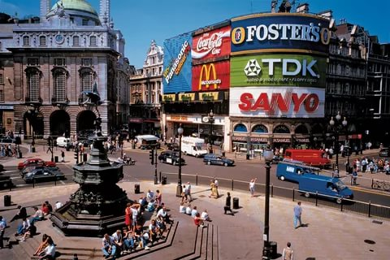
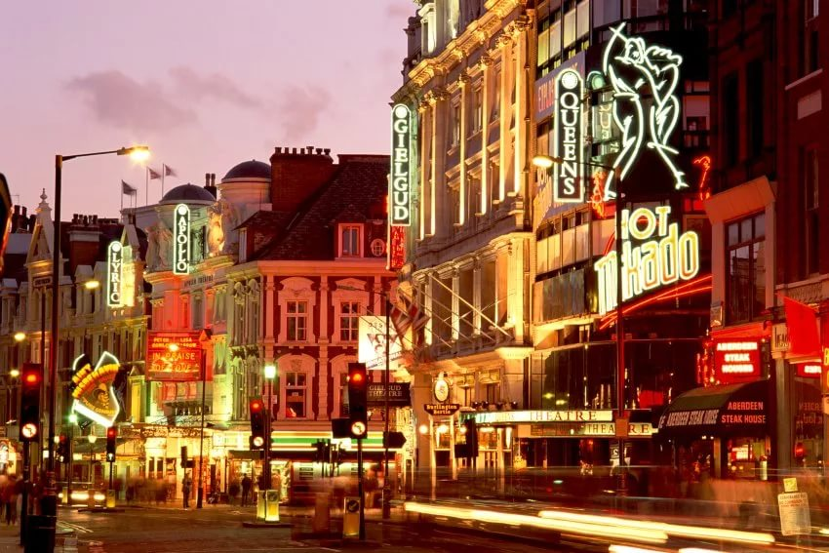
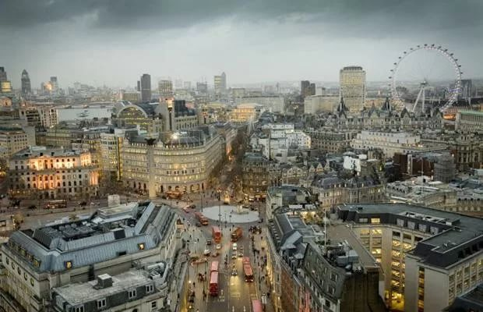
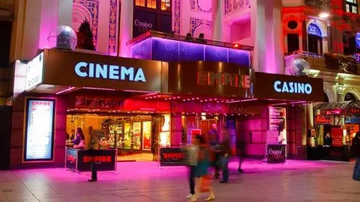

Slide 10
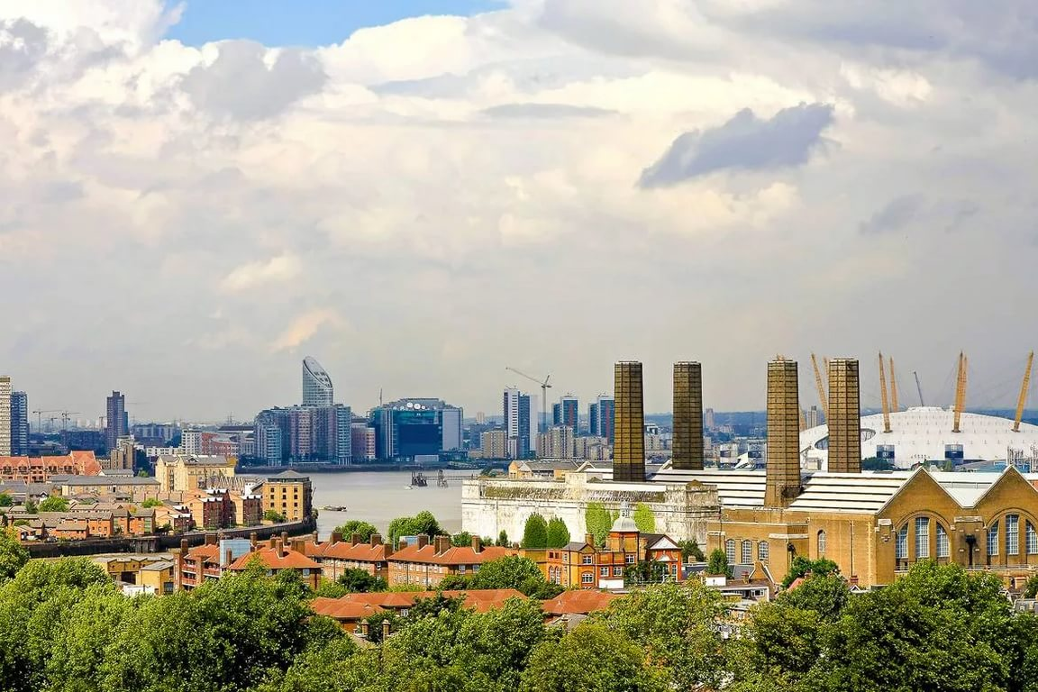

Slide 11
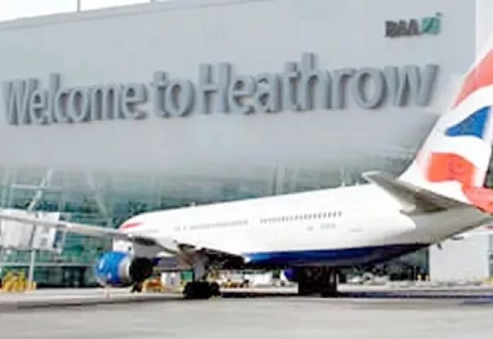
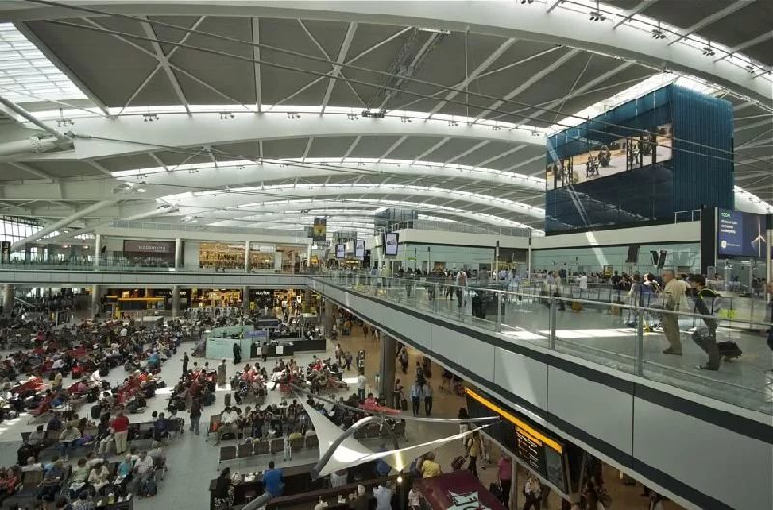
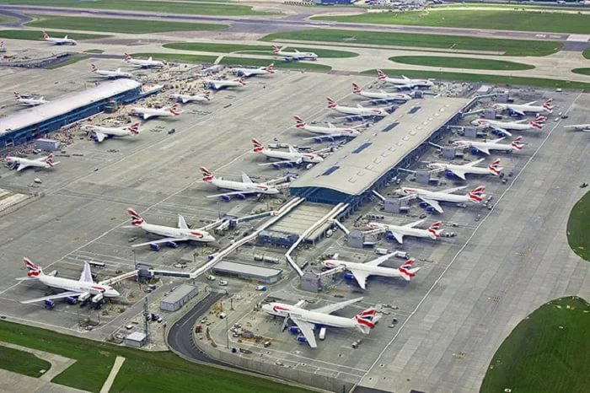

Slide 13
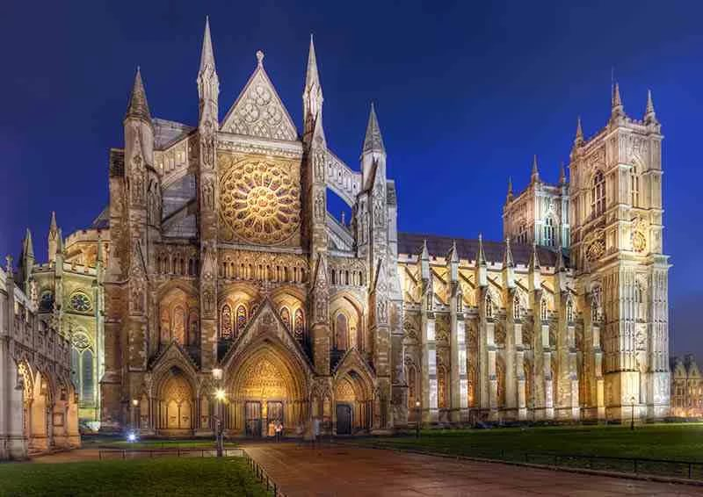
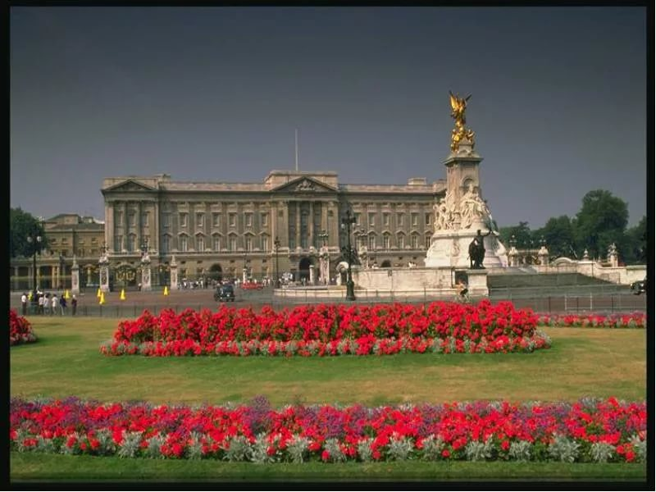
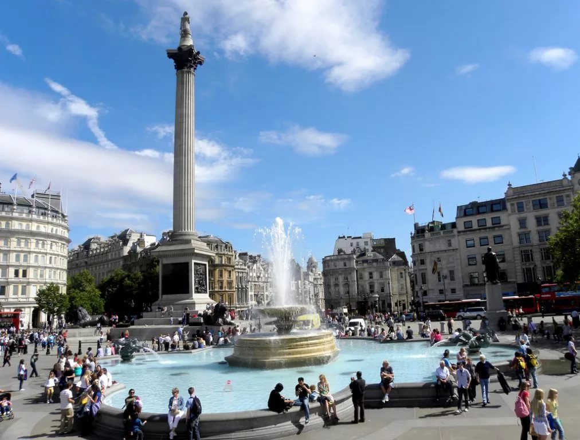
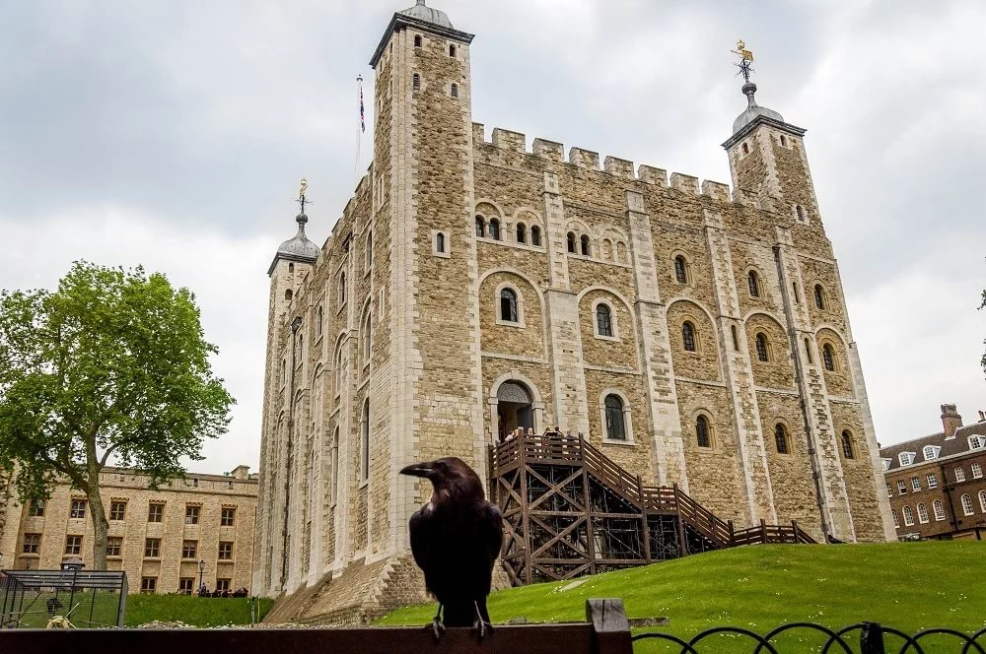
routing sheet
the Houses of Parliament and Big Ben
Westminster Abbey
Buckingham Palace
Trafalgar Square
The Tower of London

Slide 14
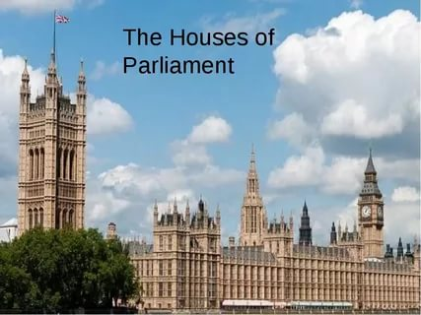

Slide 16
the Victoria Tower
the Clock Tower.

Slide 21
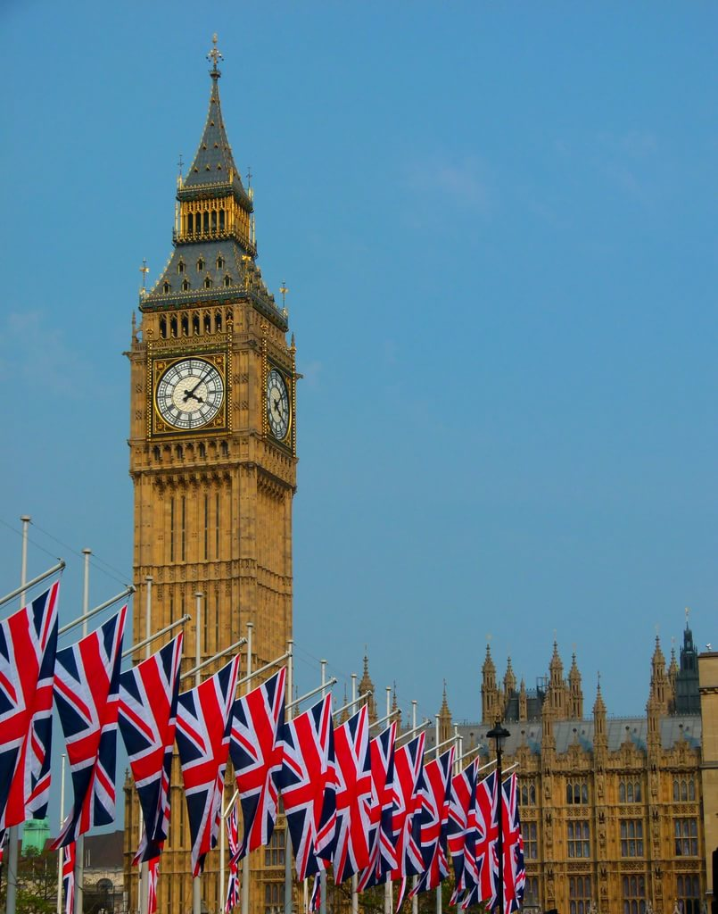
Big Ben

Slide 23
Benjamin Hall

Slide 27
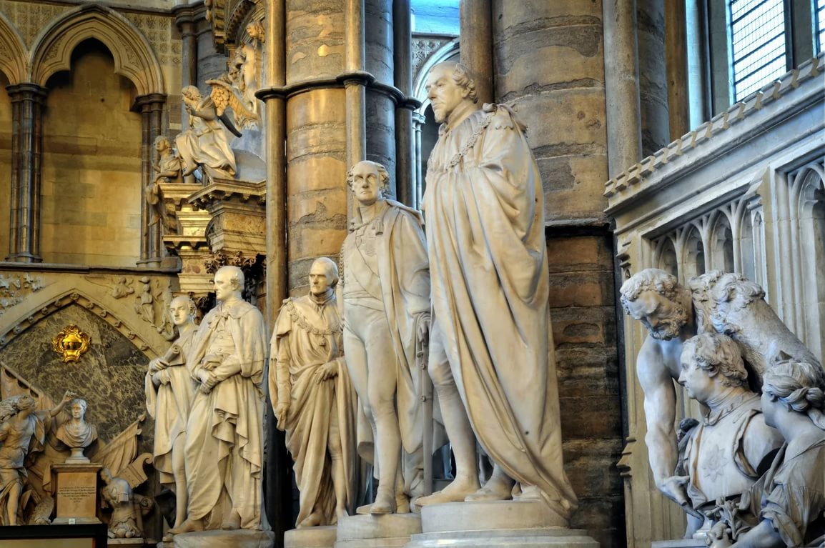

Slide 33
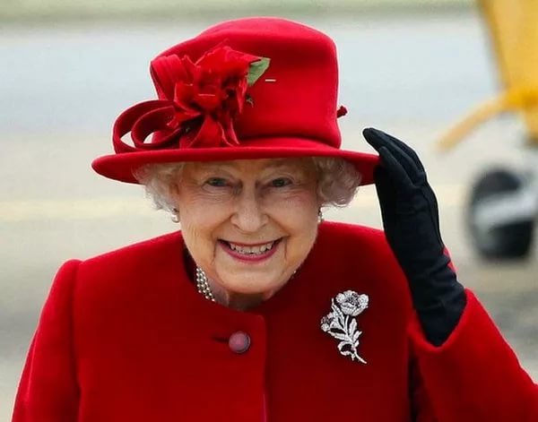
the Queen of the United Kingdom
Elizabeth II

Slide 36
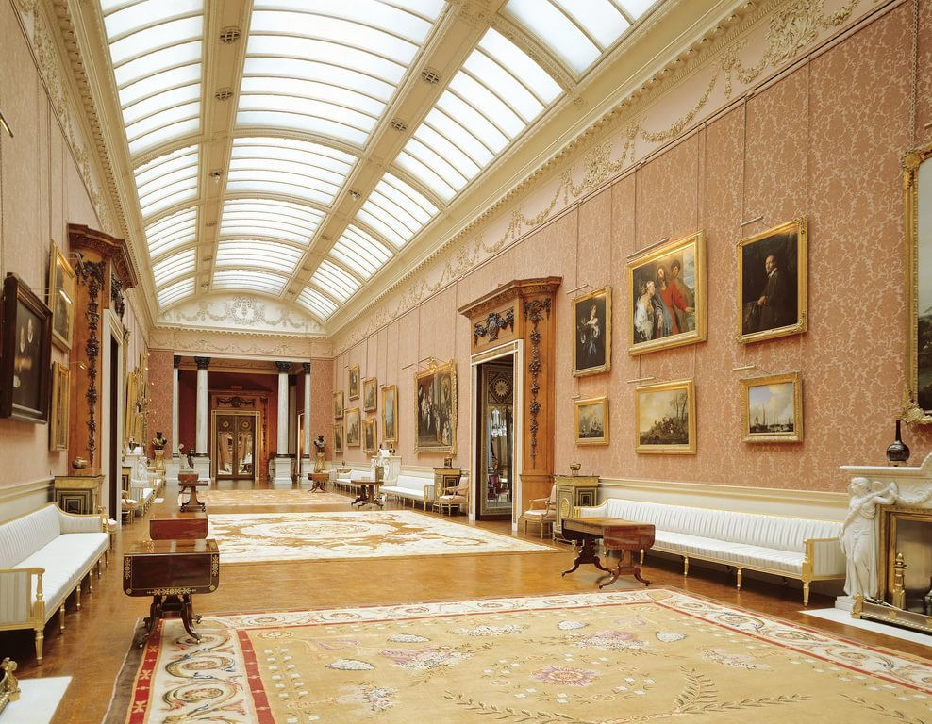

Slide 37
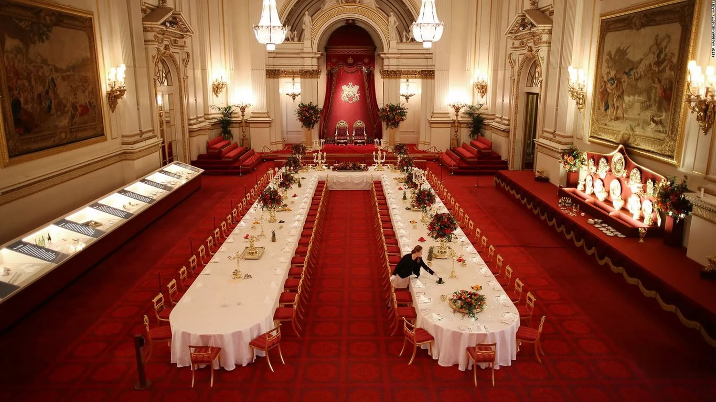

Slide 38
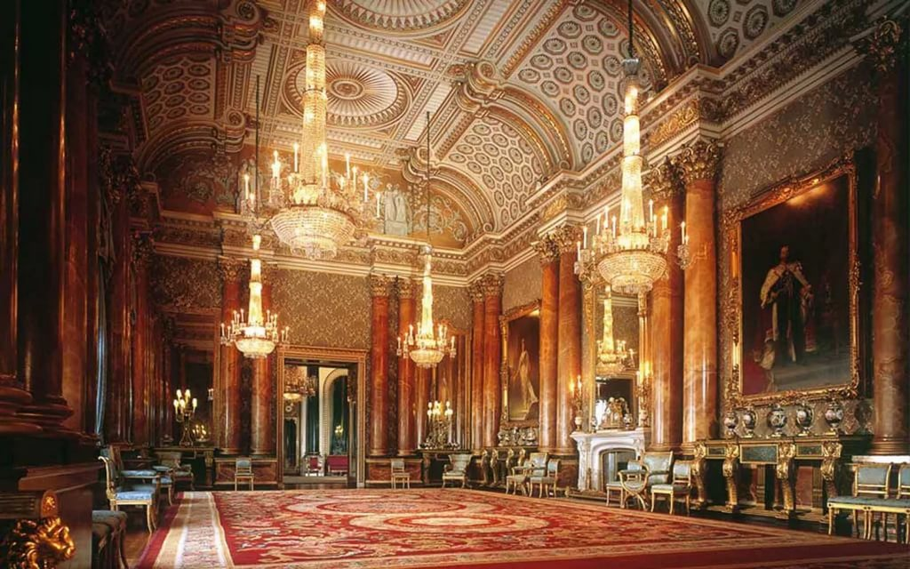

Slide 40
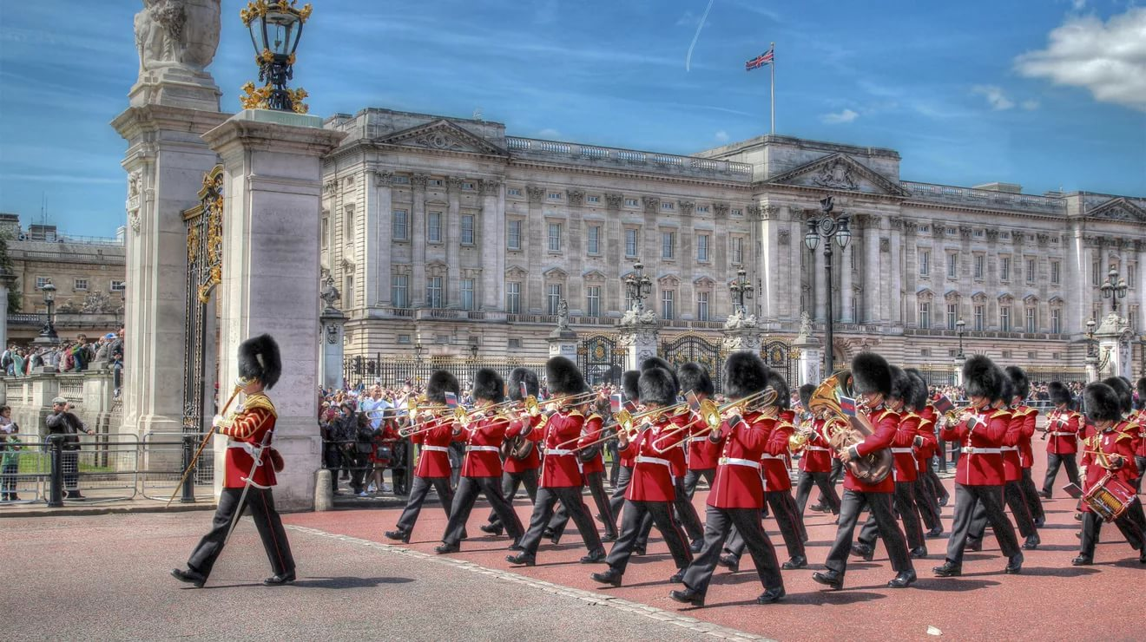

Slide 41
Trafalgar Square

Slide 44
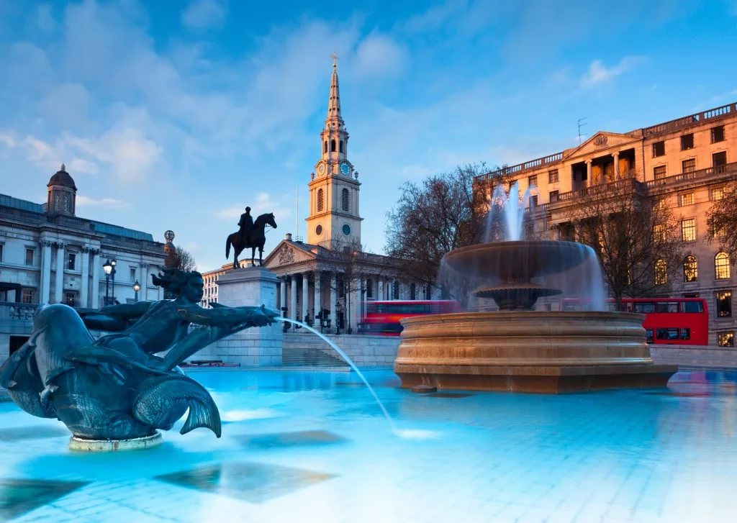

Slide 45
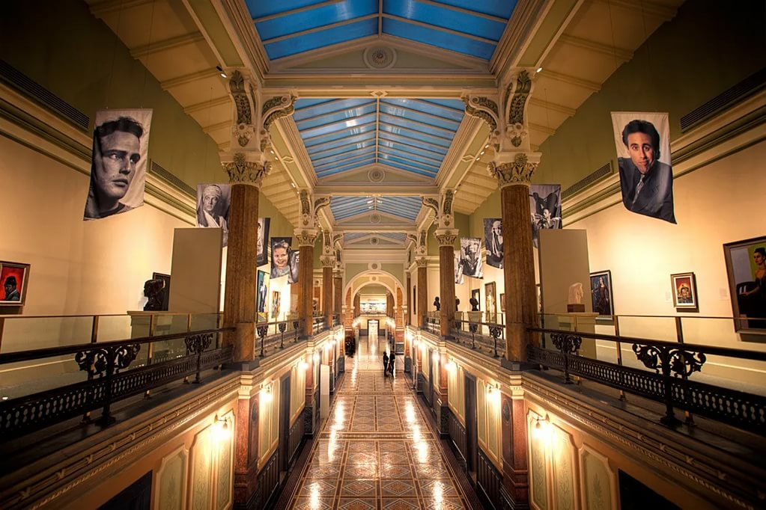
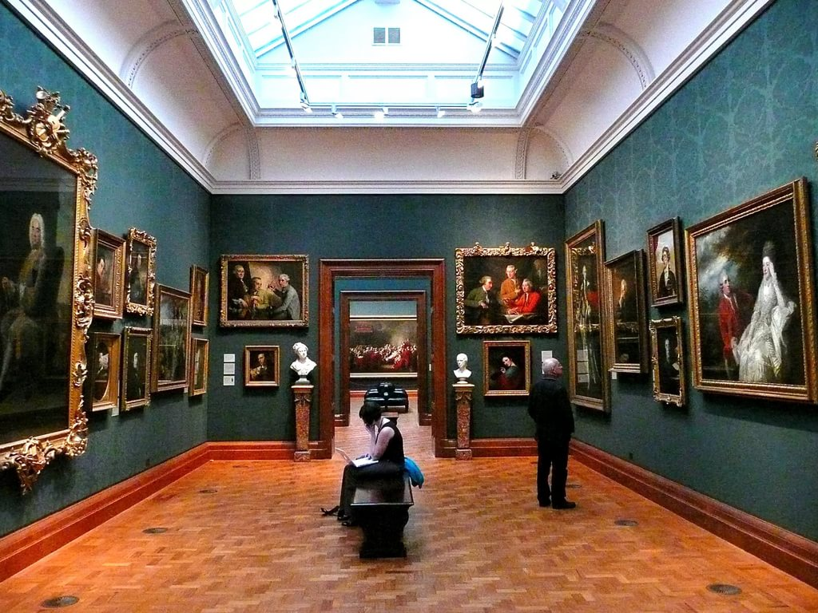
the National gallery

Slide 46
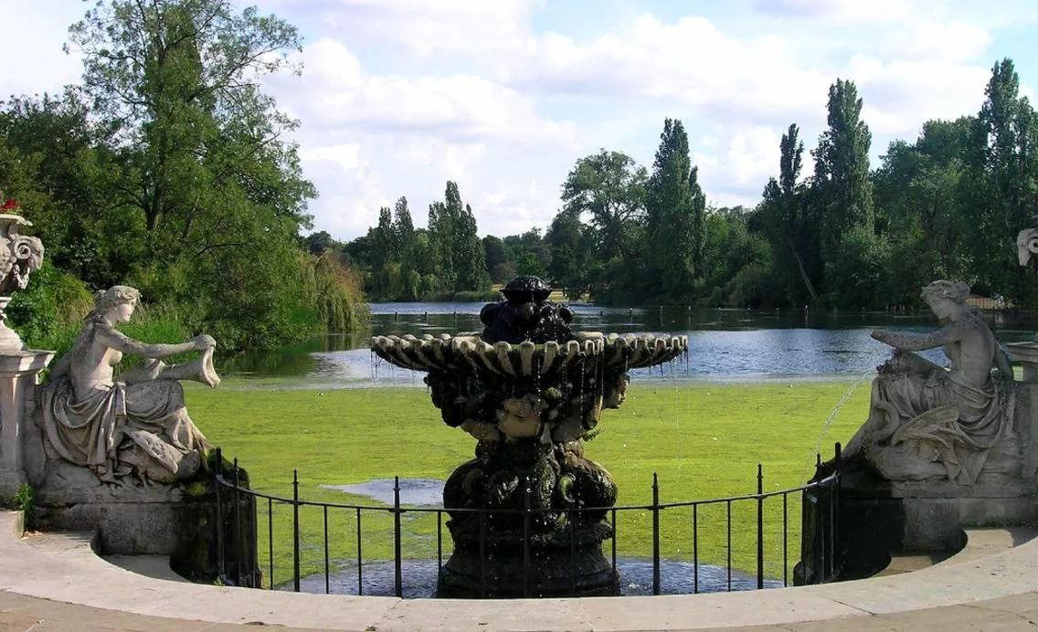
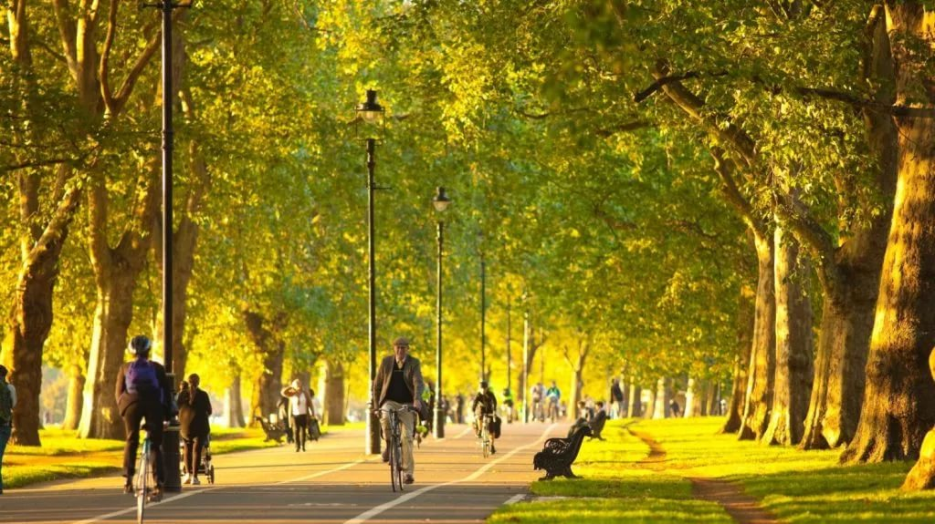
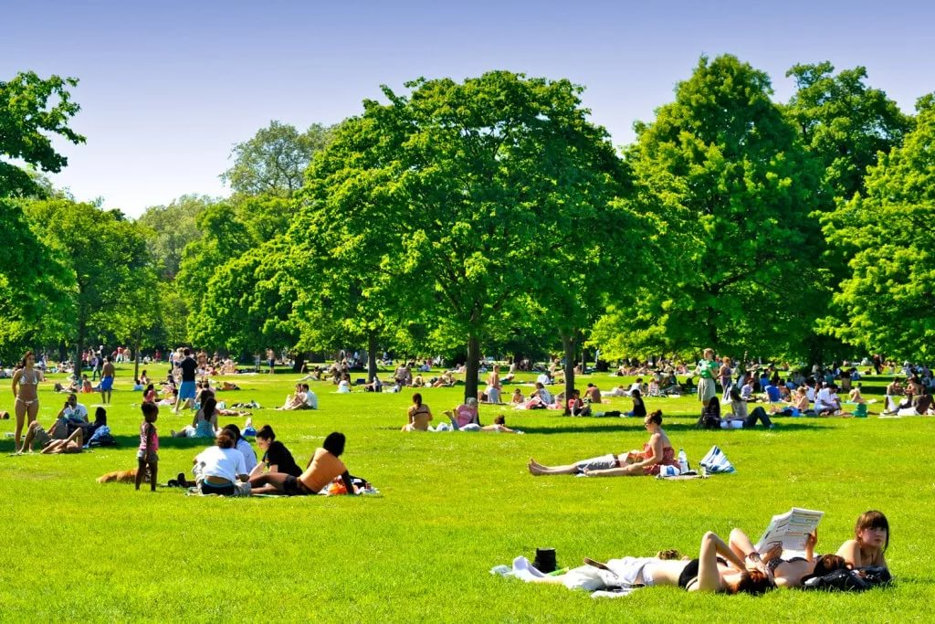

Slide 47
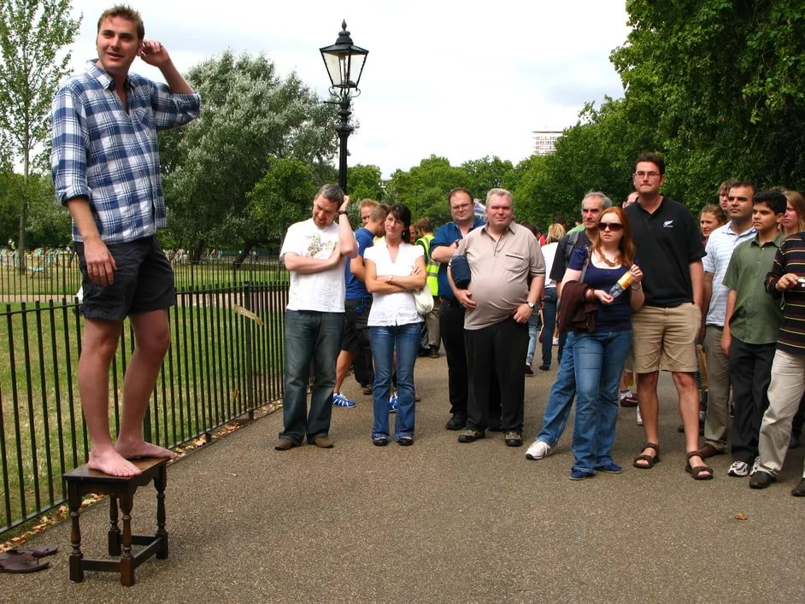

Slide 53
Open the brackets in the following text using
Present Simple Passive or Past Simple Passive
The Tower of London
The Tower of London (build) by William the Conqueror in 1078 as a castle and palace. Since that time it (expand) to its present size, and (use) as an Armory, a zoo, a royal mint, a prison, and a museum. At the time when it was a prison a lot of people (lock) in the Tower for their religious beliefs or suspected treason. Some of the prisoners (allow) to walk in the grounds, live in comfortable rooms and receive visitors. Many convicted (publicly/execute) on Tower Hill. The Jewel House (situate) at the Tower. The collection of the Crown Jewels (keep) in it. Saint Edward’s Crown, the Imperial State Crown, and the royal scepter (guard) there. Saint Edward’s Crown (use) for the coronation ceremonies. 3000 precious jewels (contain) in the Imperial State Crown.

Slide 54
The Tower of London
The Tower of London was built by William the Conqueror in 1078 as a castle and palace. Since that time it was expanded to its present size, and was used as an Armory, a zoo, a royal mint, a prison, and a museum. At the time when it was a prison a lot of people were locked in the Tower for their religious beliefs or suspected treason. Some of the prisoners were allowed to walk in the grounds, live in comfortable rooms and receive visitors. Many convicted were publicly executed on Tower Hill. The Jewel House is situated at the Tower. The collection of the Crown Jewels are kept in it. Saint Edward’s Crown, the Imperial State Crown, and the royal scepter is guarded there. Saint Edward’s Crown is used for the coronation ceremonies. 3000 precious jewels are contained in the Imperial State Crown.

Slide 55
HOMEWORK: make up a list of places you would like to visit.

Slide 56
What information have you known?
At the lesson…
We have learnt…
We have listened about …
We have known…
We have spoken …

Slide 57
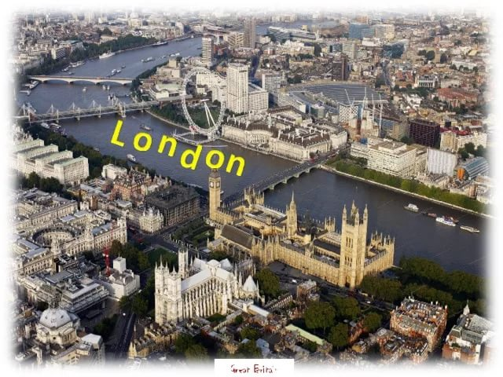
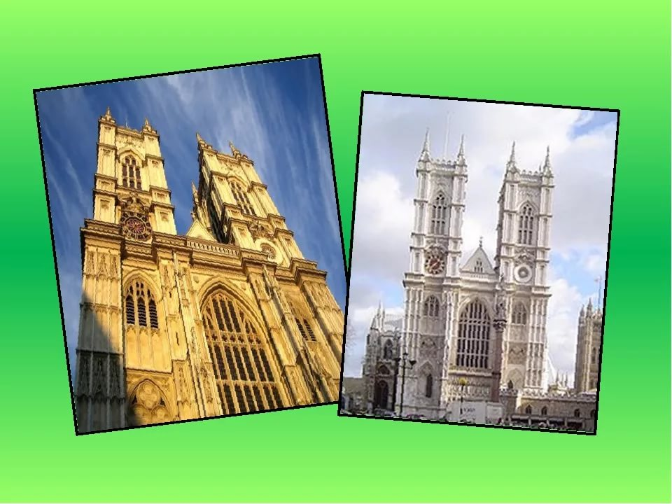
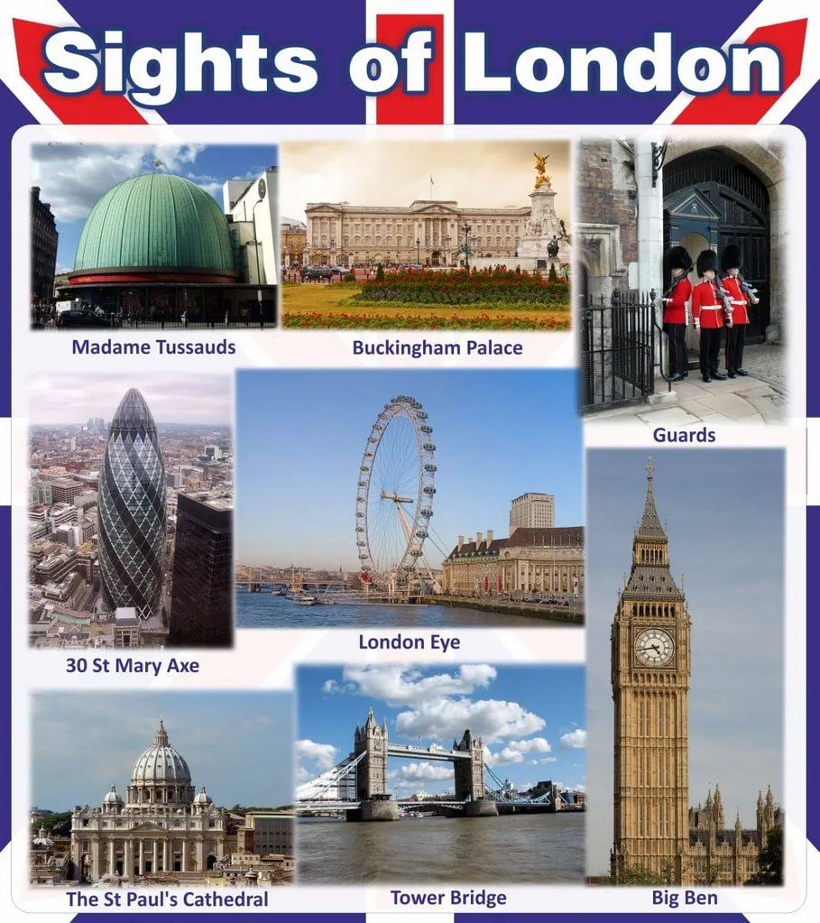
Londoners like to say:
“When a man is tired of London,
he is tired of life”
Жители Лондона любят говорить: «Когда человек устает от Лондона, он устает от жизни»

Slide 58
Our lesson is over.
Thank you for your work.
I hope you’ve enjoyed our lesson!

